Slide 1
SCOG Travel Demand Model Update
April 29, 2026
Robert Wertman and Michael McCarthy

Slide 2
Agenda
Model Overview
What’s New?
Model Specifications
Model Scenarios and Outputs
Possible Future Improvements
Questions

Slide 3
Model Overview
SCOG Travel Demand Model Update

Slide 4
3-step Aggregate Travel Demand Model
Aggregate, trip-based, 3-step design
Generates passenger trips at a zone level for cross-classified households, influenced by a new household submodel
Distributes trips using gravity models
Assigns vehicle trips to the road network with a user equilibrium algorithm in PTV Visum 2024 software
The model is calibrated to a 2022 Base Year and predicts future travel demand for 2045 and 2050 scenarios

Slide 5
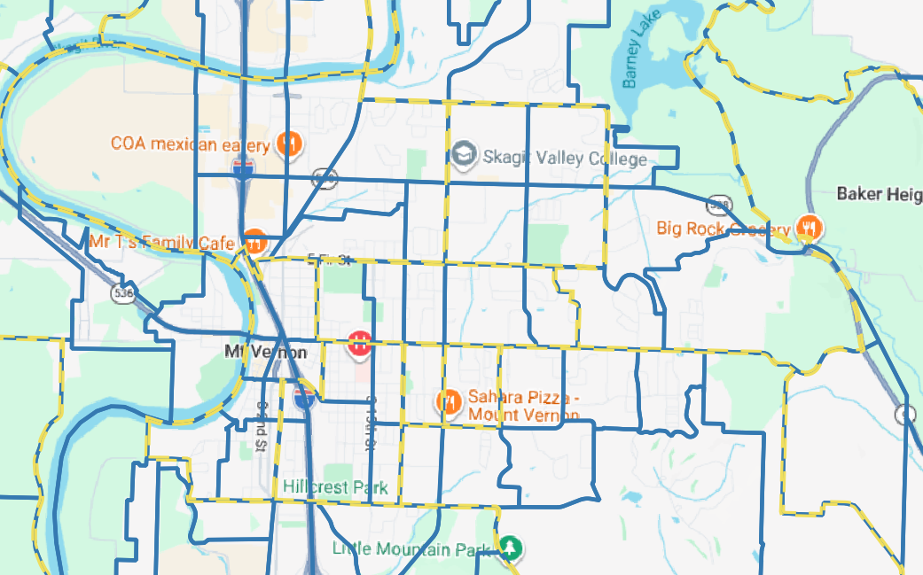
Zone System
Transportation Analysis Zone (TAZ) system developed by SCOG
Ensures that zones (blue) nest into Census Tracts (yellow dash) for better comparison and validation to the Decennial Census and American Community Survey (ACS)

Slide 6
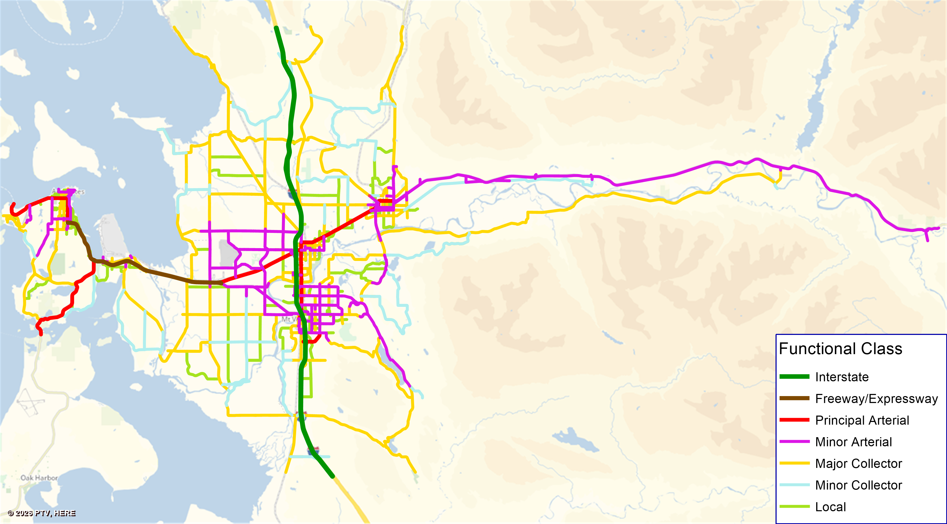
Road Network
Network represents I-5 and State Routes, Arterials and Collectors, and some local roads where appropriate with zone densities

Slide 7
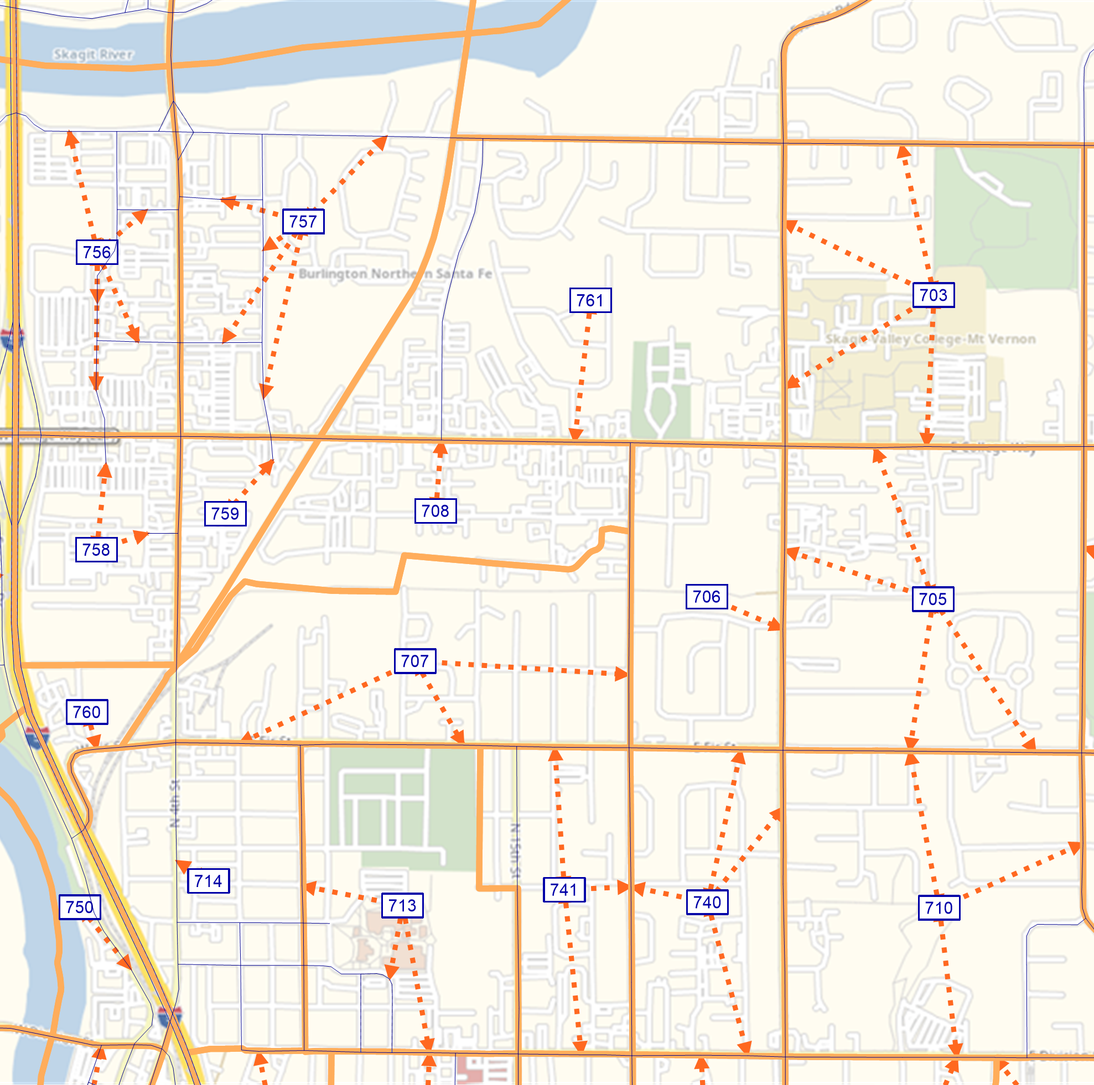
Road Network
Centroid Connectors (shown in Mount Vernon) load traffic to/from zones onto the road network, using shortest paths

Slide 8
Data Sources
Household Travel Survey (RSG) with 672 households and 1,343 people in Skagit County collected between October 5 and December 2, 2021
Traffic counts collected by WSDOT and SCOG
Socioeconomic projections from CAI
Replica Northwest model
U.S. Census Bureau American Community Survey (ACS) and Public Use Microdata Sample (PUMS)

Slide 9
What’s New
SCOG Travel Demand Model Update

Slide 10
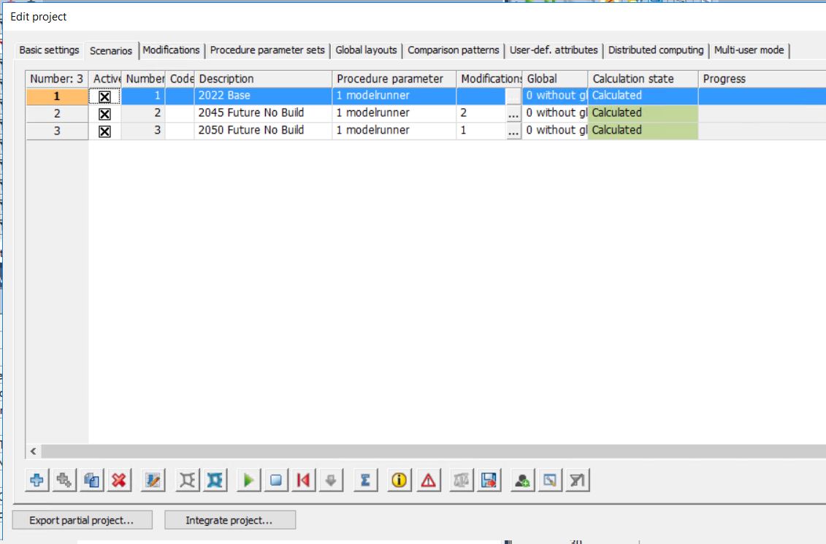
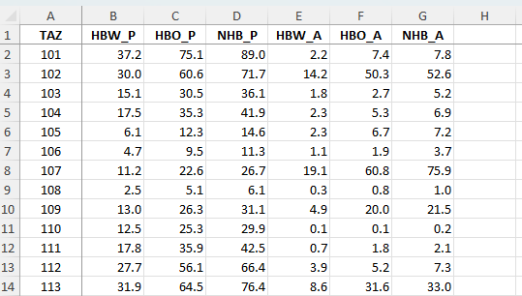
Scenario Manager Interface
Prior Model
New Model
Generated trips were copied from Excel workbook into Visum before running distribution and assignment via procedure sequence
Base and Future networks were maintained in separate version files, i.e. a change in the Base year would not automatically carry forward to future scenarios
Utilizes Visum’s Scenario Manager
Future scenarios are defined by a combination of modifications and are built on-the-fly on top of the Base year conditions

Slide 11
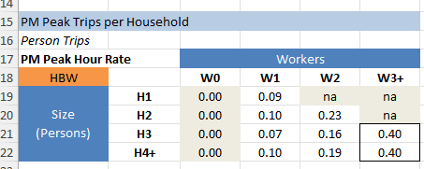
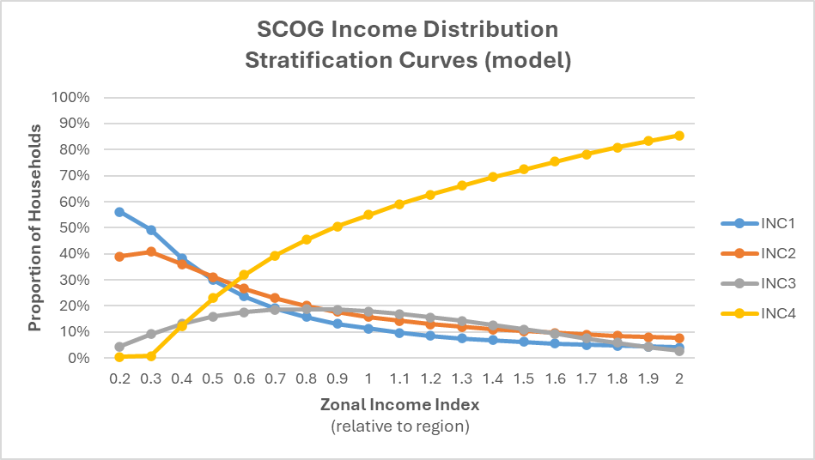
Household Submodels
Previously, cross-classified households (by size and number of workers) were a direct input to the model for household trip production
Now, the model uses stratification curves developed from ACS data and joint distributions from PUMS to classify households from simpler inputs: total households, average household size, average income relative to region
Prior model trip generation rates for cross-classified households

Slide 12
Household Submodels
Household Size and Income classification are fed into Multinomial Logit models for Number of Workers and Vehicle Availability:
Number of Workers | 1 worker | 2 worker | 3 worker
Alternative-specific constant (base: 0 worker) | 2.93 | 3.68 | 3.2
Household size
1-person household | -2.39
2-person household | -2.97 | -3.3
3-person household | -1.59 | -1.85 | -1.85
4+-person household
Household Income
Income < $25,000 | -1.84 | -3.97 | -9.02
$25,000 ≤ Income < $50,000 | -0.736 | -2.01 | -3.99
$50,000 ≤ Income < $75,000 | -0.15 | -0.761 | -1.59
Income ≥ $75,000
Number of Vehicles | 0 Vehicle | 1 Vehicle | 3 Vehicle
Alternative-specific constant (base: 2 Vehicle) | -3.75 | -1.34 | 0.19
Household size
1-person household | 1.96 | 1.83 | -0.19
2-person household
3-person household |  | 0.26 | 0.88
4+-person household |  | -0.34 | 1.07
Household Income
Income < $25,000 | 2.01 | 1.16 | -0.83
$25,000 ≤ Income < $50,000 | 0.93 | 1.06 | -0.65
$50,000 ≤ Income < $75,000 |  | 0.59 | -0.58
Income ≥ $75,000
Vehicle Sufficiency
Vehicles < Workers | -0.56 | -0.56 | -0.56
Vehicles > Workers |  | -0.563 | -0.563

Slide 13
External Model
A new External Model automatically grows AADT at the external gates for future year scenarios
The external AADT is split into trips by market:
External-External (XX)
Internal-External (IX) Work Skagit residents to adjacent counties
External-Internal (XI) Work Non-residents to Skagit
IX/XI Non-Work
Trips are distributed separately for each market, calibrated to Replica model trip lengths
The model calculates Vehicle trips and then converts to Person trips for reporting

Slide 14
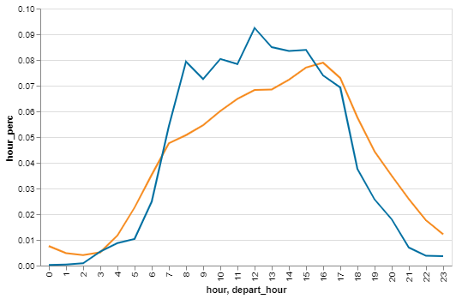
Time of Day Assignments
Trips are generated at the Daily level and split into: AM, PM, and OP (Off-Peak) periods, plus a PM Peak Hour for assignment
Period volumes are saved to the network and can be exported in loaded networks
Off-Peak
AM
Off-Peak
PM
Off-Peak
- Traffic counts
- Survey Auto Vehicle Trips (weighted)

Slide 15
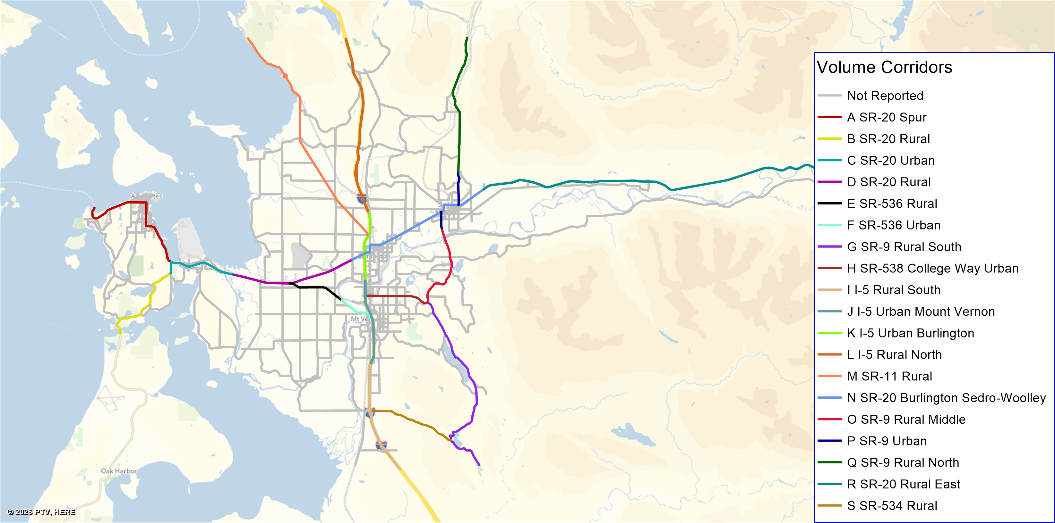
Model Reporting
The model automatically calculates and reports the following metrics for each scenario:
Regional Vehicle Miles Traveled, Vehicle Hours Traveled, and Vehicle Hours of Delay by Period and Daily, Total and Per-capita/Per-household
Total Person and Vehicle Trips
Corridor Level of Service based on Florida DOT method and Travel Time for 19 corridors (shown in map)
Reports are saved in CSV format and open in Excel

Slide 16
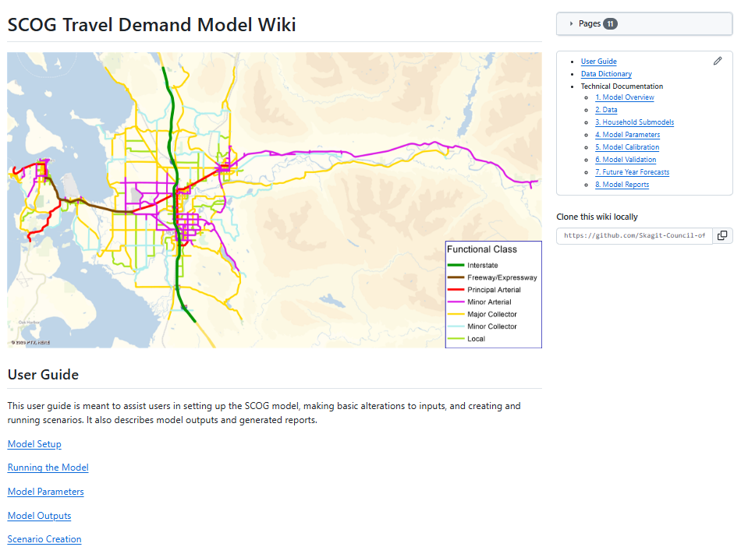
Wiki Documentation
The Model Technical Documentation and User Guide are available as a wiki on GitHub

Slide 17
Model Specification
SCOG Travel Demand Model Update

Slide 18
Trip Generation Model in Daily Person Trips
HH Workers | HBW Person Trips
Zero Workers | 0.00
1-worker | 0.64
2-workers | 1.41
3+-workers | 2.73
Trip Attractions
Employment Category | HBW | HBO | NHB
Retail trade, food services | 1.0732 | 6.9461 | 4.6384
Finance, insurance, real estate, services | 0.4500 | 2.1514 | 1.9610
Government | 0.6299 | 1.7637 | 1.3063
Education | 1.0487 | 4.7120 | 3.9449
Wholesale trade, transportation, utilities | 0.6848 | 1.2255 | 1.0647
Manufacturing | 0.3031 | 0.5070 | 1.1165
Agriculture, forestry, fishing, mining | 0.3487 | 0.5113 | 0.6646
Health care, social assistance | 0.7920 | 3.3533 | 2.1493
HBO | HH1 | HH2 | HH3 | HH4
Zero vehicles | 1.439 | 3.577 | 0.325 | 0.325
1-vehicle | 2.237 | 4.661 | 3.705 | 4.375
2 vehicles | 0.000 | 3.094 | 3.232 | 7.223
3+ vehicles | 0.000 | 0.000 | 3.232 | 8.879
NHB | HH1 | HH2 | HH3 | HH4
Zero vehicles | 3.560 | 1.608 | 0.316 | 0.316
1-vehicle | 2.204 | 2.105 | 3.993 | 2.494
2 vehicles | 0.000 | 2.765 | 3.551 | 4.201
3+ vehicles | 0.000 | 0.000 | 3.551 | 5.132
Notes:
Generated and Distributed as daily person trips
Converted to auto vehicle trips using auto mode share and occupancy
Then time of day and directional split

Slide 19
Trip Distribution Parameters
Trip Purpose | B Parameter | C Parameter
HBW | -1.096 | 0
HBO | -1.2 | -0.0572
NHB | -0.0284 | -0.235
IX Work | -2.5 | 0.05
XI Work | -3.8 | 0.09
XI/IX Non-Work | -3.8 | 0.112

Slide 20
Trip Lengths vs Survey and Replica
Purpose | Replica | Model | Survey | Model v Replica Coincidence Ratio
HBW | 7.15 | 8.86 | 8.89 | 0.803
HBO | 5.99 | 6.01 | 5.41 | 0.803
NHB | 5.03 | 4.63 | 3.95 | 0.792
 | Avg Trip Length (miles)

Slide 21
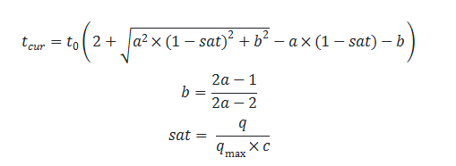

Assignment Parameters
Functional Class | Capacity Vehicles per Lane per Hour | A param | C param
Interstate | 2200 | 10 | 1.01
Ramps | 1200-1500 | 10 | 1.01
State Highway Freeways and Arterials | 1600 | 10 | 1.01
Rural Arterials | 900-1600 | 8 | 0.91
Rural Collectors and Arterials | 900-1100 | 6 | 0.89
Urban Arterials | 850-1250 | 4 | 0.86
Urban Collectors and Local Roads | 650-800 | 4 | 0.86
Local Roads | 500 | 4 | 0.86
Using Conical Volume Delay Functions that result in increasing delays when assigned demand approaches link capacity:
Where:
$t_{cur}$ is the congested travel time
$t_{0}$ is the free-flow travel time
$a,c$ are user-supplied parameters
$q$ is assigned demand on the link
$q_{max}$ is the link capacity
Notes:
As with all static user equilibrium assignment models, assigned demand may exceed link capacity, resulting in increasingly excessive delay on heavily traveled links.
The feedback mechanism allows for trip distribution to react to these delays potentially shifting trips to alternate destinations with shorter congested travel times.

Slide 22
Model Scenarios and Outputs
SCOG Travel Demand Model Update

Slide 23
2022 Base Year Assignment Validation
Model Volume vs Count RMSE | Model | FSUTMS Acceptable | Preferable
AADT < 5k | 61.30 | 100 | 45
AADT 5k to 10k | 37.74 | 45 | 35
AADT 10k to 15k | 31.34 | 35 | 27
AADT 15k to 20k | 21.97 | 30 | 25
AADT 20k to 30k | 16.15 | 27 | 15
AADT 30k to 50k | 11.57 | 25 | 15
AADT 50k to 60k | 0.00 | 20 | 10
AADT > 60k | 0.00 | 19 | 10
Areawide | 43.75 | 45 | 35
Model Volume vs Count Percent Error | Model | Acceptable | Preferable
AADT < 10k | -2.98 | 50 | 25
AADT 10k to 30k | 0.14 | 30 | 20
AADT 30k to 50k | 7.29 | 25 | 15
AADT 50k to 65k | 0.00 | 20 | 10
AADT 65k to 75k | 0.00 | 15 | 5
AADT > 75k | 0.00 | 10 | 5
Areawide | -1.18 | 5 | 2
Model Volume vs Count Percent Error by Functional Class | Model | Acceptable | Preferable
Freeway | 3.97 | 7 | 6
Arterials | -7.94 | 15 | 10
Collectors | 0.14 | 25 | 20
RSG adopted the Florida DOT Florida State Urban Transportation Model System (FSUTMS) validation guidelines to assist in the determination of a properly validated model. The FSUTMS guidelines have two levels of maximum acceptable error: “acceptable” and “preferred.”

Slide 24
2045 and 2050 Scenarios
Modification Number | Code | Scenario | Project Description
5 | ANA-1 | Baseline | 12th & K Ave Roundabout
6 | ANA-2 | Baseline | Add right turn lane at SR20 and Thompson Rd
11 | CON-1 | Baseline | Construct school secondary access road
13 | MV-1 | Baseline | Riverside Drive/Pacific Place Intersection Improvements (oblong roundabout)
18 | SC-1 | Baseline | MARINE DRIVE / ROSARIO ROAD / MARINE WYE DRIVE INTERSECTION IMPROVEMENTS - roundabouts
20 | SAM-1 | Baseline | SR 20 - Campbell Lake Road - Intersection Improvements - add roundabout
21 | WSDOT-1 | Baseline | I-5 Speed Limit Change - Decreased to 60 mph btwn Chuckanut and Cook Rd exits
26 | 2050NB-Additions | Baseline | Network edits that should be included in the 2050 Baseline. All built between 2022 and 2026
27 | WSDOT-2 | Baseline | SR20/Burlington to Sedro-Woolley Corridor Improvements. Roundabouts at Gardner, District Line and Collins
10 | BUR-4 | Planned | Construct roundabout at Burlington Blvd and Fairhaven
12 | SW-1 | Planned | Jones/John Liner RR undercrossing (Reed to Sapp)
14 | MV-2 | Planned | Blackburn Rd Extension - New "Complete Street" between little Mountain Rd and Eaglemont
19 | SC-2 | Planned | COOK ROAD / I-5 INTERCHANGE VICINITY IMPROVEMENTS Add R turn lane to NB off ramp. Add EB travel lane
24 | SW-2 | Planned | Trail Road Improvements Phase 1 - construct new arterial and shared use path
25 | SC-3 | Planned | Make intersection improvements on Old Hwy 99 with Bow Hill Road/Prairie Road - roundabout
8 | BUR-2 | Illustrative | Construct grade separated RR crossing and extend Gilkey between Spruce and Anacortes
15 | MV-3 | Illustrative | Hickox Rd/I-5 Interchange Improvements - complete N side of freeway interchange to provide full access
16 | MV-4 | Illustrative | Kincaid Street Complete Streets Improvements - add roundabouts
17 | MV-5 | Illustrative | 30th Street Extension - New roadway extension connecting Blackburn with 27th. Will also reconfigure intersection of Blackburn and Little Mountain
Year | Population | Housing Units | Total Employment
2022 | 128,635 | 49,919 | 59,572
2045 | 158,268 | 63,004 | 80,096
2050 | 163,664 | 65,162 | 85,076
Future Socioeconomic Scenarios
2045 and 2050 household, population, and job growth
Future Highway Network Scenarios
Baseline includes expected and committed projects already planned through 2050
Planned includes Baseline plus fiscally-constrained projects proposed in the RTP
Illustrative includes Baseline + Planned and projects beyond the fiscal constraints of the RTP

Slide 25
Future Model Improvements
SCOG Travel Demand Model Update

Slide 26
Model Limitations
3-step aggregate model lacks Trucks/Commercial vehicles and Passenger mode choice
Transit is not modeled
Non-Home-based Trips are generated by households and attracted to employment
Notes:
Work Mode Share: 86% auto, 1% public transit, 2% walk/bike, 11% WFH (ACS 2022 5-year)
Trucks: on classified counts, about 6% of daily traffic

Slide 27
Future Model Improvements
Link Non-Home-based trips to Home-based trip ends
A method used in other trip-based models uses the home-based trip ends as a basis for the NHB trips
Improved Intersection delay
A method developed for Southern Oregon and implemented for Spokane models intersection and mid-link capacities and delays based on the functional classes of intersecting links, control type, and number of thru and turn lanes
Enhanced model reporting in a web-based dashboard
Truck and Commercial Vehicle model
Upgrade to a 4-step model with Skagit Transit fixed routes and a Mode Choice model

Slide 28
Questions?
SCOG Travel Demand Model Update

Slide 29
Robert Wertman, AICP, PTP
Managing Consultant
Robert.Wertman@rsginc.com
Michael McCarthy, AICP
Consultant
Michael.McCarthy@rsginc.com

