Slide 1
Introductions
Name : - Skand chaubey , Rakchit
Class :- Bca 6th D
Subject :- Data Visualization
Topics :- Cyber Analysis (Visionlytics)
Roll No:- 92200527266 , 92200527258

Slide 2
Crime Dataset Analysis - India

Slide 3
About the Dataset
Dataset contains crime reports from various cities in India.
Includes fields like City, Crime Type, Date, Age, Gender, Domain, etc.
Useful for trend analysis, domain-wise crime understanding, and resource planning.

Slide 4
Crimes by City
Cities with highest number of crimes identified.
Visualized using Bar Chart for quick comparison.
Helps prioritize high-crime regions for law enforcement.

Slide 5
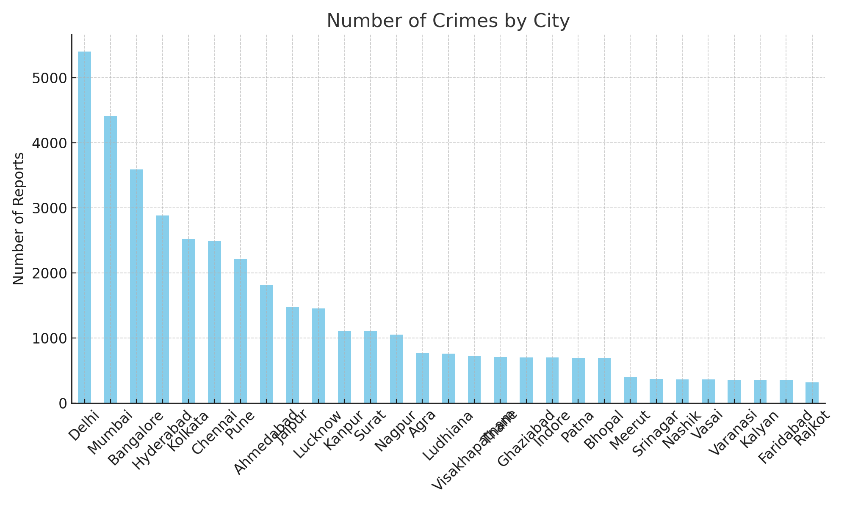
Crimes by City

Slide 6
Crime Domain Distribution
Shows which domains (e.g., Cyber, Domestic, Theft) are most prevalent.
Pie chart used to show proportional breakdown.
Assists policymakers in allocating domain-specific resources.

Slide 7
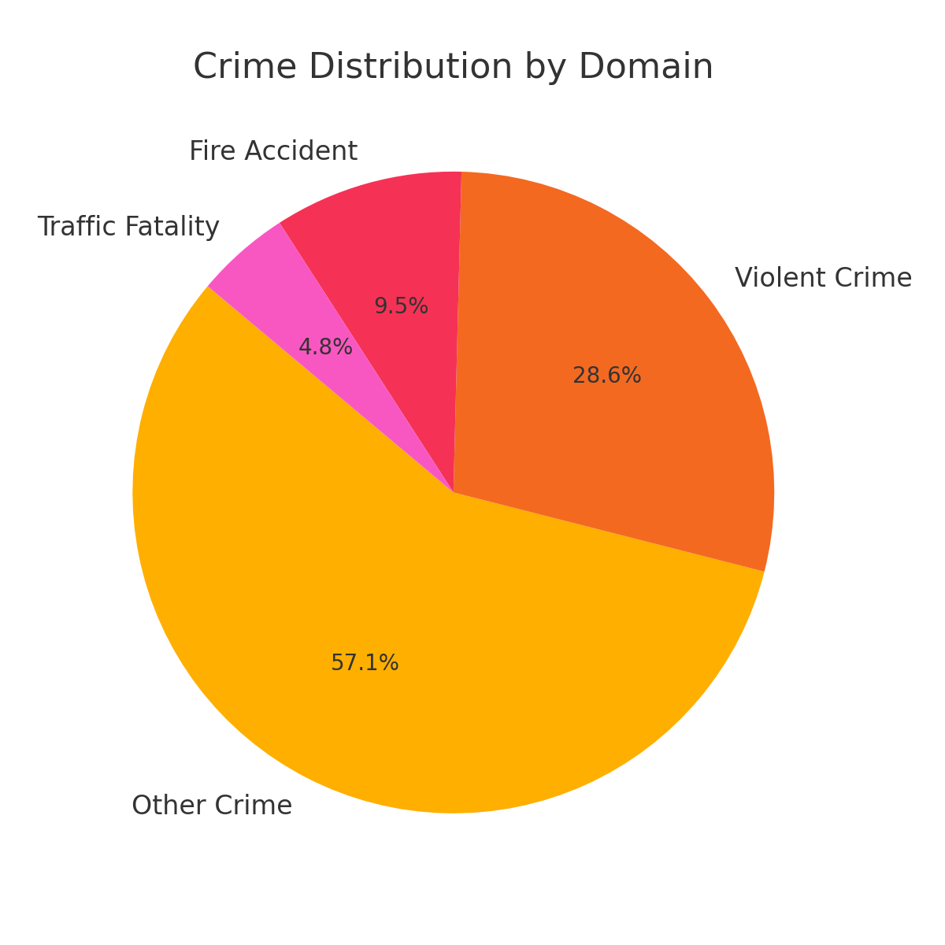
Crime Domain Distribution

Slide 8
Crimes Over Time
Monthly crime trends analyzed using Line Chart.
Identifies seasonal or monthly spikes in crime rates.
Can support time-based patrol or awareness campaigns.

Slide 9
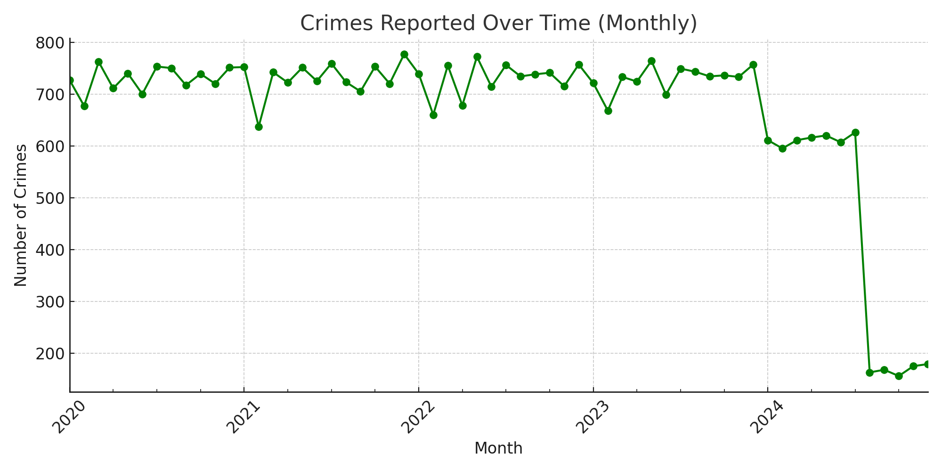
Crimes

Slide 10
Victim Gender Analysis
Shows which gender is most affected across crime reports.
Highlights need for targeted safety measures.
Supports gender-sensitive policing policies.

Slide 11
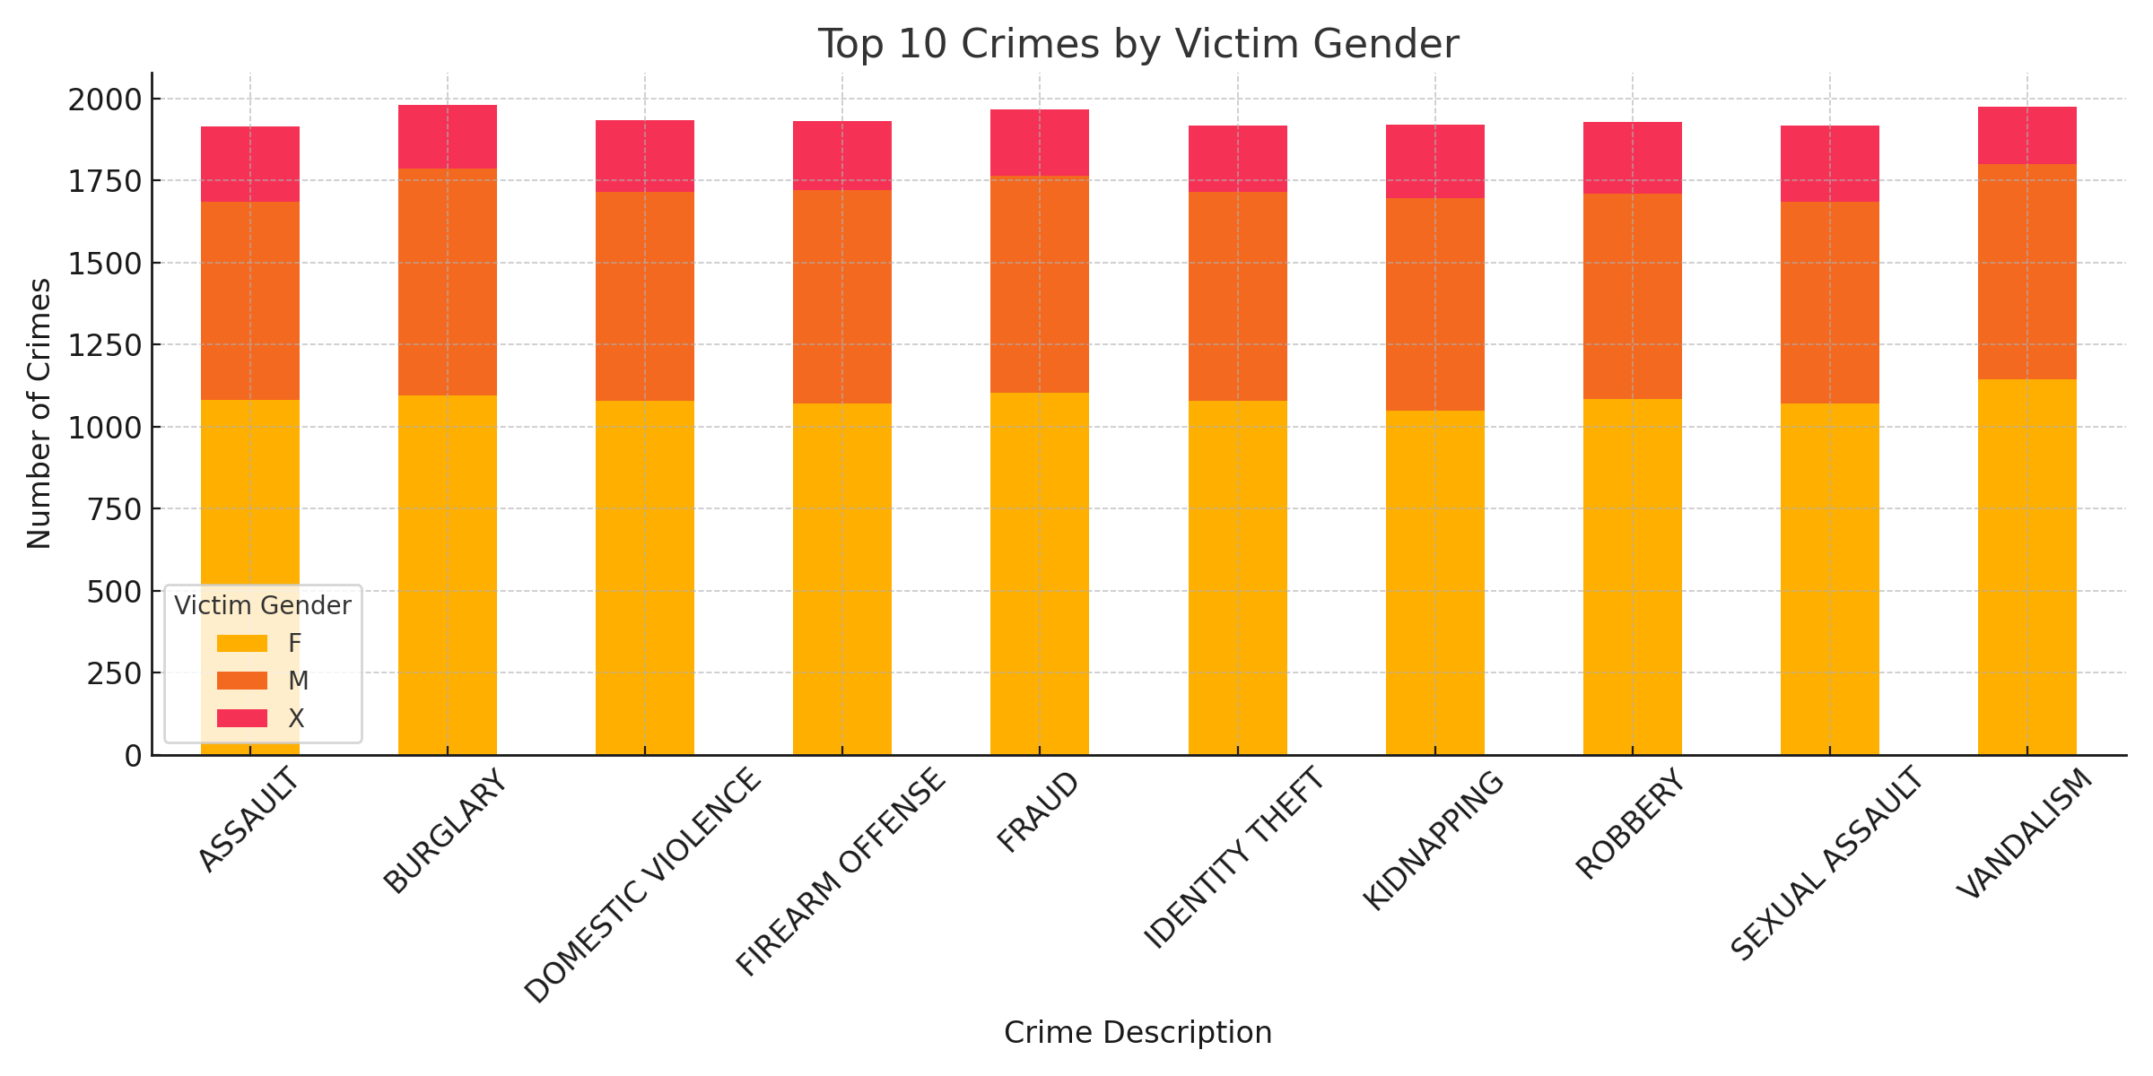
Victim Gender Analysis

Slide 12
Age Distribution of Victims
Bar chart shows age ranges most affected by crimes.
Critical to create awareness campaigns for vulnerable age groups.
Useful for educational institutions, NGOs, and police.

Slide 13
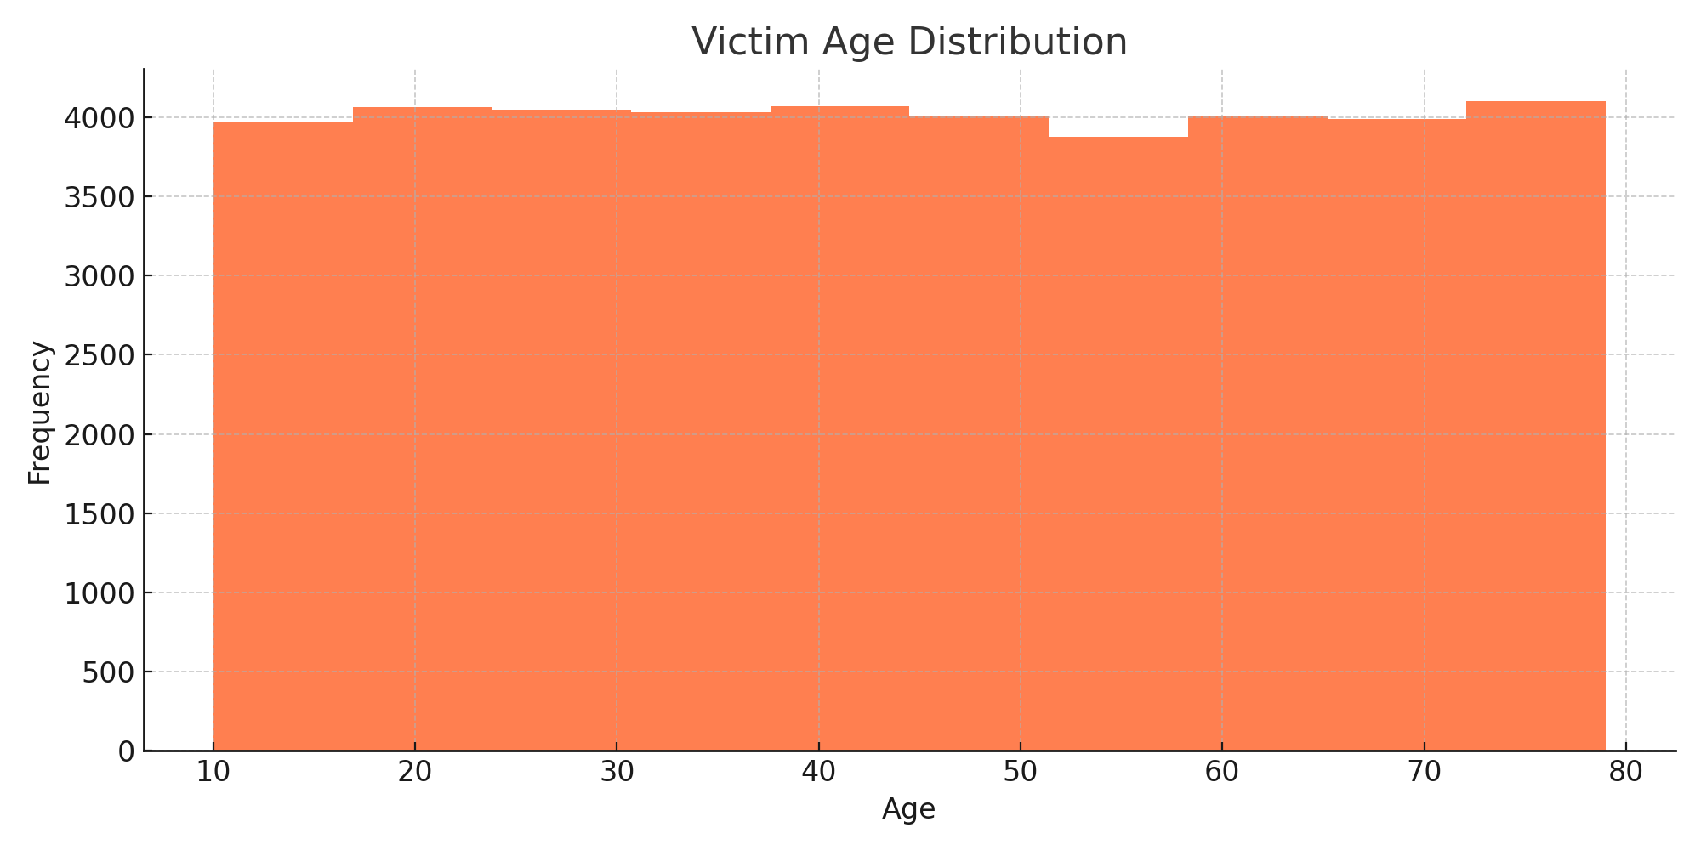
Age Distribution of Victims

Slide 14
Police Response Analysis
Measures police deployment and cases solved.
Bar/line charts used to correlate crime rate and response.
Indicates efficiency of law enforcement in different cities.

Slide 15
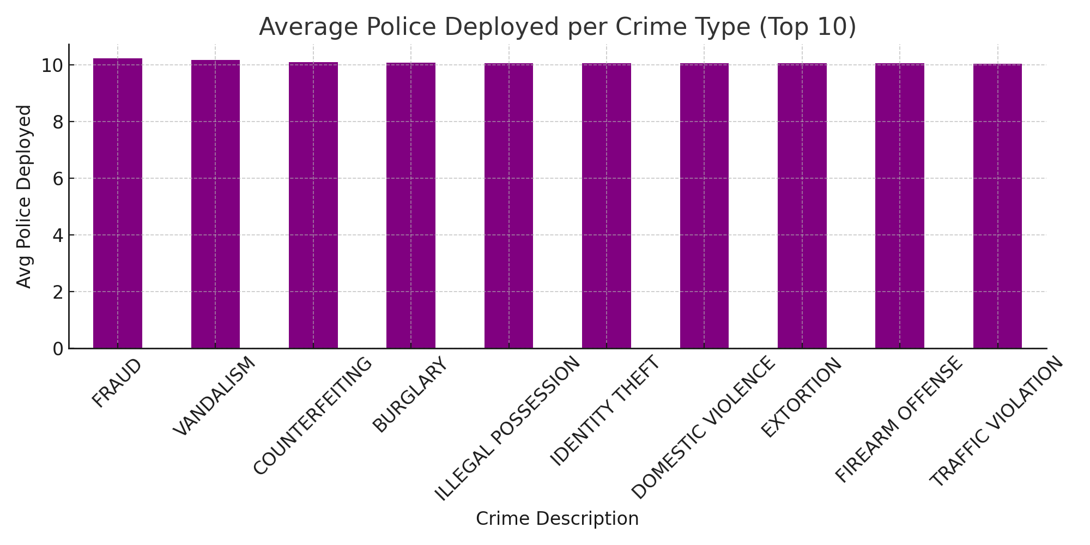
Police Response Analysis

Slide 16
Summary of Key Insights
High crime zones identified for action.
Certain crime domains dominate in specific regions.
Female and youth are frequent targets.
Need for better police allocation and quicker response time.
Data-driven approach can enhance public safety.

Slide 17
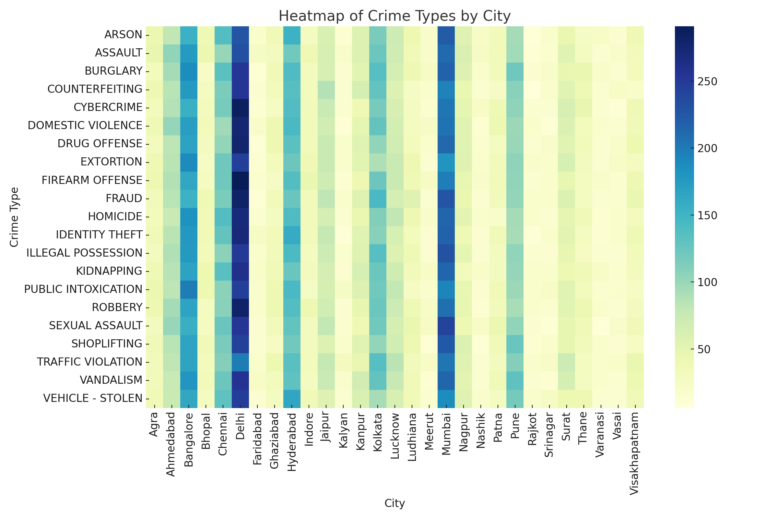
Summary of Key Insights

Slide 18
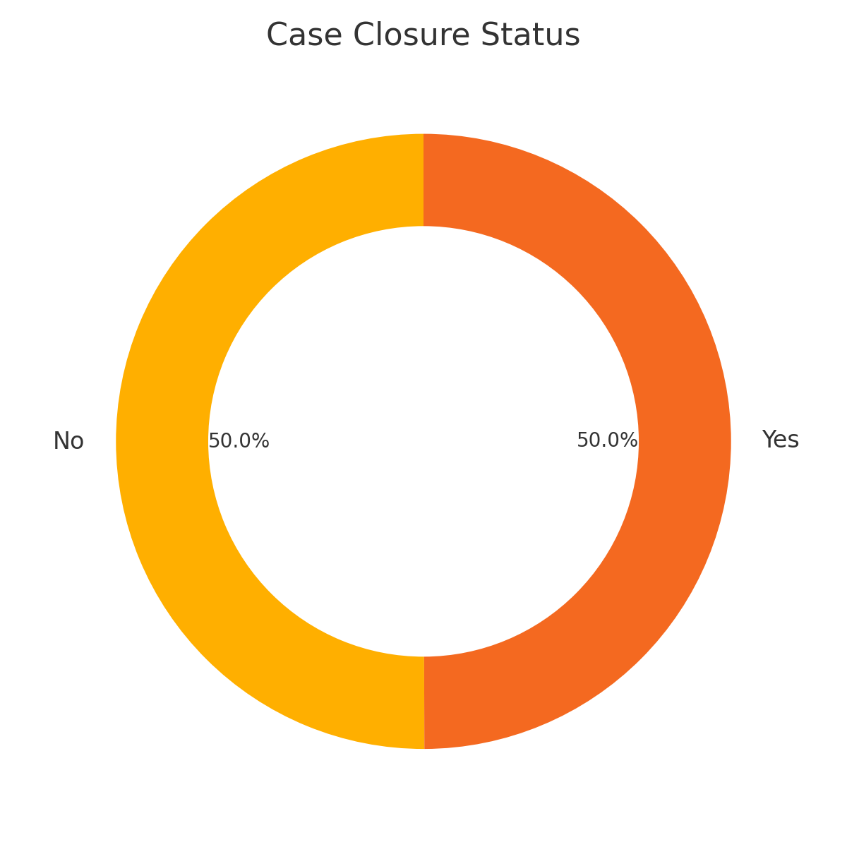
Summary of Key Insights

Slide 19
Types of Crimes Analyzed
Crime domains include Cyber Crime, Domestic Violence, Theft, Assault, etc.
Categorization helps understand crime nature and victim demographics.
Each category demands different preventive and legal strategies.

Slide 20
Top 5 Cities with Highest Crime
Cities with largest number of reported crimes: Delhi, Mumbai, Bangalore, Hyderabad, Chennai.
Urbanization and population density are major contributing factors.
Strategic deployment of police resources needed in these cities.

Slide 21
Low Crime Rate Cities
Some cities reported significantly fewer crimes.
Could reflect effective policing, underreporting, or smaller population.
Opportunity to learn and replicate crime-prevention models.

Slide 22
Monthly Crime Pattern Observations
Spikes observed in festive or vacation seasons.
Summer months show higher crime reports.
Helps in proactive deployment and public safety awareness.

Slide 23
Victim Profile Analysis
Most victims are in the age group 18–30 years.
Youth and women are frequently targeted.
Highlights the importance of self-defense programs and awareness campaigns.

Slide 24
Law Enforcement Resource Allocation
Analyzing police deployment in high-crime areas.
Assessing relation between police presence and crime reduction.
Can improve budgeting and resource planning.

Slide 25
Unsolved vs Solved Cases
Important metric to measure police effectiveness.
High number of unsolved cases indicate need for better training/tools.
Builds public trust when cases are consistently solved.

Slide 26
Limitations of Dataset
Missing values in some columns (e.g., victim age, police count).
Lack of geographical coordinates limits map analysis.
Data depends on reported crimes only (may not reflect actual rate).

Slide 27
Recommendations
Increase public crime reporting awareness.
Use predictive policing based on historical patterns.
Enhance cybercrime monitoring and training for law enforcement.

Slide 28
Future Scope
Integrate crime data with GIS for map-based analysis.
Use machine learning to forecast crime hotspots.
Develop mobile apps for real-time crime alerts and reporting.

Slide 29
Thank You

