Slide 1
EFFICIENT TICKETING & TRACKING SYSTEM
Name of College and City: P.E.S Institute of Technology , Bangalore Course of specialization: Telecommunication Year/ Batch:2011-2015 College ID: Name of the Professor/ Placement officer involved in this project:
 | Name | Email | Mobile
Team member 1 | Chandan Kumar R | chandanrkumar619@gmail.com | 8951817035
Team member 2 | Skanda S Bharadwaj | skandabharadwaj94@gmail.com | 9741762900
Team member 3 | Sumukha B.N. | sumukha.bn@gmail.com | 9538040168
Maximum points: 10

Slide 2
Choose the stage of Innovation you’ve submitted: Identify the innovation stage by putting a black DOT under the relevant stage category listed below.
Idea: It is at a nascent stage where it is a thought with substantial research material or a design
Prototype: Your idea has taken shape into a prototype/ model of your innovation
Established: Your submission has evolved into an establishment that you’ve set up and the public is already aware of it
Scaling: The innovation submitted has been well accepted amongst people around you and you are now in the advance stage of scaling up your innovation
Idea | Prototype | Established | Scaling
n

Slide 3
Summarise your innovation
Category name | Explanation
Digital Government | The system constitutes two major functions. Automated ticketing and tracking of buses using RFID technology which is efficient, sophisticated and user friendly. The important drawback that we are looking to overcome is, the tedious job of issuing tickets and there by preventing people from deceiving government and improve the efficient usage of resources. The system designed assures cost effectiveness, deployable on short term and also open for easy extension.
Maximum points: 10

Slide 4
Compelling need for the innovation
The present ticketing system in public transport is tedious and has many drawbacks , such as malfunction ,malicious arguments among public and also many people travel without paying .All these lead to unnecessary wastage of time and resources.
Also no prior notification of arrival and departure of transports are available creating a lot of confusion among passengers. The tracking and automated ticketing system can be merged to solve the prevailing problems
RFID based tickets is proposed as it is low cost ,easy operation ,portability, durability, reliability and very user friendly.
Maximum points: 30

Slide 5
Solution
Solution to the addressed problem is quite simple but effective. RFID technology is answer that we found for the existing problem. This is cost effective and easily implementable; in other words a feasible solution.
The solution addresses two major problems
1. Issuing of Tickets 2. Tracking of buses
RFID Tags will be provided to every individual and every bus will have a scanner installed in it. This makes the ticketing automated and hence overcomes the problems faced in the present situation.
When it comes to tracking of buses, a tag and a scanner will be installed in the bus and in the station as well. This enables tracking of the buses’ location without using GPS.
Also this can be further improved to a higher level in which the technology can be made nation wide for all sorts of transport like a universal pass card.
Maximum points: 30

Slide 6
Value proposition
Elaborate about the value proposition, and how end users will benefit from your idea.
As the system is user friendly there will be no chaos or confusion among the passengers when it comes to issuing of tickets. Public don’t have to wait for the conductor to give them the tickets and return change. In fact the system eliminates the need of the conductor. Both government and passengers will not be deceived in any way. A more disciplined way of life style will be assured.
On the other hand, without using GPS the bus can be tracked down and can be monitored from the base station. Information of all the buses will be available in the base station. On the whole, this system makes the present scenario much better.
The whole system can also be used in vehicles on highways, their toll payment and in also in railway systems with modifications accordingly. The card being reusable, they are much more convenient compared to present paper based ticketing system. The card can also be used as a universal travel pass card. Also this system reduces traffic jam and chaos in the transport system .
Using the information collected in the base station an SMS service can be provided to the public regarding the location of their expected buses.
Maximum points: 30

Slide 7
Implementation
Ticket Issuing
In the card, personal details like name, address ,phone number will be stored along with the account information. The card is rechargeable from certain electronic booths. Each bus will have RFID scanners attached at the doors. Passengers are supposed to scan their RFID cards while boarding and while exiting from the bus. Based on the number of zones travelled by the passenger the fare is automatically deducted from his account.
-- Bus stop
-- Bus route
Sample data to calculate bus fare for a particular route
A
B
D
E
R
R
R
R
C
Start point | End point | Distance | Ticket fare
A | B | R | 2X
A | D | 4R | 8X
C | E | 3R | 6X
Maximum points: 50

Slide 8
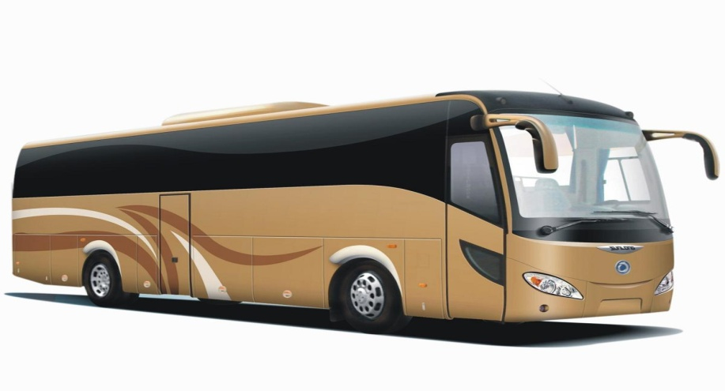
Implementation
Bus Tracking
All the buses will have a RFID tag fitted on the front and a scanner at the rear end. The RFID tag at the front is fixed so that it is scanned by the RFID scanners placed at each bus stop. All the details of the bus and its route details will be stored in the card .The RFID scanner at the rear end on the bus is fixed to scan the RFID tag which will be placed at each bus stop containing details of the location and zone of the stop and other route details. Hence this tag is detected when the bus departs from a particular bus stop. This helps the bus system know its location in its route. Based on the location information acquired from each bus stop the automated fare system is governed.
Diagram representing the setup of bus stop .
RFID TAG CONTAINING INFO OF BUS STOP
BUS STOP
RFID SCANNER TO SCAN BUSES
DISPLAY SCREEN
RFID TAG
RFID SCANNER

Slide 9
The Competitive Advantage
Presently there is no such system in the market which uses RFID to monitor bus and issue tickets. We deliberately focused on this since there is not much improvement towards the betterment of the management. The transport system is now a complete hokum. We are addressing this problem to provide a better management and improve the life style. This will be revolutionary if the idea is implemented in a proper manner. There are not many systems working in this area. So we can proclaim that we do have a great advantage to take this idea to the next level.
If the idea is accepted then we would like to approach for a patent. Currently we are not pursuing any patent.
Maximum points: 30

Slide 10
Upload a video
Create a 1 minute video describing your idea and its benefits
This will be seen by thousands, including the contest review committee
Upload the video to your YouTube page and copy-paste its url onto this slide for our reference
Tweet this to help us view and retweet your video: I’ve submitted my idea (insert name of innovation) to #InnovationJockeys. View my video here: (insert url)
Note:
Any video containing inappropriate material will be rejected by the Organisers
Uploading a video is optional, but if you do, you can earn bonus points
Bonus points: 10

Slide 11
Accenture presents “Innovation Jockeys 3”, Powered by Yahoo India Rules of Participation (“Rules”)
“Innovation Jockeys 3” (the “Contest”) shall be organized and conducted by Yahoo India Private Limited and sponsored by Accenture India Private Limited ("Organizer") and shall be open shall be open for submitting the entries from 5th May 2014 to 20th July 2014 (both days inclusive) ("Entry Period").
1. Receipt of Entries and Eligibility
Entry will be invited through an online entry form as available on http://innovationjockeys.yahoo.net/ (“Contest Website”) and during the Entry Period the participants need to complete the online entry form and submit it along with the original idea related to given innovation categories of ‘Internet of Things’ and ‘Digital Government’ (“Idea/s”).
The Contest is open to all full-time undergraduate, graduate and post-graduate - students and who are 18 (eighteen) years of age or older, who otherwise meet all eligibility requirements in these Contest Rules. The participants can be either (a) an individual; or (b) teams of up to 3 (three) participants from the same college or different colleges (a "Team") provided that each member of the Team meets these eligibility criteria.
The nomination for the Contest shall be invited from 2 (two) categories as specified on the Contest Website (“Category”). The participant shall be entitled to participate in both Categories. All Idea/materials presented must be original work, the ownership and all intellectual property rights in the same must belong to the participant.
Entries will be accepted in English language only and the Presentations should be in ‘PPT’ or ‘PPTX’ format, in the template provided on the Contest Website and the maximum limit of the file size shall not exceed 10 (ten) MB.
Any incomplete/inaccurate entries or entry after the Entry Period shall be invalid and any entry after the close of Entry Period may be permitted only at the discretion of Organizer.
The right to permit or restrict participation is at the sole discretion of the Organizer.
2. Incorrect Information
Organizer has the right to substantiate/audit/verify the participants’ details/information as provided in the entry form or Organizer may seek any further document, as may be required to verify the participants’ details/ information. The participant must provide all supporting details requested by the Organizer to substantiate/audit/verify the information provided in the entry form. If such a request is made and the participant either fails or does not agree to provide the same, then the Organizer reserves the right to disqualify the participant from participation for the Contest.
Determination of whether information is correct or not, rests with Organizer.
If at any time, any information provided by any participant is found to be incorrect in any manner, then the participant will be disqualified for the participation for the Contest.
If, after the conclusion of the Contest ceremony, any information provided by any participant is found to be incorrect in any manner, the participant will be liable to return the Contest and any monetary / non-monetary incentives provided as part of the Contest.
3. Short-listing
Upon receiving the entries, and from a period between 20th July to 30th July 2014, an initial jury of the Organizer will collate the list of entries and evaluate the same based on pre-defined evaluation criteria as specified on the Contest Website to determine nominees in each Category. These short listed nominees will be submitted further for the final jury evaluation.
The decision of the above short listing is binding and final on all participants.
Nominees could be contacted for further relevant information for the final round of evaluation.
In the event no entries in a particular or all Categories meet the eligibility criteria for the Contest, the Category could be cancelled at the discretion of the initial jury or Organizer and the decision shall be binding on all participants.
continued >

