Slide 1
A Novel Approach to Peak Detection Using Sequential Learning Algorithm
Paper Id - 475
B.N. Sumukha, R. Chandan Kumar, Skanda S. Bharadwaj, and Koshy George
PES Centre For Intelligent Systems
PES University Campus
Bangalore, India

Slide 2
Agenda
Objective
Peak Detection
Present Trends
Disadvantages
Proposed Approach
Novelty
Advantages
Results and Conclusions

Slide 3
Objective
Online detection of peaks in sinusoidal signals without pre-processing and feature extraction.

Slide 4
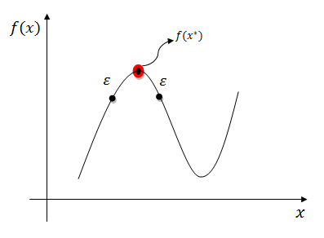
Peak Detection
Detection of local maximum points in function f at a point x* if there exists some ε > 0 such that f (x* ) >= f (x) for all x within distance ε of x*

Slide 5
Current Trends in Peak Detection
Conventional Methods
Machine Learning Techniques
Window Threshold
Wavelet Transforms
Hilbert Transform
K – Means Clustering
Fuzzy C-Means Clustering
Artificial Neural Network

Slide 6
Disadvantages of conventional methods
Common pre-requisites
Entire signal must be made available before-hand
Relies on complex pre-processing and feature extraction.
Not suitable for real – time applications

Slide 7
Online Peak Detection

Slide 8
Online Peak Detection
To detect peaks as detected by human cognition.

Slide 9
Online Peak Detection
To detect peaks as detected by human cognition.
Characterized by instantaneous detection without pre-processing and feature extraction !!

Slide 10
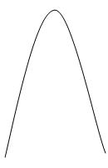
Inspiration : Human Cognitive Learning
Human cognitive learning (HCL)– An intuitive analysis
Detect the shape in the signal
Find the maximum in the given array of points
No pre-processing and feature extraction.
At a particular depth, only shape of the signal is perceived to detect the peak.

Slide 11
Deviation from the Human Cognitive Learning Process
How are the current algorithms deviating from the human cognitive learning and processing ?
Entire signal is required
Pre-processing and Feature Extraction
Offline

Slide 12
Problem Definition
Detection of peaks as and when they appear – “Online Peak Detection” – without pre-processing and feature extraction.

Slide 13
Solution
Identification of shapes –
Classification problem – Artificial Neural Networks.
Identification of largest value in the classified chunk of the signal.

Slide 14
Approach
An Artificial Neural Network (ANN) is trained using online sequential learning algorithm (OSLA) to identify the shape of the signal.
If the required shape is found, peak is detected by finding the maximum in that particular chunk of the signal.

Slide 15
Novelty
Mimics the exact process of a Human Cognitive Learning and Recognition.
No pre-processing or feature extraction is required.
Requirement of the entire signal before-hand is overcome.

Slide 16
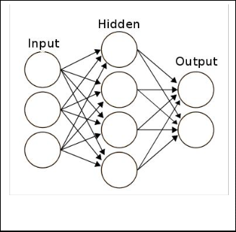
Online Sequential Learning in Feed Forward Neural Networks
FFNN with single hidden layer

Slide 17
Online Sequential Learning in Feed Forward Neural Networks
FFNN with single hidden layer
Weights corresponding to input layer are independent of the environment.
Independent of the Environment
Based on ELM (Extreme Learning Machines)
G.-B. Huang, Q.-Y. Zhu, and C.-K. Siew

Slide 18

Online Sequential Learning in Feed Forward Neural Networks
FFNN with single hidden layer
Weights corresponding to input layer are independent of the environment.
Solution is determined using Least-Squares method.
Independent of the Environment
Based on ELM (Extreme Learning Machines)
G.-B. Huang, Q.-Y. Zhu, and C.-K. Siew

Slide 19
Why Online Sequential Learning Algorithm (OSLA) ?
Faster
Algorithms
ELM
Real Time
Applications
Peak
Detection
OSLA
Sequential
Processing

Slide 20
Why OSLA ?
To overcome time consuming processes like Pre-processing and Feature extraction.
Also to overcome the slow convergence of Back propagation algorithm.
From a practical viewpoint, online learning is better suited for real-time applications.

Slide 21
Neural Network Model
FFNN with a single hidden layer
Input Layer – m₀ nodes
Hidden Layer – m₁ nodes
Output Layer – m₂ nodes
Such a network is denoted by 𝓝_{m0:m1:m2}
The activation function of the hidden layer is a tan hyperbolic function, given by
𝛷(v) = a tanh(bv)
The activation function of the output layer is linear with unity gain, i.e.,
𝛷(v) = v.

Slide 22
Initialization and Notations
We know that, W₁ ∊ R^{m1 x (m0+1)} and W₂ ∊ R^{m2 x (m1+1)}
Initialization : W₁ is initialized as a random matrix
W₂ is initialized to a zero matrix
In OSLA –W₁ is independent of the environment.
Our notations
Input – x_{k} ∊ R^{m0}
Output of hidden layer – y_{1,k} ∊ R^{m1}
Output of output layer – y_{2,k} ∊ R^{m2}
Desired output – y_{d,k} ∊ R^{m2}

Slide 23
Training the Network with OSLA
Output of each layer is calculated as follows,
The output of hidden layer is stacked

Slide 24
Training the Network with OSLA

Slide 25
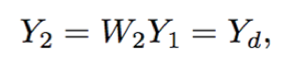
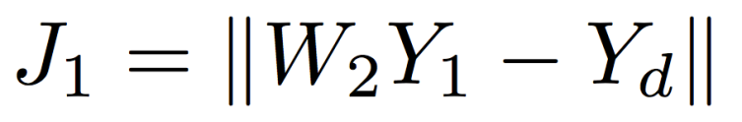
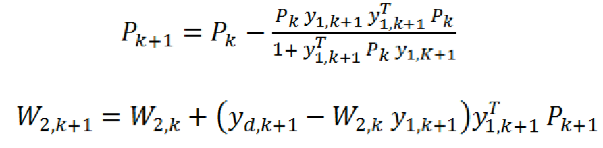
Training the Network with OSLA
Therefore, it is merely the least square solutions to
minimized by
Updating w2 :

Slide 26

OSLA
OSELM – Requires boosting with initial chunk of data and inverse matrix calculation.
P₀
OSELM
N.Y.Liang, G.B.Huang, P.Saratchandran ,N.Sundararajan

Slide 27
OSLA
OSELM – Requires boosting with initial chunk of data and inverse matrix calculation.
We initialize P and W₂ a
P₀ = I ,
and W_{2,0} = 0_{m2 x (m1+1)}
P₀
Where λ is know as the regularization parameter
OSELM
N.Y.Liang, G.B.Huang, P.Saratchandran ,N.Sundararajan

Slide 28
OSLA
OSELM – Requires boosting with initial chunk of data and inverse matrix calculation.
We initialize P and W₂ a
P₀ = I ,
and W_{2,0} = 0_{m2 x (m1+1)}
OSELM with this initialization is called “OSLA”
P₀
Where λ is know as the regularization parameter
OSELM
N.Y.Liang, G.B.Huang, P.Saratchandran ,N.Sundararajan
OSLA
K. Subramanian, S. G. Krishnappa, K. George

Slide 29
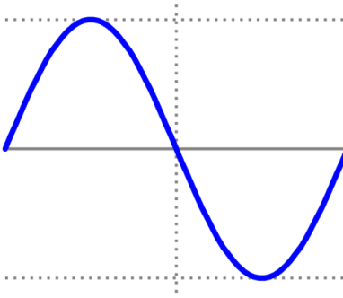
Shape Classification
Consider a sine wave for example –

Slide 30
Shape Classification
Consider a sine wave for example –
The signal can be split into 4 fundamental shapes
Class 1 – Rising Gradient
Class 2 – Hat Function
Class 3 – Falling Gradient
Class 4 – Inverse Hat Function

Slide 31
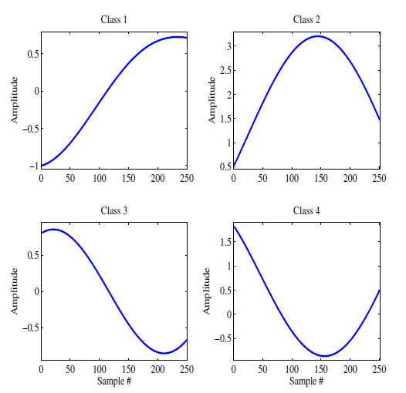
Shape Classification
Consider a sine wave for example –
The signal can be split into 4 fundamental shapes
Class 1 – Rising Gradient
Class 2 – Hat Function
Class 3 – Falling Gradient
Class 4 – Inverse Hat Function

Slide 32
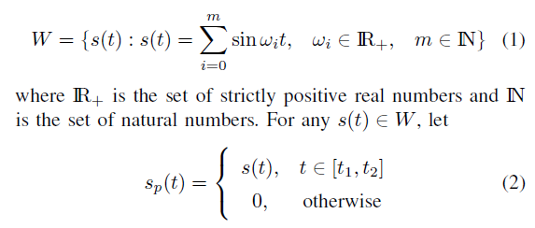
Data
Data required to train the neural network is artificially synthesized.
Consider a family of signals
For any chosen [t1 and t2], s_{p}(t) belongs to one of the classes.

Slide 33
Training and Testing Data for ANN
From the set of sinusoid signal family (W ), these signal chunks, of particular length, are created to form the training dataset.
Dataset used for testing consists of entire sinusoid signals s(t) as opposed to the chunks that make up the dataset used for training.

Slide 34
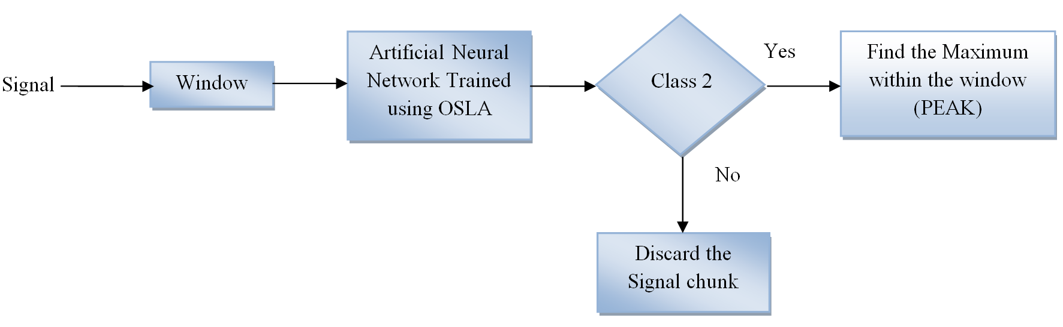
Online Peak Detection Algorithm

Slide 35
Full Length Run
An arbitrary number of signals from the family W is considered.
Each signal is split into the 4 fundamental shapes. Each of the these chunks are of a particular length, henceforth called “window”.
This entire collection is used as training set for the ANN trained using OSLA.
Once the ANN is trained, the network is tested with an entire signal s(t) chosen randomly from the family W.

Slide 36
Full Length Run
The signal s(t) is sent into the network sample by sample with a taking N samples at a time, where N is the length of the window.
At any given instant, the shape contained in the window is sent into the ANN for shape classification.
If the window is classified as class 2, the window is further processed to find the peak, else discarded.

Slide 37
Results
Accuracy of ANN for shape classification
 | Class 1 | Class 2 | Class 3 | Class 4 | Recall
Class 1 | 877 | 27 | 0 | 14 | 95.5%
Class 2 | 10 | 1071 | 11 | 0 | 98.1%
Class 3 | 0 | 20 | 866 | 22 | 95.4%
Class 4 | 8 | 0 | 8 | 1056 | 98.5%
Precision | 98% | 95.8% | 97.9% | 96.7% | 97%

Slide 38

Results
Accuracy of peak detection compared against findpeaks – inbuilt MATLAB function.
Accuracy =
Accuracy achieved by the network is found to be 98.32%, accuracy averaged over 100 trials.

Slide 39
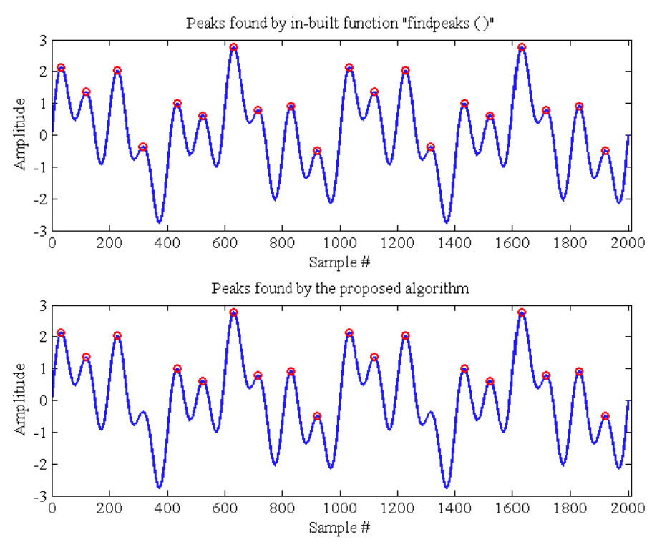
Comparison of Peak Detection in Sinusoid

Slide 40
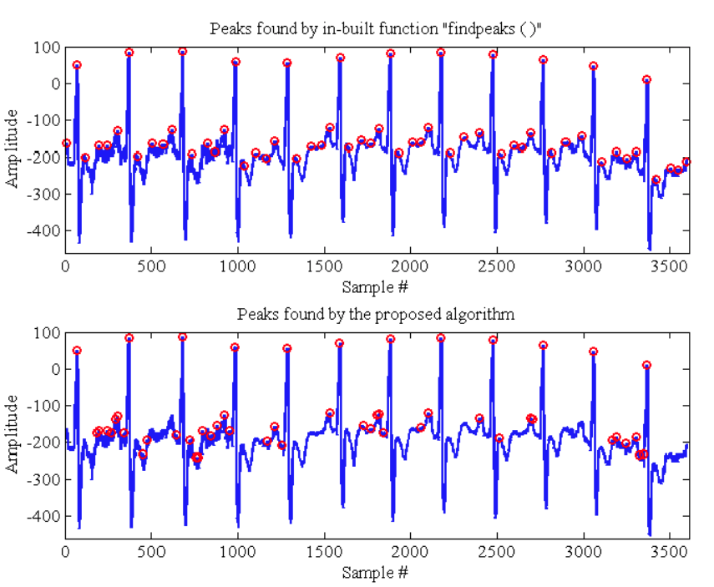
Comparison of Peak Detection in ECG

Slide 41
Online Peak Detection - Demo
Video
Peak Detection Online Demo

Slide 42
Conclusion
A method for detecting peaks is proposed in this paper with the online sequential algorithm that avoids complex pre-processing and feature extraction.
The novelty is in the capability to detect peaks using merely sequential processing of data, and hence amenable for real-time implementations.
Algorithm espouses the Human Cognitive Learning.

Slide 43
Thank you

