Slide 1
Data Analysis of ’Burrito in San Diego’ dataset
Realized by Skander MEZIANE

Slide 2
Summary
01
Introduction
02
Data Quality
03
Top 3 in depth insights
04
Review platforms/Reviwers Analysis
05
Recommendations
01

Slide 3

Introduction
02

Slide 4
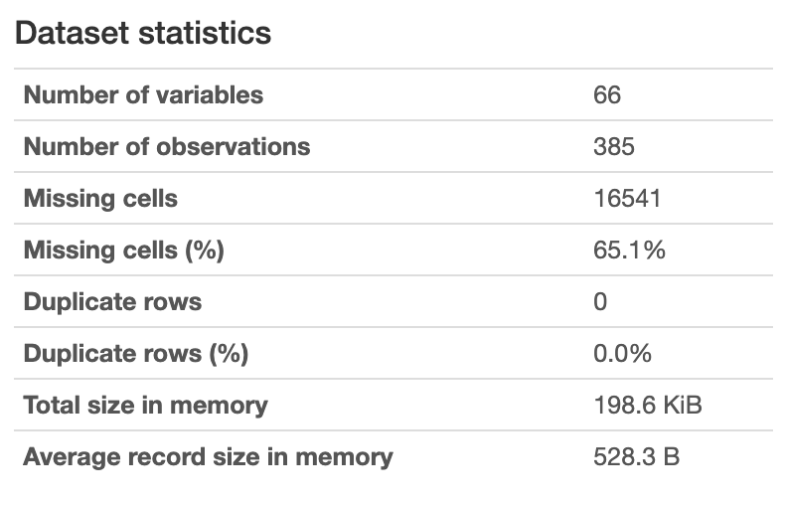




Introduction
Burrito in San Diego dataset presentation
01
66
Features
385
observations
65.1%
Missing values
70KB
Size
03

Slide 5

Data Quality
04

Slide 6

Data Quality
Dataset problems
02
Columns having crosses to represent a boolean data.
Columns having more than 78% missing values.
Columns representing boolean data with string values.
String columns are not preprocessed.
Columns have few missing values (less than 10%).
05

Slide 7

Data Quality
Solutions
02
Drop columns having more than 90% missing values
Ecoding boolean data with numerical data ( 1 or 0 )
Filling few numerical missing (less than 10% missing values) data by column mean value
Preprocess string data ( lowercase, deleting special caracters … )
Fill some missing data with business logic
05

Slide 8
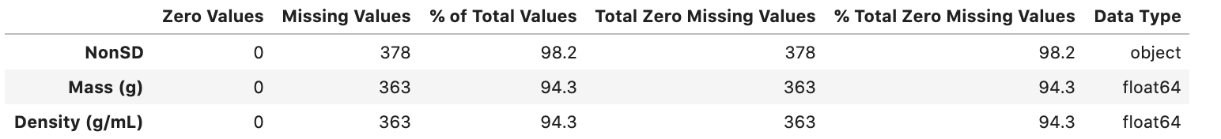
Data Quality
Interventions
02
I. Dropping columns
We delete ‘NonSD’ , ‘Mass (g) and ‘Density (g/mL)’ Columns because they have more than 90% missing values
07

Slide 9
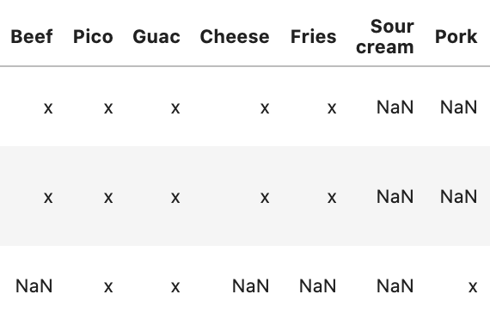
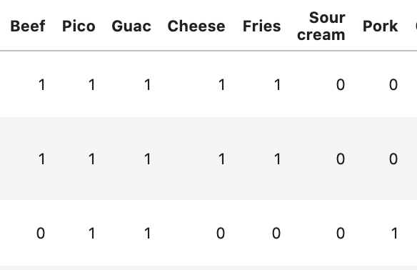

Data Quality
Interventions
02
II. Boolean data encoding
Data before encoding
Data after encoding
08

Slide 10
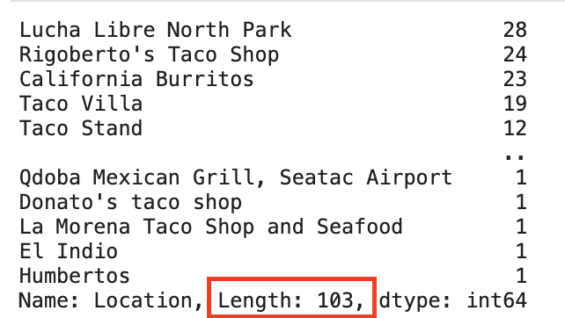
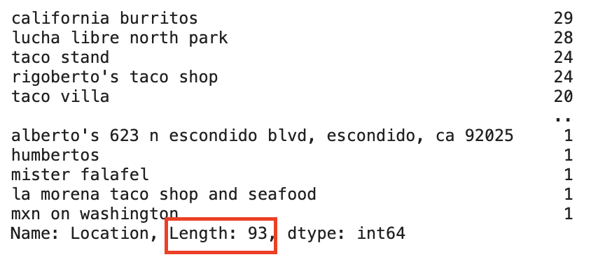
Data Quality
Interventions
02
III. String data preprocessing
Location unique values before preprocessing
Location unique values before preprocessing
The number of Location unique values have dicreased after data preprocessing.
09

Slide 11
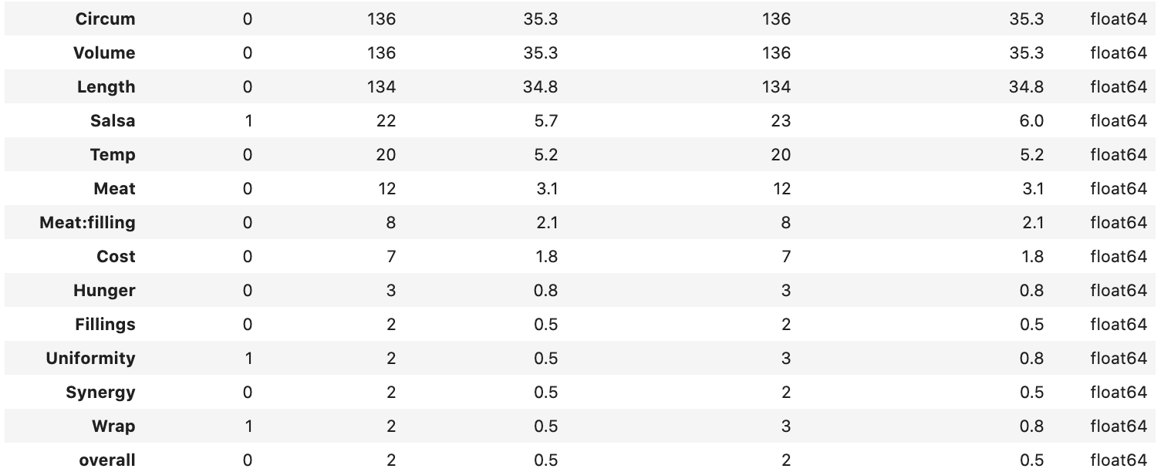
Data Quality
Interventions
02
IV. Filling missing values
Fill numerical data with less than 35% missing values with mean value
10

Slide 12
Data Quality
Interventions
02
IV. Filling missing values
[‘Neighborhood’, ‘Address’ , ‘URL’, ’Google’, ‘Yelp’ ] columns are filled once for each unique location ( 88% of locations have these columns filled once ) .
Duplicate data for location that are filled once and have some missing values for these columns.
11

Slide 13
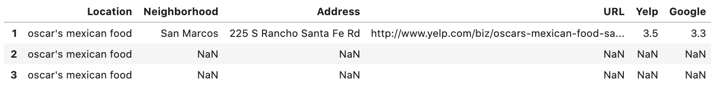
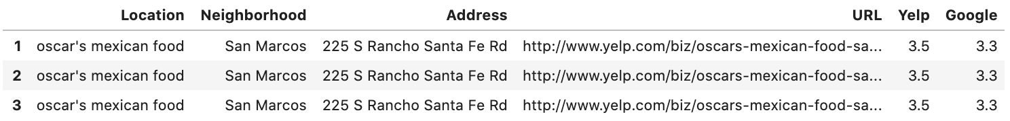
Data Quality
Interventions
02
IV. Filling missing values
Example
12

Slide 14

Top 3 in depth insights
13

Slide 15
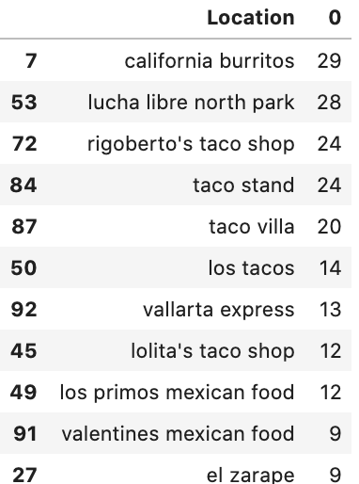
Top 3 in depth insights
03
Feature Engineering
1. Best restaurant
Extract the best burrito restaurant which have the best overall rating.
Compare locations that have at least 9 or more reviews.
14

Slide 16
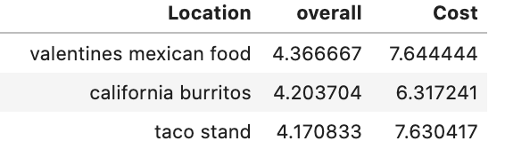
Top 3 in depth insights
03
Feature Engineering
1. Best restaurant
The top 3 best locations are :
* Valentines Mexican Food
* California Burrtios
* Taco Stand
15

Slide 17
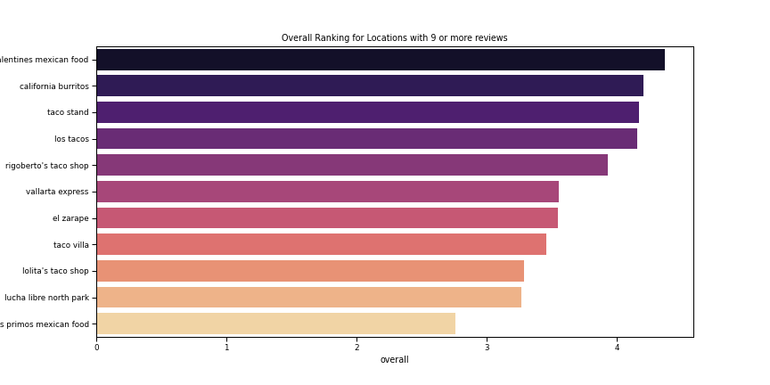

Top 3 in depth insights
03
Feature Engineering
1. Best restaurant
16

Slide 18
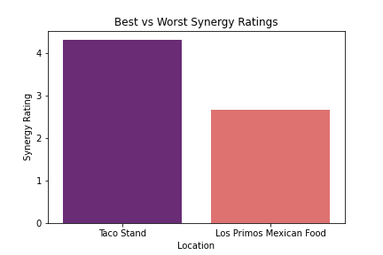
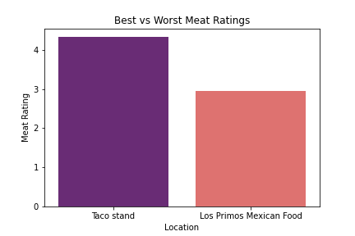
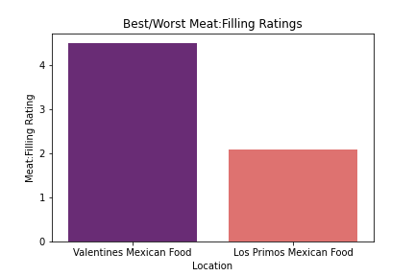
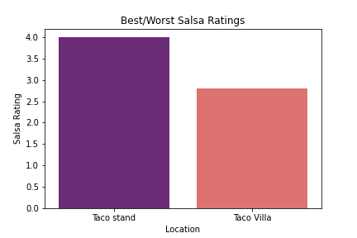

Top 3 in depth insights
03
Feature Engineering
1. Best restaurant
17

Slide 19
Top 3 in depth insights
03
Feature Engineering
1. Best restaurant
Locations aren’t consistent based on individual features.
This is due to ratings between 0 and 5 which is a small interval.
Increasing interval will provide consistency.
18

Slide 20
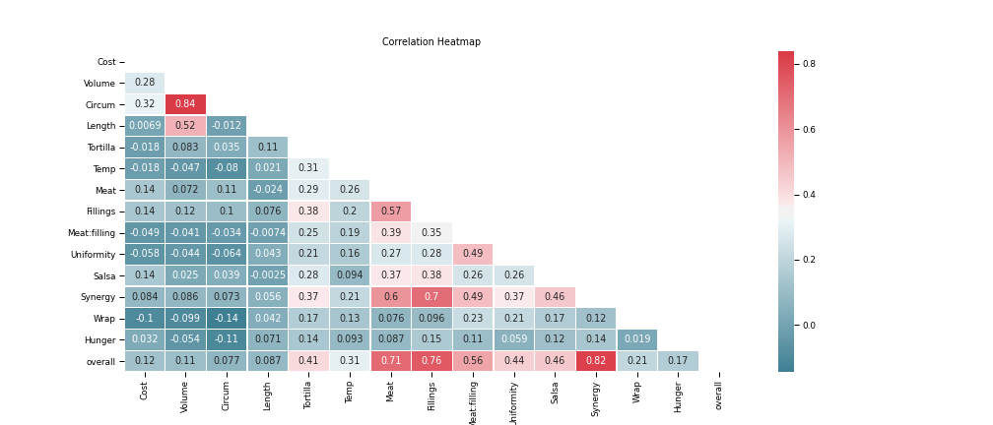
Top 3 in depth insights
03
Feature Engineering
2. Most important features
19

Slide 21
Top 3 in depth insights
03
Feature Engineering
2. Most important features
According to the Correlation heatmap :
Burrito cost does not affect it’s rating : very low correlation between cost and overall
Salsa, Meat, Uniformity, Synergy, Meat:Filling and Fillings are important for a good rating
Being hungry does not affect the rating.
20

Slide 22
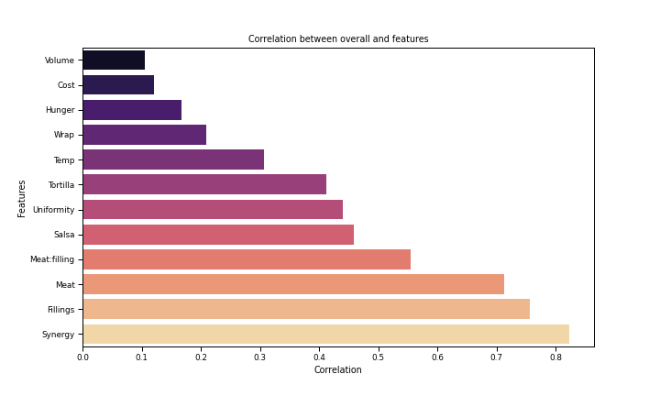
Top 3 in depth insights
03
Feature Engineering
2. Most important features
-The most 3 important features for a good rating:
* Synergy
* Fillings
* Meat
-A burrito is especially rated on the synergy , fillings and the meat quality.
21

Slide 23
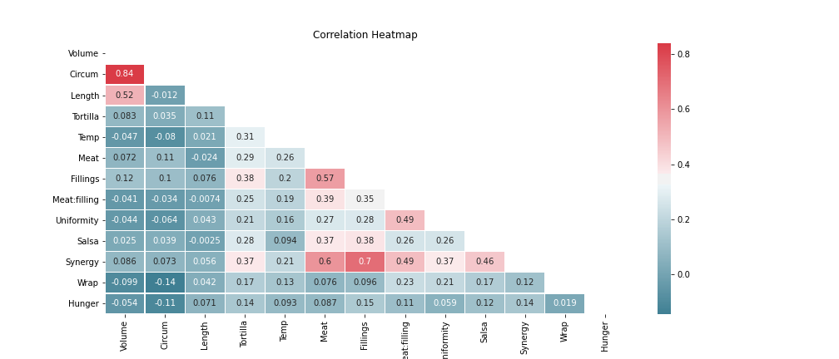
Top 3 in depth insights
03
Feature Engineering
3. Best Synergy
22

Slide 24
Top 3 in depth insights
03
Feature Engineering
3. Best Synergy
According to the Correlation heatmap :
A good synergy depends on the all coming together off all the component such as meat , salsa…
Burrito length and volume does not have affect synergy ratings.
23

Slide 25
Top 3 in depth insights
03
Feature Engineering
3. Best Synergy
-The most 3 important features to have a good synergy:
* Fillings
* Meat
* Meat:Fillings
24

Slide 26

Review platforms/Reviwers Analysis
25

Slide 27
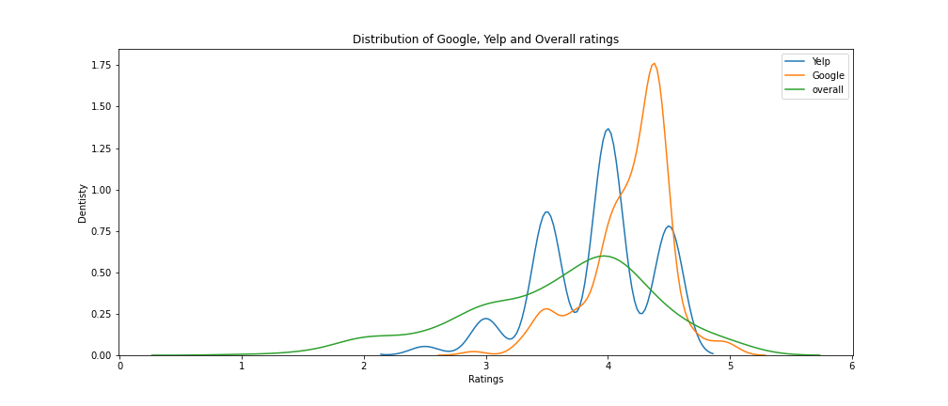
Review platforms/Reiwers Analysis
04
Recommandation
Compare Google/Yelp ratings to reviews
26

Slide 28
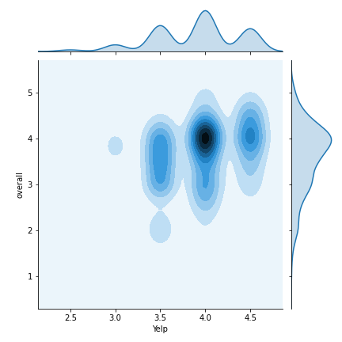
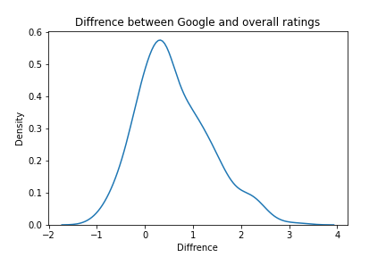
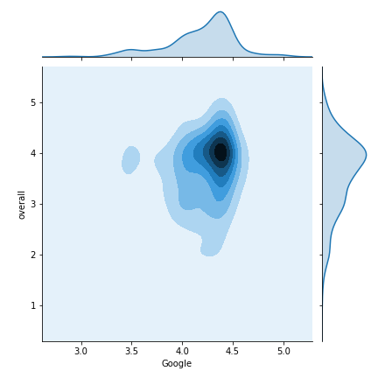
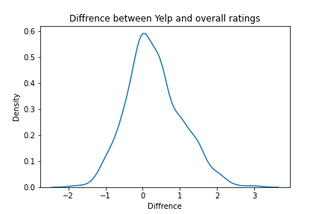
Review platforms/Reiwers Analysis
04
Recommandation
Compare Google/Yelp ratings to reviews
Google and Yelp ratings are very correlated to overall ratings.
These platform’s ratings are reliables.
27

Slide 29

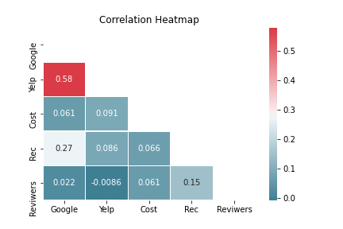
Review platforms/Reiwers Analysis
04
Recommandation
Impact of Goole/Yelp ratings
on Reviwers number
The reviwers number does not depend on Google/Yelp ratings.
28

Slide 30

Recommendations
29

Slide 31

Recommendations
05
Recommendations to increase restaurant’s profit
Focus on platforms like google and yelp since they are reliable by having values very close to reviewer’s ratings.
Provide good meat quality and a good synergy since it’s the most important features that customers like.
Increase burrito cost if it is mandatory in order to improve the quality beacause cost has not a negative correlation with ratings.
focus on quality and not quantity as length and volume are not important
30

Slide 32
Thank you for your attention !
31

