Slide 1
How to setup the environment and run the test script with 3 nodes?

Slide 2
On the compute Canada cloud
Create 5 VMS manually (1 manage machine, 1 mininet machine, 3 target machines).
Requirements:
1. Make sure the key in your computer’s ~/.ssh folder can ssh to the manage machine, mininet machine and target machines without password. So the public key you upload in Compute Canada Cloud should match the private key in your ~/.ssh folder.

Slide 3
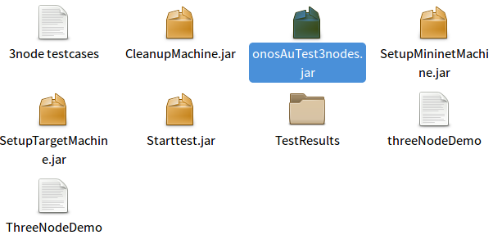
The structure of my scripts
OnosAuTest3nodes.jar: We use this one to setup all the test environments. It will install all the softwares on the manage machine, mininet machine and target machines. And it will also create user sdn on all those machines. After that it will try to run the sample testcase with 3 nodes (SAMPstartTemplate_3node) on the manage machine and record the result in TestResults folder.

Slide 4
The structure of my scripts
Starttest.jar: After run onosAuTest3nodes, we use this one to run the testcase we choose.
The input is the manage machine’s ip address and the name of the testcase we want to run.

Slide 5
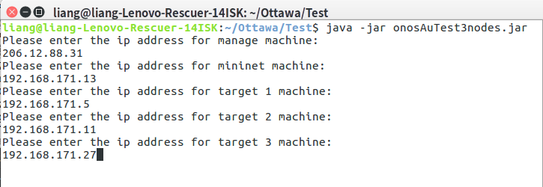
The structure of onosAuTest3nodes.jar
Mininet
Target 1
SetupMininetMachine.jar
SetupTargetMachine.jar
JSCH
Manage
Target 2
SetupTargetMachine.jar
SetupTargetMachine.jar
My computer
Target 3
We can run it by input “java -jar onosAuTest3nodes.jar”. Then we input 5 ip addresses (the public network ip for manage machine and the intranet ip for the other machines like the following image).

Slide 6
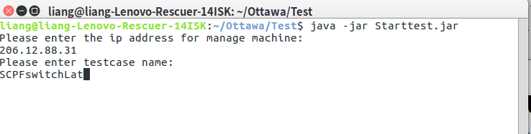
The structure of Starttest.jar
Mininet
Target 1
CleanupMachine.jar
CleanupMachine.jar
JSCH
Manage
Target 2
CleanupMachine.jar
CleanupMachine.jar
My computer
Target 3
We can run it by input “java -jar Starttest.jar”. Then we input the ip address of the manage machine (public network ip) and the name of the testcase we want to run like the following image. The result will be recorded in TestResults folder.

Slide 7
The file “3node testcases” contains the name of all the testcases which need 3 nodes.
Thank you!

