Slide 1

Project Work Phase 1 (19AI702) – Review 2
Digital Privacy & Security Guardian (DPSG) - CyberX
Submitted by:
Kantha Sishanth S (212222100020)
2022-2026 Batch
TEAM NO: 026
Under the guidance of:
Rajesh C
Assistant Professor, Department of CSE(IOT)
DEPARTMENT OF COMPUTER SCIENCE AND ENGINEERING(CS)
SAVEETHA ENGINEERING COLLEGE
(Autonomous Institution – UGC, Govt. of India)
(Affiliated to Anna University, Approved by AICTE - Accredited by NBA & NAAC – ‘A’ Grade - ISO 9001:2015 Certified)
Saveetha Nagar, Thandalam, Chennai-602 105, TamilNadu, INDIA.

Slide 2
Agenda
Introduction
Statement of the Problem
  <subtitles >
Scope of the project
  <subtitles >
Methodology
  Architectural Diagram & Flow
  Algorithm used
  Design - Use Case Diagram, Class Diagram
  Implementation
  Important code segments
Output, Results
Test Cases
Conclusions
Future work
References

Slide 3
Introduction
Digital Privacy & Security Guardian (DPSG)
The Context: In the current digital landscape, personal data collection by mobile apps is opaque, continuous, and growing exponentially.
The Gap: Traditional security tools are reactive, focusing only on known viruses/malware after a breach has occurred.
The Solution: DPSG is an AI-powered mobile and desktop application designed for proactive, real-time protection.
Core Shift: Moves beyond anti-malware to privacy-first behavioral monitoring and absolute user control.

Slide 4
Statement of the Problem
The Challenge: Lack of Control & Awareness
Information Asymmetry: Users are often unaware of which apps access sensitive sensors (Mic, Camera, Location) in the background.
Reactive Legacy Tools: Existing antivirus solutions fail to detect "grayware"—apps that are technically legal but exploit permissions for tracking or unauthorized data harvesting.
Privacy Erosion: Without a baseline for "normal" behavior, subtle privacy breaches and unusual app activities go undetected.
Objective: To restore complete visibility and granular control over data access through real-time monitoring and AI-driven anomaly detection.

Slide 5
Scope of the project
Phase 1: Android Security & Privacy
Focus: Comprehensive design and deployment of core security features on the Android platform.
Key Deliverables:
  Real-Time Monitoring: Optimized background services to track sensor usage.
  Intelligence Layer: Rule-based and Light ML detection for unusual activity.
  Unified Dashboard: A single interface for managing all app permissions.
  Network Security: Built-in VPN with DNS-based Ad-Blocking.

Slide 6
Scope of the project
Inclusions:
Development of the Monitoring Layer for Camera, Microphone, and Location.
Implementation of the Intelligence Layer (Rule-Based + Light ML).
Network Layer integration (VPN + Ad-Blocker).
Automated Weekly Privacy/Security Reports.
Exclusions & Future Scope:
Complex ML models requiring heavy computation (reserved for Phase 2 to ensure battery efficiency).
Full-scale cross-device IoT management (Basic network scan only in Phase 1).

Slide 7
Methodology
How DPSG Works:
Data Collection (Real-Time Monitoring): The system deeply integrates with OS APIs to log sensitive app permissions and network activity in real-time.
Behavioral Analysis (Intelligence Layer):
  Rule-Based: Immediate detection of known threats.
  Anomaly Detection: ML models flag unusual behaviors (e.g., a calculator app accessing the microphone).

Slide 8
Methodology
3. Network Filtering: A local VPN tunnel intercepts DNS requests to block trackers and ads before connections are established.
4. Actionable Insight: Converting logs into simple "Weekly Reports" to educate users and improve digital literacy.

Slide 9
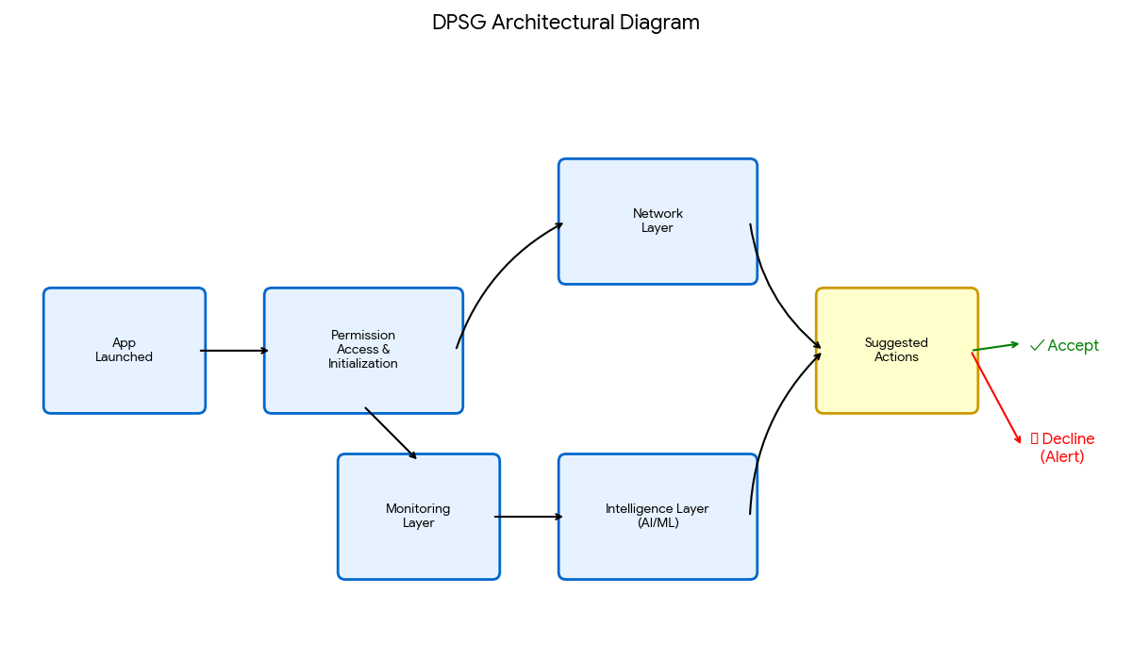
Architecture Diagram/Flow

Slide 10
Architecture Diagram/Flow
Flow Description:
App Launched: A third-party app initiates a process.
Permission Access: The app requests/uses a sensor (Mic/Camera).
Monitoring Layer: Captures the event and logs the usage.
Intelligence Layer: Analyzes the event against "normal" behavioral baselines.
Suggested Actions:
  Accept: If behavior is normal.
  Alert: If behavior is anomalous (Push Notification sent)

Slide 11
Design-Use Case Diagram
Actor: User
System: DPSG Application
Use Cases:
View Dashboard: User views active permissions (Mic/Cam status).
Manage Permissions: User revokes/grants app permissions via Unified Dashboard.
Toggle VPN: User enables/disables Secure Browsing (Ad-Block).
Receive Alert: User receives Push Notification for suspicious activity.
View Weekly Report: User reads the educational privacy summary.

Slide 12
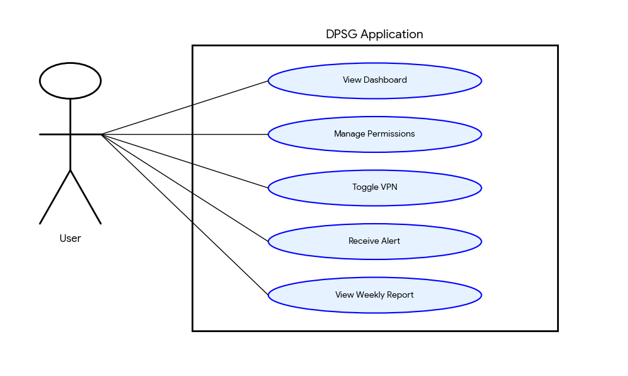
Design-Use Case Diagram

Slide 13
Design-Class Diagram
Class: DPSG_Main
  Methods: initServices(), showDashboard()
Class: MonitoringService
  Attributes: activeSensors, appLog
  Methods: trackSensorUsage(), logEvent()
Class: IntelligenceEngine
  Methods: analyzeBehavior(log), detectAnomaly(), triggerAlert()
Class: NetworkGuard (VPN)
  Attributes: vpnStatus, blockList
  Methods: enableVPN(), filterDNS()
Class: ReportGenerator
  Methods: generateWeeklySummary(), displayInsights()

Slide 14
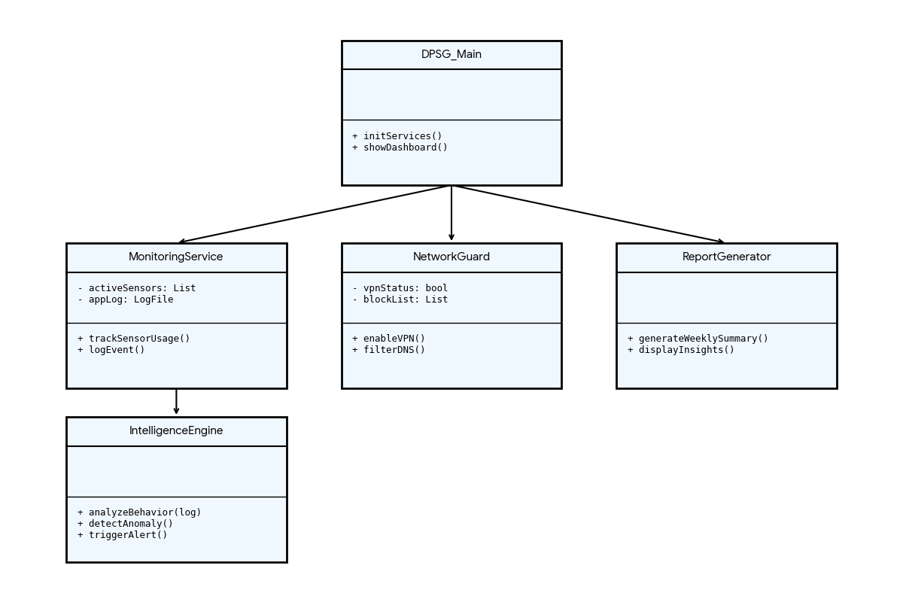
Design-Class Diagram

Slide 15
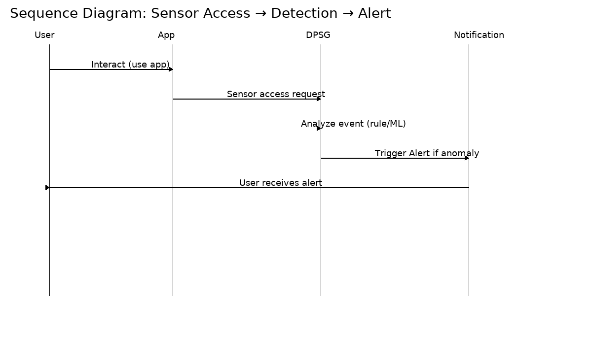
Sequence Diagram

Slide 16
Algorithms used
Hybrid Intelligence Approach
Rule-Based Detection:
  Purpose: Immediate identification of known risks and policy violations.
  Function: Checks against a static set of strict privacy rules (e.g., "Block Camera access for App X in background").

Slide 17
Algorithms used
2. Light Machine Learning (ML) Anomaly Detection:
  Purpose: To identify novel, unknown threats (Zero-day privacy attacks).
  Function: Establishes a "normal" behavioral baseline for apps. It scores activity based on deviation. If an app acts "out of character" (statistically significant deviation), it is flagged.
  Optimization: Specifically designed as "Light ML" to prioritize low resource consumption and battery life.

Slide 18
Implementation
Technology Stack & Tools:
Platform: Android (Mobile Application).
Monitoring: Android OS APIs for AccessibilityService and AppOpsManager to track runtime permissions.
Network: VPN Service using protocols like WireGuard/OpenVPN with local DNS filtering.
Database: Encrypted local storage (SQLite/Room) to store logs securely and comply with GDPR.
Design: Follows Android Material Design guidelines for the Unified Dashboard.

Slide 19
Important Code segments
1. Sensor Monitoring Logic:
# Logic for Real-Time Monitoring Layer [cite: 349, 443]
def monitor_sensor_usage():
active_apps = get_running_processes()
for app in active_apps:
# Check if Mic or Camera is currently in use
if app.is_using_permission(MIC) or app.is_using_permission(CAMERA):
log_event(app.name, "SENSOR_ACCESS", timestamp)
# Send to Intelligence Layer
analyze_behavior(app.name, "SENSOR_ACCESS")

Slide 20
Important Code segments
2. Anomaly Detection Logic:
# Logic for Intelligence Layer (Light ML) [cite: 350, 401]
def analyze_behavior(app_name, action):
baseline = load_app_baseline(app_name)
deviation_score = calculate_deviation(action, baseline)
# Threshold for anomaly (e.g. infrequently used app accessing Mic)
if deviation_score > ANOMALY_THRESHOLD:
trigger_alert("Suspicious behavior detected: " + app_name)

Slide 21
Output
Expected User Interface Outputs:
Unified Dashboard:
  A clean interface showing exactly which apps are currently using the Microphone or Camera.
  One-click toggle to revoke permissions for specific apps.
Alert System:
  Input: "Calculator" app attempts to access the Microphone in the background.
  Output: Immediate Push Notification: "Alert: Calculator is using Microphone unexpectedly. Block now?".
Weekly Report:
  A structured summary card showing: "50 Apps tracked," "3 Anomalies blocked," "Privacy Score: High".

Slide 22
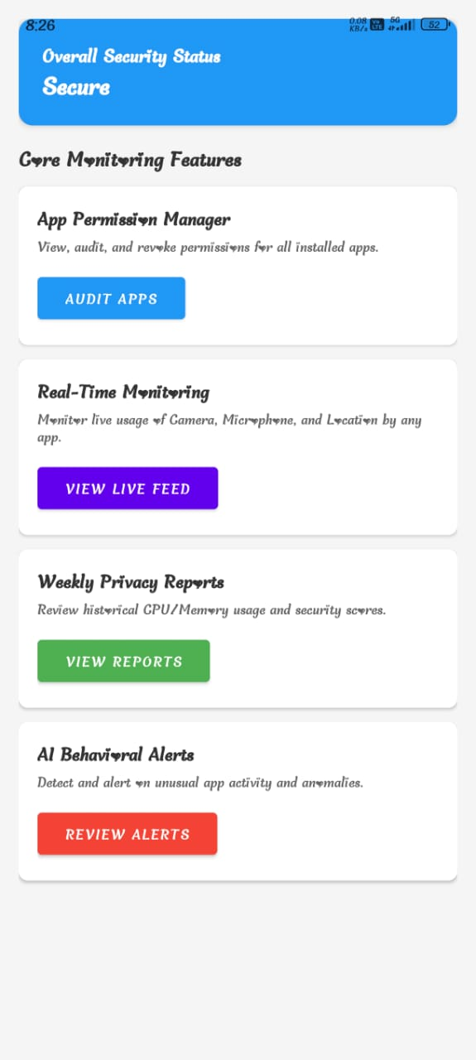
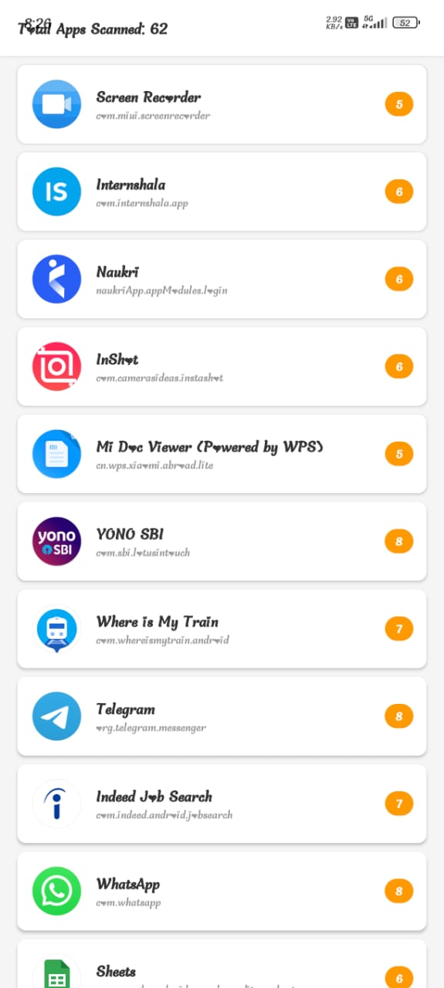
Output

Slide 23
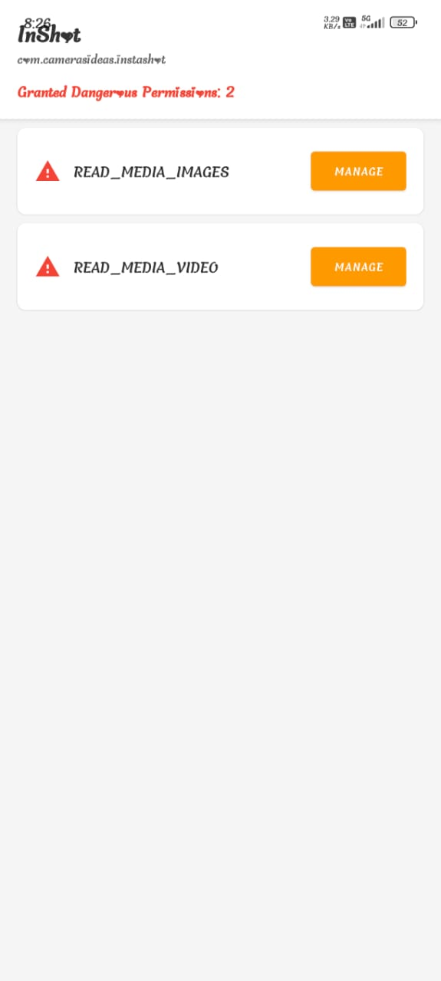
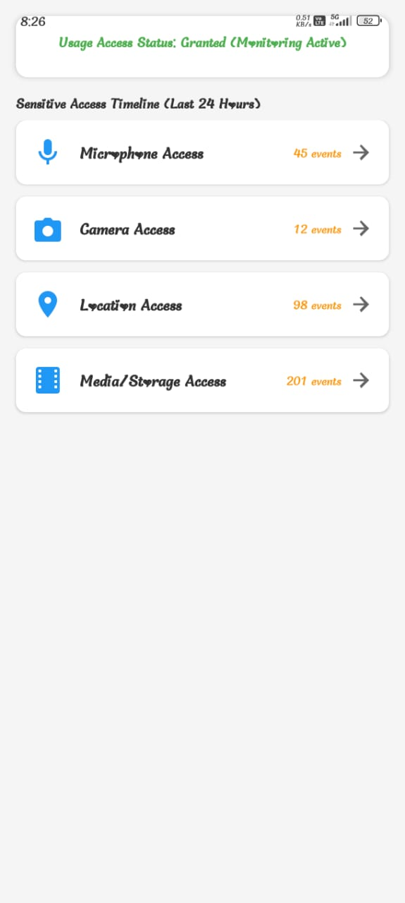
Output

Slide 24
Test Cases
Test Cases
S.NO | Action | Input | Expected output | Actual output | Test Result
1 | Test Case 1: Check Active Sensor | Input: Open a Voice Recorder app. | Expected Output: Dashboard displays "Recorder is using Microphone" in real-time | Actual Output: Same | Result: Pass
2 | Test Case 2: Anomaly Alert | Input: A background app (e.g., Notepad) tries to access Camera. | Expected Output: System triggers a "Suspicious Activity" Push Notification immediately. | Actual Output: Same | Result: Pass
3 | Test Case 3: VPN Toggle | Input: User clicks "Enable Protection" on Dashboard. | Expected Output: VPN icon appears in status bar; Ads/Trackers are blocked in browser. | Actual Output: Same | Result: Pass
4 | Test Case 4: Permission Audit | Input: User opens Unified Dashboard. | Expected Output: List of all apps with sensitive permissions is displayed clearly | Actual Output: Same | Result: Pass
5 | Test Case 5: Report Generation | Input: End of week cycle. | Expected Output: "Weekly Privacy Report" is generated and notifies the user | Actual Output: Same | Result: Pass

Slide 25
Results
Key Performance Indicators (KPIs):
False Positive Rate (FPR): < 5%
  Goal: To ensure alerts are accurate and prevent user "alert fatigue".
System Uptime: 99.9%
  Goal: Continuous background monitoring to ensure no gaps in privacy protection.
Blocking Efficiency: High (Zero Latency)
  Goal: The local DNS-based blocking ensures ads/trackers are stopped before the connection leaves the device, improving page load speeds.
Inferences:
Battery Impact: The "Light ML" approach ensures the app runs effectively in the background without draining the battery.
Privacy Control: The shift from reactive scanning to real-time behavioral monitoring provides immediate visibility into invisible app activities.

Slide 26
Conclusion
Proactive Protection: DPSG successfully bridges the gap between passive device security and the user's need for total digital control.
Empowerment: By centralizing controls and providing educational reports, the system transforms users from passive targets into informed privacy managers.
SDG Alignment: The project aligns with SDG 9 (Innovation) and SDG 16 (Strong Institutions/Privacy).

Slide 27
Future Work
IoT Ecosystem: Expansion of the monitoring capabilities to cover connected IoT devices within the user's local network.
Advanced ML Models: Integration of more complex Machine Learning models for deeper behavioral analysis as device hardware capabilities increase.
Cross-Platform: Extending the DPSG architecture to support iOS and Desktop environments for a unified cross-device experience.

Slide 28
References
A. Sharma and S. Gupta, “Machine Learning for Runtime Permission Monitoring in Android Applications,” International Journal of Computer Applications, 2023.
M. Chen and R. Kumar, “A Novel Approach to DNS-based Tracking Prevention in Mobile VPN Architectures,” International Journal of Emerging Technologies, 2022.
Y. Li and K. Das, “Empowering Users: A Review of Privacy-Enhancing Technologies in Mobile Operating Systems,” IEEE Access, 2022.
Android Design Guidelines: https://www.developer.android.com/design.

Slide 29

Questions

Slide 30


