Slide 1


MSc in Business Analytics Machine Learning & Content Analytics Argument Detection Project
Group 6
Agapiou Marios – f2821901
Kontos Christos – f2821906
Skarlis Vasileios – f2821912

Slide 2
01
DESCRIPTION OF THE PROJECT
02
WORKFLOW OF THE PROJECT
03
METHODOLOGY OF THE MODELS
04
EVALUATION OF THE MODELS
05
VALIDATION OF THE BEST MODEL
CONCLUSIONS / FUTURE WORK
05
06

Slide 3

Description of the Project
The importance behind the implementation
The Sustainable Development Goals (SDGs) or Global Goals are a collection of 17 interlinked goals designed to be a “blueprint to achieve a better and sustainable future for all”.
The SDGs, set in 2015 by the United Nations General Assembly and intended to be achieved by the year 2030, are part of a UN Resolution called the "2030 Agenda".
There is an interest in measuring how the work of the United Nations system aligns with the Sustainable Development Goals (SDGs) and a need for a scalable, objective and consistent way to measure and classify the main arguments that are being detected in publications concerning the specific SDG target.
Between the many resolutions, speeches, reports and other documents that are produced each year, the United Nations is awash in text.

Slide 4
Description of the Project
Main goals
Business Workflows
Algorithms can be used at scale with objectivity and can help identify patterns and gaining important insights across publications and over time
Classify text content by its relevance and more specifically trying to predict sentences including claims and evidences of various documents to the measurable indicators of the SDGs
Reducing as much as possible the time and the volume of documents one’s has to read
Will help governments taking better decisions and implementing more accurate actions, concerning the SDGs
Three Deep Neural Networks were used:
Feed Forward Neural Network (FFNN)
Convolutional Neural Network (CNN)
Long Short-Term Memory Neural Network (LSTM)
Explore and discover new texts and to inform the direction of future research.
Will inspire other efforts to use modern data analytics to better understand the body of work of the United Nations.

Slide 5



Workflow of the Project
ML Experiments
Models Evaluation
Preliminary Procedures
Web Scrapping for data collection
Annotation & Curation procedures of the sentences
Data Parsing (900 different csv files)
Learning curves, test accuracies, confusion matrices and classification reports of each model
Keep the model with the least validation loss and subsequently with the greatest test accuracy
Three (3) models were used:
Feed Forward Neural Network
Convolutional Neural Network
Long-Short Term Memory NN
Models training
Final Model Deployment
Pre-processing procedures
Descriptive Statistics
Cleaning of the text
Split data to train-validation (85%) and test data (15%) using Stratified Shuffle Split
Fitting the tokenizer and padding on the train dataset
Find the best hyperparameters, embeddings, dense layers and activation functions for each model
Stratified 5-fold cross validation (80% - 20%) on the train data for each model
A blind test set (data never seen before – 99 new observations) were used in order to check the predictions of the best selected model
Tried to predict the label of each unique sentence.

Slide 6
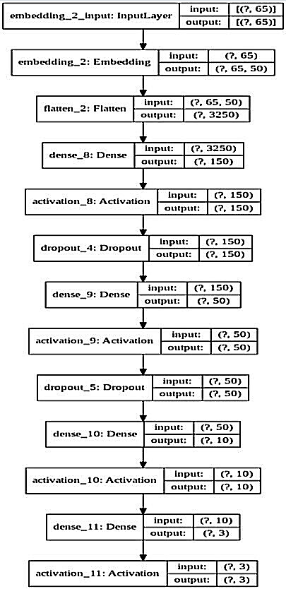
Methodology of the models – MLP model
Notable Model Characteristics
Model’s Architecture
It is comprised of 5 layers.
An Embedding layer was used as the first layer. It manages to transform words into word embedding vectors
Dropout was also applied to the 1st and 2nd hidden layers to regularize the neural network.
The Relu & Sigmoid activation functions were used to define the output of the hidden layers & the output layer.
Model’s Hyperparameters
Input Layer
Output Layer
Name of hyperparameter | Value
Size of each word embedding | 50
Batch size | 64
Epoch number | 30
Optimizer | Adam Optimizer
Learning Rate | 0,005%
3 Hidden Layers

Slide 7
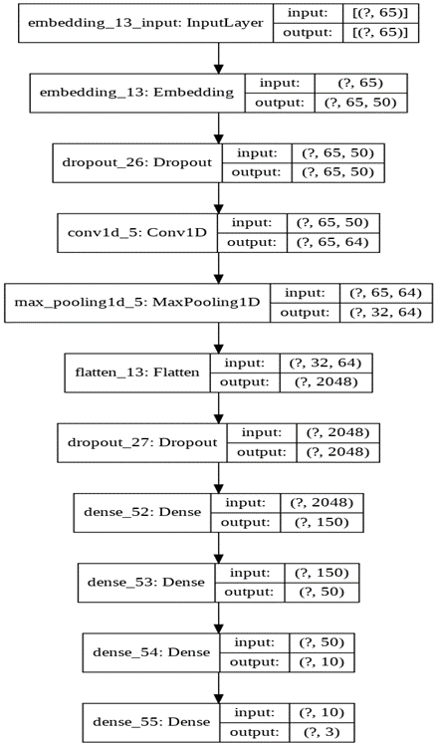
Methodology of the models – CNN model
Model’s Architecture
Model’s Hyperparameters
Name of hyperparameter | Value
Size of each word embedding | 50
Kernel height | 3
Number of kernels | 64
Batch size | 64
Epoch number | 30
Optimizer | Adam Optimizer
Learning Rate | 0,005%
Kernel size: 3 x 50
Notable Model Characteristics
1D Convolutional layer with padding
64 different kernels are applied to each 65-word long sentence.
Each kernel is multiplied with the input and outputs a 65x1 feature vector.
A GlobalMaxPooling1D layer is applied to the 1D Convolutional layer with padding to retain only the maximum values in each feature vector.
A Flatten layer was later applied & 3 additional Dense layers.
Outputs a 65 x 64 matrix
Size of max pooling window = 2

Slide 8
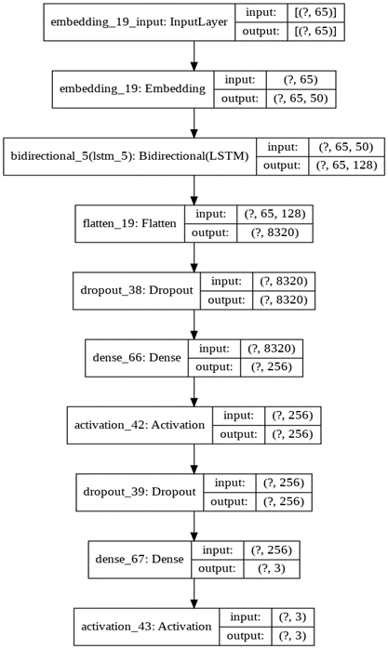
Methodology of the models – LSTM model
Model’s Architecture
Model’s Hyperparameters
Name of hyperparameter | Value
Size of each word embedding | 50
Batch size | 32
Epoch number | 10
Number of Memory units | 64
Optimizer | Adam Optimizer
Learning Rate | 0,005%
Notable Model Characteristics
Bidirectional LSTM Layer
A Flatten layer & a Dense layer were later applied.
Forward LSTM layer
Backward LSTM layer
Output

Slide 9
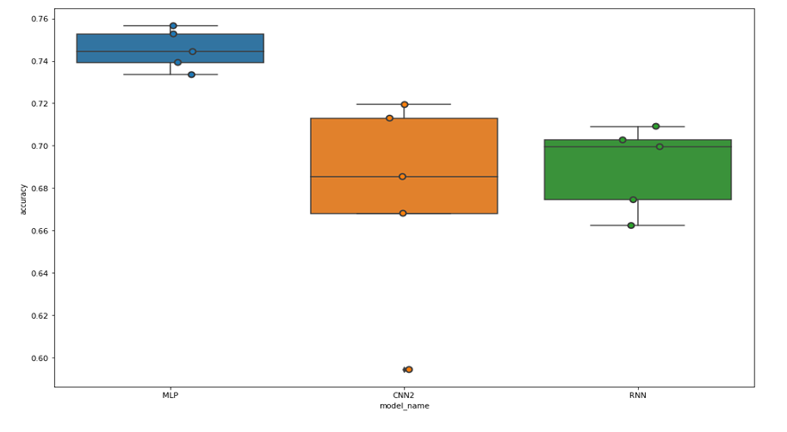
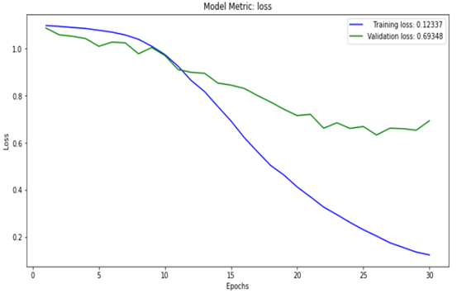
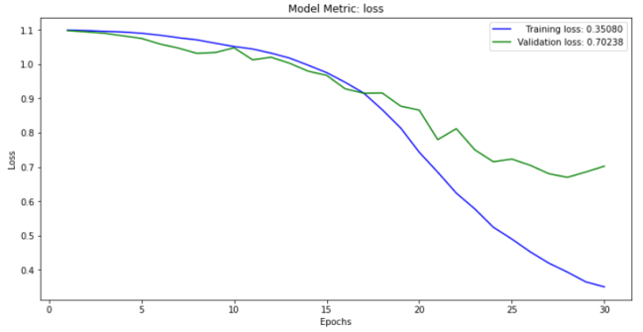
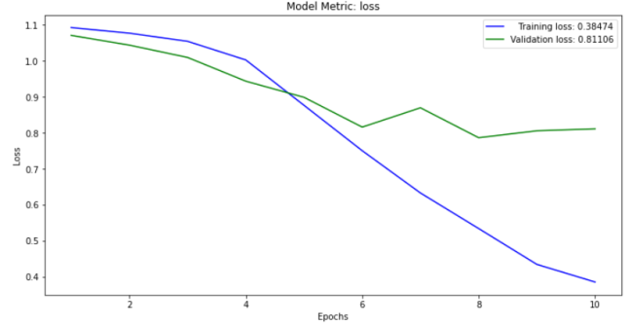
Evaluation of the models
Test accuracies of all models using the cross-validation procedure
Learning curve of the MLP model
Learning curve of the CNN model
Learning curve of the LSTM model
MLP’s last prediction accuracy:
75,65%
CNN’s last prediction accuracy:
71,3%
LSTM’s last prediction accuracy:
69,95%

Slide 10
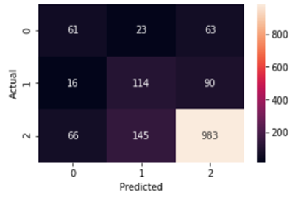
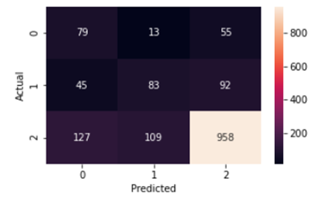
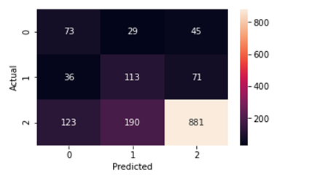
Evaluation of the models
Confusion matrix and classification report of the MLP model
Confusion matrix and classification report of the CNN model
 | Precision | Recall | F1-score | Support
CLAIM | 0.43 | 0.41 | 0.42 | 147
EVIDENCE | 0.40 | 0.52 | 0.45 | 220
NO LABEL | 0.87 | 0.82 | 0.84 | 1194
Accuracy |  |  | 0.74 | 1561
Macro avg | 0.57 | 0.59 | 0.57 | 1561
Weighted avg | 0.76 | 0.74 | 0.75 | 1561
 | Precision | Recall | F1-score | Support
CLAIM | 0.31 | 0.54 | 0.40 | 147
EVIDENCE | 0.40 | 0.38 | 0.39 | 220
NO LABEL | 0.87 | 0.80 | 0.83 | 1194
Accuracy |  |  | 0.72 | 1561
Macro avg | 0.53 | 0.57 | 0.54 | 1561
Weighted avg | 0.75 | 0.72 | 0.73 | 1561
Confusion matrix and classification report of the LSTM model
 | Precision | Recall | F1-score | Support
CLAIM | 0.31 | 0.50 | 0.39 | 147
EVIDENCE | 0.34 | 0.51 | 0.41 | 220
NO LABEL | 0.88 | 0.74 | 0.80 | 1194
Accuracy |  |  | 0.68 | 1561
Macro avg | 0.51 | 0.58 | 0.53 | 1561
Weighted avg | 0.75 | 0.68 | 0.71 | 1561

Slide 11
Validation of the best model
After having selected the MLP model as the best model for our business purpose, we checked its prediction accuracy at a blind test set as well, i.e. on data that has never seen before.
In a total of 99 new observations
Confusion matrix of the MLP model on the blind test set data
 |  | Observed class
Predicted class |  | Claim | Evidence | -
 | Claim | 44 | 13 | 52
 | Evidence | 9 | 64 | 85
 | - | 38 | 77 | 862
Model’s prediction accuracy:
77,8%
Sentences that labeled as Claims, 48,35% of them have actually being Claims, while the sentences that labeled as Evidences, 41,56% of them have actually being Evidences (Precision)
Classification report of the MLP model on the blind test set data
It classified correctly 40,37% of the Claim sentences and 40,51% of the Evidence sentences (Recall)
 | Precision | Recall | F1-score | Support
CLAIM | 0.4835 | 0.4037 | 0.44 | 109
EVIDENCE | 0.4156 | 0.4051 | 0.4103 | 158
Micro avg | 0.4408 | 0.4045 | 0.4219 | 267
Macro avg | 0.4496 | 0.4044 | 0.4251 | 267
Weighted avg | 0.4433 | 0.4045 | 0.4224 | 267
The harmonic mean of Precision and Recall (F1 score) indicates well to moderate Precision and Recall results. 44% of the positive prediction for Claims were correct while 41,03% for Evidences were correct.

Slide 12
Conclusions / Future Work
All the models that we trained, managed to capture a high total accuracy, but had low recall and precision metrics, meaning that they couldn’t classify properly the minority classes. This is probably due to the fact that the produced training dataset was small
Our future plans will include:
By re-adjusting some hyperparameters and reconstructing the architecture of each model
Limit overfitting with the regularization method of Data Augmentation using the back-translation method or Synonyms replacement (Word2Vec, GloVe and fast-text)

Slide 13
Our Team
Members / Roles
Agapiou Marios
Web Scrapping Script on PubMed site & Data collection
Annotation & Curation
Data Parsing & Preprocessing & Model Construction & Model Evaluation
Report the Methodologies used to create the models
Kontos Christos
Data collection
Annotation & Curation
Data Parsing & Descriptive Statistics & Preprocessing & Model Construction & Model Evaluation
Report the Business Problem Description, the Mission and Data Preprocessing
Skarlis Vasilis
Data collection
Annotation
Data Parsing & Preprocessing & Model Construction & Model Evaluation
Report the Evaluation & Comparison of the models

Slide 14
THANK YOU FOR YOUR ATTENTION
Athens University of Economics and Business
Department of Management Science & Technology
Master of Science in Business Analytics
Machine Learning & Content Analytics

