Slide 1
Neo4j
07: Intro Neo4j - IPSA - Winter 2025
10/03/2025 - 2 a.m.

Slide 2
Last time on NoSQL
Projects
Embeddings
Vector search
Weaviate
RAG

Slide 3
This week
Graph databases, Graph networks, Graph knowledge
Uses and benefits of graph databases
Cypher the query language of Neo4j
Graph networks and graph data science
centrality measures
shortest path algorithms
community detection, anomalies
Knowledge graphs - LLMs

Slide 4
This week: Neo4j
Today Monday
Intro graph database
Practice on Aura
And Thursday
Intro graph database
Practice on Aura
And Friday
Graph data science

Slide 5
graph networks

Slide 6
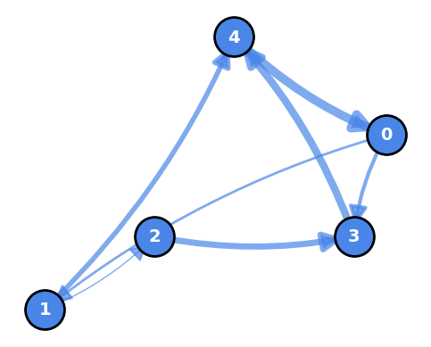
Graphs
A graph is a structure composed of
nodes or vertices.
Nodes
nodes are connected by edges or links.
Edges, vertices
Degree : Number of edges connected to a node
Path : Sequence of edges connecting two nodes
Cycle : Path that starts and ends at the same node

Slide 7
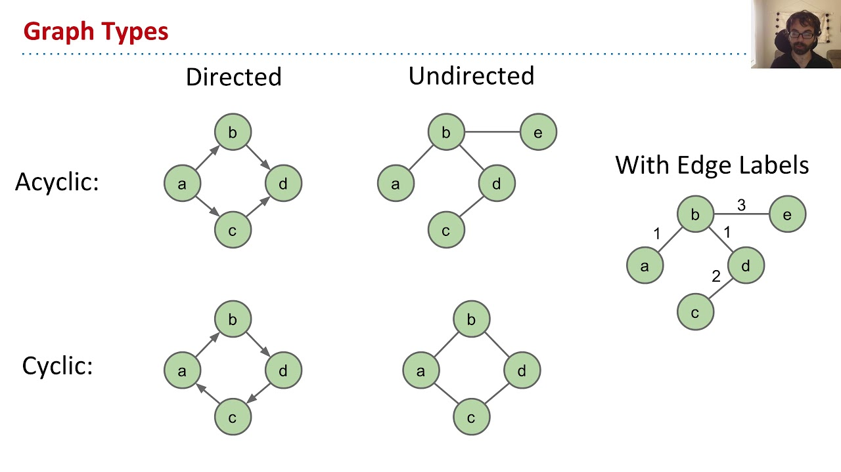
acyclic, cyclic, directed graphs
Oriented / Directed graph: explicit direction between nodes:
parent -> child,
acyclic : cannot go back (DAG)
A -> B -> C
cyclical : there is at least one cycle that allows you to go back:
A -> B -> C -> A
https://youtu.be/anRVomtGXFc?t=204

Slide 8
Use cases
Social network analysis: Studying relationships between individuals.
Transportation networks: Optimizing routes and traffic flows.
Biology: Modeling interactions between proteins.
Computer science: Representing dependencies between software components.
Digital sociology: Behaviors, modeling
Scientometrics: Evolution of Science, Cross-References

Slide 9
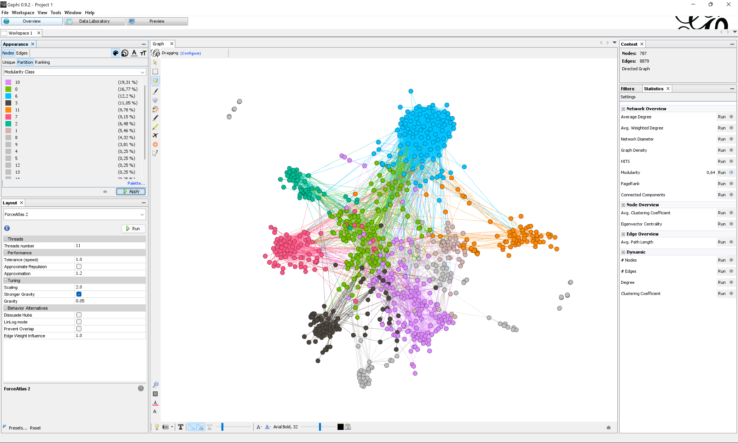
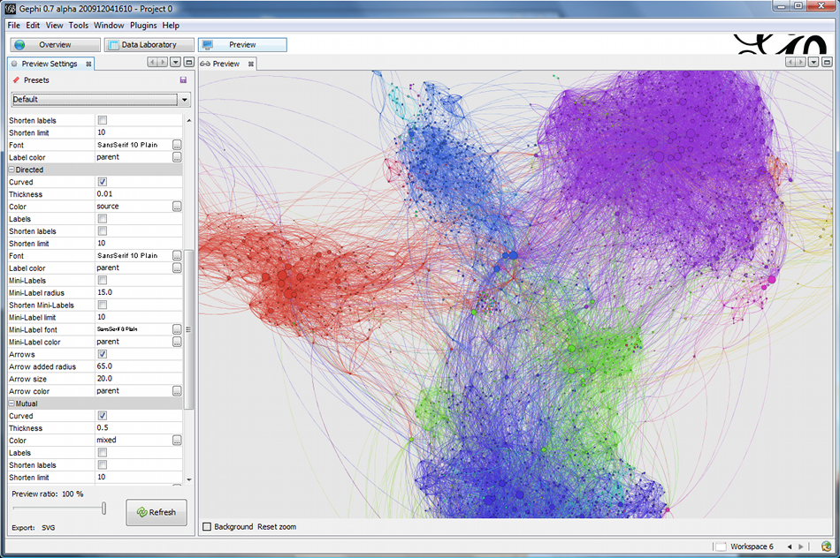
Analysis tools: Gephi
Gephi: Interactive software for visualizing and exploring graphs.
Mathieu Jacomy - https://gephi.org/ - https://gephi.wordpress.com/

Slide 10
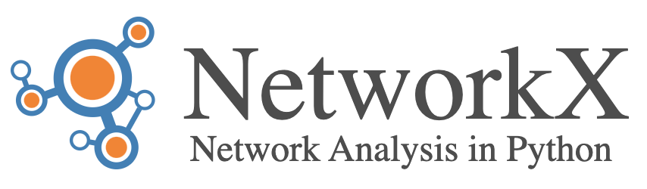
Analysis tools: networkx
NetworkX : Python library for creating, manipulating, and studying graphs.
https://www.toptal.com/data-science/graph-data-science-python-networkx

Slide 11
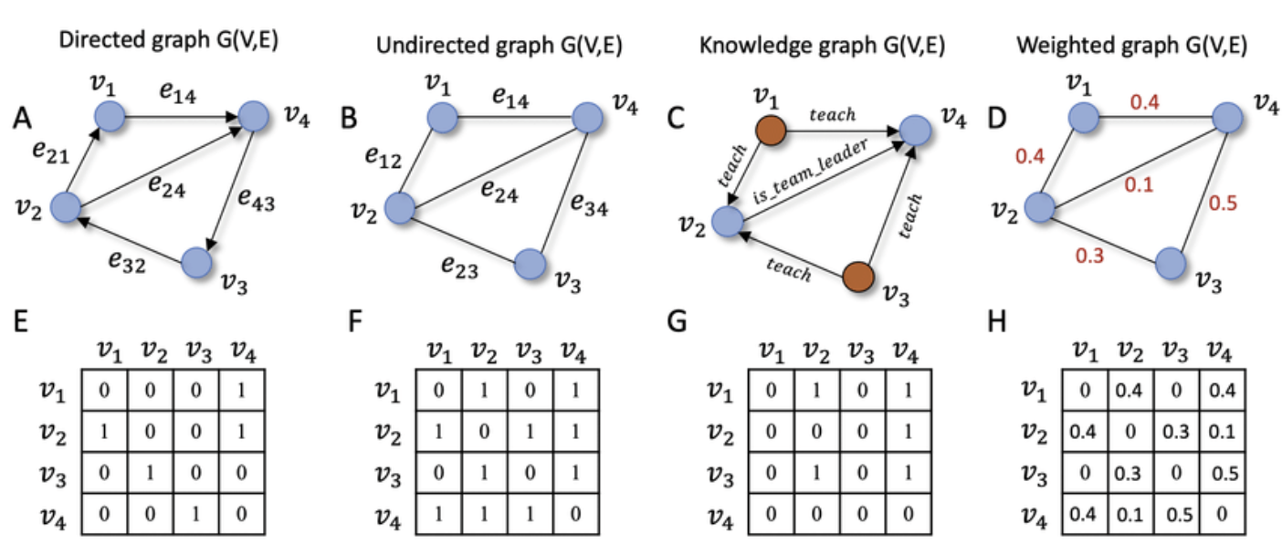
Data representations
Adjacency Matrix : N×N matrix where element (i,j) indicates connection
Adjacency List : Each node stores a list of its connected neighbors
Edge List : Simple list of all node pairs that form edges
Incidence Matrix : Rows represent nodes, columns represent edges
Adjacency Matrix

Slide 12
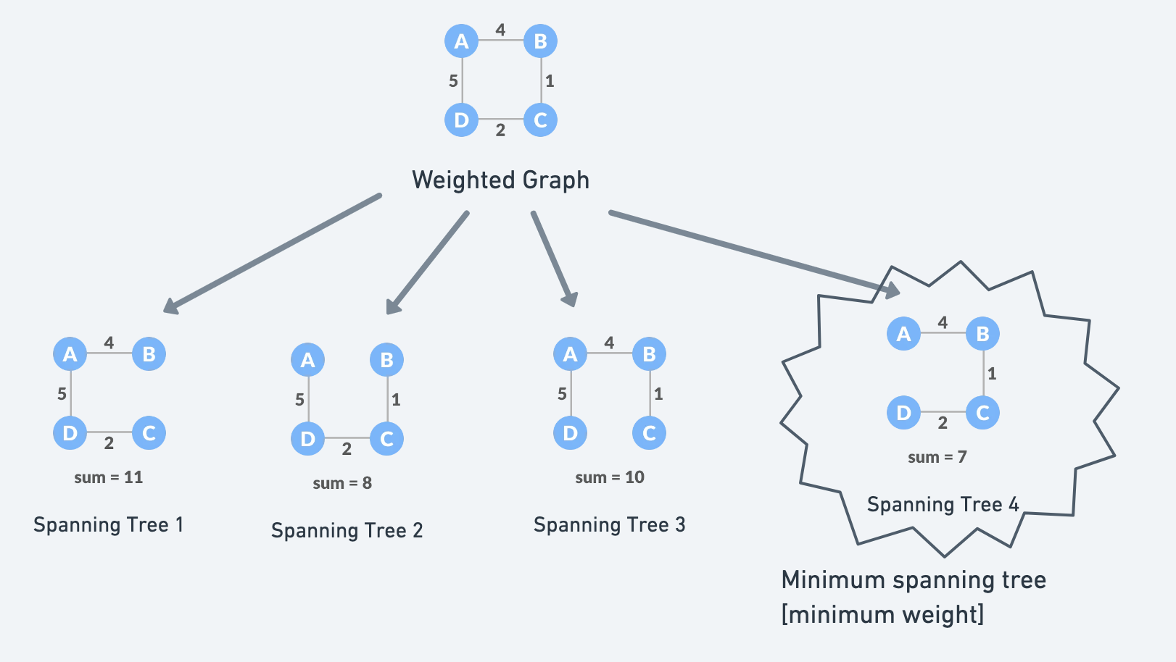
Analysis algorithms
Traversal : BFS (Breadth-First Search), DFS (Depth-First Search),
Shortest Path : Dijkstra, Bellman-Ford, A*
Minimum Spanning Tree : Kruskal, Prim, link , wikipedia
Centrality Measures : Degree, Betweenness, Closeness, Eigenvector
Community Detection : Search for clusters or groups of nodes

Slide 13
Neo4j

Slide 14

Take a deep breath!

Slide 15
SQL vs MongoDB vs Neo4j
Neo4j is above all a Graph Database .
PostgreSQL : performance, optimization and data normalization.
MongoDB : Schema flexibility, aggregation pipelines, and performance for large volumes.
Graph databases like Neo4j bring a dimension of analysis of data modeled in the form of graphs
graph datascience & knowledge graphs

Slide 16
Graph data science
Analyze complex data modeled in the form of graphs.
algorithms for identifying patterns, communities or anomalies
Study of relationships between entities (nodes) and their connections (edges) to extract information.
network analysis,
community detection,
link prediction
Applications : social networks, bioinformatics, product recommendations, etc.

Slide 17
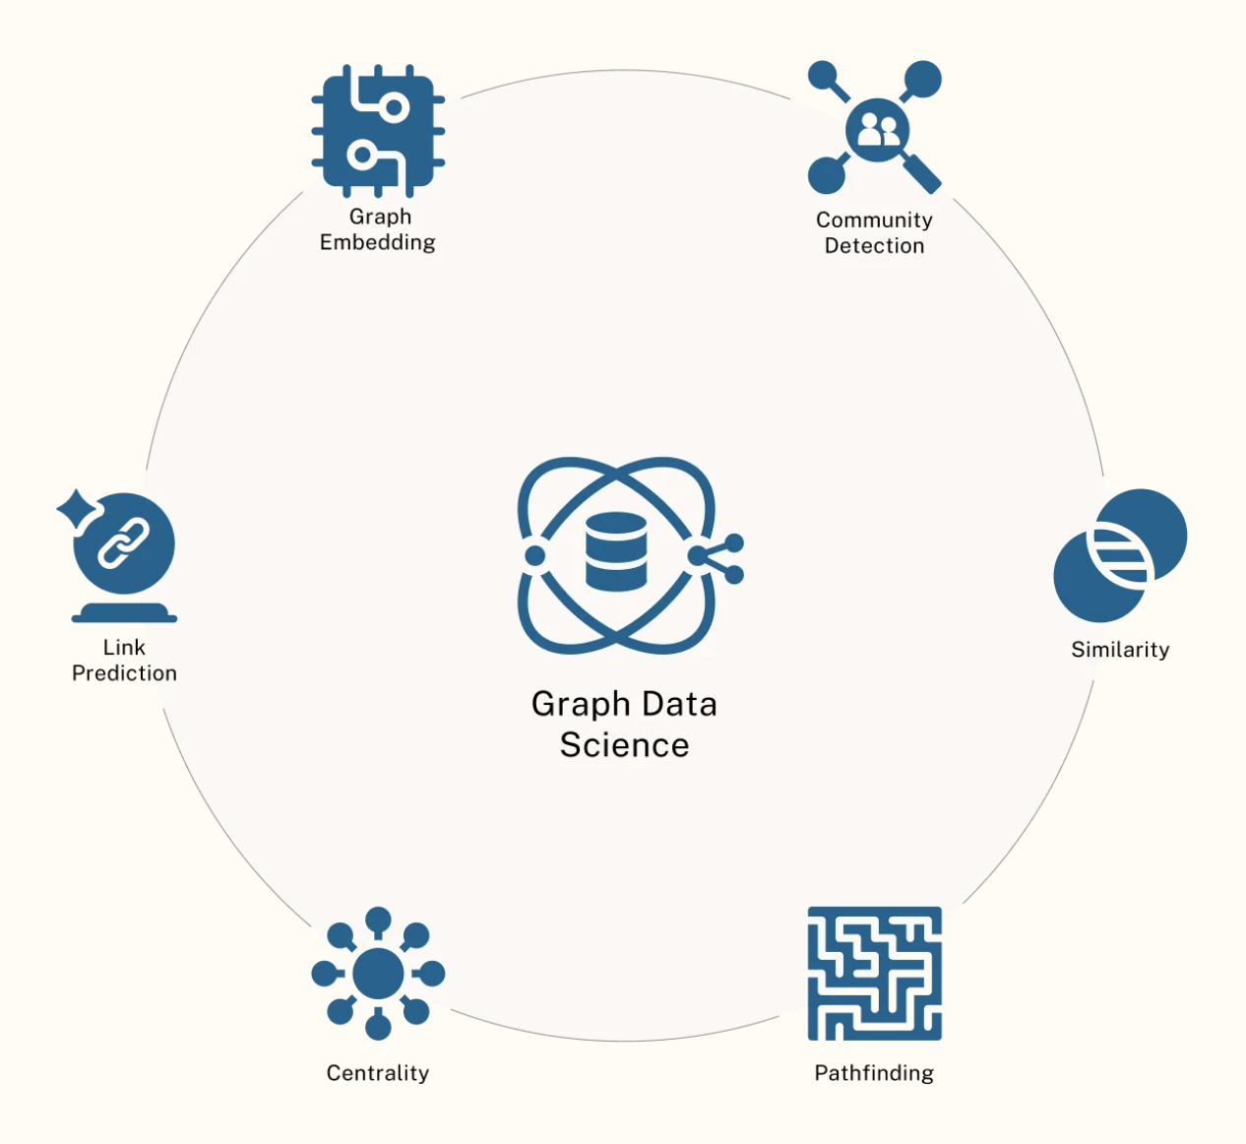
Graph data science
Centrality Algorithms: Find important/influential nodes in network
Community Detection: Identify groups of densely connected nodes
Path Finding: Discover optimal routes between nodes
Similarity Algorithms: Calculate how similar nodes/communities are
Machine Learning: Node embeddings and predictions
Node Embedding: Convert graph structure to vector space
Link Prediction: Predict future/missing relationships
https://neo4j.com/use-cases/knowledge-graph/

Slide 18
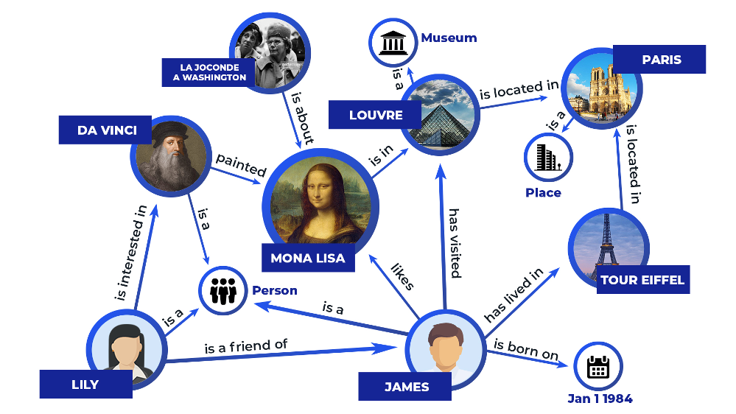
Knowledge Graphs
Structured representation of facts and relationships between entities.
Nodes (Entities): People, places, objects, concepts.
Edges (Relationships): How entities are connected
Paris is the capital of France
Why use knowledge graphs?
research
reasoning
inference
https://zilliz.com/learn/what-is-knowledge-graph

Slide 19
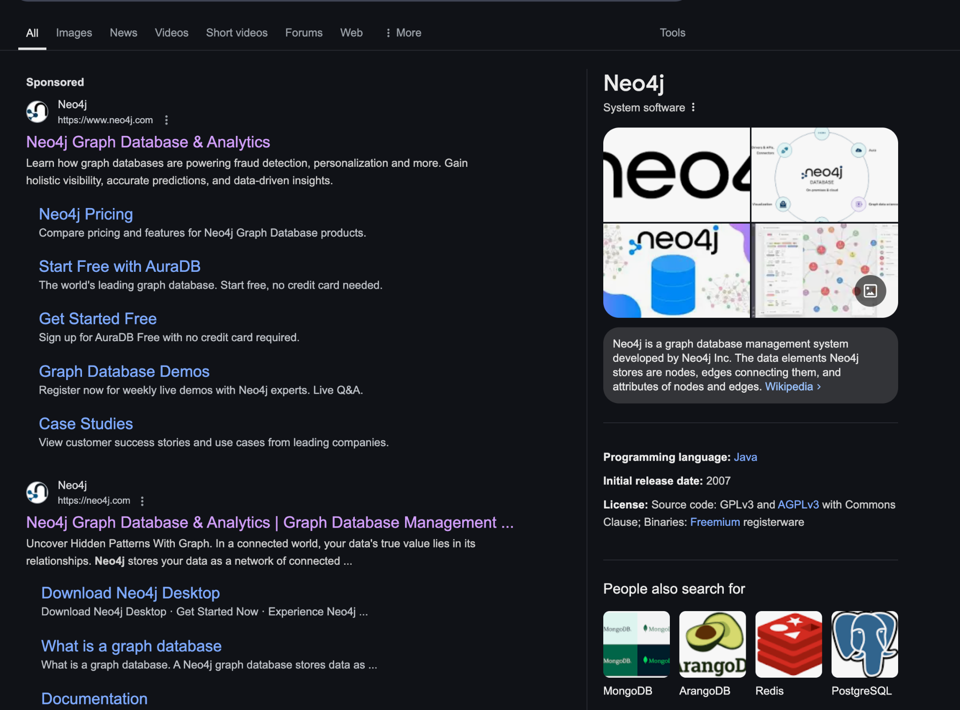
Google Knowledge Graphs
There is an API!
https://developers.google.com/knowledge-graph
https://www.google.com/search?q=Neo4j

Slide 20
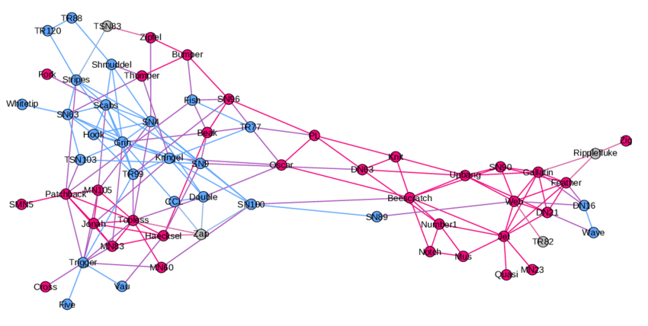
Graph
Nodes
&
Edges
A node-edge diagram of the dolphin social network. Node labels are the names researchers assigned to the individual dolphins. Node color indicates male (pink), female (blue) or unknown (gray).
from Algorithms and Software for the Analysis of Large Complex Networks

Slide 21
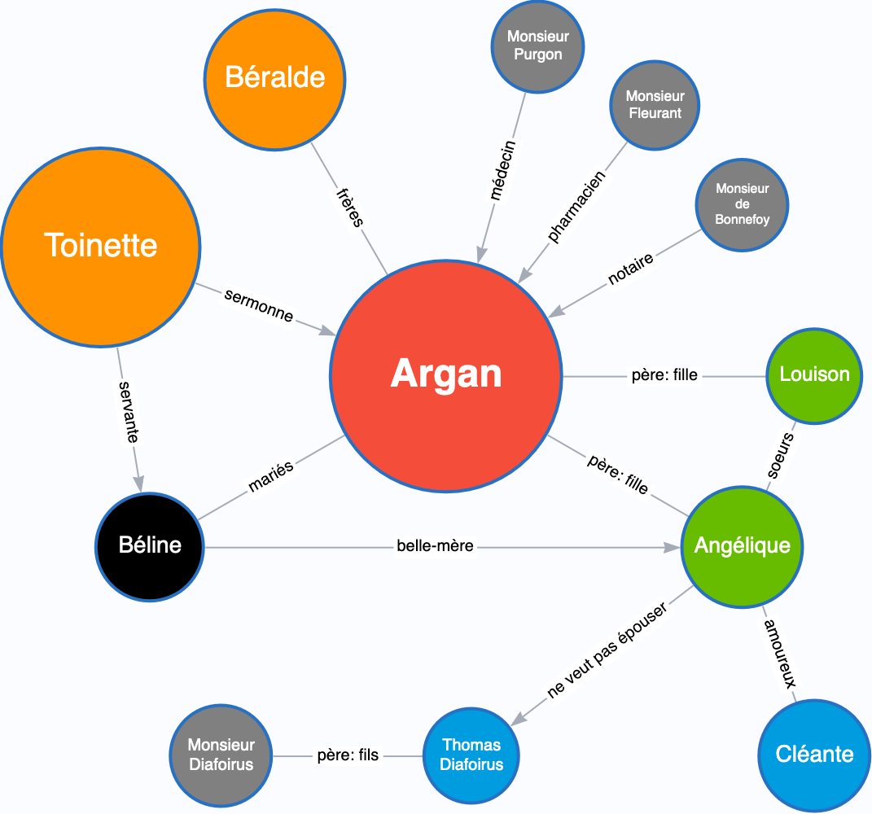
Graphs in Neo4J: weights, properties, labels
Nodes and relationships (Aretes) can have
weights according to their relative importance
properties
labels
Relations are verbs or verb phrases which describe the action, the connection between the nodes.
They define the semantic meaning of how nodes interact. Like verbs in sentences, they must be clear and specific about the nature of the relationship.
Moliere.love

Slide 22
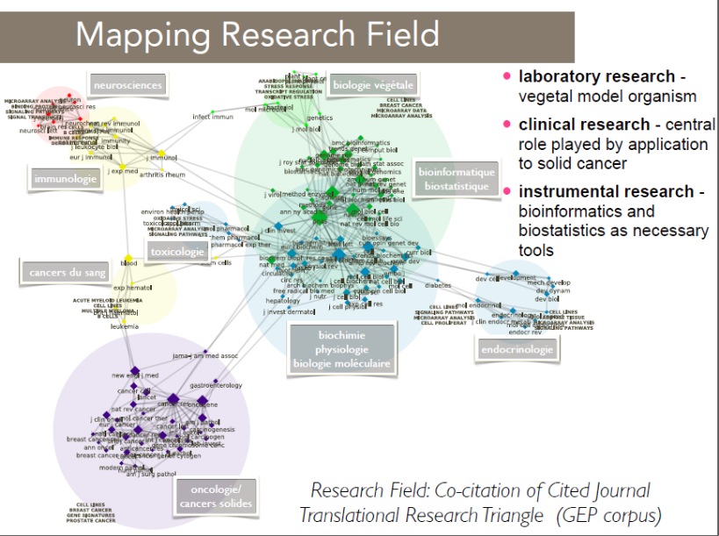

Slide 23
Example of the Paris metro
Knots
labels: Metro / RER
properties:
name
accessibility,
overhead or underground
event properties
Relationships
BELONGS_TO_LINE
properties: line number, maintenance time, distance
PASSENGER_CONNECTS_TO
can be unidirectional or both ways
properties: distance, stairs, ...
CONNECTS_TO_LINE
properties: line number, ...
Relationship types (BELONGS_TO_LINE, PASSENGER_CONNECTS_TO, CONNECTS_TO_LINE) are verbs or verb phrases that describe the action, the connection between nodes.
They define the semantic meaning of how nodes interact.
Like verbs in sentences, they should be clear and specific about the nature of the relationship.

Slide 24
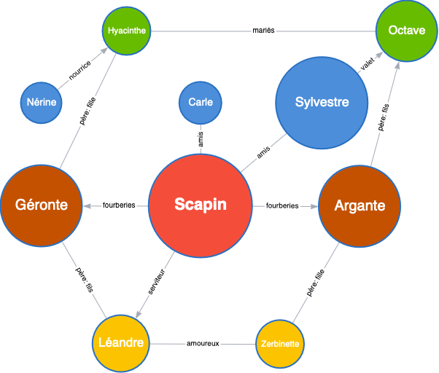
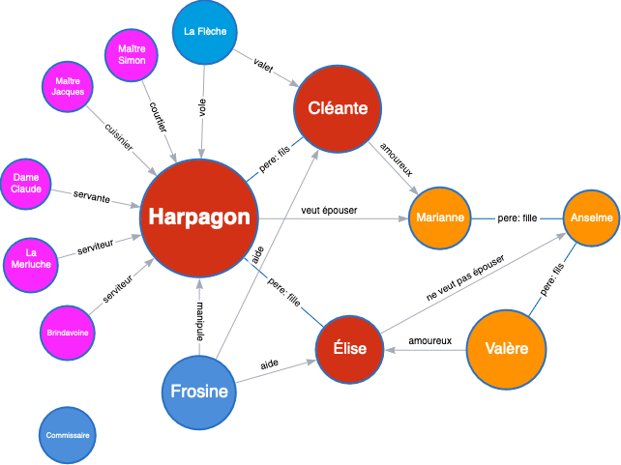
Theater
from Moliere.love

Slide 25
Neo4J: Property Graph Model or KG
What Makes a Graph in Neo4j a "Knowledge Graph" vs. Just a Graph?
Semantics & Ontology
If your Neo4j graph follows a formal ontology (eg, "Person" → "won" → "Award"), then it is a proper knowledge graph .
If it's just a graph without clear entity relationships, it's a general graph .
Querying for Facts & Reasoning
If you use Neo4j to infer new facts (eg, "If Einstein won the Nobel Prize, he must have been a scientist"), it's closer to a knowledge graph .
If you use Neo4j for network analysis (eg, shortest path between nodes), it's just a graph database application .
So, Is Every Graph in Neo4j a Knowledge Graph?
👉 Yes, if it represents structured knowledge and relationships. 👉 No, if it's just a general graph for things like social networks, logistics, or recommendation systems.
In short:
Neo4j CAN store and query knowledge graphs.
But it can also be used for non-KG applications.

Slide 26
Use cases
https://neo4j.com/graphgists/
https://neo4j.com/use-cases/

Slide 27
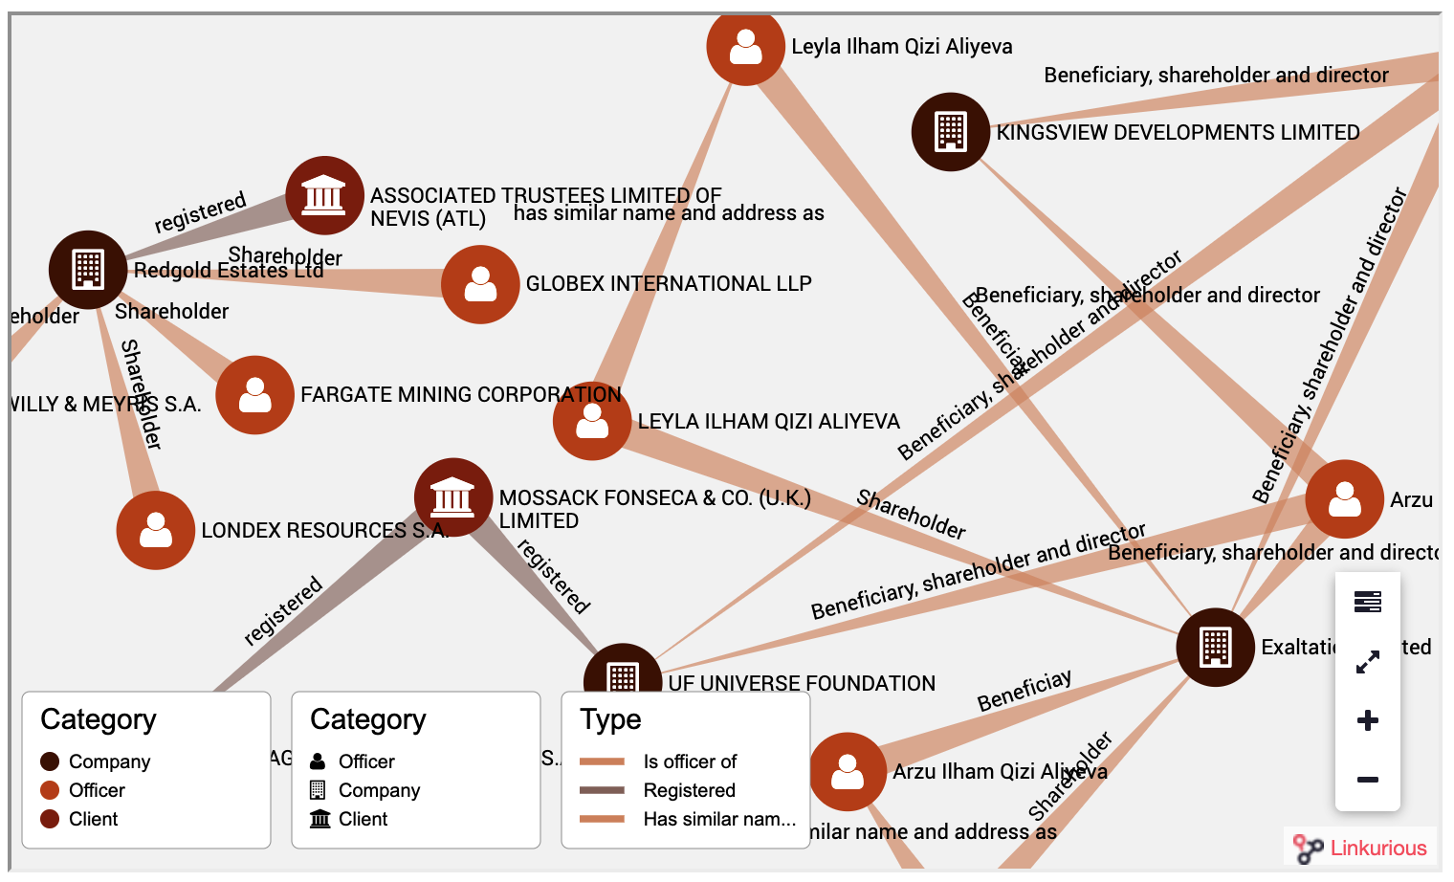
Investigative journalism - The Panama Papers
What Happened?
Leak: 11.5 million documents (2.6 TB) from Mossack Fonseca.
Revealed: Offshore companies used for tax evasion, money laundering, and corruption .
Investigated by: ICIJ + 400+ journalists across 80+ countries .
Why Use Neo4j?
Traditional databases fail due to complex relationships.
Graph database = better for uncovering hidden networks.

Slide 28
Panama Papers
Graph-Based Investigation
Nodes: People, companies, addresses, banks.
Edges: Relationships like "owns" , "directs" , "registered at" .
Key Techniques
Pattern discovery: Found secret owners of offshore firms.
Cypher queries: Traced hidden financial flows.
Visualization: Used Linkurious for easy exploration.
Major Discoveries
✔ 143 politicians & world leaders involved. ✔ Banks & law firms enabled tax havens. ✔ Complex money trails exposed .
Global Impact
🔥 $1.36B recovered in unpaid taxes. 🔥 Iceland's PM resigned , global investigations launched. 🔥 Led to Paradise Papers & Pandora Papers .

Slide 29
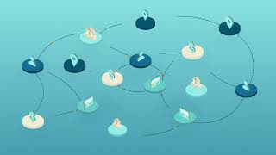
Fraud detection

Slide 30
Characteristics

Slide 31
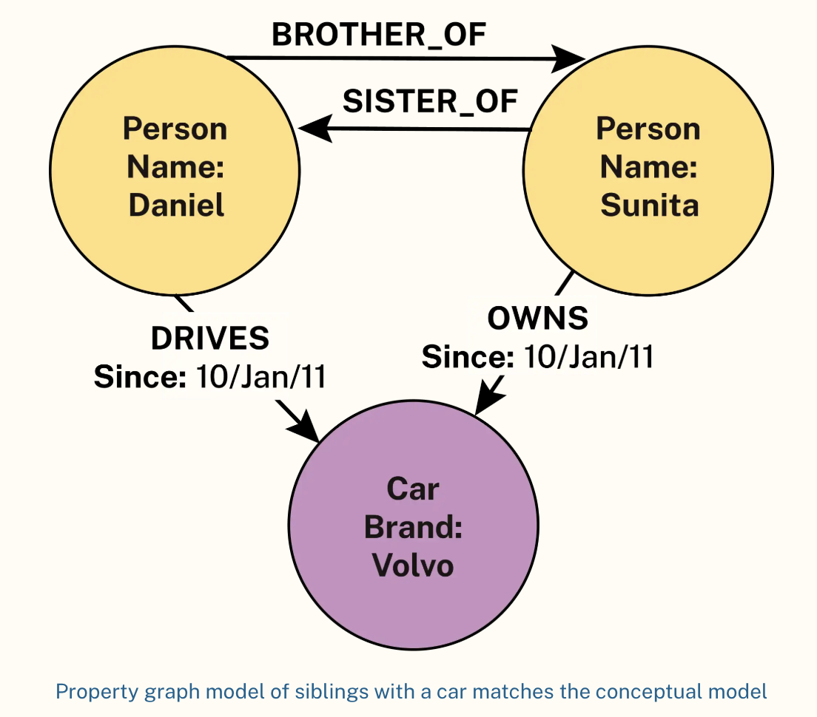
Property Graph Model
natural objects into tables, foreign keys, etc.
Relationships express themselves naturally
https://neo4j.com/use-cases/knowledge-graph/

Slide 32
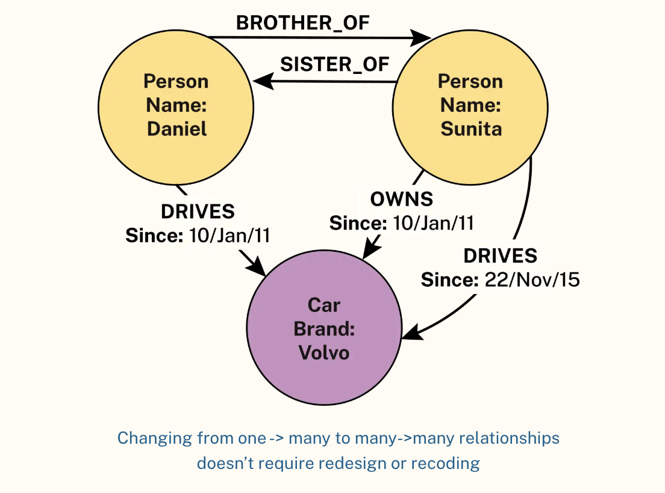
Flexible schema
We find the flexible schema of MongoDB
with the added ease of modifying relationships between objects.
In this example we transform a one to many relationship into a many to many relationship by creating only one additional relationship
Node and relationship attributes can also evolve without constraints

Slide 33
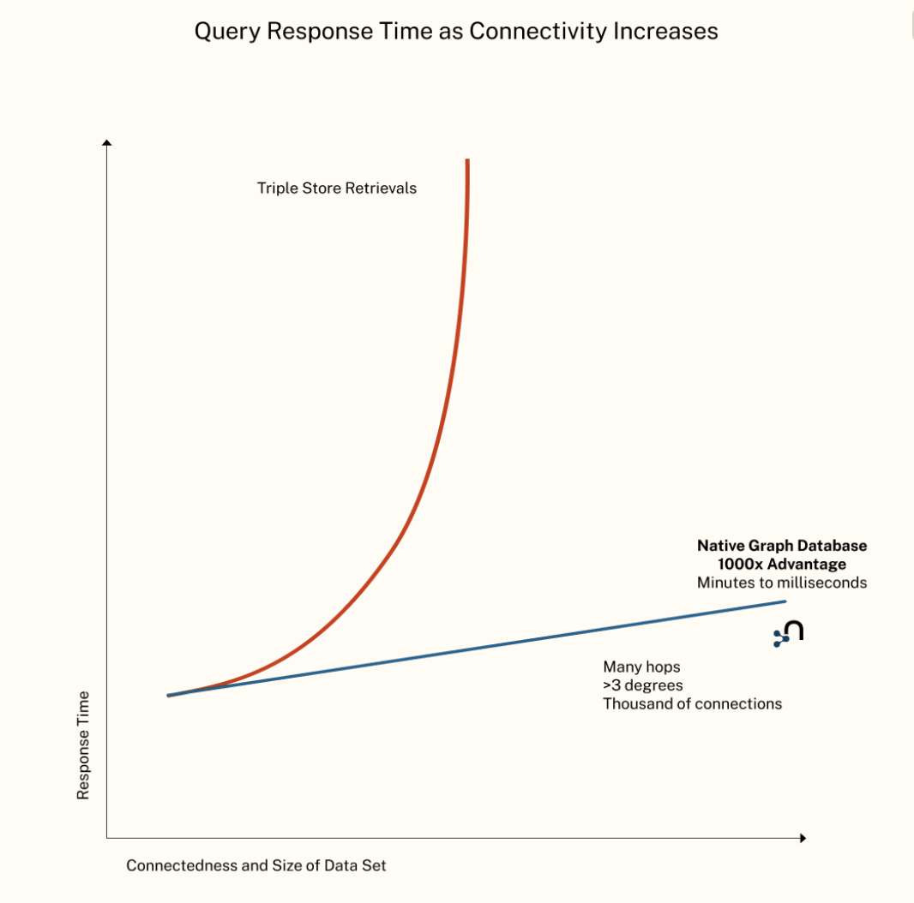
Free Adjency Index
Nodes directly reference their relationships without using index lookups.
When a node needs to find its neighbors:
It directly follows physical pointers to connected nodes
Avoids expensive index lookups required in relational databases
Constant travel time regardless of base size
The relationship is a kind of micro index

Slide 34
Ecosystem

Slide 35
core platforms
Neo4j Graph Database (Community & Enterprise): a native graph database that stores and processes connected data
GraphAcademy : Free official learning platform with structured courses and certifications
Neo4j AuraDB : Fully managed cloud service that handles infrastructure, updates, and scaling automatically
Cypher : Declarative graph query language designed to be visual and intuitive, like ASCII art for queries

Slide 36
Tools
Neo4j Desktop : All-in-one development environment for local database management and project organization
Neo4j Browser : Web-based interface for writing queries, visualizing results, and exploring your graph
Neo4j Bloom: Business-friendly tool for visual graph exploration without writing queries
APOC library : Swiss army knife of useful functions that extend Neo4j's capabilities
GDS (Graph Data Science) library: Machine learning and graph algorithms for advanced analytics
Official drivers: Native connectivity for major programming languages like Python, Java, JavaScript
Arrows.app : Free web-based tool for creating and sharing graph data models visually

Slide 37
Practical

Slide 38
Neo4j desktop
https://neo4j.com/docs/desktop-manual/current/installation/download-installation/

Slide 39
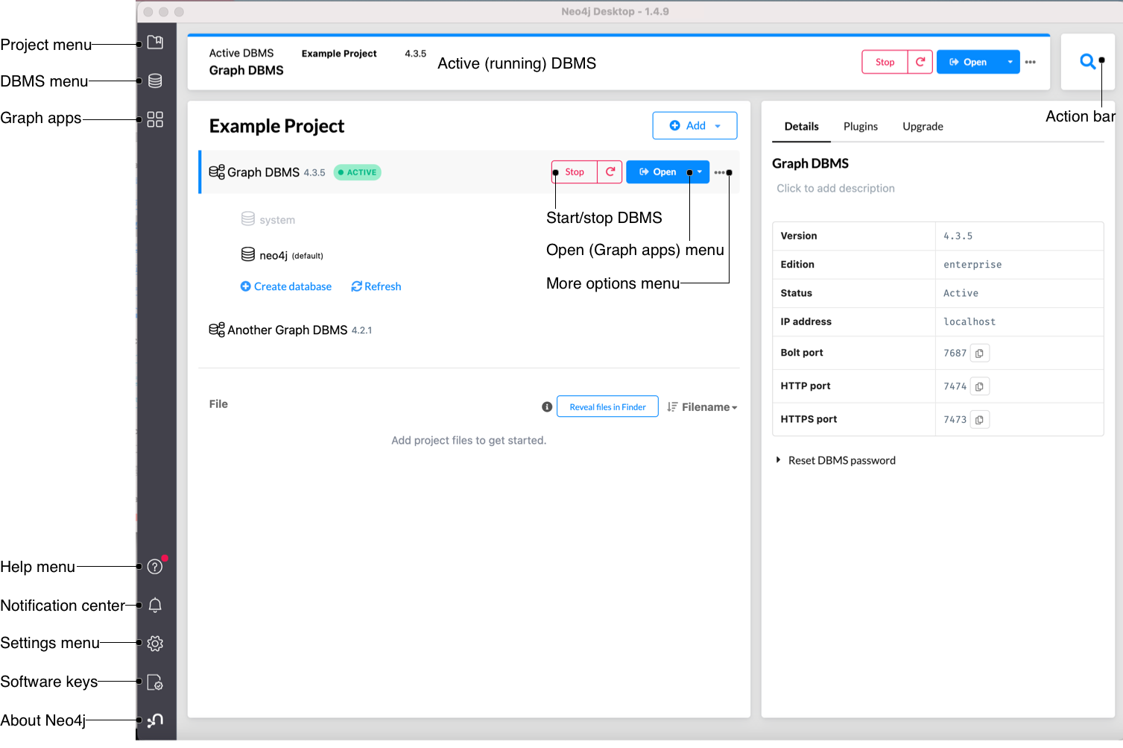
Neo4j desktop

Slide 40
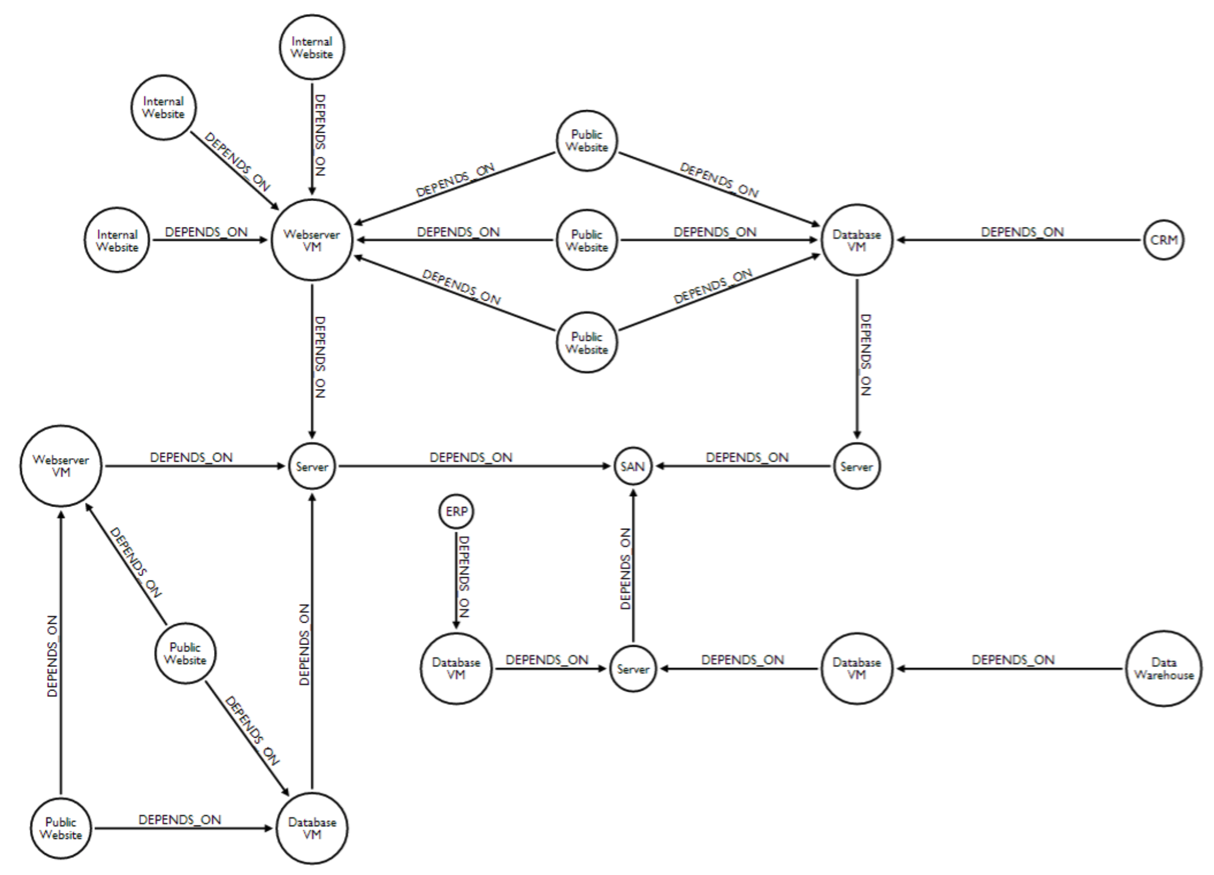
Network Dependency Graph
Network Dependency Graph
As a Colab notebook using the icypher extension

