Slide 1
Embeddings
Epita - Advanced database
Friday the 13th of June

Slide 2
Classic NLP
Natural Language Processing
(before 2020)

Slide 3
Language is complex
I saw her duck
I saw her duck. She tried to avoid a flying ball.
Let’s eat, grandpa.
Let’s eat grandpa.
"Will you marry me?" is a marriage proposal.
"Will, You, Mary, Me" is a card game proposal.
"Will, you marry me" is a time traveller spoiling the future.
"Will you, Mary me" is a cavewoman named Mary, trying to make Will, who has amnesia, remember who he is.

Slide 4
Classic NLP Applications
Text mining
NER: Named Entity Recognition: LOC, PER,
POS: Part of speech Tagging : nouns, adjectives, verbs, …
demo: https://cloud.google.com/natural-language
speech to text, text to speech
Translation
Classification: sentiment analysis, spam, toxicity, ...
Text generation, summarization, question answering
Topic identification, topic modeling
word sense disambiguation : bank, duck,

Slide 5
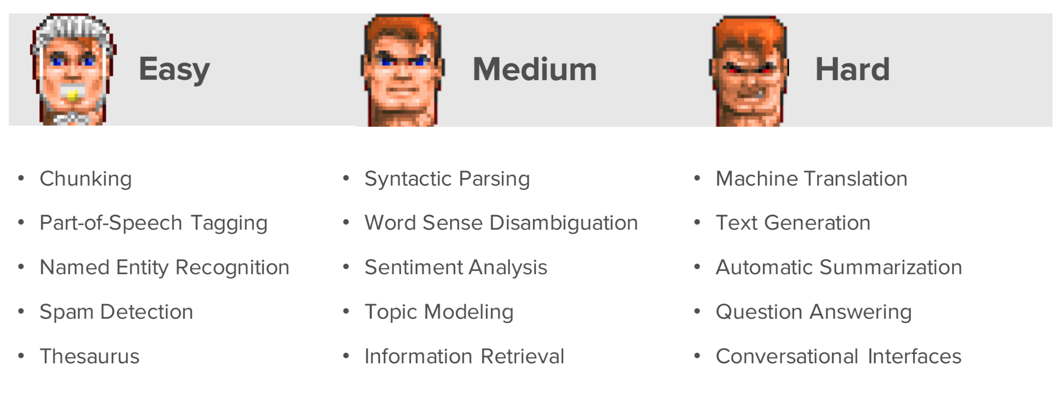
Way back in 2021!

Slide 6
Classic NLP Hurdles
stopwords: many words have no meaning
Choosing the right Unit of text to work with
words, syllables, tokens, letters & punctuation
Bigrams, n-grams: New York, cul-de-sac, pain au chocolat
sentences, paragraphes, tweets, articles, books, comments
stopwords = ['the', 'of', 'and', 'is', 'to', 'in', 'a', 'from', 'by', 'that', 'with', 'this', 'as', 'an', 'are', 'its', 'at', 'for', …]

Slide 7
Vocabulary
Vocabulary can be huge
OOV: out of vocabulary
Named entities and proper nouns
Domain-specific technical terms
Neologisms and emerging words
Misspellings and typos
Morphological variants

Slide 8
Unit of text: tokenization
What's the most efficient unit of text ?
Using words is problematic: vocab size, forms, OOV etc
Using letters is too short
Split words into multiple tokens: subwords tokenization
unhappiness -> un + happ + in + ess
running -> run + ing
biiig -> b + iii + g

Slide 9
Benefits of subword tokenization
no words are OOV: out of vocabulary
gpt 3.5 did not know about COVID
butt knew cov + id
typo resilient
smaller vocabulary size
captures semantic and morphological meaning better

Slide 10
Language specific tokenizing strategy
Character-based tokenization works better for languages like Chinese, Japanese, and Korean
Morphologically rich languages (Arabic, Turkish, Finnish) need Morphologically-aware tokenizers
Multilingual models often under-represent non-European languages

Slide 11
Text to Vectors

Slide 12
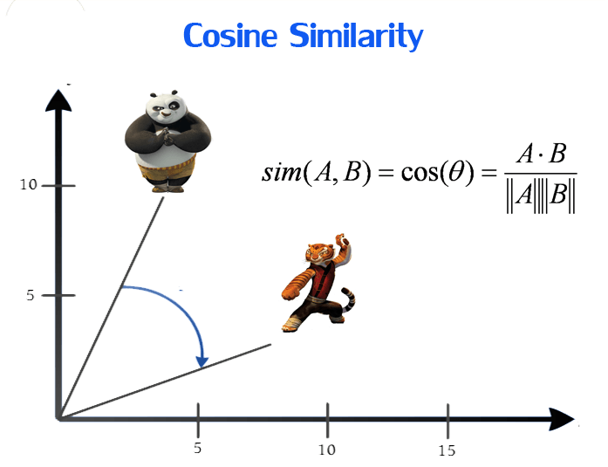
Why do we need vectors?
if we have vector representation, we have a distance between texts:
cosine similarity
but we need vector representation that captures semantic information : meaning
banana is closer to apple than it is to plane;

Slide 13
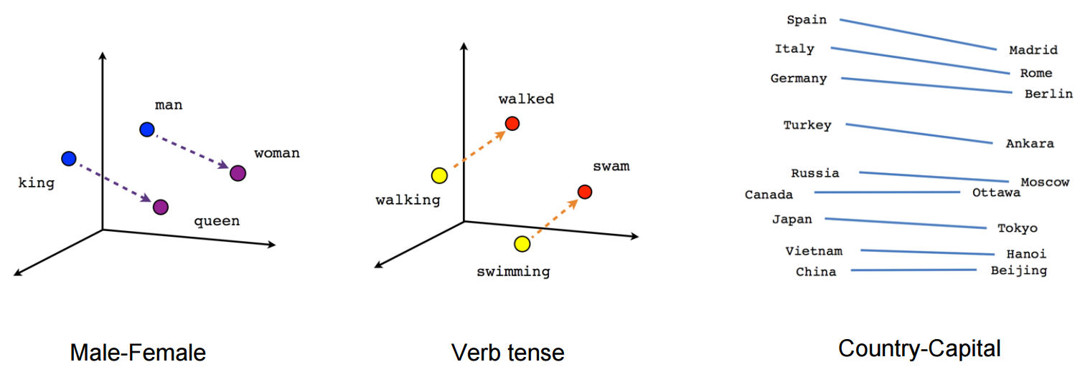
cosine similarity

Slide 14
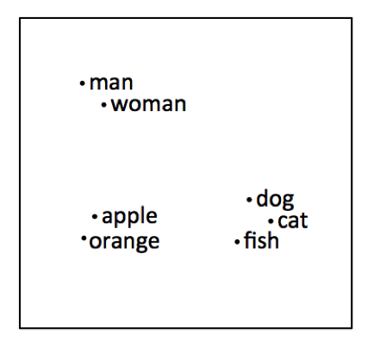
Pre BERT (2018)
tf-idf before 2013: counting words and their relative frequencies: messy, crude, worked well for spam detection
Word2vec 2013: Thomas Mikolov @Google Efficient Estimation of Word Representations in Vector Space https://arxiv.org/abs/1301.3781
bank the river has the same vector as bank the company
Transformer architecture (Attention Is All You Need, June 2017) and ELMo (February 2018), which introduced bidirectional context-aware embeddings
BERT oct 2018: contextual embeddings become the new standard

Slide 15
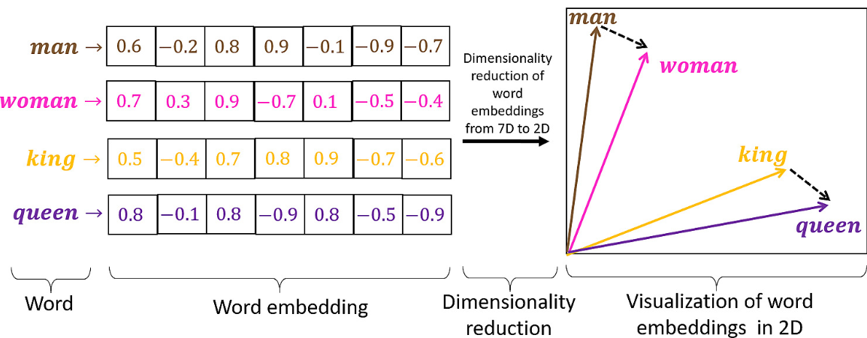
Word2vec
Word2vec was groundbreaking!
https://airbyte.com/data-engineering-resources/sentence-word-embeddings

Slide 16
Current embeddings
Contextual understanding
different representations for the same word based on surrounding context
Transfer learning capabilities
models can be fine-tuned for specific tasks with relatively small datasets
Multilingual support
cross-lingual embeddings that work across dozens of languages without language-specific training
Task-specific adaptation
adapted for downstream tasks (classification, QA, generation) through fine-tuning
Semantic richness
Capture complex linguistic phenomena like syntax, semantics

Slide 17
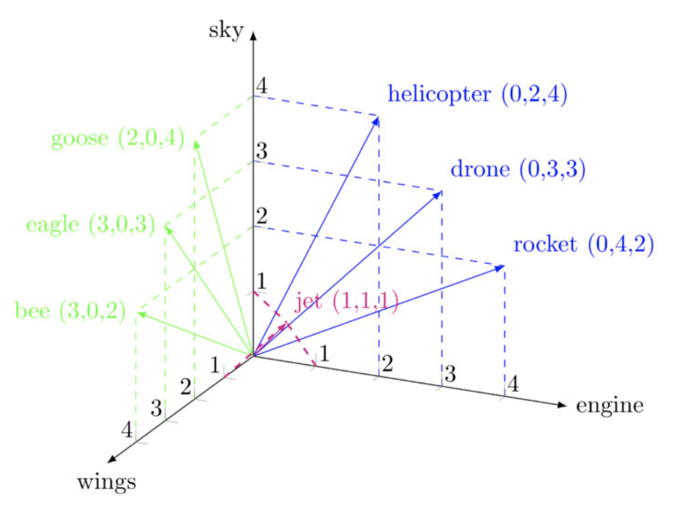
Embeddings
words => vecteurs
chicken -> [1,4,5,-2, 7, … ,8]
banana -> [2,-3, 5.3, 12, 127, …. -0.1]
cat -> [1,2,3,, …., ]
Everything is a vector
word2vec (2013)
bert,
transformers,
semantic relationship
king - man = queen - woman
distance between text
d(cat, dog) < d(cat, banana)
We are all vectors now

Slide 18
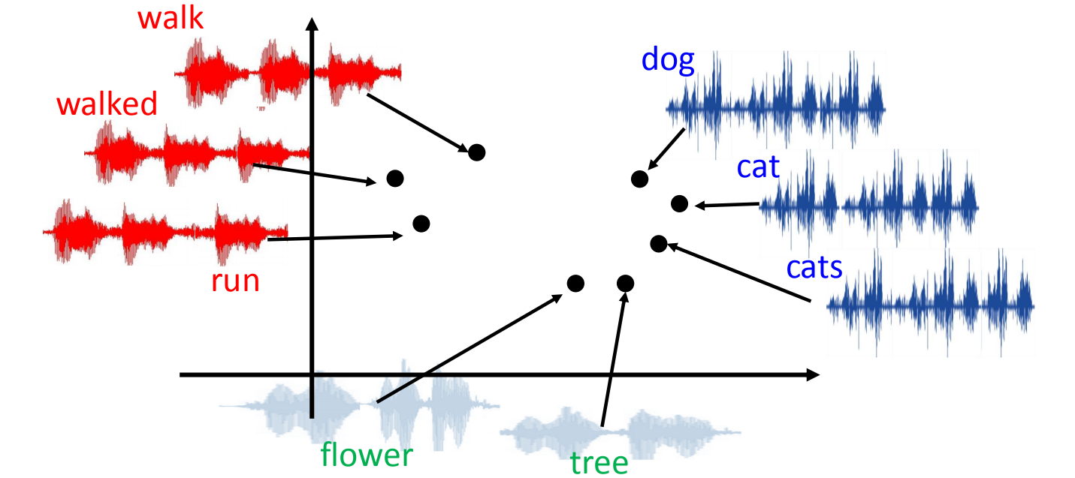
Audio Embeddings

Slide 19
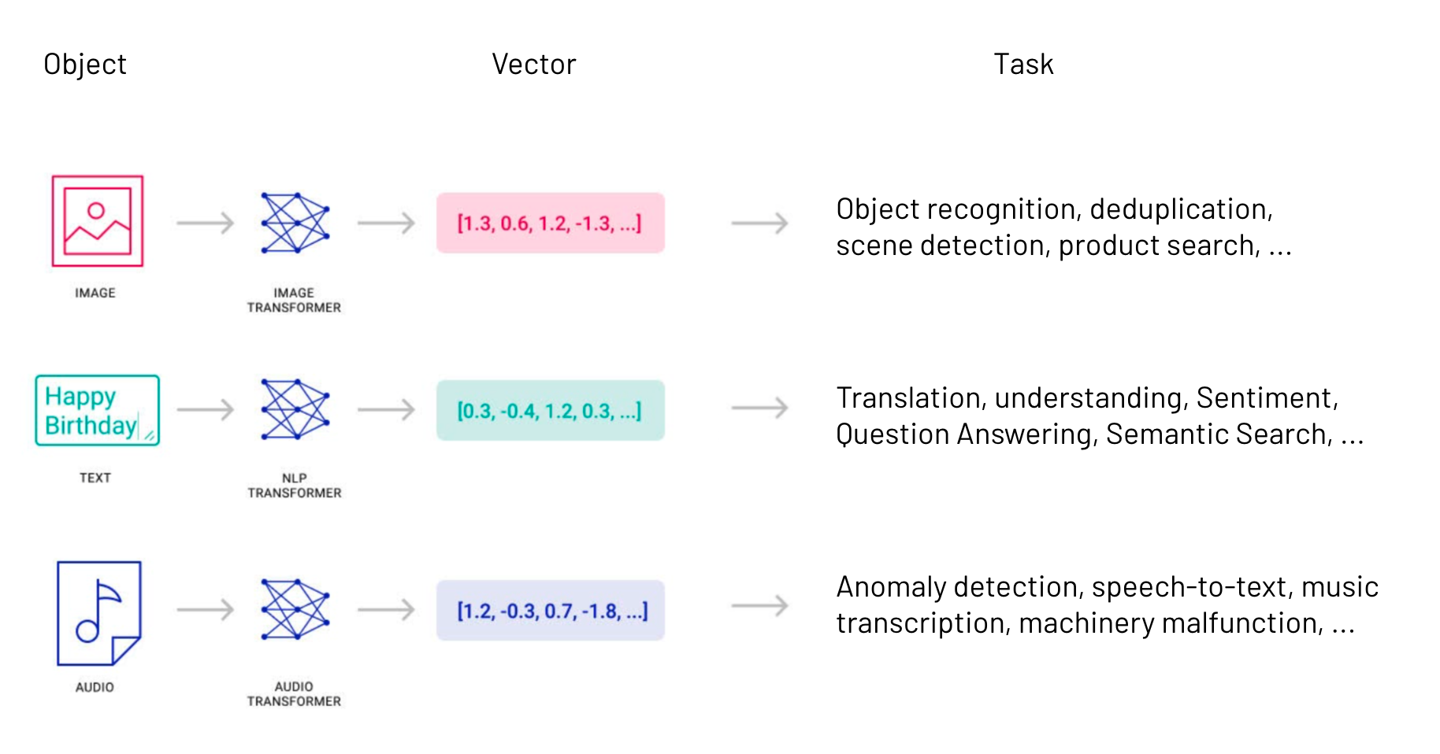
Multimodal embeddings
Must read: The Multimodal Evolution of Vector Embeddings

Slide 20
Applications of embeddings: NLP++
Classification: Text categorization
Clustering: Identification of natural groups
Recommendation systems: Suggestion of similar content
Information retrieval: Improvement of search relevance
Anomaly detection: Identification of atypical documents
Knowledge graph construction: Creation of structured relationships
Transfer learning: Use as features for other AI tasks
Multi-modal applications: Connection of text with images, audio or video
Intent recognition: Understanding of user queries
Semantic compression: Compact representation of documents
Q&A, RAG, search etc etc
In short: use embeddings as feature representation of the text

Slide 21
How to embed

Slide 22
How to embed: 1. get a model 2. embed!
API
OpenAI, Gemini, Mistral, VoyageAI, …
not all platforms provide embedding models
Local
HuggingFace Transformers
many models for general or specific tasks
Ollama
nomic-embed-text
Example Workflow:
Load a pre-trained embedding model.
Pass your sentences through the model.
Get a N-dimensional vector for each sentence.
Use these embeddings for your downstream task.

Slide 23
query
in what follows we consider
we have a database of texts with their embeddings
we want to find the texts that are similar to a given query
we retrieve N texts whose embeddings are closest to the query embedding

Slide 24
Let's practice
https://colab.research.google.com/drive/1mG8fFl6U_W3qvaQcLFwdcRZo9vBPNz24#scrollTo=nTFO3UnTDbIr
use wikipedia API
get the Transport pages for Paris, Rome, Berlin, …
split the text into sentences
calculate the embeddings for each sentence
given a query sentence "biking" and its embeddings find the N sentences that are most similar to the query sentence

Slide 25
Back to databases

Slide 26
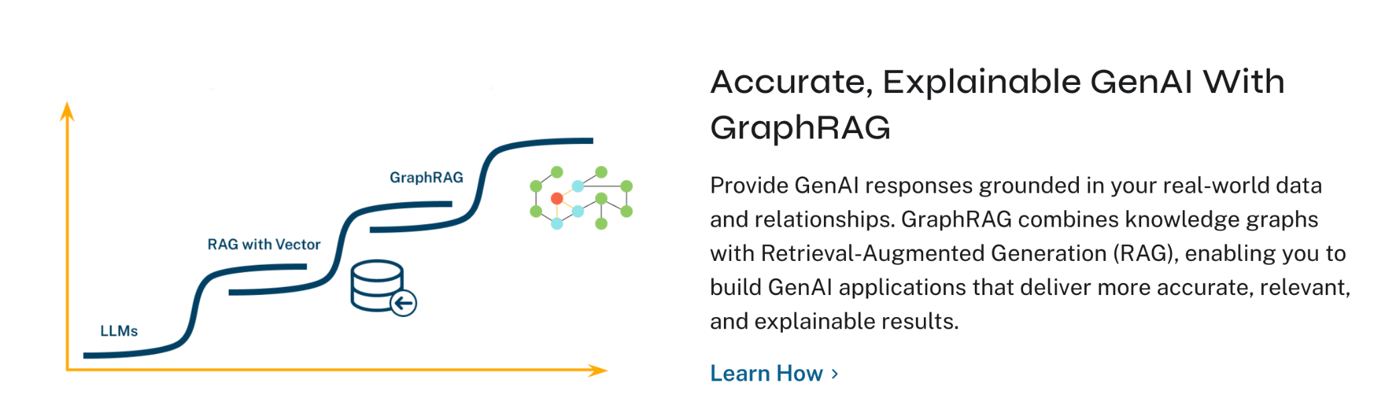
Vector search in Neo4j
https://neo4j.com/labs/genai-ecosystem/vector-search/

Slide 27
Vector search in MongoDB

Slide 28
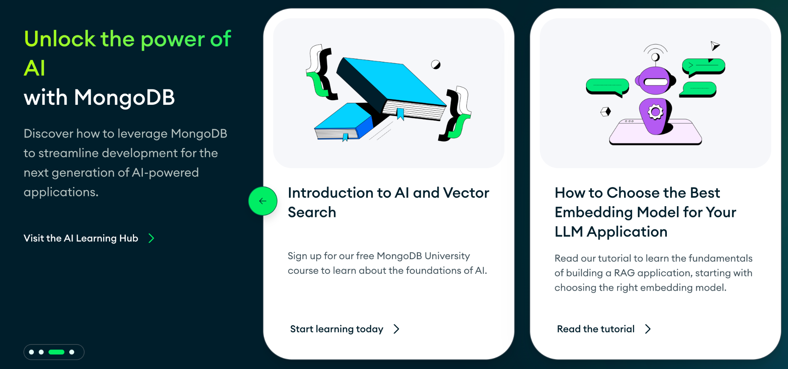
Vector search in MongoDB
https://www.mongodb.com/products/platform/atlas-vector-search

Slide 29
Vector search in MongoDB
Index the vector field
$vectorSearch: 2 main algorithms
ANN: faster, focused on a smaller set of vectors
ENN: slower, scans all the vectors in the database
Run Vector Search Queries - MongoDB Atlas
{
"$vectorSearch": {
"exact": true | false,
"filter": {<filter-specification>},
"index": "<index-name>",
"limit": <number-of-results>,
"numCandidates": <number-of-candidates>,
"path": "<field-to-search>",
"queryVector": [<array-of-numbers>]
}
}

Slide 30
Example with MongoDB
Construction of the reference database from a dataset already split into chunks, then retrieval from a query and response generation
VoyageAI for embeddings (Stanford, joined MongoDB)
OpenAI for response generation
MongoDB for the reference database and dataset
https://github.com/mongodb-developer/GenAI-Showcase/blob/main/notebooks/rag/anthropic_mongodb_pam_ai_stack.ipynb

Slide 31
Example 2: MongoDB + DeepSeek
data: MongoDB/embedded_movies
SentenceTransformer("sentence-transformers/all-MiniLM-L6-v2")
MongoDB + indexing
DeepSeek (from Hugging Face)
https://github.com/mongodb-developer/GenAI-Showcase/blob/main/notebooks/rag/deepseek_r1_rag_pipeline_with_mongodb.ipynb

Slide 32
Example 3: MongoDB + Keras-NLP
dataset: MongoDB/subset_arxiv_papers_with_embeddings
embeddings OpenAI: text-embedding-3-small
MongoDB + indexing
Keras: CausalLLM models
keras_nlp.models.GemmaCausalLM.from_preset( "hf://gg-tt/gemma-2-instruct-9b-keras" )
https://github.com/mongodb-developer/GenAI-Showcase/blob/main/notebooks/rag/rag_pipeline_kerasnlp_mongodb_gemma2.ipynb

Slide 33
Vector Search
Retrieves N documents whose vector is closest to a query vector
{
"$vectorSearch": {
"exact": true | false,
"filter": {<filter-specification>},
"index": "<index-name>",
"limit": <number-of-results>,
"numCandidates": <number-of-candidates>,
"path": "<field-to-search>",
"queryVector": [<array-of-numbers>]
}
}
ENN | ANN
Classic MQL filtering
vector field indexing
Number of results
Nombre of candidates
vector field name
query vector

Slide 34
MongoDB aggregation pipeline
db.embedded_movies.aggregate([
{
"$vectorSearch": {
"index": "vector_index",
"path": "plot_embedding",
"queryVector": [-0.0016261312,-0.028070757,..., .009710136],
"numCandidates": 150,
"limit": 10,
"quantization": "scalar"
}
},
{
"$project": {
"_id": 0,
"plot": 1,
"title": 1,
"score": { $meta: "vectorSearchScore" }
}
}
])
In the Atlas cluster,
embedded movies dataset

Slide 35
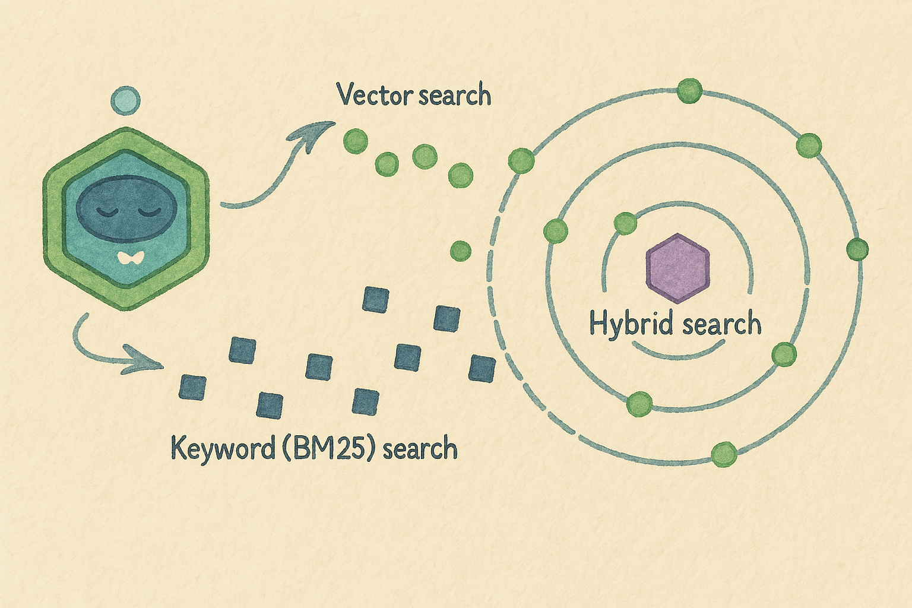
Gotchas!
vector search, only available in Atlas, not on local
no native hybrid search natif
Hybrid search combines vector search (cosine similarity) and keyword search with weights
dense vectors(embeddings)
sparse vectors (tf-idf)
Hybrid Search Explained | Weaviate

Slide 36
Dedicated vector stores

Slide 37
Dedicated vector stores
A vector store is a specialized database designed to efficiently store, index, and search high-dimensional vectors.
Weaviate.io – Open-source vector search engine with built-in ML models. (Netherlands)
vespa.ai (Norway)
Pinecone – Scalable, fully managed vector database. (US)
FAISS (by Facebook) – Fast indexing for large-scale search. (US)
Chroma – Lightweight vector store often used in RAG pipelines. (US)
and many others

Slide 38
Why use a dedicated vector store?
In short: scale & speed & smarter neighbor search algorithms
Performance optimization - Dedicated vector stores use specialized indexing algorithms (HNSW, IVF) built specifically for high-dimensional similarity search, typically 10-100x faster than generic NoSQL approaches
Advanced similarity metrics - Native support for cosine, euclidean, dot product, and custom distance functions, while MongoDB's vector search has more limited metric options
smallish database: any solution will do
huge-ish data: choose a dedicated vector store

Slide 39
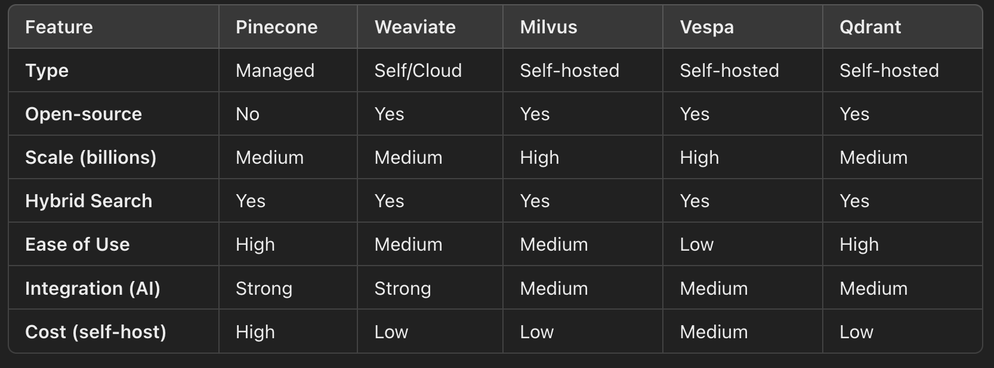
Comparison

Slide 40
Weaviate

Slide 41
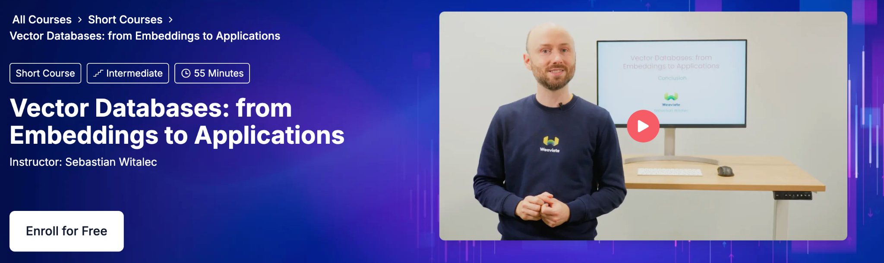
Excellent short course on weaviate
Vector Databases: from Embeddings to Applications - DeepLearning.AI

Slide 42
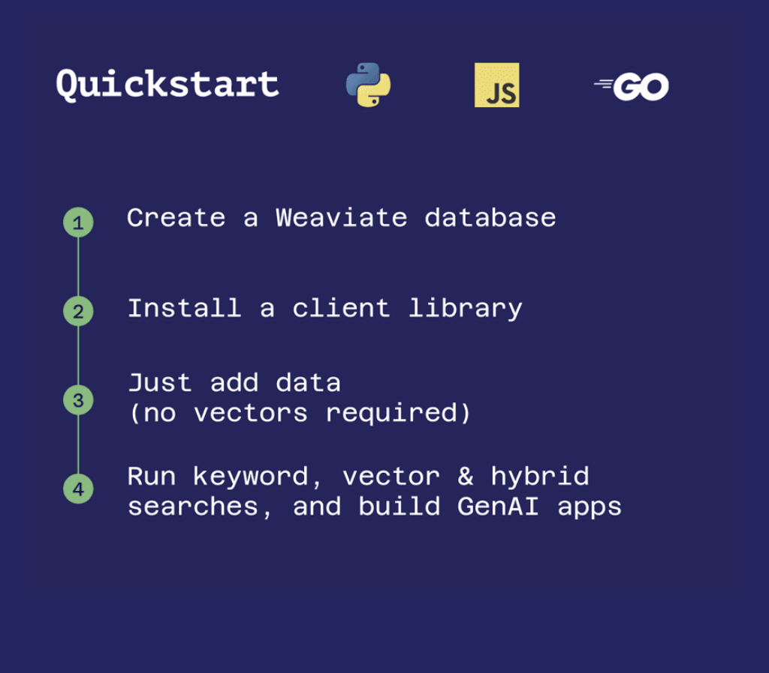
Weaviate - cloud or local
Cloud: usual steps
weaviate.io
Install on Local
install (with Docker + Ollama)
then create cluster & connect

Slide 43
Import data into weaviate
You can either
have weaviate create the vectors at import time through one of the many available modules
or embed the text yourself and Bring your own vectors
then you need to generate the vector for the query

Slide 44
Weaviate quickstart
Quick Start on hosted cluster
Quota for free cluster
Expiration : This sandbox will expire in 14 days
Number of objects: Max. 300K objects
Vector dimension: 256, 768, 1536
Disk size: 20 GB
Daily limit of 2,000 requests
or install on Local (you need Docker + Ollama)

Slide 45
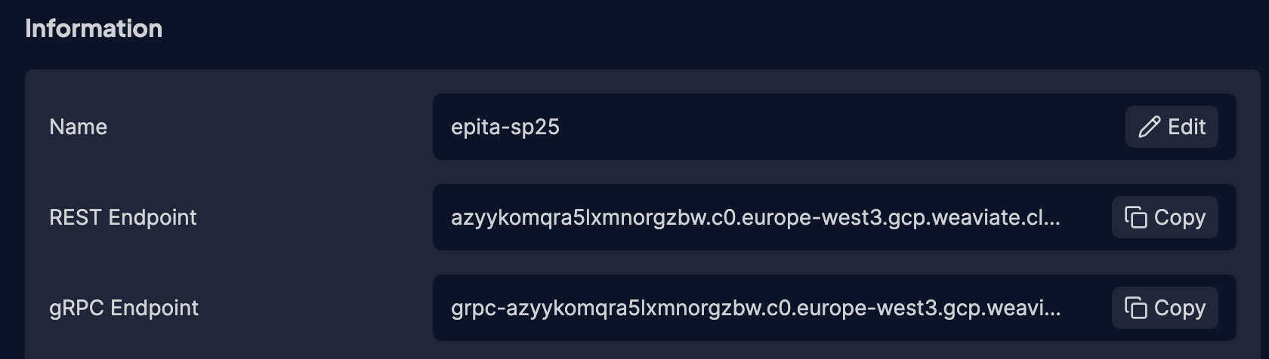
Create your cluster
endpoints

Slide 46
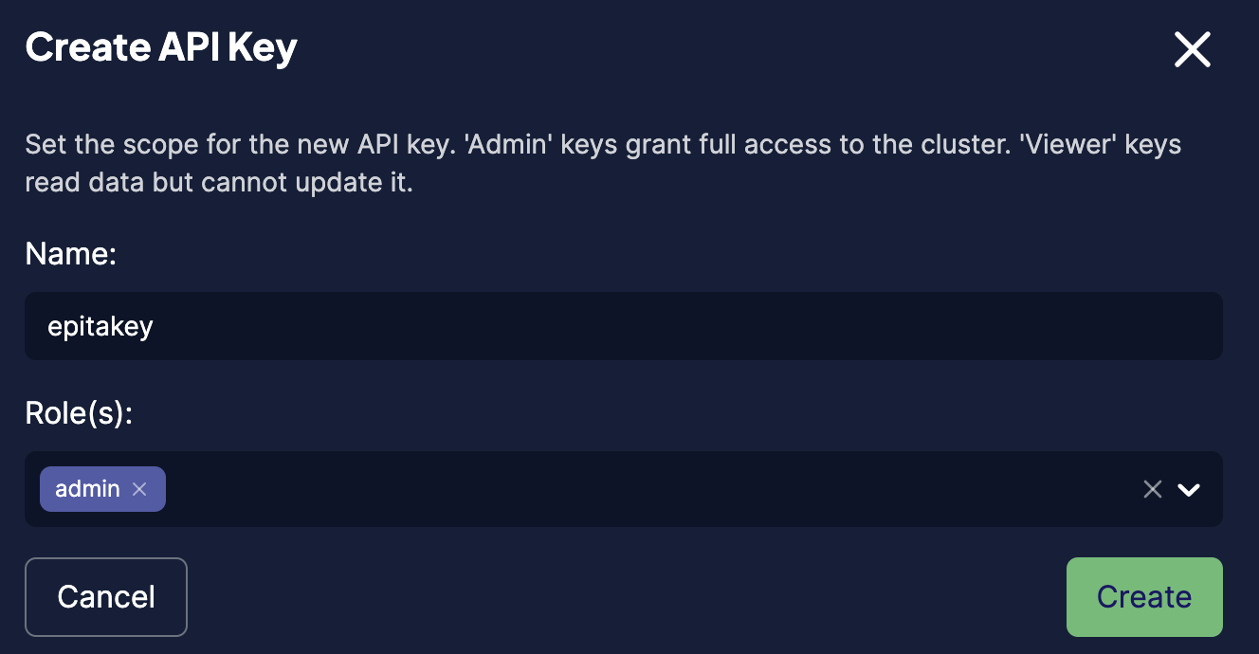
create API key
once the cluster is created, scroll down and create an API key. download the file

Slide 47
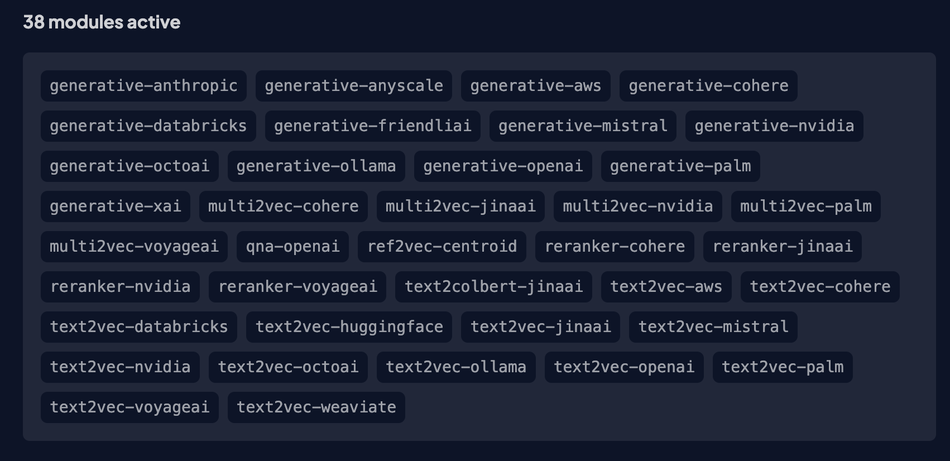
Active modules
generative
multi2vec
reranker
qna
ref2vec
text2vec
text2vec ollama and the generative-ollama module do not require external credentials but they do require a locally running ollama. out of scope.

Slide 48
Weaviate demo
https://colab.research.google.com/drive/1o57exNo2DTAIEBqPXpnbQjJGffi2Sqe3
does not work :(

Slide 49
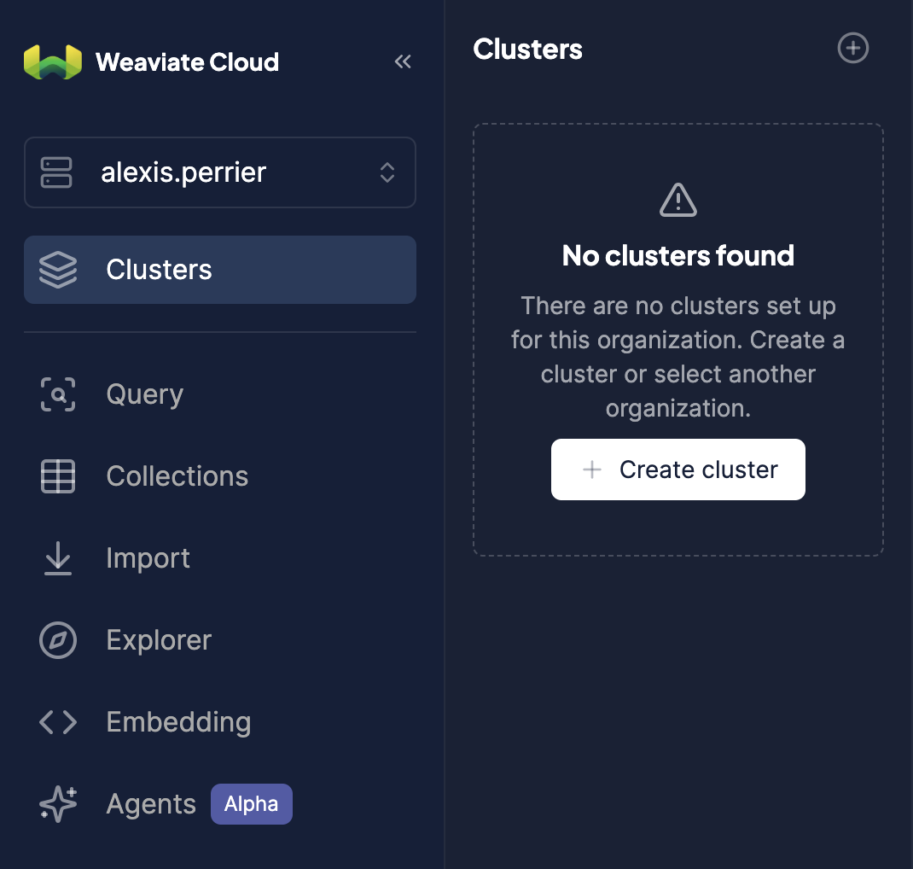
Weaviate cloud
https://console.weaviate.cloud/cluster-details

