Slide 1
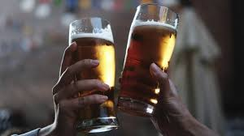
BEER 2.0

Slide 2
What we will go over:
Description
Motivation
Results
Team Efforts
Challenges
Improvements

Slide 3
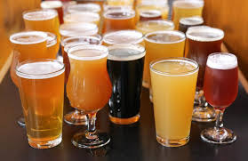
BEER 2.0 Description
Search and save your favorite beers
See the most popular beer

Slide 4
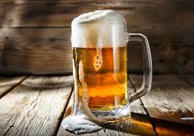
Motivation
What is the Problem where we need BEER 2.0?
With so many kind of beer out there, it can be difficult to know where to start
With BEER 2.0 Finder, we aim to help you discover your favorite brews

Slide 5

Results
Search through hundreds of beers and save your selections

Slide 6
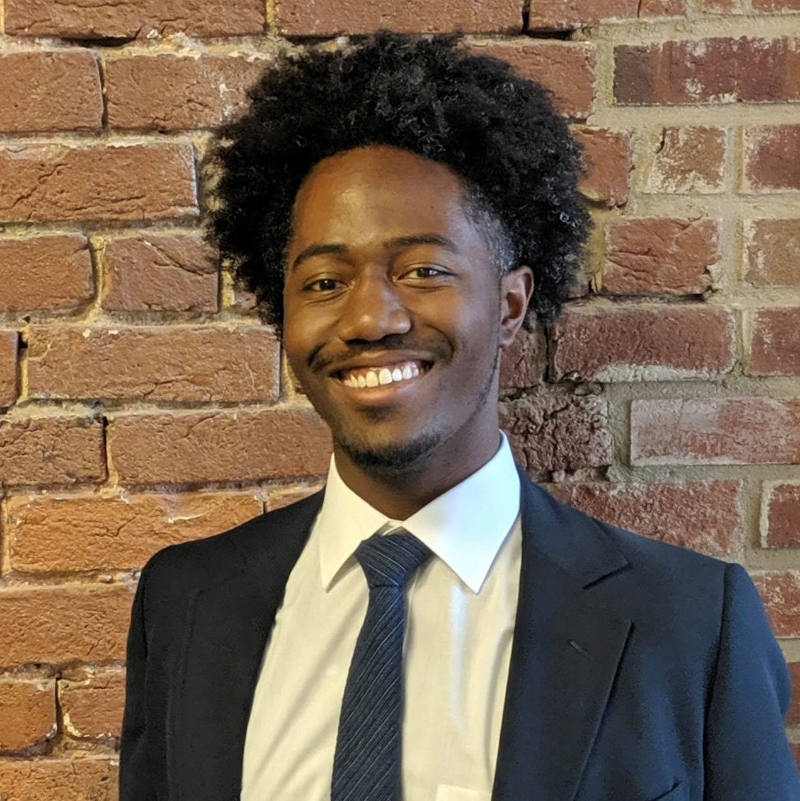

Team Efforts
The Brew Crew
Branford:
Kyle:
Shannen:

Slide 7
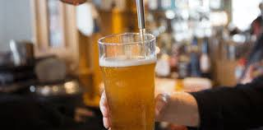
Challenges!
Coordinating the MVC model with each other and resolve issues in the code

Slide 8
Challenges
Our Challenges consisted of:
Coordinating the MVC model with each other and resolve issues in the code

Slide 9
Improvements

