Slide 1
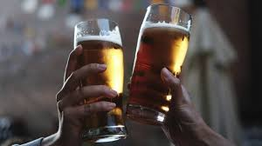
BEER 2.0

Slide 2
What we will go over:
Description
Motivation
Results
Team Efforts
Challenges
Improvements

Slide 3
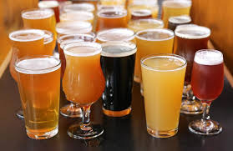
BEER 2.0 Description
Search and save your favorite beers
See the most popular beer

Slide 4
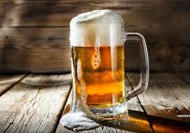
Motivation
What is the Problem where we need BEER 2.0?
With so many kind of beer out there, it can be difficult to know where to start
With BEER 2.0 Finder, we aim to help you discover your favorite brews

Slide 5

Results
Find your most compatible beer

Slide 6
Team Efforts
The Brew Crew
Branford
Kyle
Shannen

Slide 7
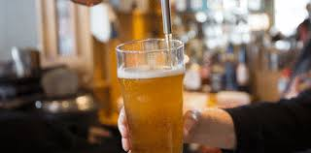
Challenges!
Coordinating the MVC model with each other and resolve issues in the code

Slide 8
Challenges
Our Challenges consisted of:
Coordinating the MVC model with each other and resolve issues in the code
Coordinating time together and resolving errors

Slide 9
Improvements
We’d like to enhance our application by allowing a search of the Brewerydb to find details of any beer and its related brewery.

