Slide 1
Born MCMLXXVIIVXXIII (approx. 56 tree rings)
First program: COBOL, 1974 (4th grade)
First working program: AutoLISP, 1987
Defense world from 1984 – 2007, 2008-2010
Consulting since 2007, currently with Catapult Systems
Wife, 4 kids (grown), 2 dogs (grown), 1 cat (really grown)
Hobbies: walking, sleeping, breathing, complaining
(actually: music, art, woodworking stuff, and beer)

Slide 2
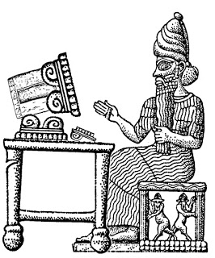
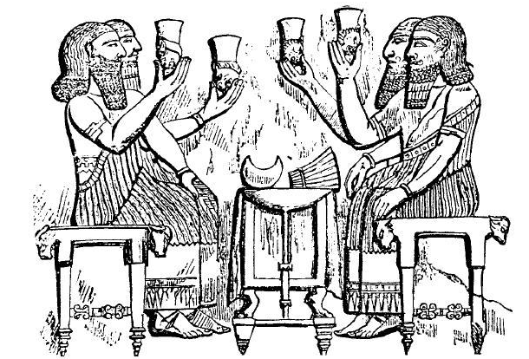
First Desktop
Staff Meeting

Slide 3
PowerShell Gallery
CMHealthCheck – ConfigMgr health check reporting (*)
GPODoc – GPO comment reports
Tuner – Windows configuration utilities
FudgePop – I won a $10 bet
SkTools – CMWT client app
Scrubber – dumb idea
CMBuild – semi-dumb idea
GitHub / Skatterbrainz
https://www.powershellgallery.com/profiles/skatterbrainz

Slide 4
System Center
Configuration Manager
Deployments
Azure
Systems Validation
Updates
AzureAD
Active Directory
Automation
Onboard/Offboard
ETL
SQL Server
Intune
Windows 10
Office365
HTML
SOAP/REST
JSON
XML
Group Policy
Office365 ProPlus
Reporting

