Slide 1


A presentation by Kieran, Rebecca, Goran and Onur

Slide 2

Division of labor
Kieran; project leader; was in charge of organising the tasks and implementing Javascript to our webpage. Explaining branches to our team members.
Onur; HTML/Design of mainpage; POWERPOINT; was in charge of the HTML scripts and he put contributions to the design of the mainpage.
Rebecca, CSS/SASS, designed the header, footer and the subpages of our webpage.
Goran, HTML/CSS, put serious contributions to the HTML and CSS to our webpage. Took part, in explaining github to Rebecca and Onur.

Slide 3
Tools we used
Draw.io
SCSS
JAVASCRIPT
TRELLO

Slide 4
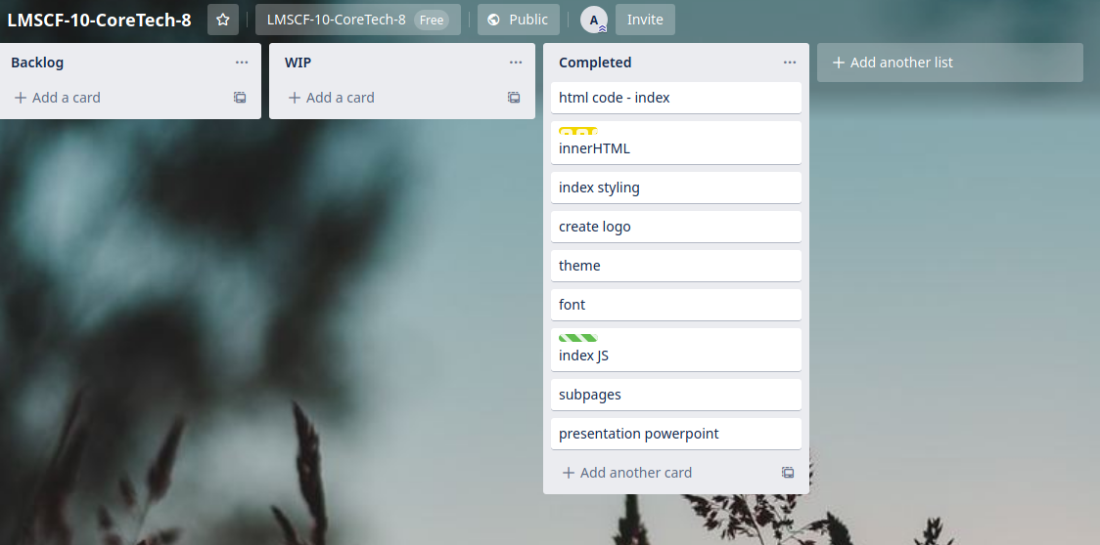
TRELLO

Slide 5

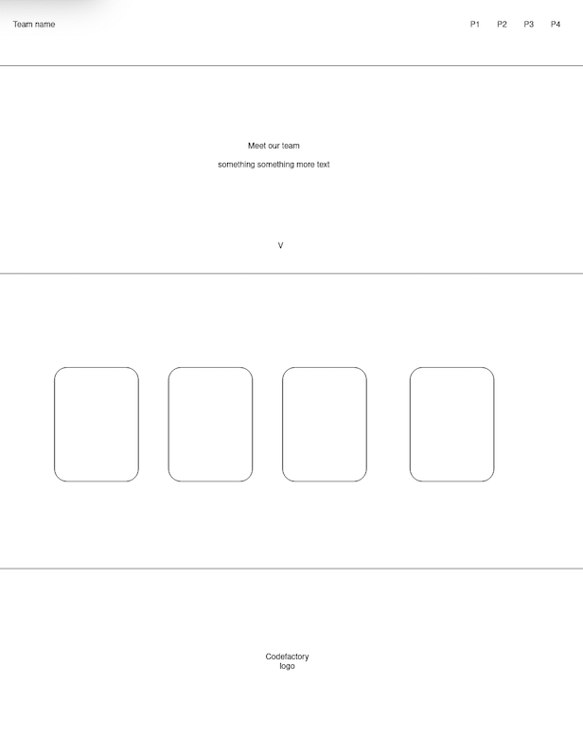
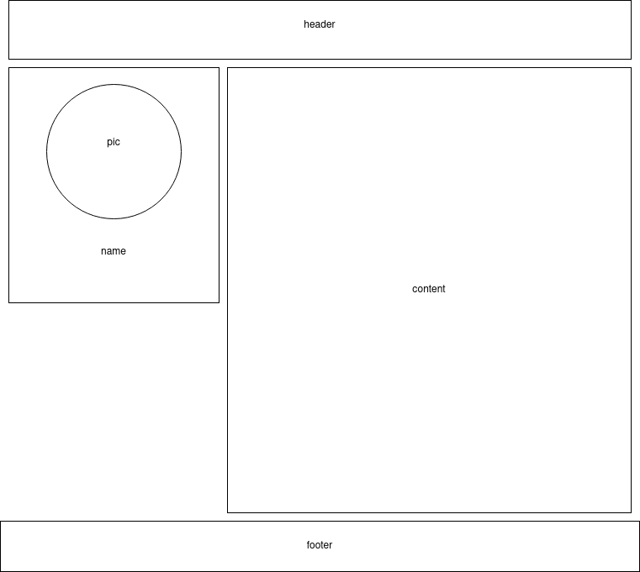
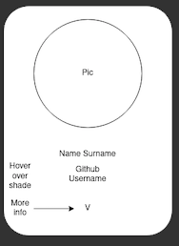
Designing our blueprint
MAINPAGE
MEMBERCARDS
SUBPAGES

Slide 6
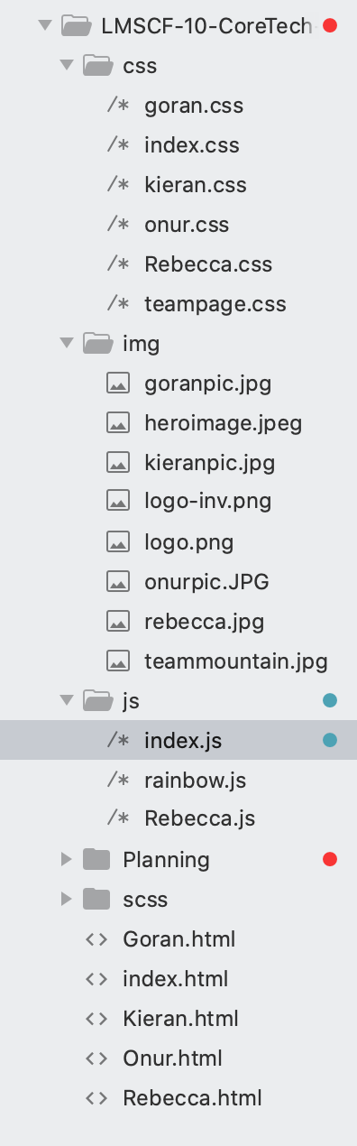
PROJECT MANAGEMENT
CLEAN STRUCTURE
INHERANT READABILITY

Slide 7
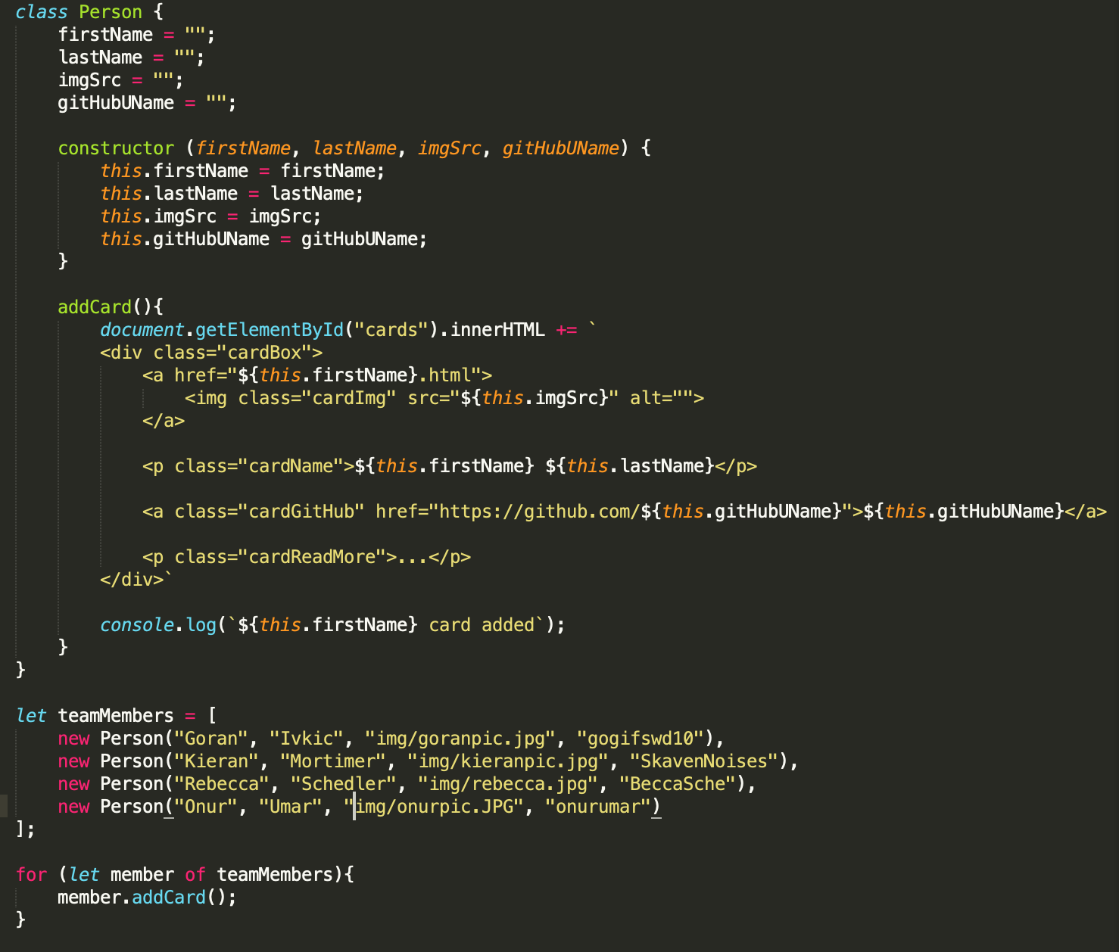
JAVASCRIPT CARD STRUCTURE

Slide 8



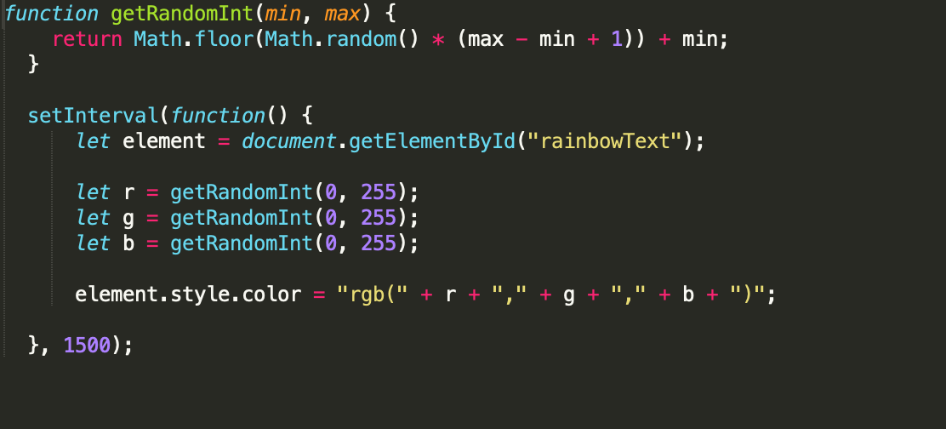
JAVASCRIPT RAINBOW

Slide 9
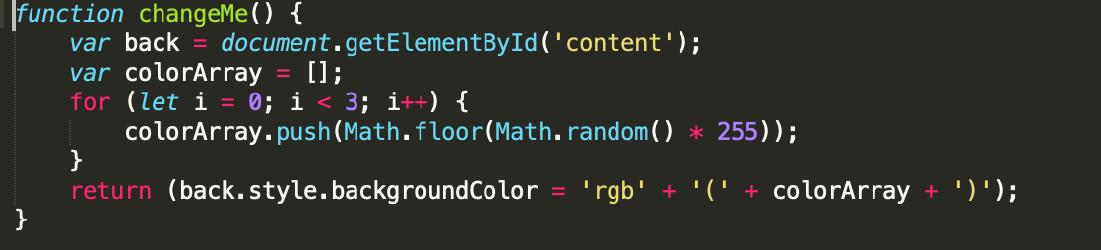
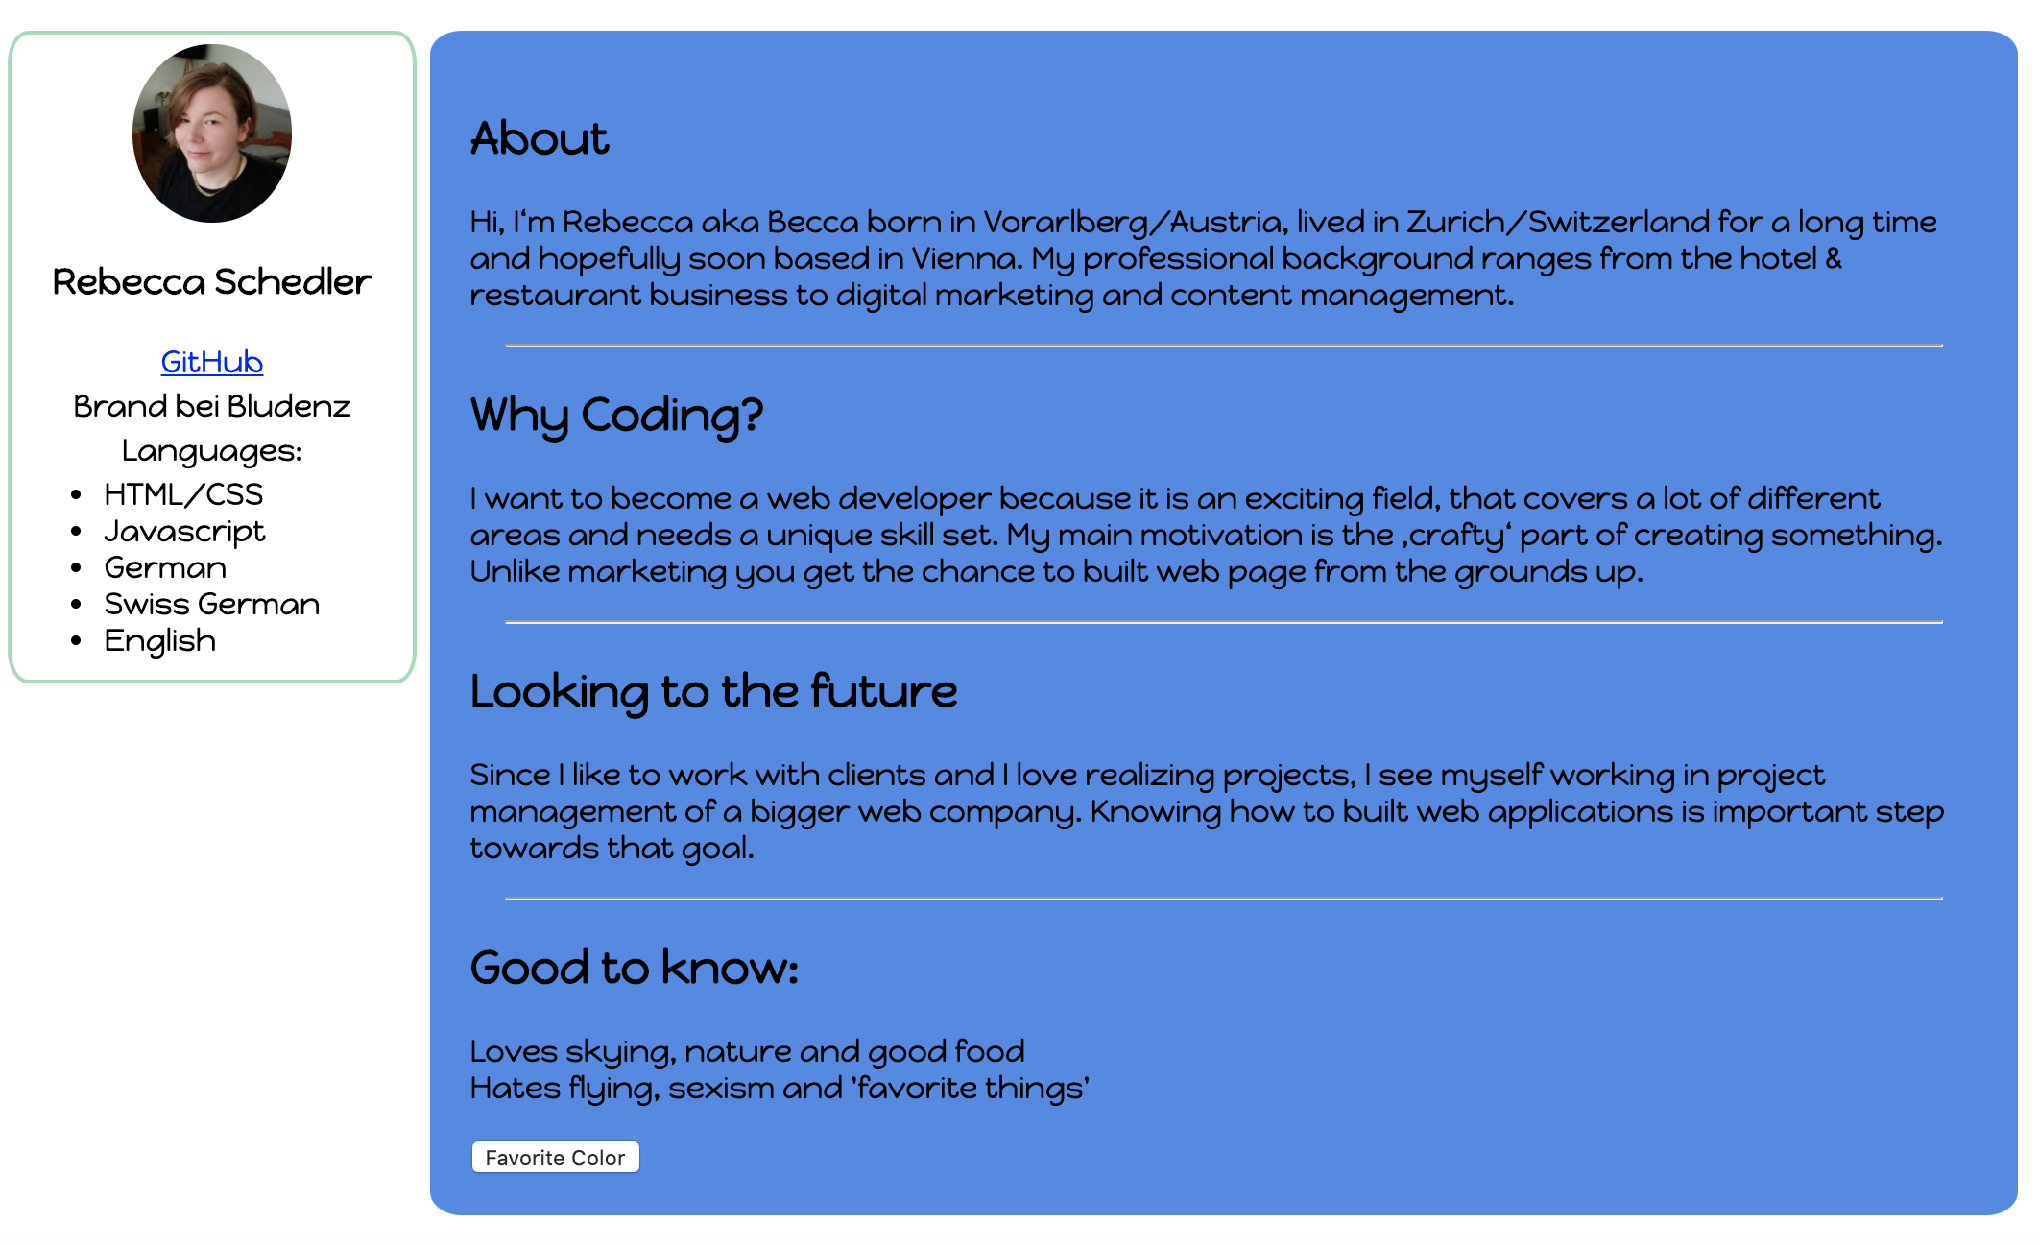
JAVASCRIPT BUTTON CHANGE

Slide 10

PROBLEMS WE FACED
ZOOM
KOALA
GITHUB (BRANCHES)
SUBLIME/VISUAL STUDIO

Slide 11
GITHUB LINK
https://github.com/CodeFactoryWien/LMSCF-10-CoreTech-8.git

Slide 12
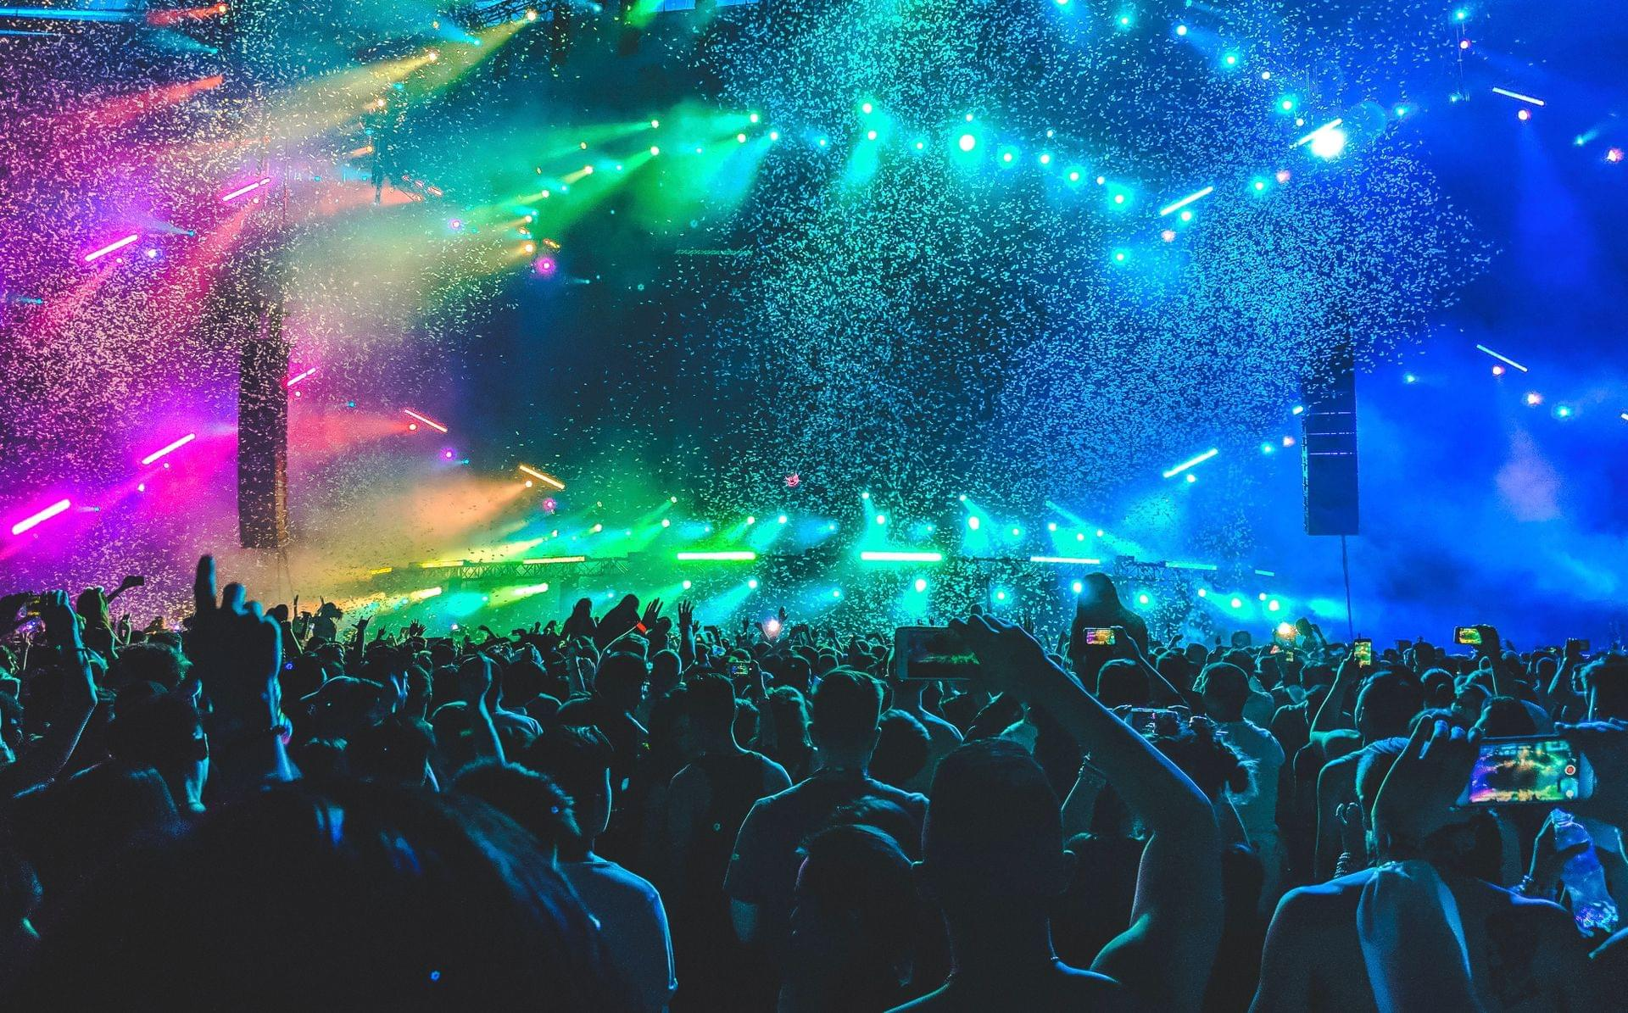
THANK YOU FOR YOUR ATTENTION

