Slide 1
Recurrent Neural Networks

Slide 2


Applications
NLP
Generating text
Time series predictions
Image captioning
Sentiment classification
Machine translation
…

Slide 3
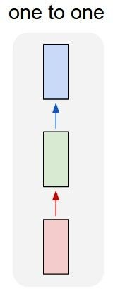
“Vanilla” Neural Network
Vanilla Neural Networks

Slide 4
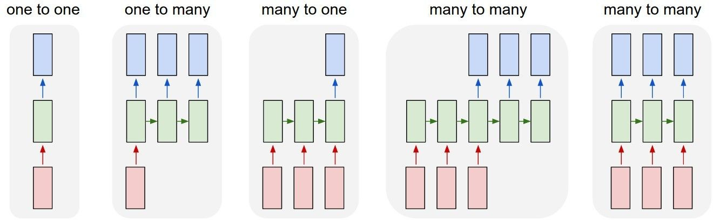
Recurrent Neural Networks: Process Sequences
e.g. Image Captioning
image -> sequence of words

Slide 5
Recurrent Neural Networks: Process Sequences
e.g. Sentiment Classification
sequence of words -> sentiment

Slide 6
Recurrent Neural Networks: Process Sequences
e.g. Machine Translation
seq of words -> seq of words

Slide 7
Recurrent Neural Networks: Process Sequences
e.g. Video classification on frame level

Slide 8
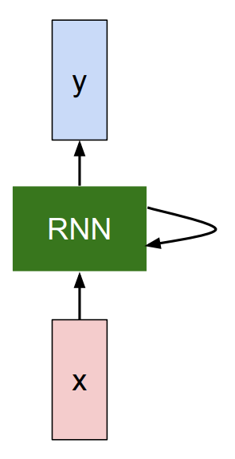
Inventing recurrent neural network

Slide 9
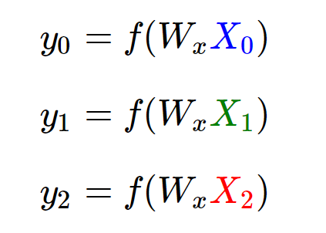
Inventing recurrent neural network

Slide 10
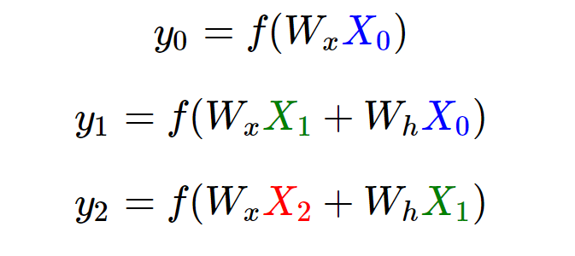
Inventing recurrent neural network

Slide 11
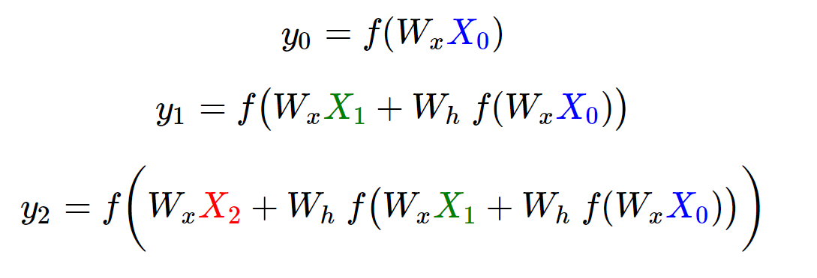
Inventing recurrent neural network

Slide 12
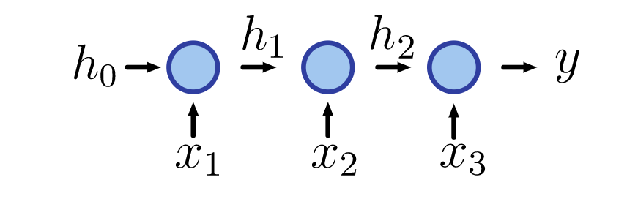
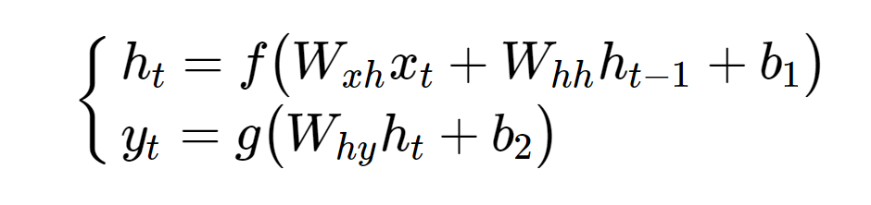
Inventing recurrent neural network

Slide 13
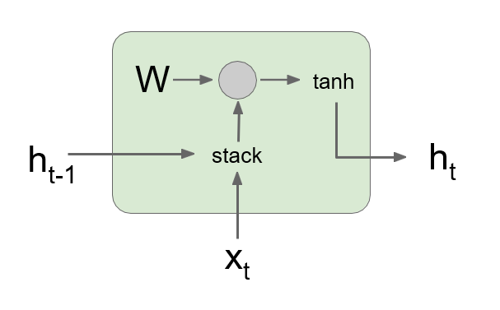
Inventing recurrent neural network

Slide 14
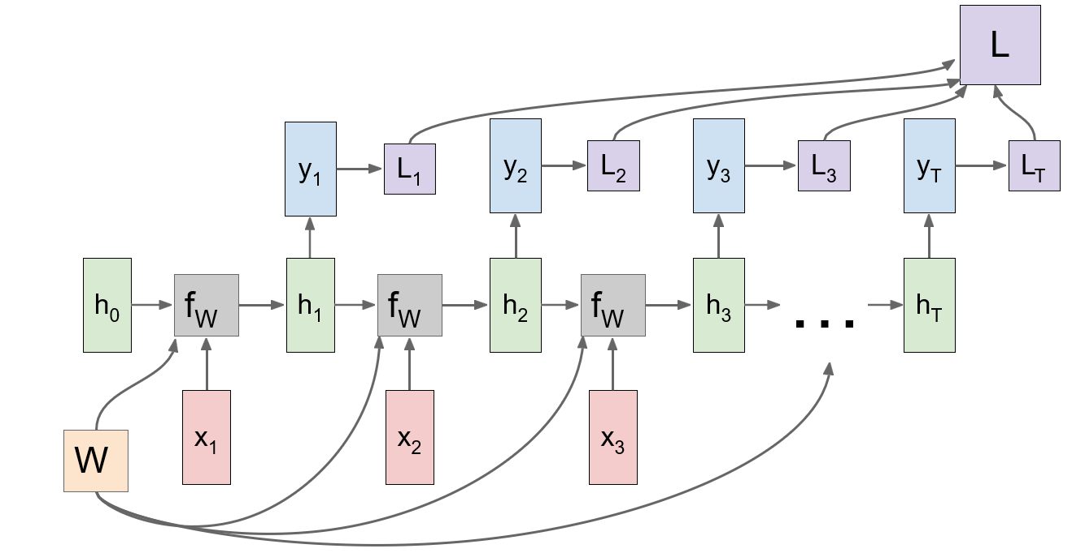
Many to Many

Slide 15
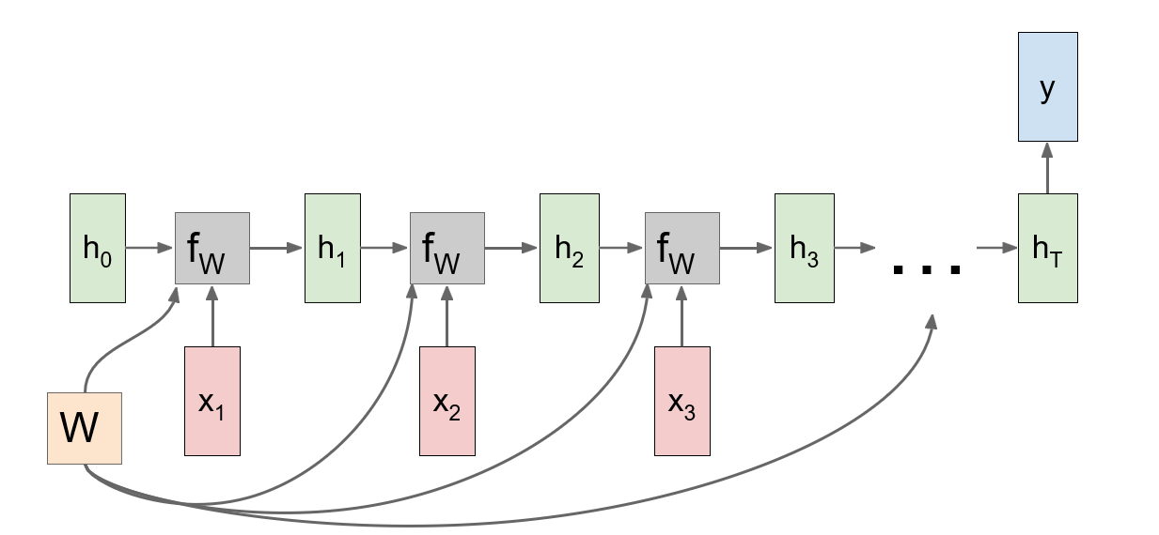
Many to One

Slide 16
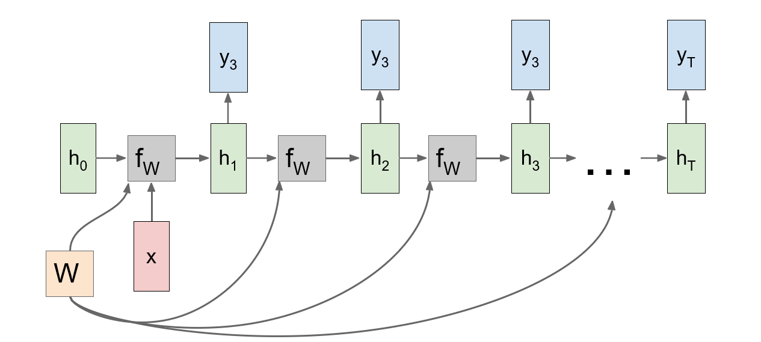
One to many

Slide 17
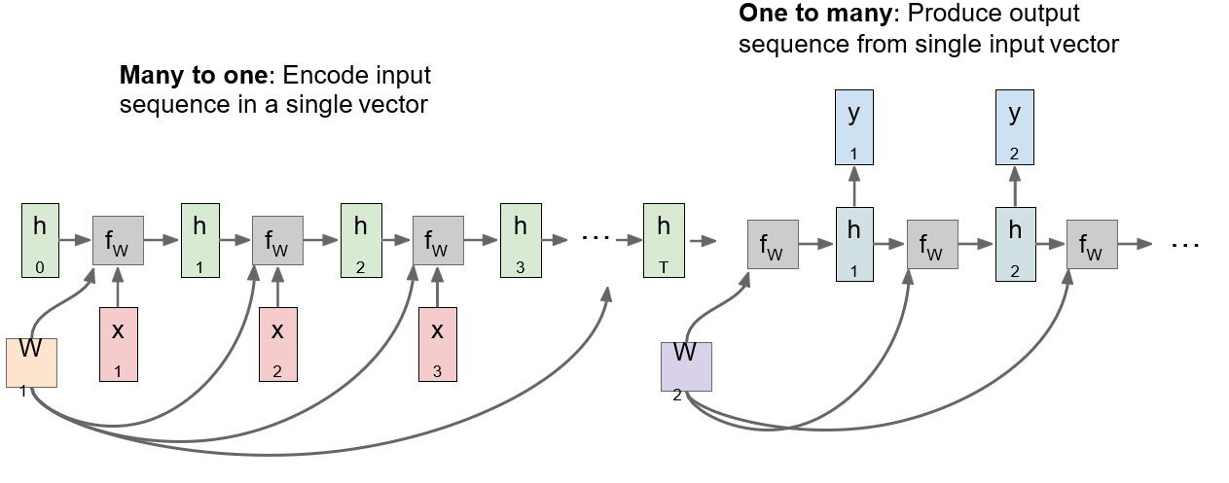
Sequence to sequence = Many-to-one +
one-to-many

Slide 18
Sequence to sequence = Many-to-one +
one-to-many

Slide 19
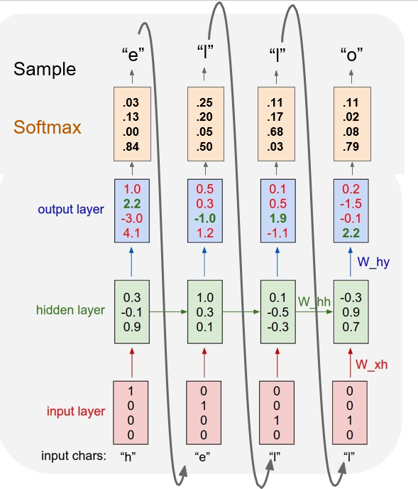
Example: Character-level RNN
Training sequence: “hello”
Vocabulary: [h,e,l,o]
At test-time sample characters one at a time, feed back to model

Slide 20
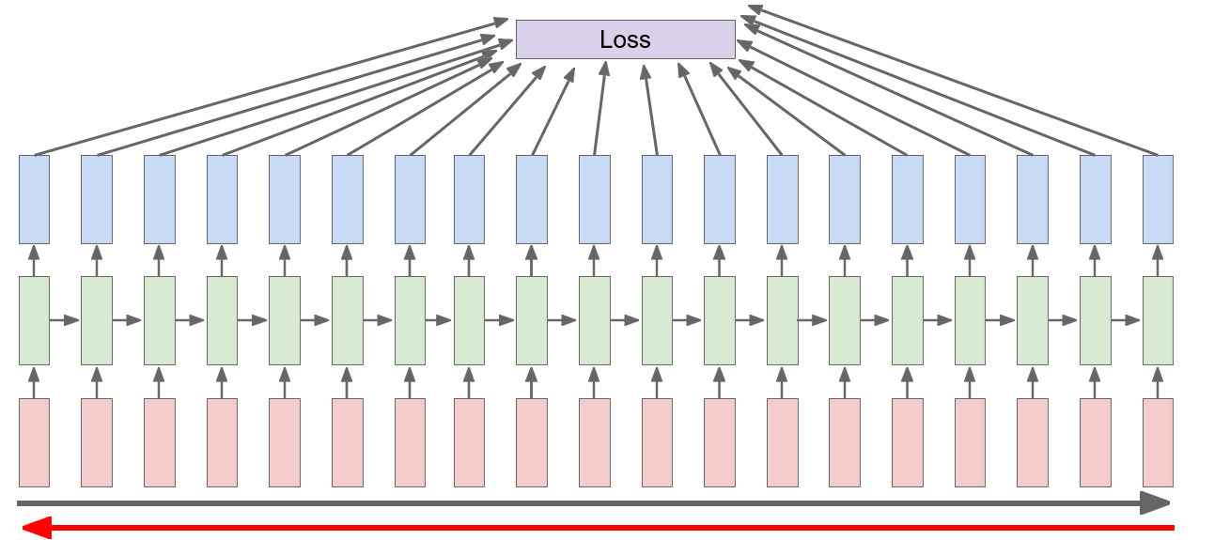
Backpropagation through time
Forward through entire sequence to compute loss, then backward through entire sequence to compute gradient

Slide 21
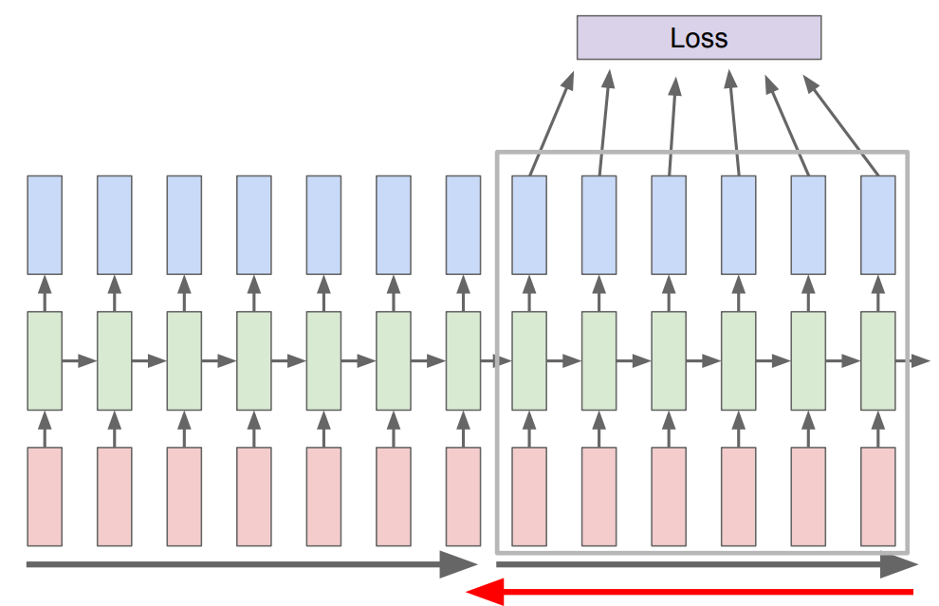
Truncated Backpropagation through time
Run forward and backward through chunks of the sequence instead of whole sequence.
Carry hidden states forward in time forever, but only backpropagate for some smaller number of steps

Slide 22

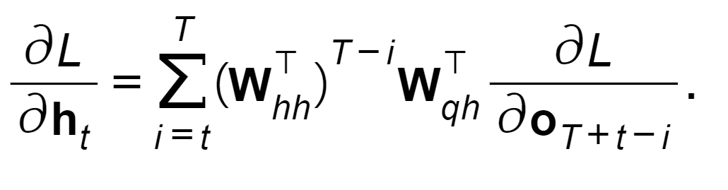
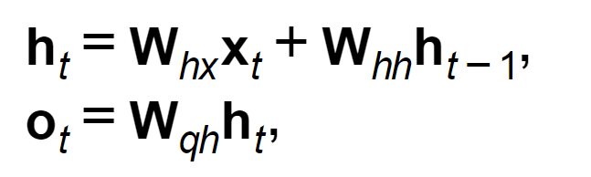
Problems with Vanilla RNN
Computing gradient of h₀ involves many factors of W
Gradient computation for any time step gives:
Exploding gradients
Vanishing gradients

Slide 23
Problems with Vanilla RNN
Computing gradient of h₀ involves many factors of W
Gradient computation for any time step gives:
Exploding gradients ->
Gradient clipping: Scale gradient if its norm is too big.

Slide 24
Problems with Vanilla RNN
Computing gradient of h₀ involves many factors of W
Gradient computation for any time step gives:
Exploding gradients
Vanishing gradients -> Change RNN architecture

Slide 25
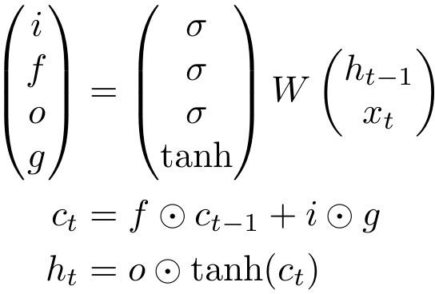
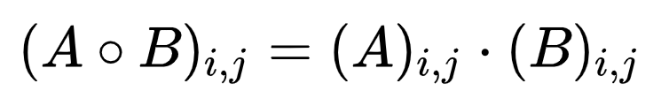
Long Short Term Memory (LSTM)
f: Forget gate – Whether to erase cell
i: Input gate – whether to write to cell
g: Candidate memory cell – How much to write to cell
o: Output gate – how much to reveal cell

Slide 26
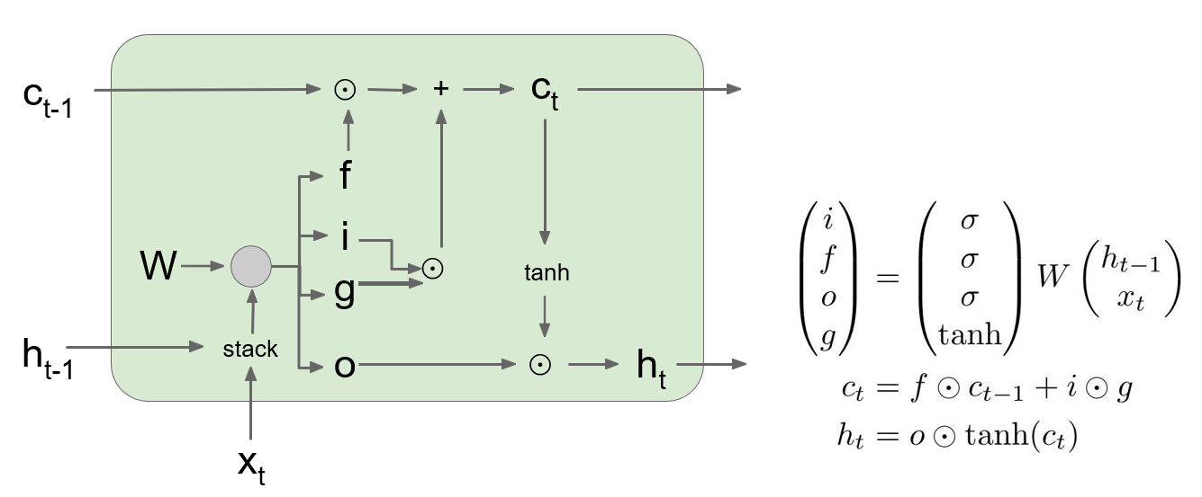
Long Short Term Memory (LSTM)
f: Forget gate – Whether to erase cell
i: Input gate – whether to write to cell
g: Candidate memory cell – How much to write to cell
o: Output gate – how much to reveal cell

Slide 27
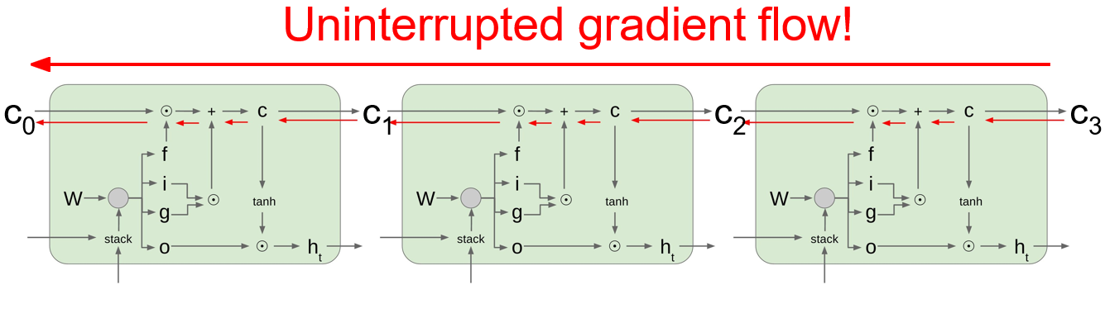
Long Short Term Memory (LSTM)

Slide 28
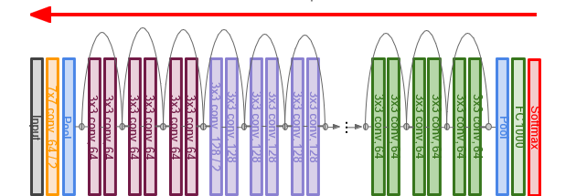
Long Short Term Memory (LSTM)

Slide 29
Long Short Term Memory (LSTM)
Similar to ResNet!

Slide 30
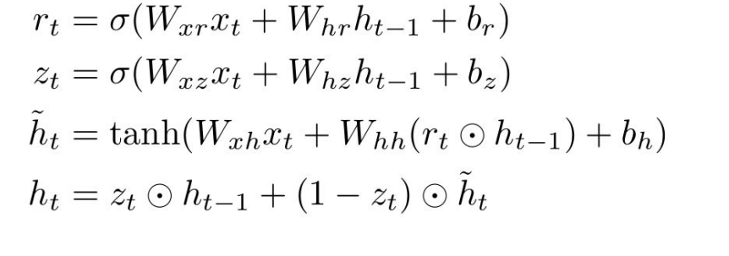
What’s more?
Gated recurrent Units (GRU)
Highway networks
Deep RNN’s
Bidirectional RNN’s
Sampling methods (Beam search, Greedy Search, Exhaustive Search)

