Slide 1



SuRF: Identification of Interesting Data Regions with Surrogate Models
Essence
Fotis Savva, Christos Anagnostopoulos, Peter Triantafillou
School of Computing Science, University of Glasgow
Essence: Pervasive & Distributed Intelligence
E-mail: f.savva.1@research.gla.ac.uk

Slide 2
Outline
Essence
Introduce problem of identifying sub-regions (examples and then formulation – aggregate function as a function mapping parameters to aggregate values)
Baseline solution (visually) and complexity of baseline
Introduce optimization problem – why multi-modal
Glow-worm optimization
Back-end data analytics system as the bottleneck
Surrogate functions to learn back-end analytics system
Experimental Evaluation – Accuracy, Efficiency, Example with Crimes

Slide 3


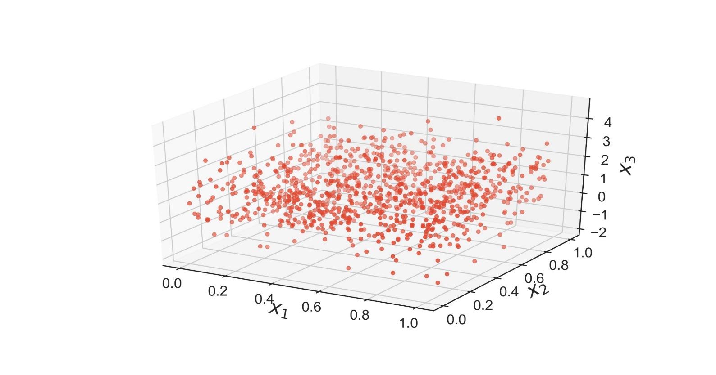
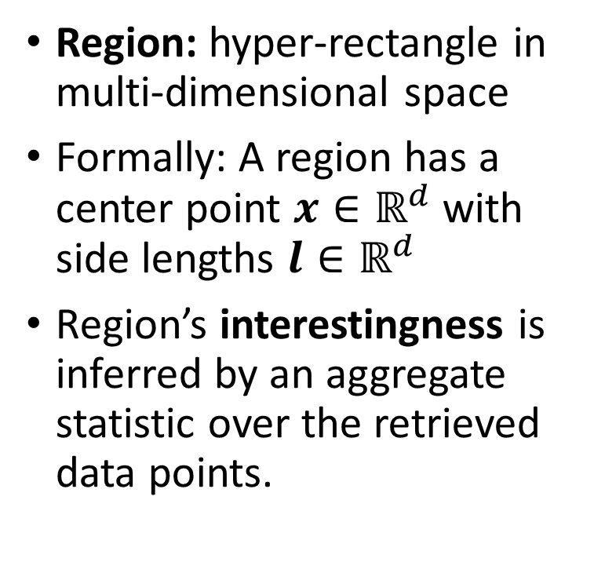
Regions in Multi-dimensional Data Space
Essence
A region in 3D data space.
(x)
Region: hyper-rectangle in multi-dimensional space
Formally: A region has a center point $x∈ℝ^{d}$ with side lengths $l∈ℝ^{d}$
Region’s interestingness is inferred by an aggregate statistic over the retrieved data points.
Using only the included data points, compute a statistic such as COUNT/AVG/SUM/VAR
Example : $x_{1}, x_{2}, x_{3}$ are the values (X, Y, Z) obtained from an accelerometer and the aggregate statistic the ratio of a specific activity (ie ‘sitting’).

Slide 4
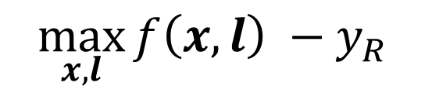

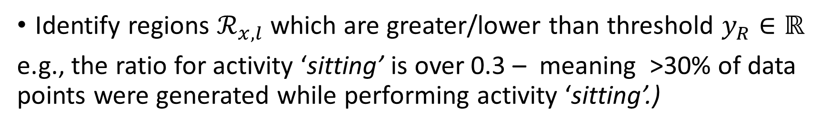
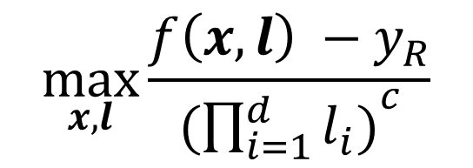
Identifying Interesting Regions
Essence
Identify regions $ℛ_{x,l}$ which are greater/lower than threshold $y_{R}∈ℝ$
e.g., the ratio for activity ‘sitting’ is over 0.3 – meaning >30% of data points were generated while performing activity ‘sitting’.)
$$f : ℛ_{x,l}→ ℝ$$
$$\max_{x,l}{f\left(x,l\right) −y_{R}}$$
Aggregate Function
$$\max_{x,l}{\frac{f\left(x,l\right) −y_{R}}{({\prod_{i=1}^{d}{l_{i})}}^{c}}}$$
To control the size of a region, we introduce a penalizing factor on its lengths
Adjusting tolerance

Slide 5
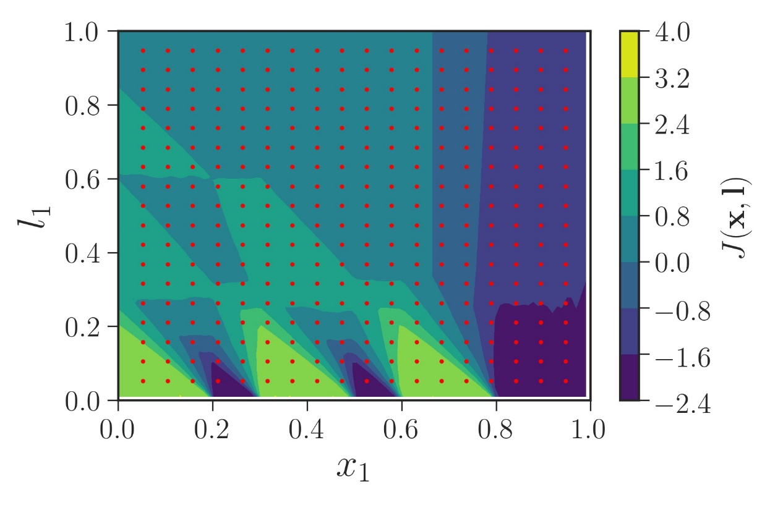
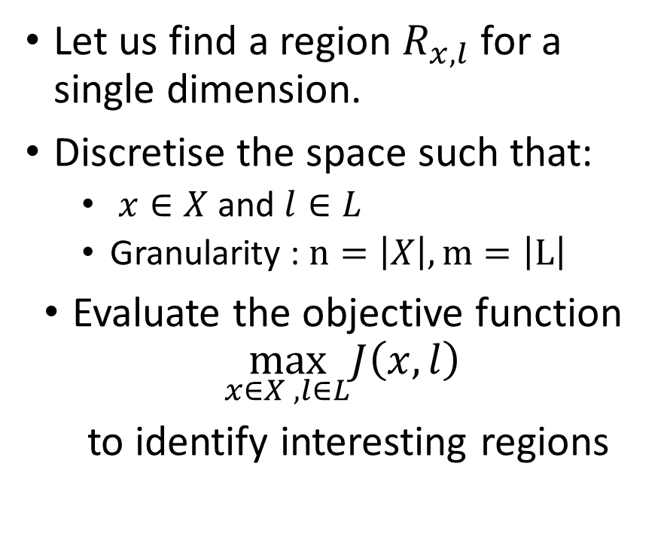
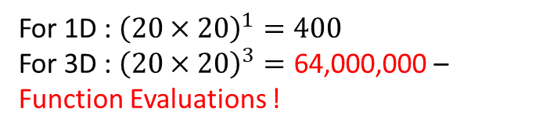
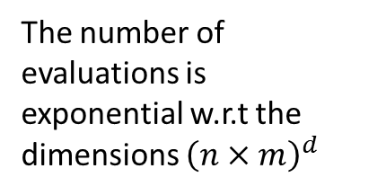
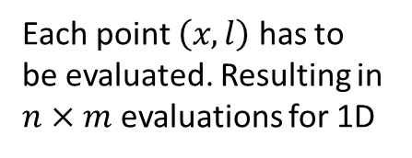
Baseline Method
Essence
Each point $\left(x,l\right)$ has to be evaluated. Resulting in $n×m$ evaluations for 1D
Colorbar denotes the value of the objective function
Let us find a region $R_{x,l}$ for a single dimension.
Discretise the space such that:
$x∈X$ and $l∈L$
Granularity : $n=\left|X\right|, m=\left|L\right|$
Evaluate the objective function $\max_{x∈X , l∈L}J\left(x,l\right)$
to identify interesting regions
The number of evaluations is exponential w.r.t the dimensions ${\left(n×m\right)}^{d}$
For 1D : ${\left(20×20\right)}^{1}=400$
For 3D : ${\left(20×20\right)}^{3}=\text{64}\text{,}\text{000}\text{,}\text{000}$ – Function Evaluations !

Slide 6
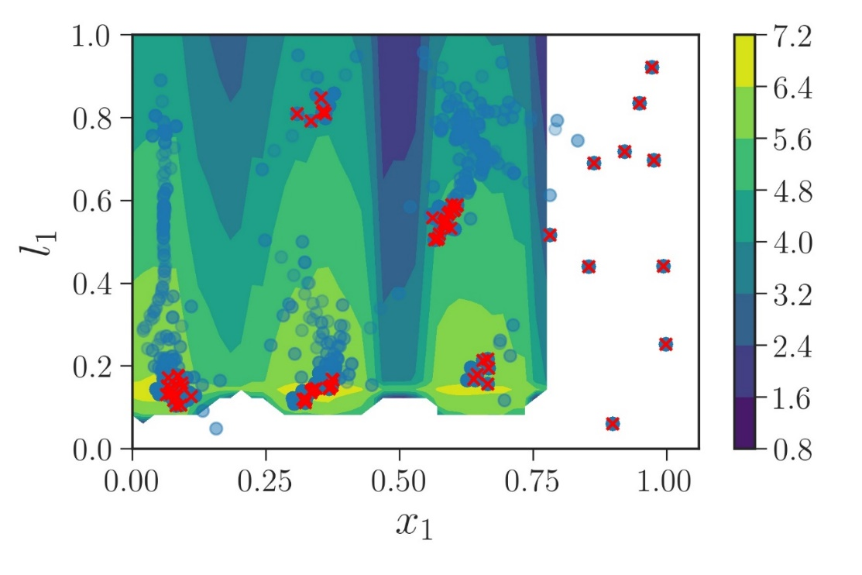
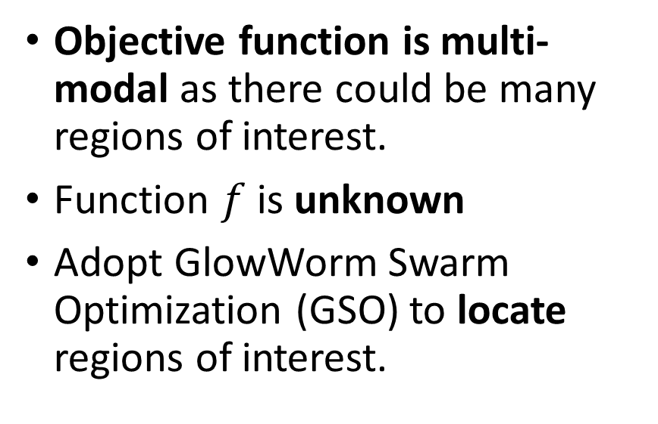
Introducing Multi-modal Optimization
Essence
Objective function is multi-modal as there could be many regions of interest.
Function $f$ is unknown
Adopt GlowWorm Swarm Optimization (GSO) to locate regions of interest.
Infeasible solutions become stranded and are pruned away
Particles in GSO only influence other particles within a neighbourhood

Slide 7


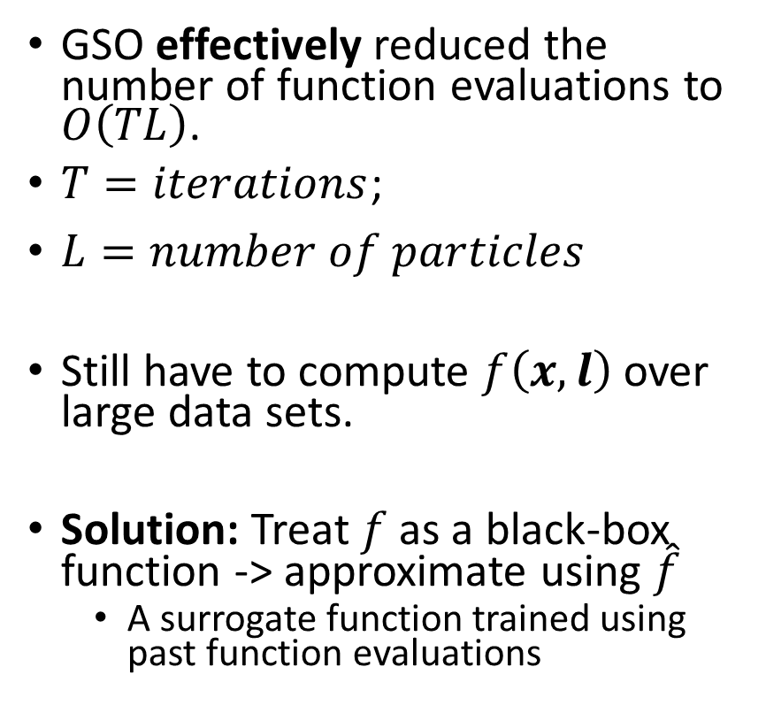
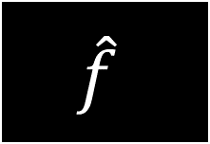


Backend Analytics System is a ‘bottleneck’
Essence
GSO effectively reduced the number of function evaluations to $O\left(TL\right)$.
$T=iterations$;
$L=number of particles$
Still have to compute $f\left(x,l\right)$ over large data sets.
Solution: Treat $f$ as a black-box function -> approximate using $\hat{f}$
A surrogate function trained using past function evaluations
$$R_{x,l}$$
$$y= f(x,l)$$
Execution time depending on data set size (minutes)
Backend Analytics
Replace with
$$R_{x,l}$$
$$\hat{f}$$
$$\hat{y}=\hat{f}(x,l)$$
Execution time depending on function evaluation (milliseconds)

Slide 8
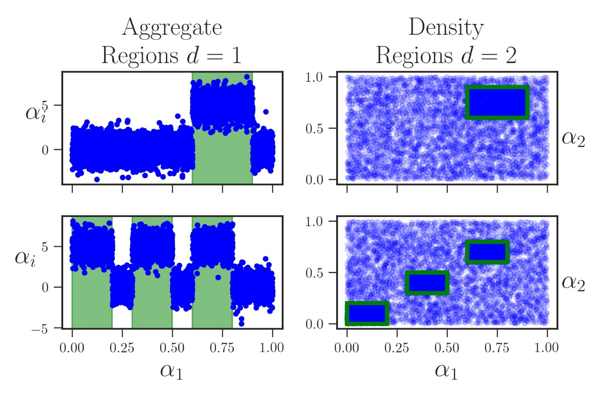
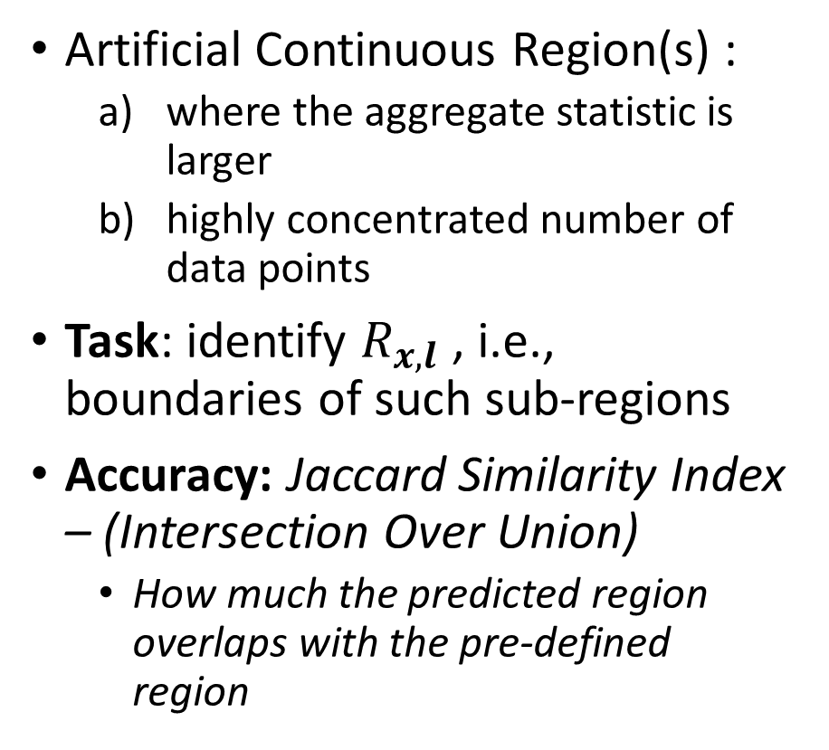
Experimental Evaluation - Task
Essence
Artificial Continuous Region(s) :
where the aggregate statistic is larger
highly concentrated number of data points
Task: identify $R_{x,l}$ , i.e., boundaries of such sub-regions
Accuracy: Jaccard Similarity Index – (Intersection Over Union)
How much the predicted region overlaps with the pre-defined region

Slide 9
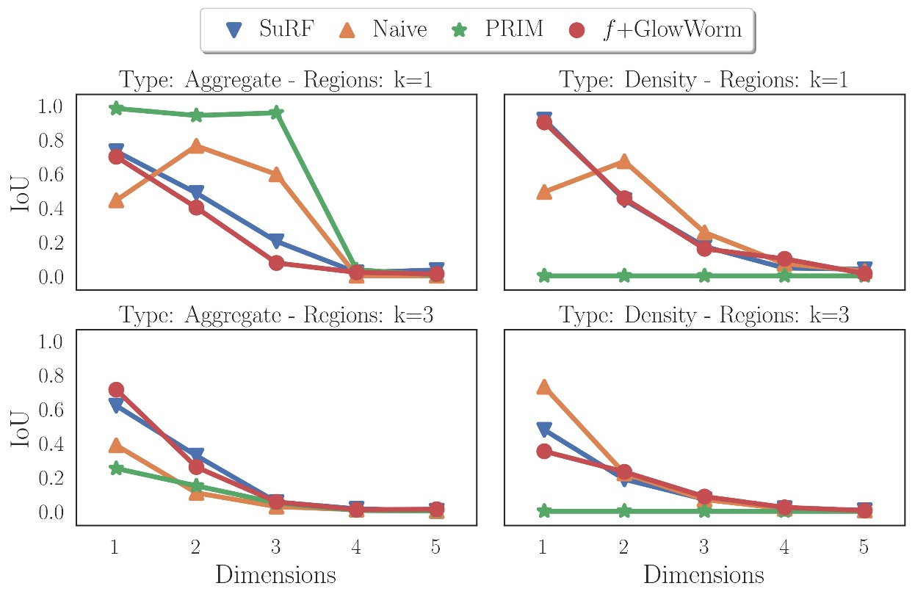
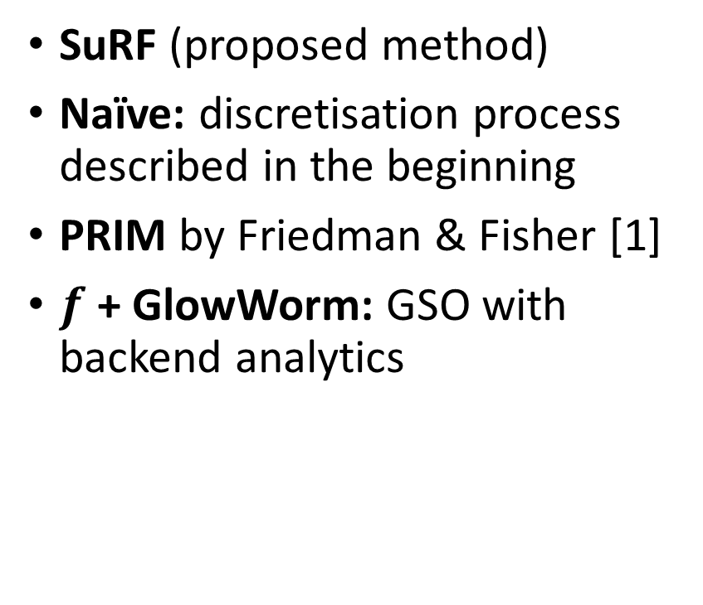
Experimental Evaluation – Key Results (1)
Essence
SuRF (proposed method)
Naïve: discretisation process described in the beginning
PRIM by Friedman & Fisher [1]
$f$+ GlowWorm: GSO with backend analytics
[1] Friedman, Jerome H., and Nicholas I. Fisher. "Bump hunting in high-dimensional data." Statistics and Computing 9.2 (1999): 123-143.
Notes:
Top – Left : PRIM and NAIVE perform best, however NAÏVE’s performance is prohibitive – Main point is SuRF compared with f+Glowworm, we can obtain similar accuracy without incurring the cost of computing the aggregate functions over the data.
Right – column : We were unable to tune PRIM to detect highly dense regions which might indicate that PRIM is unsuitable for this task
Bottom plots : For multiple regions our approach performs better than PRIM

Slide 10
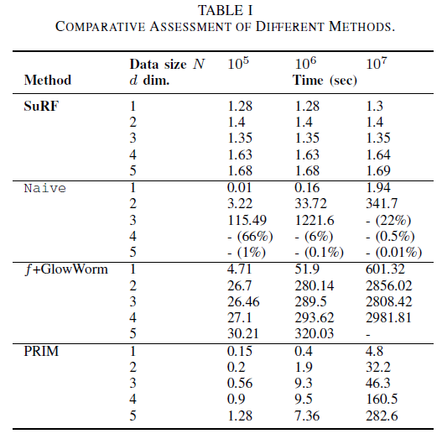

Experimental Evaluation – Results (2)
Essence
Increase in data set size $N$
Relatively constant across all settings
As data set size and dimensionality increase method does not scale.
Increase in data set dimensionality
Similar to Naive
Cuttoff time set at 5 minutes (3000 seconds)
PRIM is highly scalable, starts to degrade as data set size increases
Notes:
Naïve - Green - Only 0.01% of function evaluations were performed for 10,000,000 data points at dimensionality 5
PRIM – However, it assumes all data are loaded into memory which is often not the case

Slide 11
Thank you!
Essence
Essence: Pervasive & Distributed Intelligence
http://www.dcs.gla.ac.uk/essence/
E-mail: f.savva.1@research.gla.ac.uk

