Slide 1
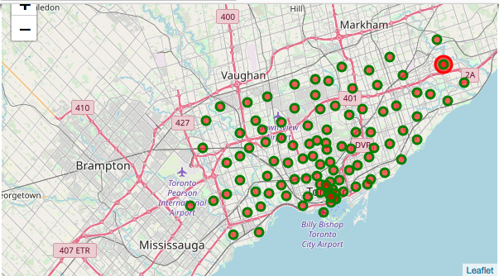
Problem Statement
Franchise Opportunity in Chicken Tikka Masala restaurant
Recommended Location by Chicken Tikka Masala is Western Toronto

Slide 2
West Toronto
6 Postal Codes
12 Neighbourhoods
99 Venus as per Foursquare

Slide 3
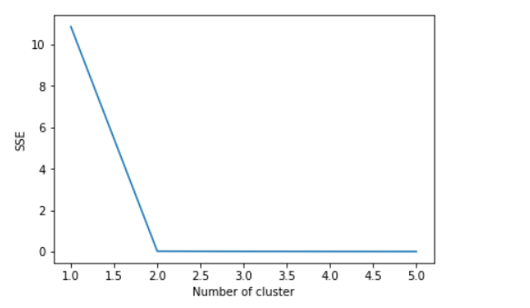
West Toronto – Clustering
Recommending Number of Clusters = 2
Cluster | Neighbourhood
1 | Dover court Village, Dufferin
1 | Little Portugal, Trinity
1 | High Park, The Junction South
1 | Parkdale, Roncesvalles
2 | Brockton, Exhibition Place, Parkdale Village
2 | Runnymede, Swansea

Slide 4
Conclusion
Market Gap: Opportunity to be first movers in fine dining category
Competition from fast food restaurants
Recommended Location in Cluster 1
Limitation:
Foursquare data
Recommendation does not take financial aspects into consideration

