Slide 1
Fake News Detector for Students
CAPSTONE PROJECT
Presented By:
Student Name: Sourashis Dey
College Name: Haldia Institute of Technology
Department : Computer Science & Engineering
4. AICTE id: STU693903360b2c01765344054

Slide 2
OUTLINE
Problem Statement (Should not include solution)
Proposed System/Solution
System Development Approach (Technology Used)
Algorithm & Deployment
Result
Conclusion
Future Scope
References
Deployment / GitHub Link

Slide 3
Problem Statement
Fake News Detector for Students
Misinformation spreads quickly through online news and social media, making it hard for students to differentiate between reliable and fake information. There is a need for an AI solution that can analyze articles, assess credibility, and provide concise, trustworthy summaries to prevent the spread of false information.

Slide 4
Proposed Solution
The proposed system utilizes BERT (Bidirectional Encoder Representations from Transformers), a state-of-the-art Natural Language Processing model, to automatically detect fake news. The system analyzes news headlines and classifies them as Real or Fake based on their contextual meaning.
The solution consists of the following stages:
Data Collection: Gather labeled datasets containing real and fake news headlines.
Data Preprocessing: Clean and prepare textual data for analysis.
BERT Tokenization: Convert news headlines into token representations understandable by the model.
Model Training: Fine-tune a pre-trained BERT model on the fake news dataset.
Prediction: Accept user-input headlines and generate real-time classifications.
Evaluation: Measure performance using Accuracy, Precision, Recall, F1-Score, and Confusion Matrix.
The developed system helps students quickly verify the authenticity of news content and reduces the spread of misinformation through AI-driven analysis.

Slide 5
System Approach
Technologies Used
Python
Google Colab
PyTorch
BERT
Transformers Library
Workflow
News Headlines -> Data Preprocessing -> BERT Tokenization -> Model Training -> Prediction -> Real / Fake Classification
Key Features
Automated Fake News Detection
BERT-based NLP Processing
Real-Time Headline Prediction
Performance Evaluation using Classification Metrics

Slide 6
Algorithm & Deployment
Algorithm: BERT (Bidirectional Encoder Representations from Transformers)
A pre-trained Transformer-based NLP model used for text classification.
Understands contextual relationships between words by analyzing text bidirectionally.
Fine-tuned on a labeled fake news dataset to classify news headlines as Real or Fake.
Provides high accuracy and effective contextual understanding compared to traditional machine learning approaches.
Workflow
Input Headline -> BERT Tokenizer -> BERT Model -> Classification Layer -> Real / Fake Prediction
Deployment
Developed using Python and Google Colab.
Implemented using PyTorch and the Transformers library.
Supports real-time prediction of user-entered news headlines.
Can be extended for deployment as a web or mobile application in the future.

Slide 7
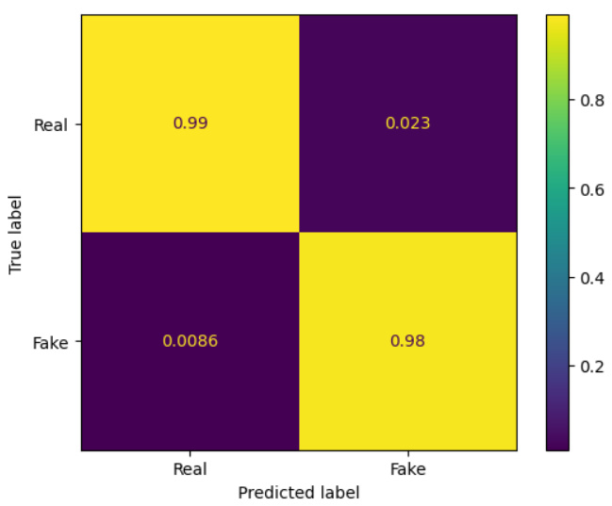
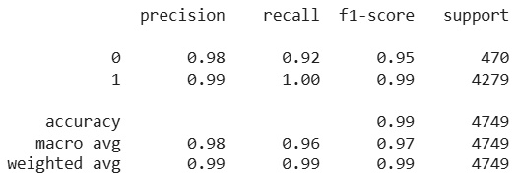
Result
Confusion Matrix
Classification Report
Model Performance
Accuracy: 98.87%
Precision: 99%
Recall: 99%
F1-Score: 99%

Slide 8
Conclusion
The Fake News Detector for Students successfully demonstrates the application of Artificial Intelligence and Natural Language Processing in identifying misinformation. By leveraging the BERT (Bidirectional Encoder Representations from Transformers) model, the system is able to understand contextual relationships within news headlines and classify them as Real or Fake with high accuracy.
The developed model achieved an accuracy of approximately 98.87%, highlighting the effectiveness of transformer-based architectures for text classification tasks. In addition, the system provides real-time predictions, enabling users to quickly evaluate the credibility of news content.
This project showcases how AI can be utilized to combat the spread of misinformation and assist students in accessing reliable information. The results indicate that deep learning models such as BERT can serve as powerful tools for enhancing digital literacy and promoting informed decision-making in today's information-driven world.

Slide 9
Future scope
Full News Article Analysis: Extend the system to analyze complete news articles instead of only headlines, improving prediction accuracy and contextual understanding.
Multilingual Fake News Detection: Support multiple languages to make the system accessible to users from different linguistic backgrounds.
Explainable AI (XAI): Integrate explainable AI techniques to highlight the words or phrases that influenced the model's prediction, increasing transparency and user trust.
Real-Time Fact Verification: Connect the system with trusted fact-checking databases and APIs to validate news content against verified sources in real time.
Web and Mobile Deployment: Develop a user-friendly web application and mobile app to enable easy access and wider adoption.
Social Media Integration: Enable automatic detection and flagging of potentially misleading content shared on social media platforms.
Continuous Learning Framework: Implement mechanisms for periodic retraining using newly available news data to keep the model updated against emerging misinformation trends.

Slide 10
References
BERT: Pre-training of Deep Bidirectional Transformers for Language Understanding Jacob Devlin, Ming-Wei Chang, Kenton Lee, Kristina Toutanova (2018)
Hugging Face Transformers Documentation Official documentation for BERT implementation and fine-tuning.
PyTorch Documentation Official deep learning framework documentation.
Scikit-learn Documentation Used for evaluation metrics such as Accuracy, Precision, Recall, F1-Score, and Confusion Matrix.
Google Colab Documentation Development and execution environment used for model training and testing.
Fake and Real News Dataset https://github.com/Reinforz/Fake-News-detection-with-ISOT-Dataset/blob/main/Fake_News_detection.ipynb

Slide 11
Deployment link / github link
GitHub Link: https://github.com/Skey9147/Fake-News-Detector-for-Students
Deployment: Google Colab

Slide 12
THANK YOU

