Slide 1
IBM University Engagement Project Submission
“Exploring the Power of Agentic AI with IBM Granite and LangFlow”

Slide 2
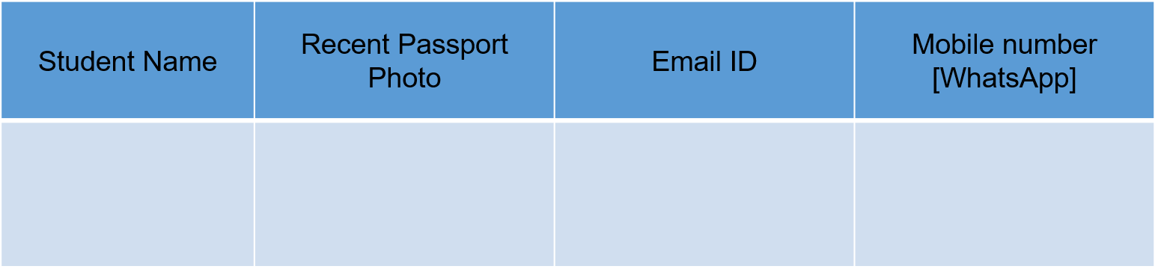

Project Tile – Agentic AI for Personalized Course Pathways
Domain of Project – Education
Sourashis Dey
sourashisdey888@gmail.com
8276087320

Slide 3
Problem Statement:
Agentic AI for Personalized Course Pathways.
The Challenge - Students often struggle to identify the right learning path that aligns with their interests and long-term goals due to the overwhelming number of online courses and a lack of personalized guidance. LearnMate aims to solve this by acting as an Agentic AI coach that interacts with students, understands their interests (like Frontend Development, Cybersecurity, UI/UX Design, etc.), assesses their current skill level, and dynamically builds a personalized course roadmap that adapts over time based on progress and preferences.

Slide 4
Technology Used
IBM Cloud Lite Services – for deploying and running the application
IBM Granite LLM – for generating AI-based responses and reasoning
Langflow – for building and managing the multi-agent workflow visually
Python – for backend logic and data handling
Prompt Engineering – to structure and control AI outputs
RAG-based Agent Design (conceptual use) – for structured information flow between agents

Slide 5
Proposed Solution:
We propose an AI-powered Course Pathway Assistant that helps students plan their learning and career journey in a structured and personalized way.
The system uses a multi-agent AI architecture built using Langflow and IBM Granite, where each agent performs a specific task:
The Student Analysis Agent understands the user’s profile (skills, interests, and goals).
The Learning Path Agent generates a structured 6-month roadmap with step-by-step learning topics.
The Resource Recommendation Agent suggests relevant certifications, platforms, tools, and practice resources.
The Career Guidance Agent provides internship preparation steps, project ideas, and career direction.
All agents work together in a pipeline to convert raw student input into a complete personalized learning and career plan.
The solution reduces confusion, saves time, and provides clear, structured guidance for students preparing for internships and skill development.

Slide 6
Langflow Components Used:
Input Component Used to take student profile data as text input.
Prompt Template Component Used to structure instructions for each AI agent (Learning, Resource, Career).
LLM Component (IBM Granite Model) Core AI engine used to generate responses for roadmap, resources, and career guidance.
Text Splitter / Parser (if used) Helps structure or clean large outputs before passing between agents.
Chain / Flow Connector Used to connect multiple agents in sequence (Student → Learning → Resources → Career).
Output Component Displays final structured response to the user.

Slide 7
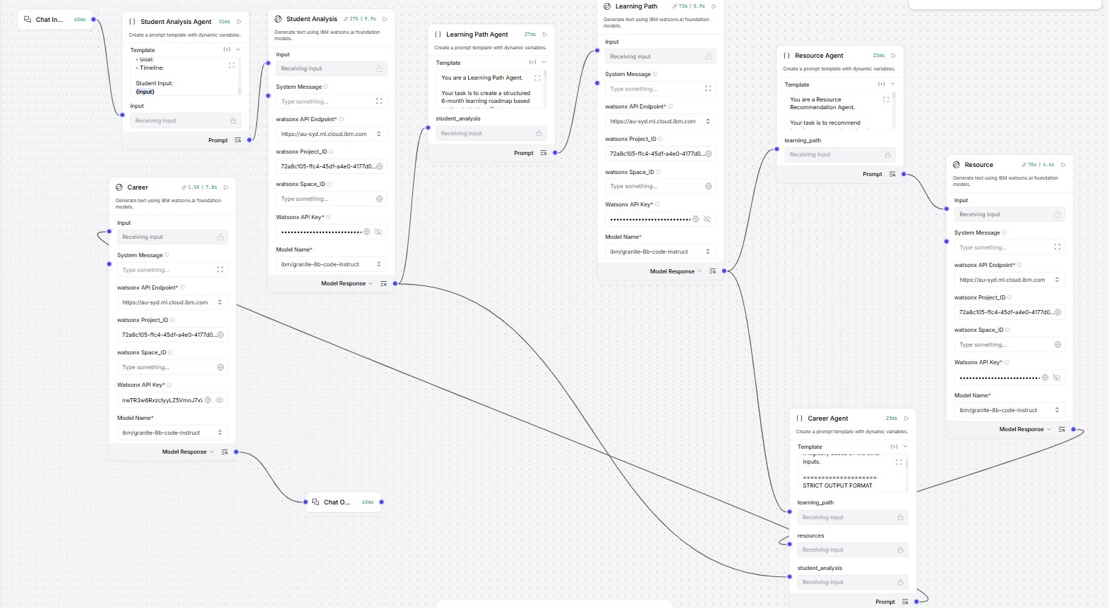
Langflow Workflow

Slide 8
Role of Agentic AI in the Solution
Agentic AI plays a central role in transforming the system from a simple chatbot into an autonomous multi-step decision-making assistant.
It enables the system to break down the problem into smaller tasks and assign them to specialized agents such as:
Student Analysis Agent
Learning Path Agent
Resource Recommendation Agent
Career Guidance Agent
Each agent operates independently with a specific goal, but they collectively work together through a coordinated workflow.
Agentic AI allows the system to:
Understand user input contextually
Plan and execute multi-step reasoning
Generate structured and goal-oriented outputs
Improve accuracy by dividing responsibilities across agents
By using IBM Granite as the underlying LLM and Langflow for orchestration, the system behaves like an intelligent assistant that can think, plan, and respond in a structured pipeline instead of a single static response.

Slide 9
Novelty & Uniqueness
The proposed system stands out due to its multi-agent AI architecture that goes beyond traditional single-response chatbots.
Key Novel Aspects:
Agentic AI-based design The system decomposes the problem into specialized agents (Student Analysis, Learning Path, Resource, and Career), enabling structured and goal-oriented reasoning.
End-to-end personalized roadmap generation Unlike generic recommendation systems, it generates a complete 6-month learning + career plan tailored to the student’s profile.
Modular and scalable architecture Each agent works independently, making the system easy to extend, modify, or integrate with new domains.
Controlled and structured LLM output using IBM Granite + Langflow Ensures consistent formatting, reduced hallucination, and reliable responses.
Integration of learning, resources, and career guidance in one system Most systems handle only one part (courses OR jobs), but this combines all three in a single pipeline.

Slide 10
Git Hub Link
https://github.com/Skey9147/course-pathway-agent
·
·
·

Slide 11
Future Scope
The proposed system can be further enhanced to improve scalability, intelligence, and real-world applicability.
Key Future Enhancements:
Personalized Adaptive Learning The system can dynamically update learning paths based on user progress and performance tracking.
Integration with Real-Time Job Market Data Career recommendations can be improved using live job postings and industry demand trends.
Multilingual Support Enabling regional language support to make the system accessible to a wider student base.
Voice-Based Interaction Adding speech input/output to make the system more user-friendly and accessible.
Integration with LMS Platforms The system can be connected with platforms like Moodle or Google Classroom for continuous learning support.
Advanced RAG Implementation Using retrieval-augmented generation with verified educational databases for more accurate responses.
Mobile Application Deployment Extending the system into a mobile app for anytime, anywhere access.

Slide 12


