Slide 1
RICE ORDERING & STORE MANAGEMENT
Bugasan ni Ali
A mobile system for a local rice store
From rice orders
to stock control.
IN THIS PRESENTATION
01
About the app
02
Conceptual framework
One app connecting customers, sales, inventory, and supplier purchases.
03
Database structure
BUGASAN NI ALI / SYSTEM OVERVIEW
01 / 06
Notes:
Introduce Bugasan ni Ali as a rice ordering, retail/wholesale sales, and inventory management application. This overview is based on the source code and database schema, not on measured business outcomes. Sources: README.md; frontend/src/theme/index.js; backend/src/db/schema.sql.

Slide 2
01 / ABOUT
One store, two user experiences
Purpose: organize rice purchases and daily store operations in one system.
Customers
Store administrator
Browse rice varieties and prices
Order for delivery or pickup
Track orders and view receipts
Apply for wholesale access
Manage products, stock, and suppliers
Process orders and verify payments
Receive supplier purchase orders
Review sales and inventory reports
Retail + approved wholesale pricing â€¢ Stock alerts â€¢ Order status updates
BUGASAN NI ALI / SYSTEM OVERVIEW
02 / 06
Notes:
Customers select rice, place an order, and follow fulfillment. The administrator maintains the catalog, handles orders, approves wholesale access, records supplier purchases, and reviews reports. Payment verification is an administrative workflow; do not describe it as an integrated payment gateway. Push notifications require device configuration. Sources: backend/README.md; frontend/src/app; backend/src/services/orders.js.

Slide 3
03 / DATABASE STRUCTURE
How the system stores its data
A React Native / Expo app connects to a Node.js / Express API backed by SQLite.
Mobile app
Backend API
SQLite database
Customer and admin screens
Business rules and validation
12 related tables
CORE BUSINESS DATA
SUPPORTING TABLES
Sales: users, orders, order_items, products
Supply: suppliers, supplier_varieties,
purchase_orders, purchase_order_items,
stock_movements
pricing_rules â€” discount conditions
settings â€” store configuration (JSON)
device_tokens â€” user push devices
BUGASAN NI ALI / SYSTEM OVERVIEW
04 / 06
Notes:
SQLite is the persistent database and the backend is the source of truth. Foreign key enforcement is enabled. The schema has 12 tables: nine core business tables and three supporting tables. device_tokens.user_id references users.id; pricing_rules and settings have no declared foreign keys. settings.value stores JSON. Sources: backend/src/db/schema.sql; backend/src/db/index.js; frontend/package.json; backend/README.md.

Slide 4
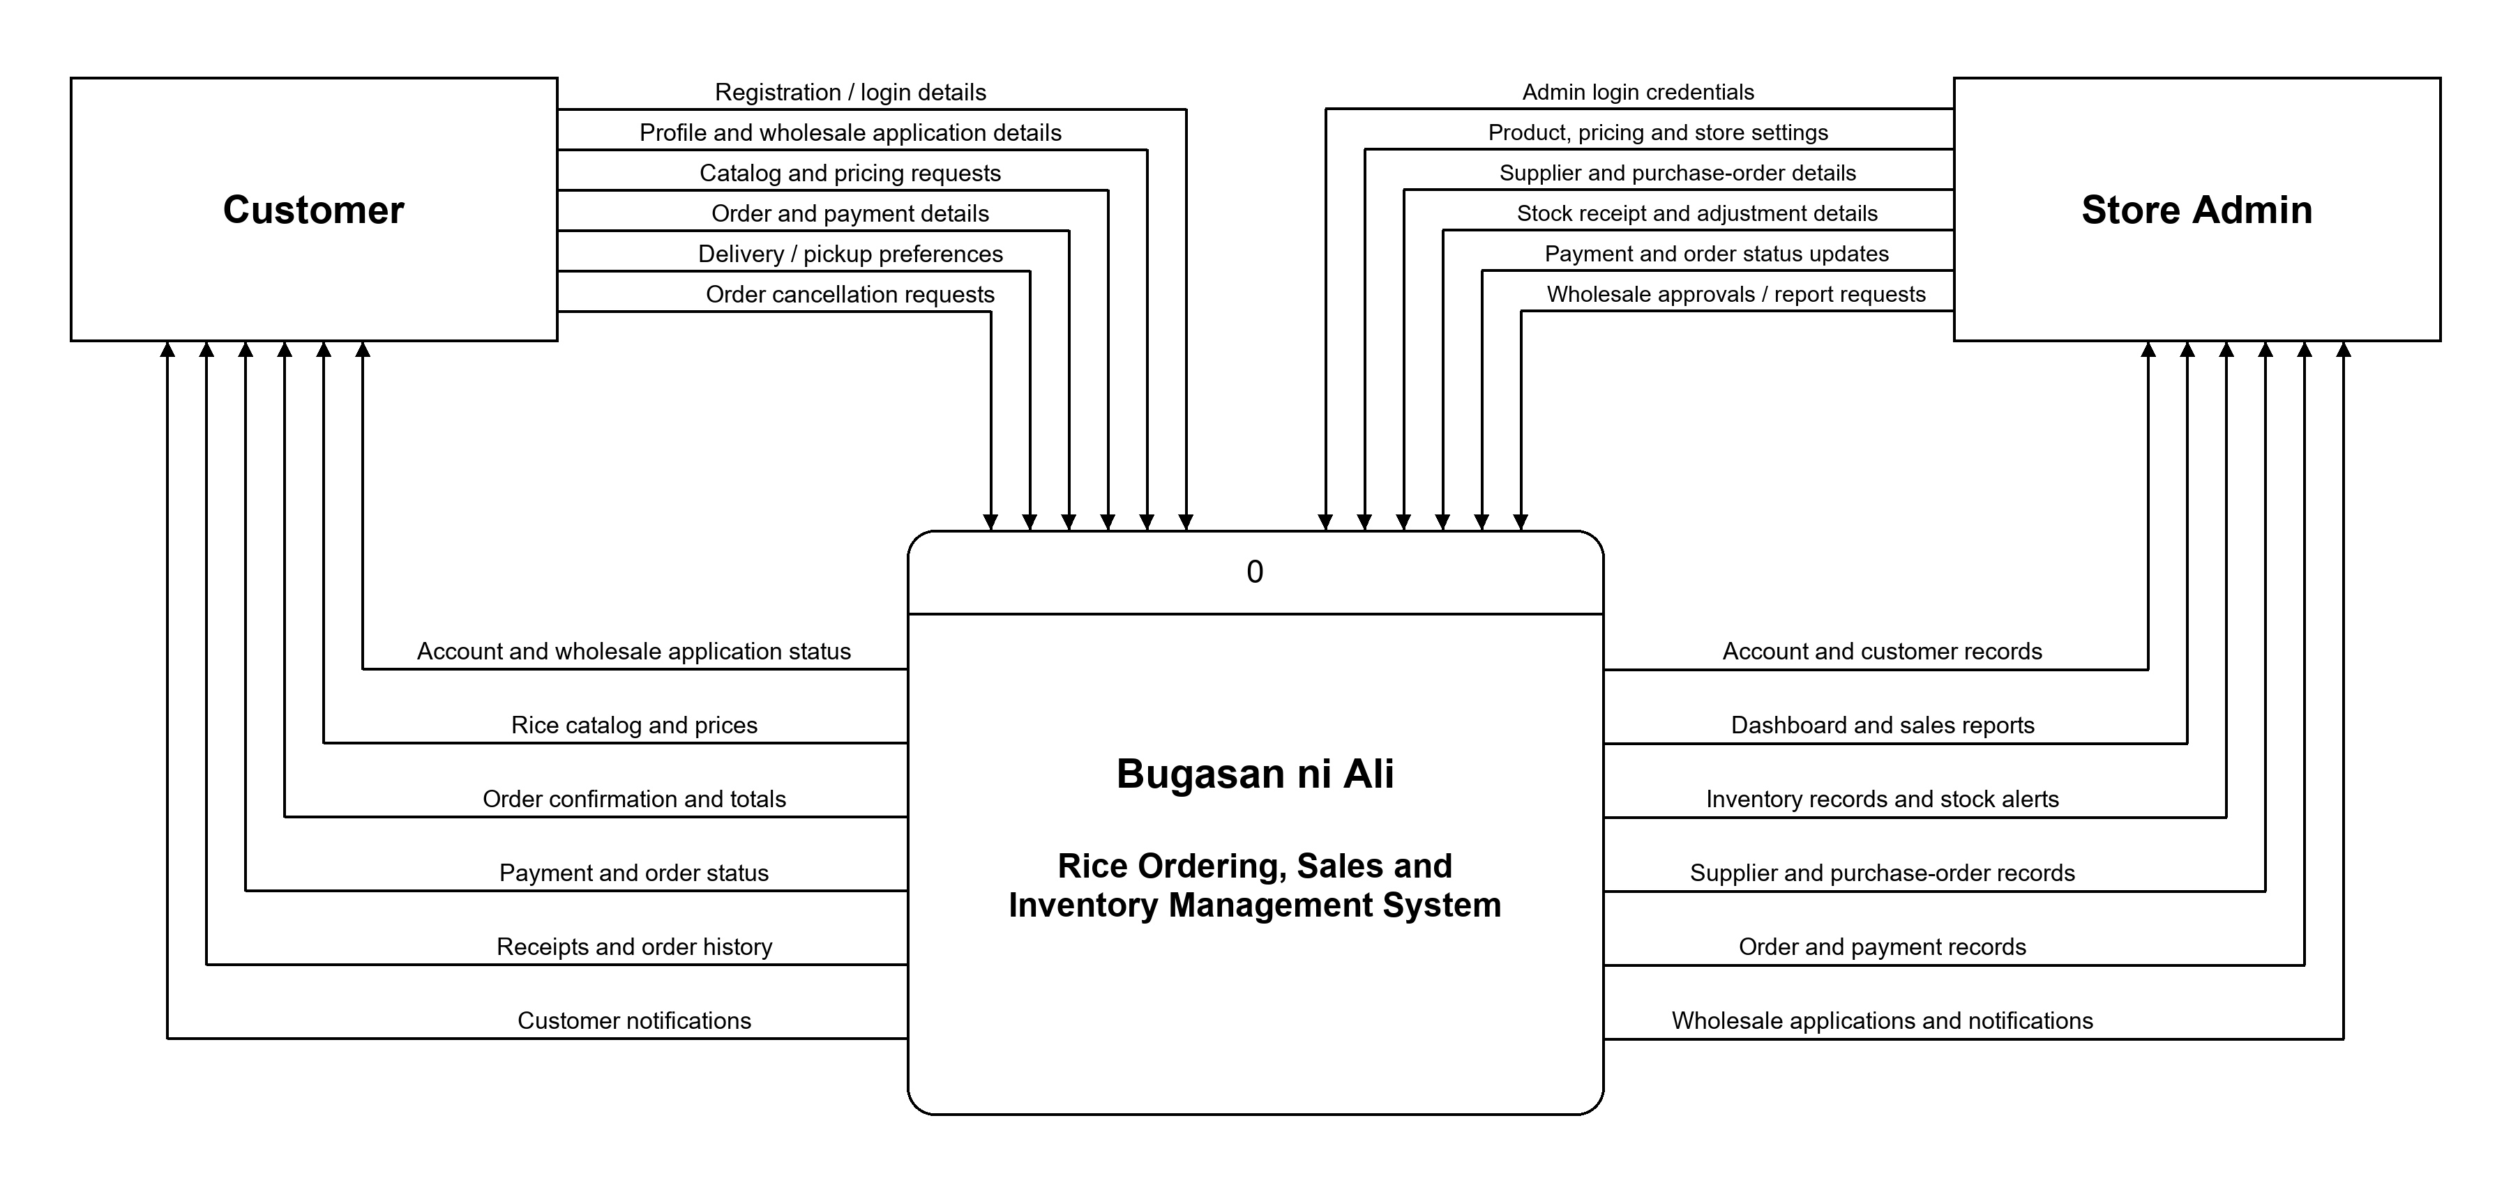
02 / CONCEPTUAL FRAMEWORK
BUGASAN NI ALI / SYSTEM OVERVIEW
03 / 06
Notes:
Explain the model from left to right. Inputs enter through the app; the backend checks stock and calculates prices, then records transactions. Outputs include receipts, current stock, status updates, and reports. Feedback means the administrator uses reports and alerts to make decisions; automatic replenishment is not claimed. Sources: backend/README.md; backend/src/services/orders.js; backend/src/services/purchaseOrders.js; backend/src/services/reports.js.

Slide 5
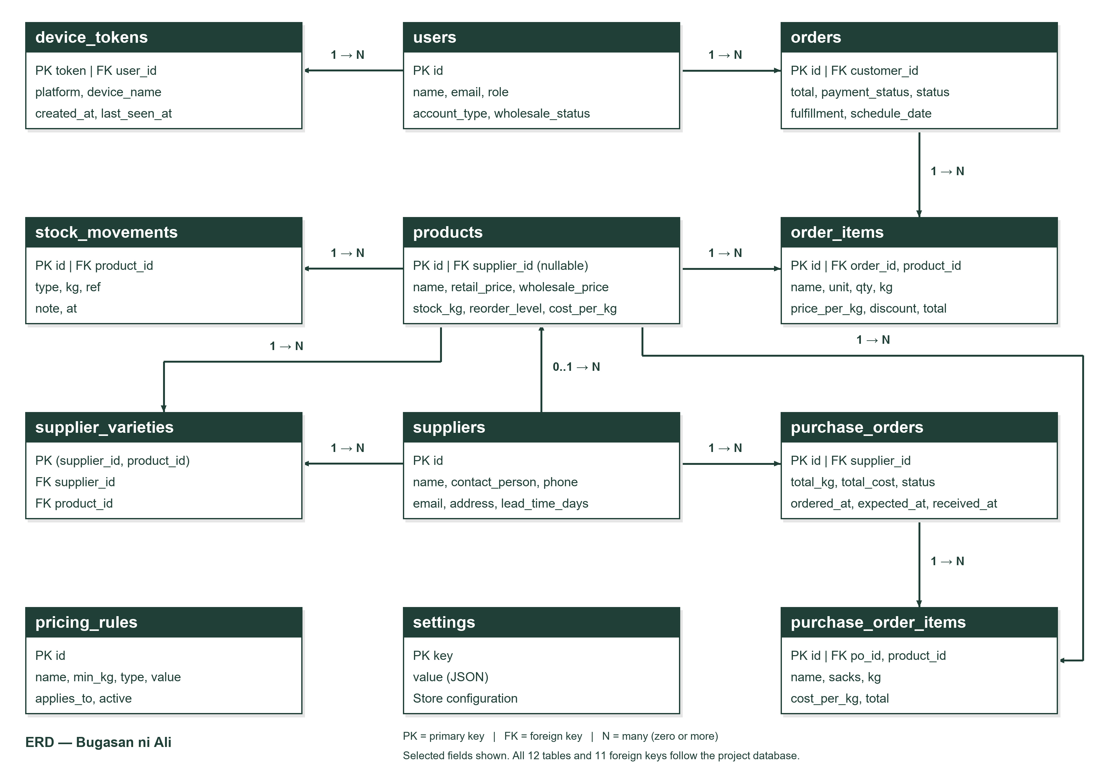
03 / DATABASE STRUCTURE
05 / 06
Notes:
A user can place multiple orders. Each order contains order item records, and each item references one product. This resolves the many-to-many relationship between orders and products. Orders also store customer/contact details, fulfillment, payment information, and totals. order_items stores the name and price at time of sale. Products are deactivated instead of deleted in normal app use. Sources: backend/src/db/schema.sql; backend/src/services/orders.js.

