Slide 1
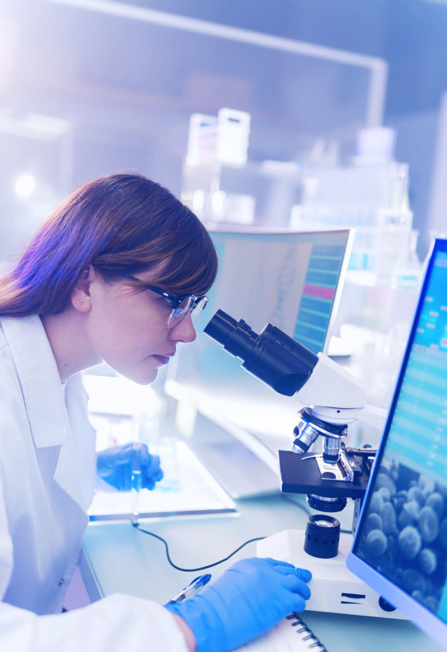

Internship focused on developing an AI platform for the rapid and accurate diseases detection like Covid-19, Alzheimer's, and brain tumors.
Produced "From 10 July to 10 August" at ENSA Fes
Supported by:
BERRADA MOHAMMED
Supervised by:
Safae Elhajbenali
Presented by hassane skikri

Slide 2
Table of Content
1
Intoduction
2
Project Objectives
3
Technologies Utilized
4
From data Collection to Modeling
5
Model Performance & Evaluation
6
Web Development
7
Conclusion

Slide 3

1. Introduction
AI in healthcare is transforming diagnostics, treatment, and patient care by enabling faster and more accurate data analysis. Through machine learning and deep learning, AI systems can identify patterns in medical images and records, aiding early disease detection and improving outcomes.

Slide 4
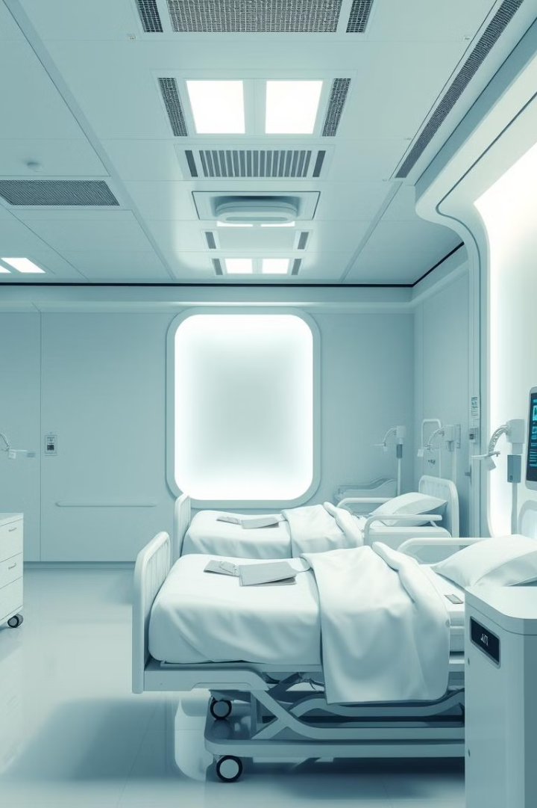



2. Project Objectives
Develop AI Platform
create a robust and scalable AI system capable of analyzing various medical data types. Machines require data to be processed in a way they can understand
Enhance Accuracy
improve diagnostic accuracy using advanced machine learning and deep learning algorithms. Since we're dealing with human health, achieving high accuracy is crucial to minimize errors.
Increase Accessibility
we want to design a user-friendly web application to make our project accessible to everyone. This interface should be intuitive and easily navigable for users of all backgrounds

Slide 5
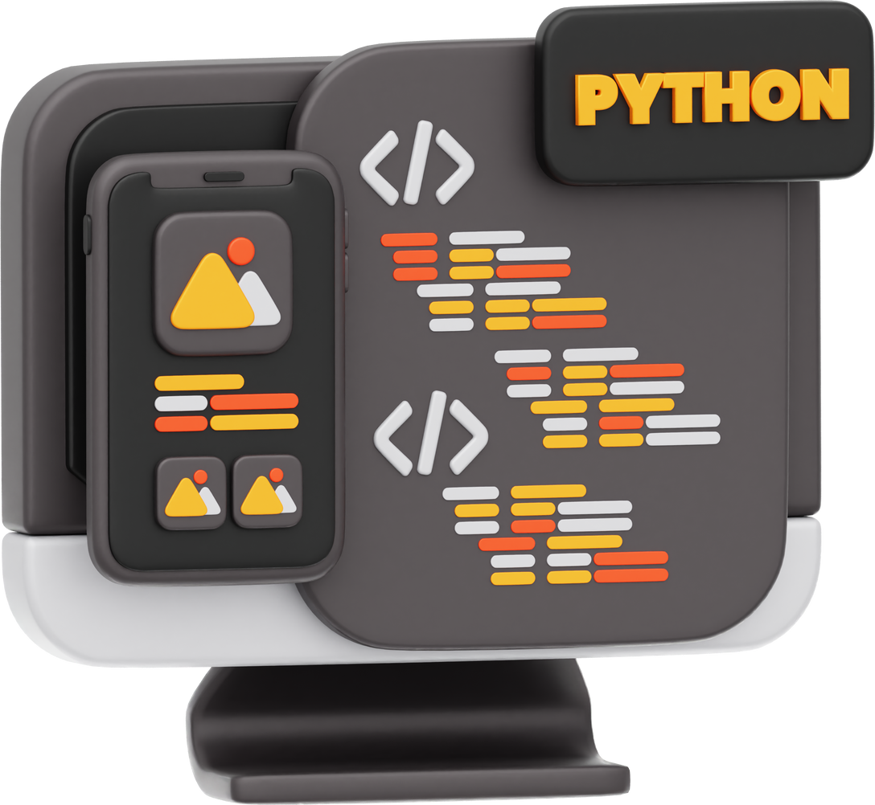
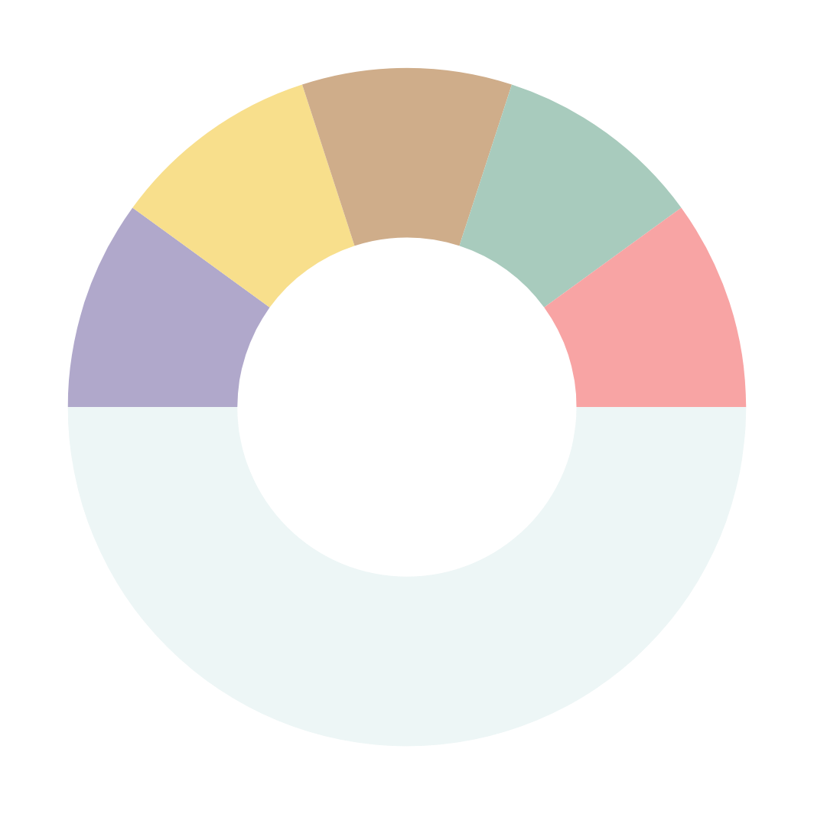

3. Technologies Utilized
3
Development Environment
4
2
Libraries and Frameworks
Version Control
5
Programming Languages
Frontend Development
1

Slide 6
a. Programming Languages
Python is a high-level, interpreted programming language known for its simplicity and readability. With its extensive ecosystem of libraries and frameworks, Python was the primary language used in our project

Slide 7


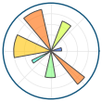






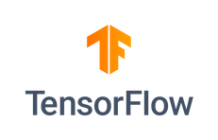


01. Pandas
02. matplotlib
b. Libraries and Frameworks
03. OpenCV
04. Scikit-Learn
05. TensorFlow
06. Flask

Slide 8
c. Development Environment
Chosen for its interactive coding and visualization capabilities, Jupyter Notebook lets us see model results instantly and adjust code in real time—making it an invaluable tool during experimentation.
With powerful extensions, debugging, and file management, VS Code keeps our code organized and deployment-ready, making it ideal for building, testing, and managing every part of the project.
01. Jupyter notebook
02. Visual Studio Code

Slide 9
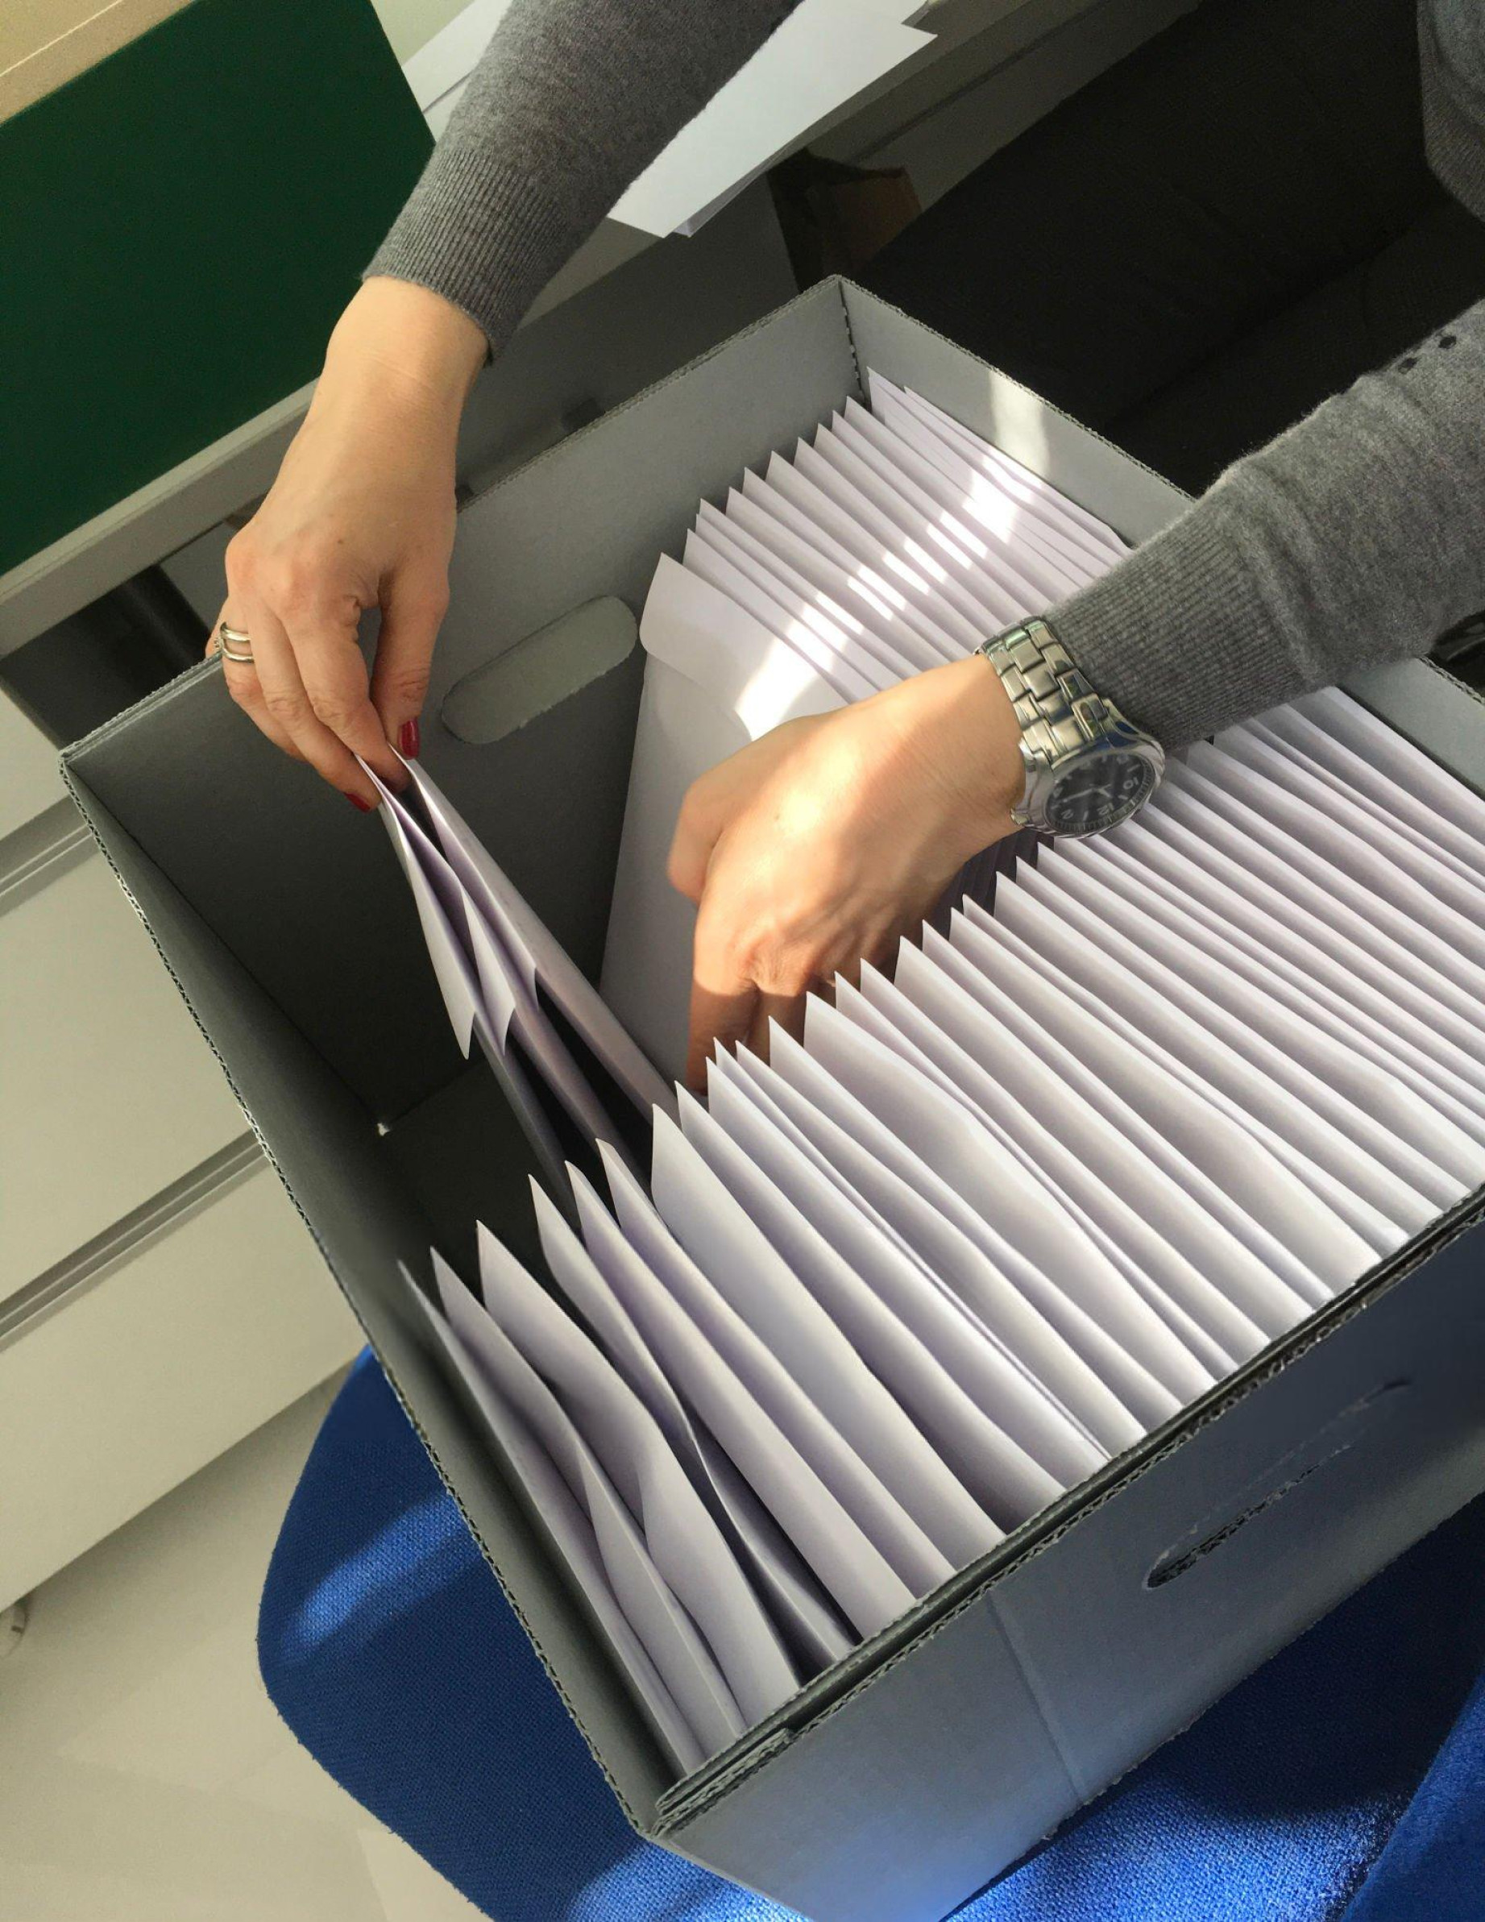
d. Version Control
For managing code changes and ensuring efficient collaboration
Monitor modifications to our codebase, experiment with different versions, and safely revert to previous states if necessary. This ensured our work was always backed up and manageable.
As a collaboration platform, GitHub provides a centralized place for sharing code, managing versions, and coordinating project updates, making teamwork and remote access seamless and efficient.
01. Git
02. GitHub

Slide 10
4. From data Collection to Modeling
data collection
In our project, we utilized both structured and unstructured data, including image datasets and tabular data, to build and train our models for disease detection. This involved collecting various datasets from Kaggle, which provided high-quality data for our analysis and modeling.

Slide 11
Data Preprocessing
DATA NORMALIZATION
FEATURE ENGINEERING
ENCODING CATEGORICAL DATA
IMAGE PREPROCESSING
DATA CLEANING
Remove or handle missing values and duplicates to ensure data accuracy and consistency
Scale numerical data to a uniform range, improving model performance and training speed.
Create new, relevant features or modify existing ones to enhance model predictions.
Convert text-based data into numerical form, making it suitable for machine learning algorithms.
For image-based models like CNNs, we resize, normalize, and augment images to prepare them for training.

Slide 12
Modeling
This step focused on selecting, and training machine learning algorithms to build predictive models. Techniques like ensemble learning and CNNs were chosen for high accuracy across various data types.
Ensemble learning
CNNs
We used the XGBoost
algorithm, an ensemble learning technique that builds a sequence of models, with each one correcting the errors of the previous one. This method is known for its high accuracy and efficiency in handling tabular data.
CNNs are specifically designed to analyze and extract features from image data, making them ideal for tasks like disease detection from medical scans. This model excels in recognizing patterns in image data.

Slide 13
5. Model Performance & Evaluation
Application
Training Accuracy
Testing Accuracy
Diabetes Detection
0.94
0.80
Breast Cancer
1.00
0.97
Pneumonia
0.96
0.83
Brain Tumor
0.9995
0.98
COVID-19
0.96
0.93
Alzheimer's
0.98
0.87

Slide 14
6. Web Development
Set Up Virtual Environment
Build the Frontend
Develop Logic with Flask
Test Locally
Deploy on AWS
Design the home page and create dedicated interfaces for each disease, allowing users to easily interact with the platform.
Launch the application on AWS, making it accessible online for users to benefit from its diagnostic capabilities.
Create a dedicated environment to manage dependencies and keep the project organized.
Implement the backend logic in Flask to handle requests and integrate the AI models for predictions.
Run the application on a local server to ensure all features work smoothly and accurately.

Slide 15
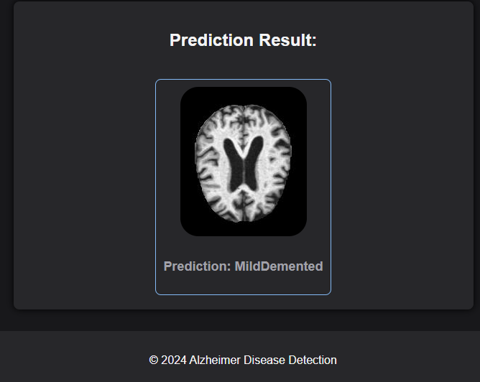
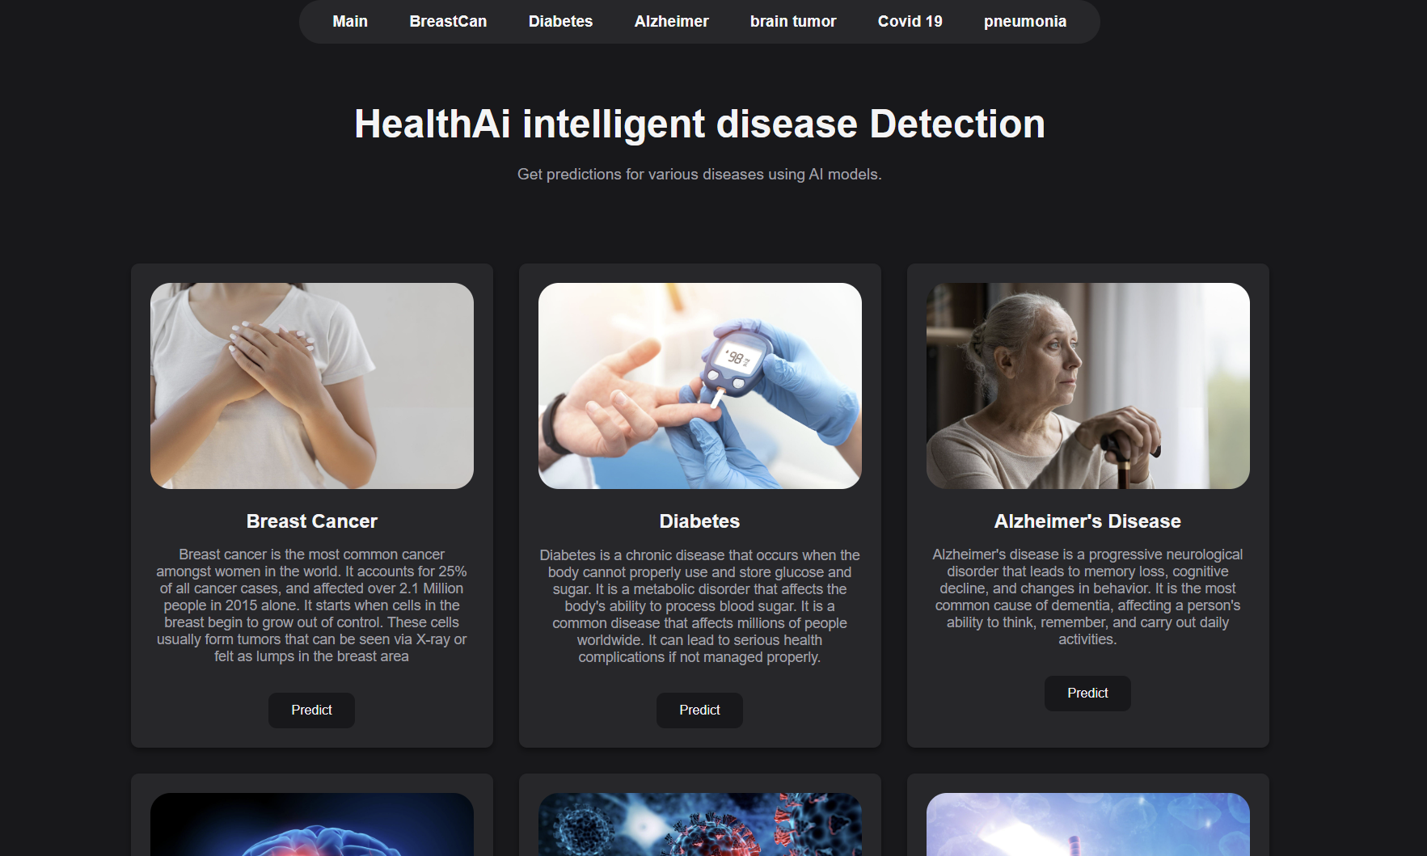
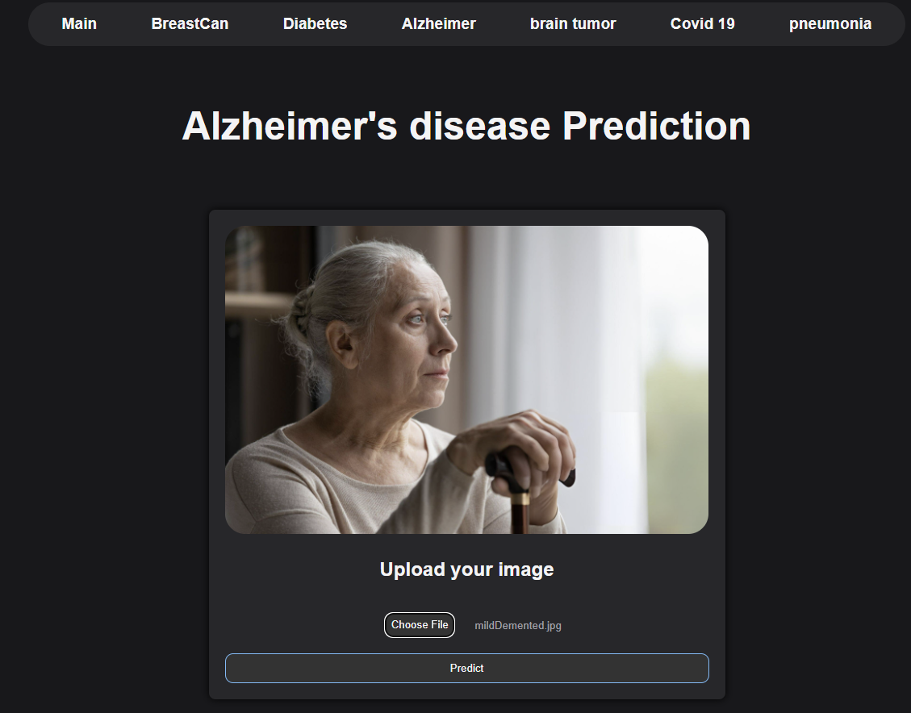
Project UI
Home Image
Alzheimer's Results
Alzheimer's Prediction

Slide 16
7. Conclusion
In this project, we leveraged machine learning and deep learning to build accurate models for diagnosing diseases like Alzheimer’s, brain tumors, and diabetes. By integrating advanced algorithms such as CNNs and XGBoost into a user-friendly web platform, we created a tool that delivers fast, reliable predictions to assist in real-world medical settings.

Slide 17


