Slide 1
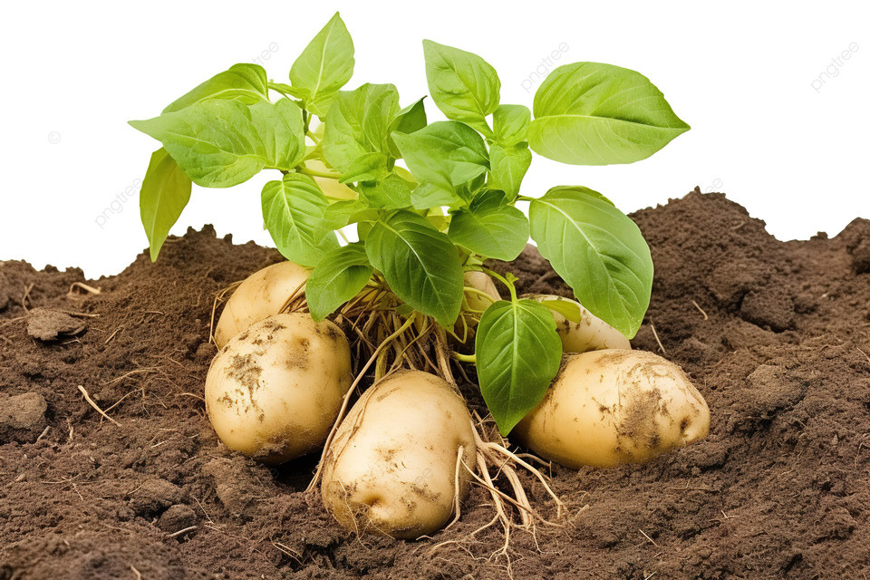


Dr.Potato
Mobile APP
3rd Year Project Finel Presentation
Group No : 10

Slide 2
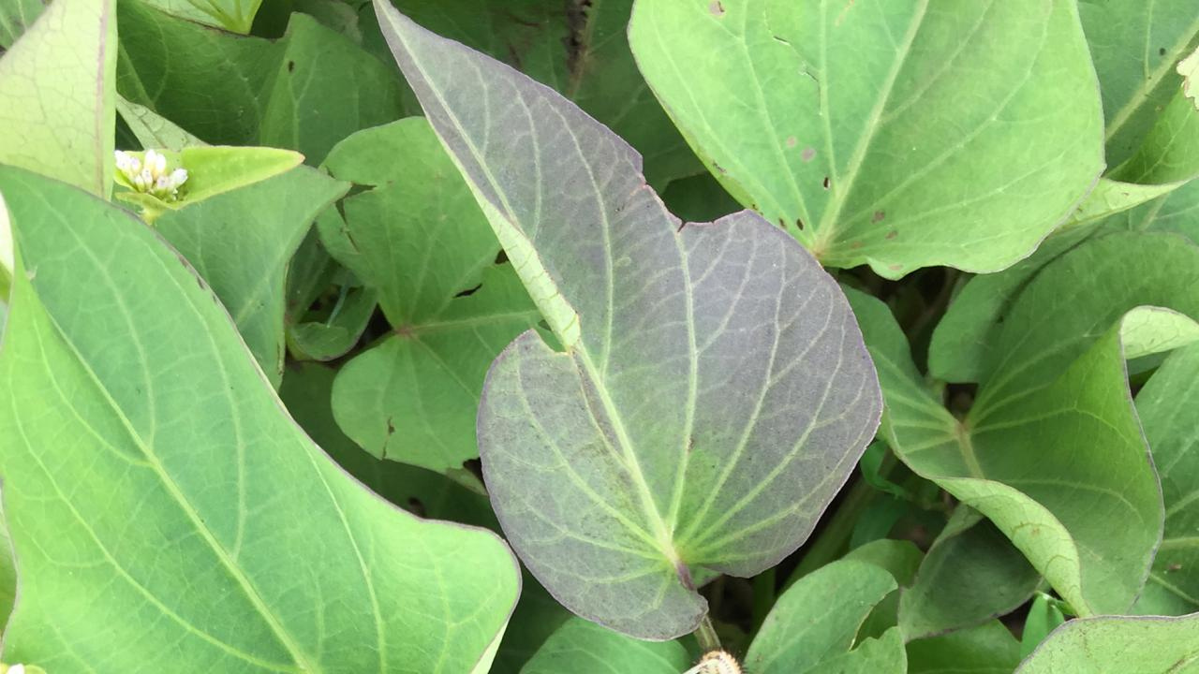
Introduction
Aims & Objectives
Requirement Specification
Methodology
Development
Conclution
Demostration
Table Of Content

Slide 3
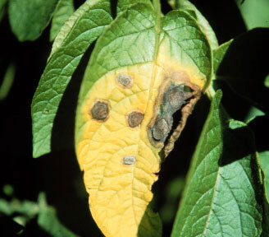
Introduction
Potato blight, caused by the fungus Phytophthora infestans, poses a serious threat to global potato production.
Traditional identification methods are time-consuming and may not be sufficiently accurate.
Advances in image processing and machine learning offer potential for rapid and accurate disease identification.

Slide 4
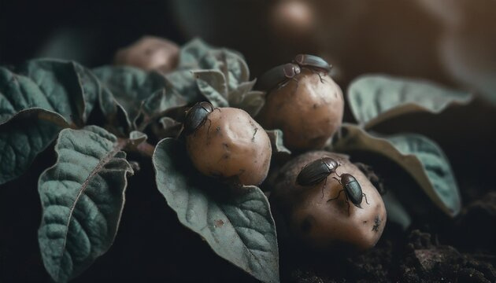
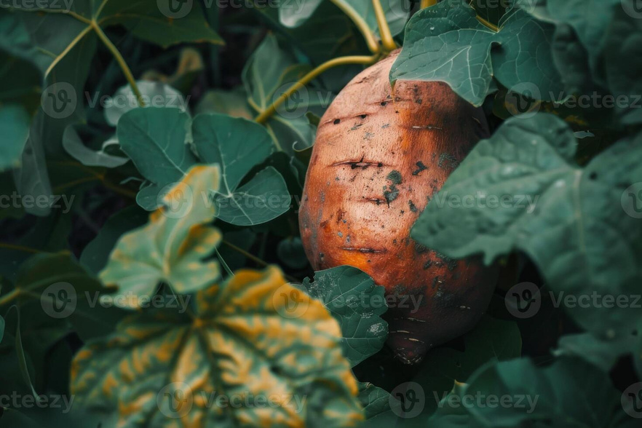
Aims
To develop a system that quickly and accurately identifies late blight in potato crops using deep learning and image processing.
Objectivs
Develop a user-friendly interface for easy navigation.
Implement advanced identification algorithms to achieve at least 90% accuracy.
Provide real-time information on cultivation status.
Integrate a comprehensive database on potato diseases and symptoms.
Optimize detection processes to enhance productivity.

Slide 5
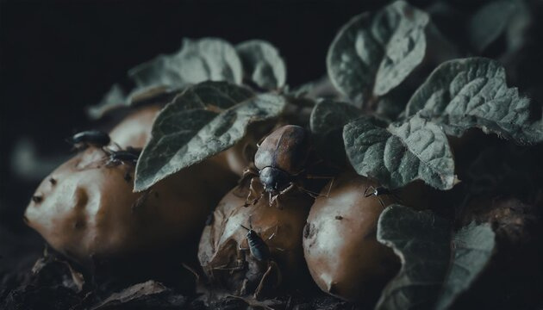
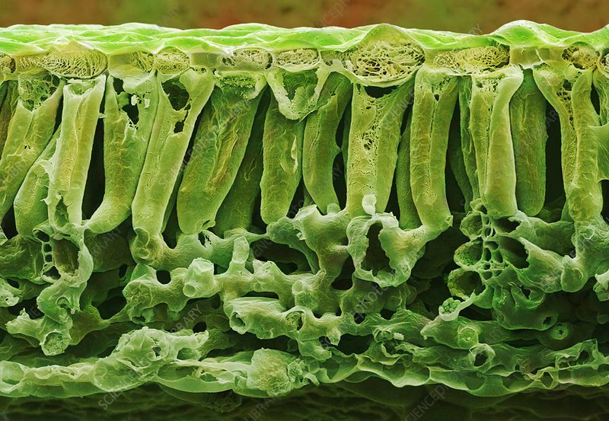
Requirement
Specifications
Scope of the project
Develop an Automated Potato Disease Detection System to combat the threat of potato blight in Sri Lanka's agricultural sector.
End users of the project
The farmers

Slide 6

Requirement Specifications
Functional requirements
Image Capture and Upload
• Camera Integration
• Gallery Access
• Image Pre-processing
Non-functional requirements
Performance and Scalability
Efficient Processing
Scalability
Multi-language Support

Slide 7
Methodology
Data Gathering
Collected datasets from Kaggle.
Analyzed existing research and reports.
System Design
Use case, class, and activity diagrams.
Client-server architecture for processing and storage.
Development
Tools: Android Studio, TensorFlow, Google Cloud Platform.
Testing: Unit, integration, and system testing.

Slide 8
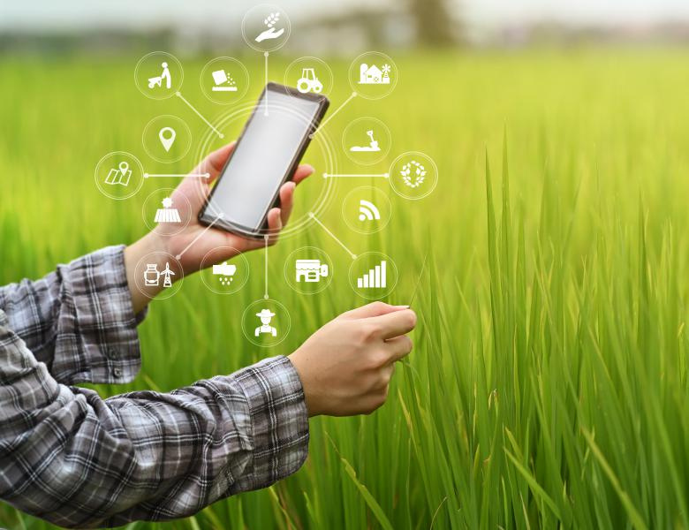
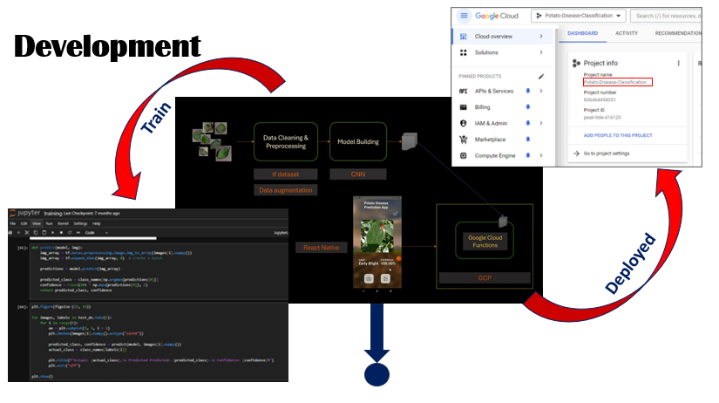
Development

Slide 9
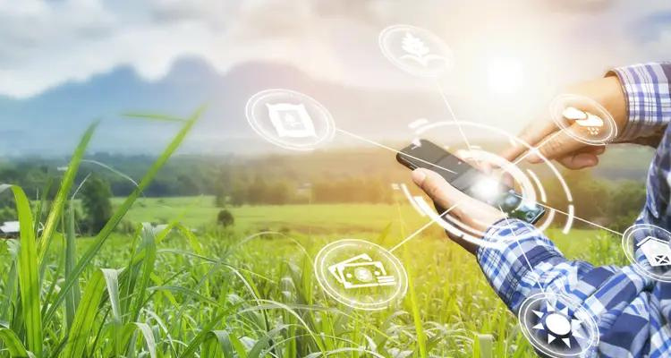
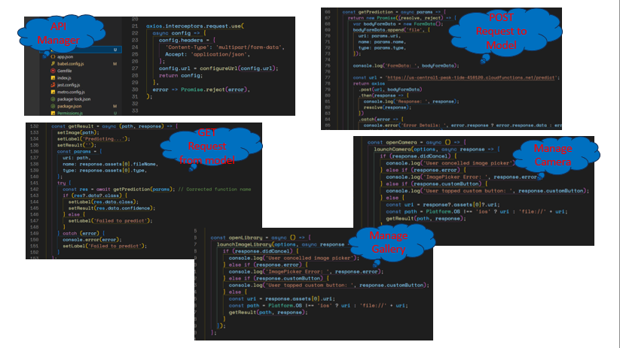
Development

Slide 10
Conclution
Lessons Learned:
Enhanced technical skills in React Native and Google Cloud.
Understand the importance of effective schema design.
Improved project management and time management.
Utilized Figma for user-friendly interface creation.
Skills Developed:
Gained experience in app building and debugging.
Learned MongoDB Cloud for data management.
Enhanced UI/UX design skills.

Slide 11
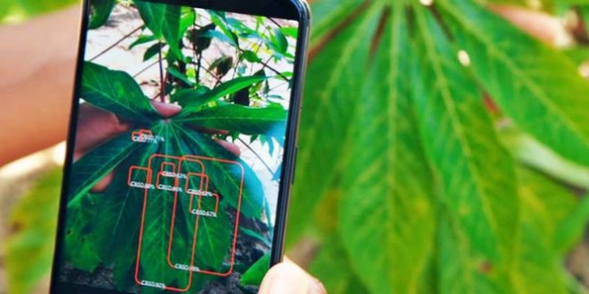
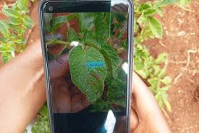
Conclution
Recommendations for Improvement:
Optimize performance with lazy loading and better database queries.
Add real-time updates via push notifications.
Regular usability testing.
Strengthen data security measures.

Slide 12
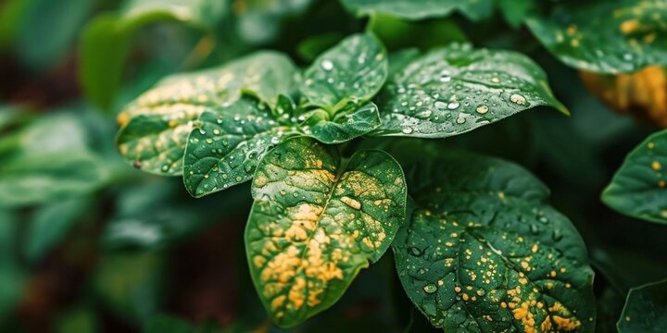
Our Team
N.A.H.T.Samaranayake - 1030
W.A.L.S.Ariyasena - 0962
S.R.Sandaruwan - 1031
T.P.Gajasinghe - 0715
S.I.A.Ahamed - 0952
P.Dilakshika - 0984
R.Shabilojan - 1037

Slide 13
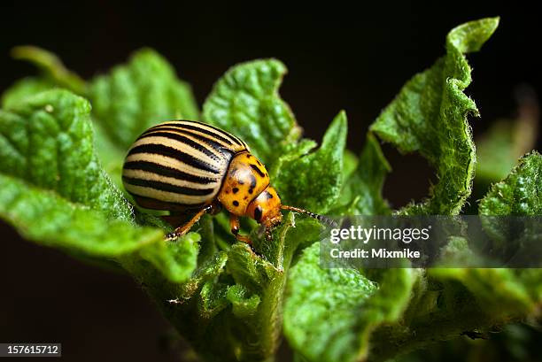
Thank You

