Slide 1
Deep Neural Networks
Deep L-layer
Neural network

Slide 2

















What is a deep neural network?
$$x_{1}$$
$$x_{1}$$
$$x_{2}$$
$$\hat{y}$$
$$x_{2}$$
$$\hat{y}$$
$$x_{3}$$
$$x_{3}$$
logistic regression
1 hidden layer
$$x_{1}$$
$$x_{1}$$
$$x_{2}$$
$$\hat{y}$$
$$x_{2}$$
$$\hat{y}$$
$$x_{3}$$
$$x_{3}$$
2 hidden layers
5 hidden layers

Slide 3
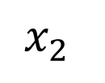
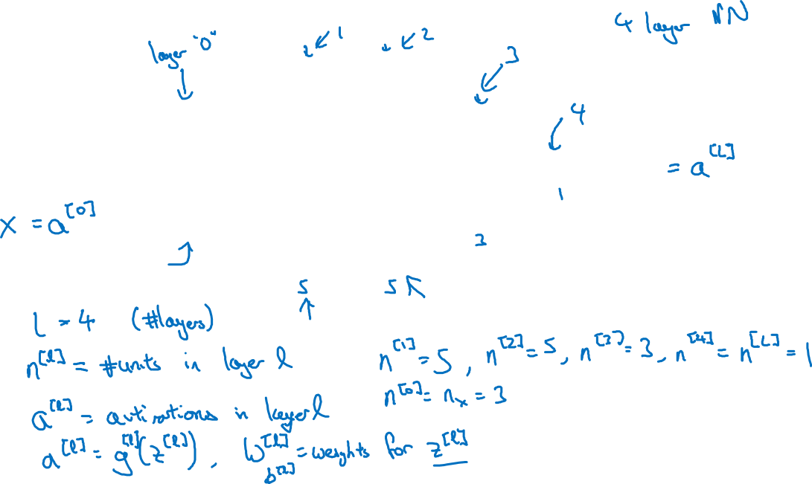
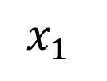

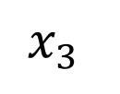
Deep neural network notation
$$x_{1}$$
$$x_{2}$$
$$\hat{y}$$
$$x_{3}$$

Slide 4
Deep Neural Networks
Forward Propagation
in a Deep Network

Slide 5

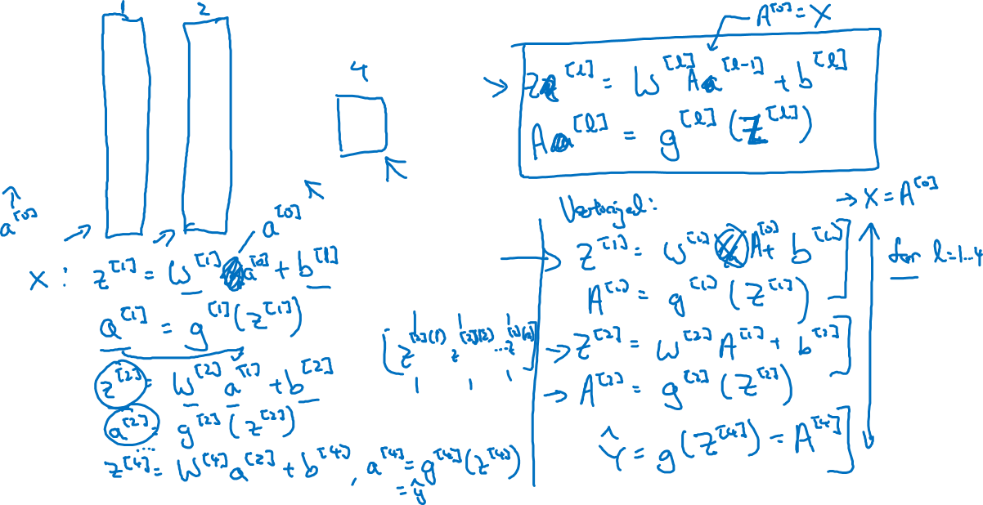



Forward propagation in a deep network
$$x_{1}$$
$$x_{2}$$
$$\hat{y}$$
$$x_{3}$$

