Slide 1
Components Design
Presented by: Tarik Rahman, Industrial Designer

Slide 2
Method
case (properties: solid; material: hard plastic)
Infra red transmitter (off the shelf)
joystick (material: plastic)
buttons (rubber, plastic, touch)
Batteries (off the shelf) –sufficient for l.e.d., speaker, and buttons
LCD screen(plastic cover)

Slide 3
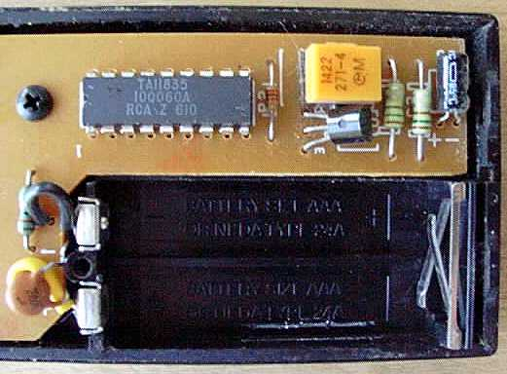
Internal Components
chip
chip
translate key-press into infrared light signals that are received by the TV
chip detects key press, translates the key into that key’s signal and sends signal to Txer to amplify
chip

Slide 4
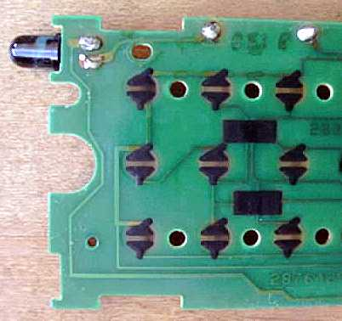
For each button there is a black conductive disk. When the disk touches the contacts on the printed circuit board, it connects them and the chip can sense that connection.

Slide 5
Findings
Battery: i) a hand dynamo
ii) kinetic
iii) use of solar cells.
Case: -> Shape i) uncurved (flat)
ii) single curved or even double curved.
-> Material i) plastic, rubber, wood, titanium (not double curved)
Buttons – scroll wheel, LCD, rubber (if double curve rubber, must use rubber buttons)
Chip – button -> simple
scroll wheel -> regular
LCD -> advanced

Slide 6
Personal Preferences

