Slide 1
Components Design
Presented by: William Cooke, Industrial Designer

Slide 2
Method
The press of the button should activate the TV
Should be able to find easily
Looked into AVAILABILITY of materials

Slide 3
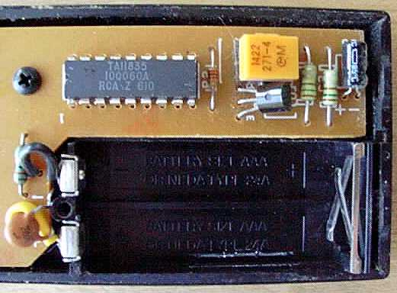
Findings
Main chip used is a “TA11835”, these are standard and used in most remote controls.
Battery options:
Standard AA,AAA
Dynamo charging
Solar Charging
Kinetic Charging

Slide 4
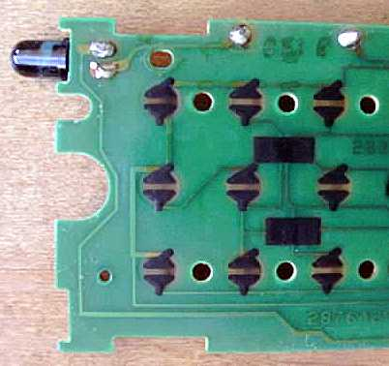
Findings
Most remotes use a silicon board with rubberised buttons
When the button is pressed it sends a unique code to the chip
This code is processed then output by the chip and sent via the IR LED to the TV.

Slide 5
Personal Preferences
To conserve battery life the remote should be in a ‘standby’ mode while not being used.
Case Material?
Plastic, Rubber, Wood, Titanium
Interface Designs?
Rubber buttons, LCD, Bare??

