Slide 1
Interface Concept
Presented by: Pawan Negi -User Interface Designer

Slide 2
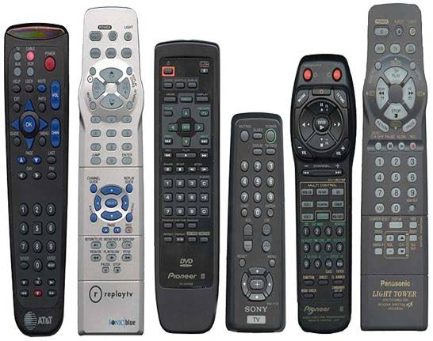
Method
Input from other departments – Marketing and Industrial Design
Competitors
GUI or Pointing device

Slide 3
Findings
To many cluttered buttons.
Repetition of certain patterns. E.g: The volume and channel control buttons in centre
Confusing and inconsistent
Voice recognition

Slide 4
Personal Preferences
Trendy - fruit colour
Certain standard buttons
Voice recognition

