Slide 1
Working Design
Presented by: Arlo, Industrial Designer

Slide 2
Method
Consider input from marketing, UI:
  What are the basic needs?
  What novel features can be added?
Consider limitations:
  Budget and timeline from The Boss.
  Practical limitations – don’t ask me for the impossible!
Design it!

Slide 3
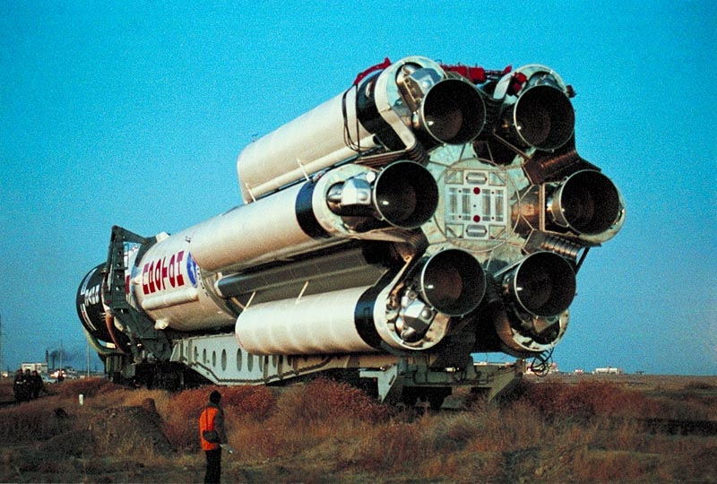
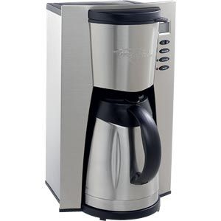
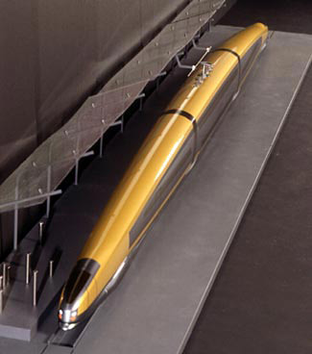
Findings
Our company produces an array of high-quality products from which to draw inspiration for this new remote control:

Slide 4
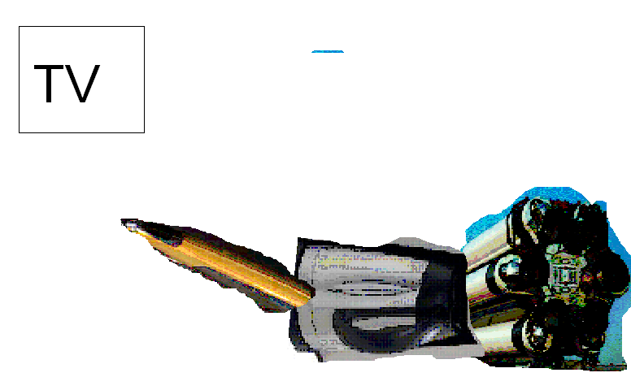
My solution: combination

Slide 5
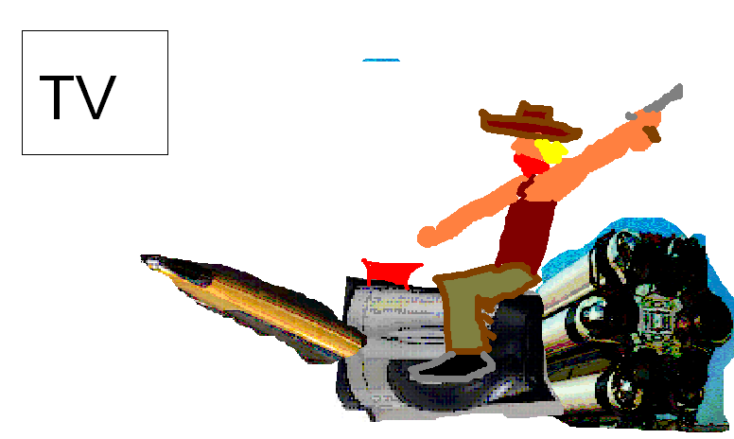
My solution: combination

Slide 6
Components
Outer casing
Energy source
User interface (i.e. buttons)
  Other alternatives?
Transmission interface

Slide 7
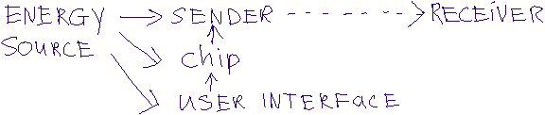
Wire
Switch
Energy source
Bulb
Infrared bulb
Chip
Subcomponent

Slide 8
Personal Preferences
Programmable options:
  Favourite channels
  Preferred volume settings
  Requires a small amount of memory
Bells and whistles
  Require more money, effort
  More likely to work poorly

