Slide 1
Functional Requirements
Presented by: Cat, Market Expert

Slide 2
Method
Usability lab observed remote control use amongst 100 subjects, who then filled in a questionnaire. They investigated:
- What the users think about the look and feel of current remote controls.
The biggest frustrations of using remote controls
Speech recognition and LCD screens in remote controls.

Slide 3
Findings
Users dislike the look and feel of current remote controls.
75% of users find most remote controls ugly
80% of users would spend more money when a remote control would look fancy
Current remote controls do not match well the operating behavior of the user
75% of users said they zap a lot
50% of users say they only use 10% of the buttons

Slide 4
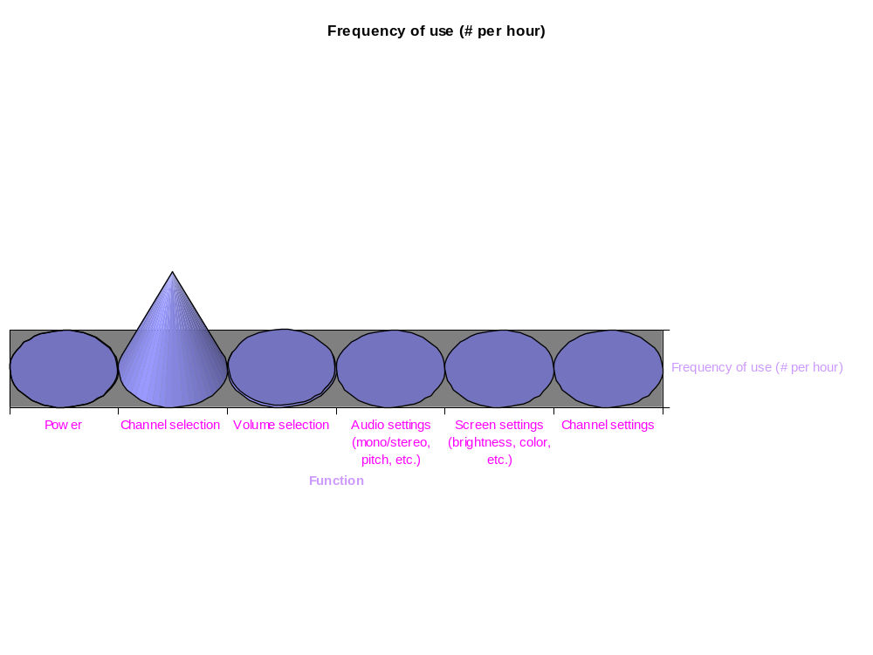

Findings
10
9
9
10
2
1.5
3
The graph shows that the most predominant uses of the remote is for
Chanel Selection
Teletext (including flipping pages)
Volume Control

Slide 5
Frustrations
Remote controls are often lost somewhere in the room (50%)
It takes too much time to learn how to use a new remote control (34%)
Remote controls are bad for RSI (26%)

Slide 6
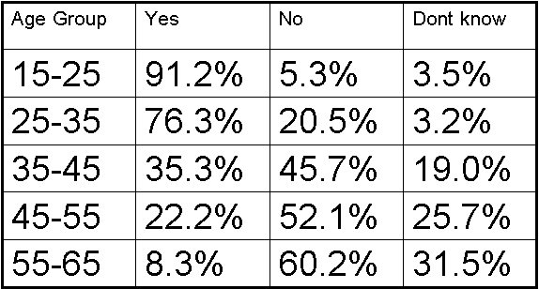
Voice Recognition?

Slide 7
Personal Preferences
Sleek
Stylish
Sophisticated
Functional
Minimalist
Long battery life
Solar power
Locator (clap and then it beeps?)

