Slide 1
Interface Concept
Presented by: Iain
User Interface Designer

Slide 2
Method
Simplicity
Fashion
Determine the essential functions
Choose a concept that supports these
Design features around this concept
Make it look coooool

Slide 3
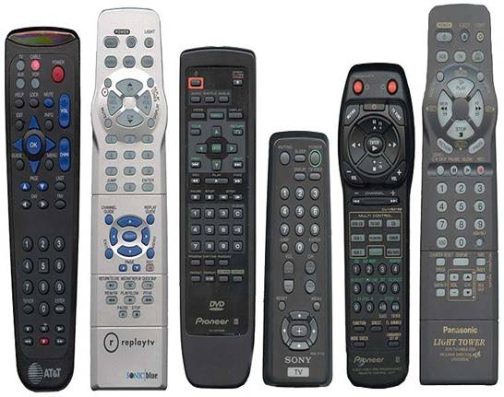
Yuk!

Slide 4
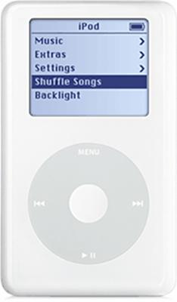
Simplicity
Only four buttons!
Still can access all features

Slide 5
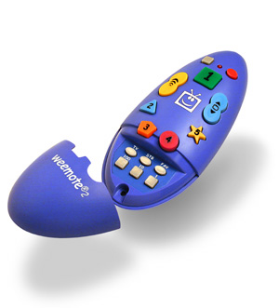
Fashion
Colourful
Cool
Fun

Slide 6
Personal Preferences
Very few buttons:
  Favourite channels (five or so)
  Volume
  On/Off
Other features accessed through display
  on-screen
  …or LCD?

