Slide 1
Technical Functions Design
Presented by: Iain
User Interface Designer

Slide 2
Method
Define specifications for the final product
Design prototype user interfaces
  Conventionality?
  Novelty?
Get feedback from others
Consider practicalities:
  Technological
  Economic

Slide 3
Findings
Examine existing TV remotes
What do they do well?
What do they do badly?
How can we improve on their design?
How can we make our product unique?

Slide 4
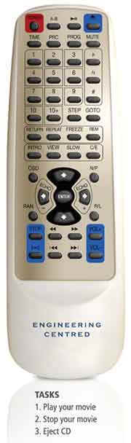
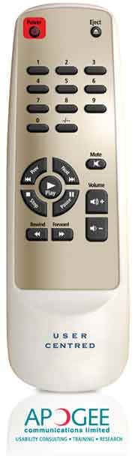
Your friend?

Slide 5
Personal Preferences
Opinions on remotes are subjective
I want a remote that is:
  Simple
  Has big buttons
  Does everything
  Looks cool, feels good

