Slide 1
Interface Concept
Presented by: Ron
User Interface Designer

Slide 2
Method
User interface
  The aspects of a computer system or program which can be seen (or heard or otherwise perceived) by the human user
  The commands and mechanisms the user uses to control its operation and input data.

Slide 3
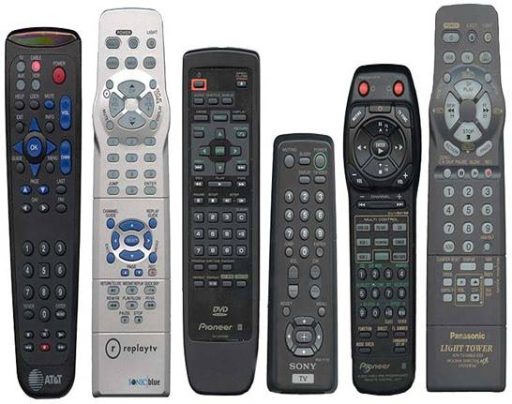
Remote Control Examples

Slide 4
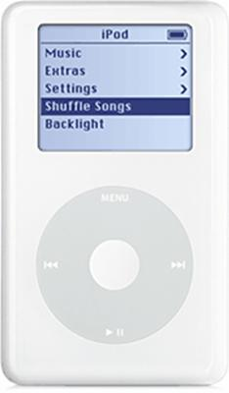
User Interface Components I
Voice recognition:
    Stores Up to 80 speech samples
    Record own verbal labels connected to remote control functions
A spinning wheel with LC display:

Slide 5
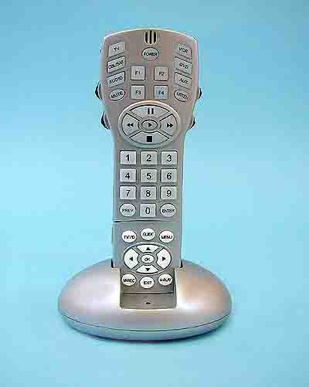
User Interface Components II
A scroll button with integrated push button (such as in modern computer mouse) at the side of the remote:

Slide 6
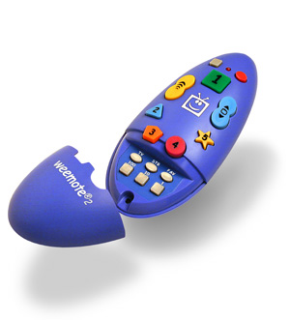
User Interface Components III
TV remote control for special user
  Program in only the channels you want your kids to watch - all others are automatically blocked!
  Program in up to 10, 4-Digit channels. Dedicated buttons make getting to channels easy.
  Secured and hidden programming and battery covers protect your settings.

Slide 7
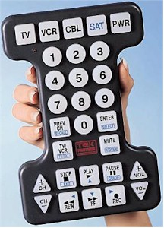
User Interface Components IV
Big Button, Oversized TV Remote is the largest universal remote control available!
This jumbo universal remote control is almost impossible to misplace or lose.

Slide 8
Personal Preferences
Slightly larger than reg. IPod
Hard plastic casing (stylishly curved)
Changeable casings
Touch screen interface
“Go To” Buttons remain on screen at all times. I.E. Power, Volume, “Jump”
Voice command system for advanced features
  Development of new voice command system with response
Use of recognizable colours and shapes to aid recognition of feature (conform industry standards)
Programmable jokes and lines for remote to say! (FUN)

