Slide 1
Technical Functions Design
Presented by: Ron
User Interface Designer

Slide 2
Method
Requirements:
  Operate electronic devices
  Universal
  Possibly operate several different types of devices

Slide 3
Findings
Function of a remote control
- send messages to the television set.
Eg.: "switch on“
"switch to next channel“
"switch to channel 9“
"turn volume up"

Slide 4
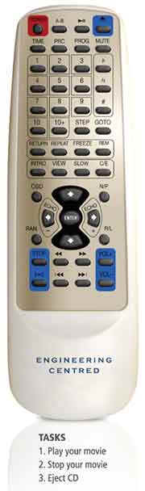
Findings II
Complicated Remote
- many functions
- user will generally have
little use as it is complicated
- BORING

Slide 5
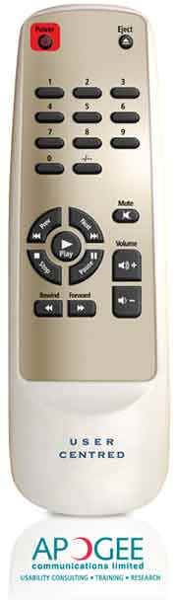
Findings III
Simple Remote
  Few functions
  Easy for user to manipulate
  Cheap look
  BORING!

Slide 6

Personal Preferences
Revolutionize!!
Attain the functionality of the complicated device
Attain simplicity through a new format of display (user interface)

