Slide 1
Functional Requirements
Presented by: Courtney Jordan, Market Expert

Slide 2
What the User Thinks
In the lab, we observed the remote control use among subjects (N = 100) who also filled in a questionnaire. We found:
75% of users find most remote controls ugly
80% of users would spend more money when a remote control would look fancy
Current remote controls do not match well the operating behavior of the user
75% of users said they zap a lot
50% of users say they only use 10% of the buttons

Slide 3
Findings
Remote controls are often lost somewhere in the room (50%)
It takes too much time to learn how to use a new remote control (34%)
Remote controls are bad for RSI (26%)
Channel, volume, power buttons most important

Slide 4
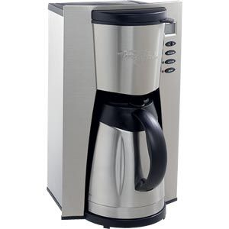
Personal Preferences
Modern, eye-catching design…yet simple
Functionality of product
Open to wide range of consumers
Hip, but not corny, marketing scheme
Speech recognition is a highly advanced property for remotes that consumers are interested in, and should be considered

