Slide 1
Interface Concept
Presented by: User Interface Designer

Slide 2
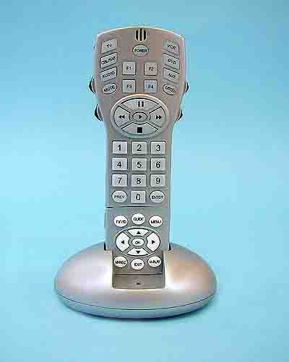
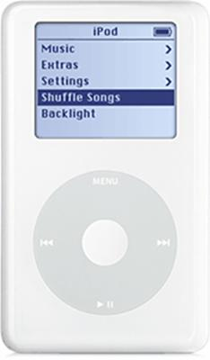

Slide 3
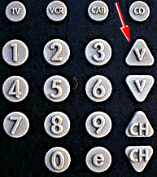
Buttons by feel. – shape and type

Slide 4
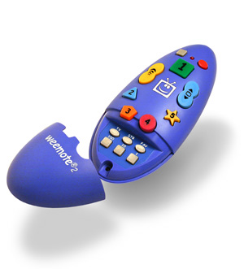
Specific design for a certain demographic.

Slide 5
