Slide 1
Technical Functions Design
Presented by: Fenella Watson, User Interface Designer

Slide 2
Function
The function of a remote control is basically to send messages to the television set. Example messages are: "switch on", "switch off", "switch to next channel", "switch to channel 9", "turn volume up", etc.

Slide 3
Considerations
Needs to include:
numbers 0 – 9
on/off
channel up/down
volume up/down
mute
functions for VHS/DVD – play, rewind, fast forward, stop, pause, Enter
Menus – for DVD as well as TV

Slide 4
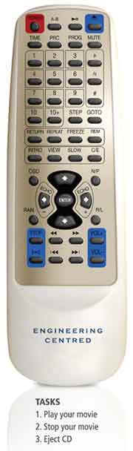
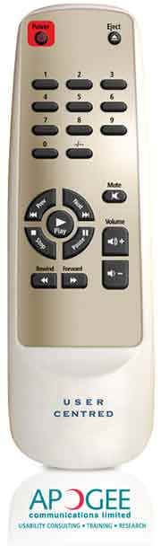
Examples
Types of design

Slide 5
Questions to Consider
What functions do we want to include?
How simple/complex should it be?
What functions are needed to complete the installation process?

