Slide 1
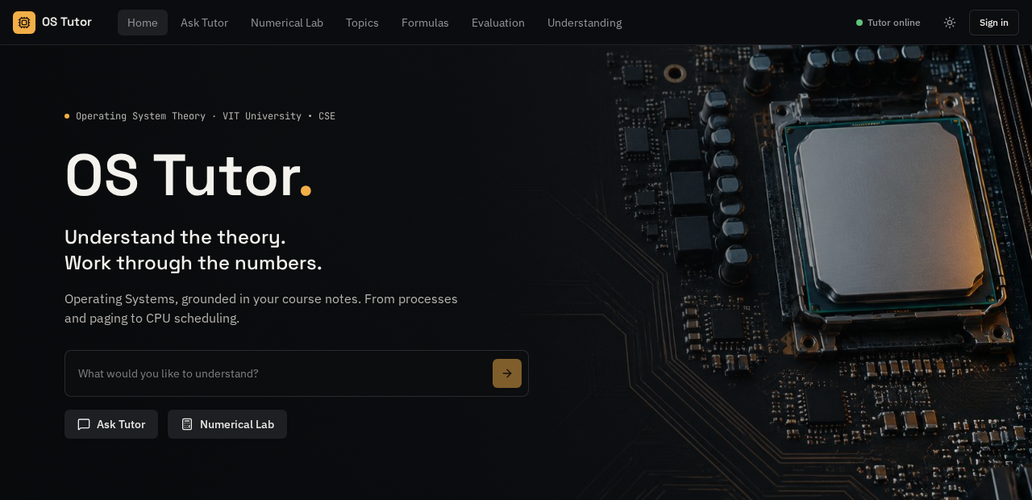
OPERATING SYSTEMS LAB · COURSE PROJECT
Developing an LLM-Based Tutor to Teach Operating System Concepts
OS Tutor
Madhav Tiwary
Reg. No. 24BCE2576
Faculty: Jagalingam P
CSE, VIT , Vellore
2026-27
os-tutor.lovable.app

Slide 2
INTRODUCTION AND OBJECTIVE
An LLM tutor grounded in course notes
General chatbots can make up facts and get scheduling arithmetic wrong. OS Tutor answers only from the course material and solves lab numericals exactly.
01
02
03
04
Grounded answers
Exact numericals
Evaluation
Free to run
Theory answers come only from the 7 course modules, with module and page shown.
FCFS, SJF, Priority and Round Robin solved by code, with Gantt chart and averages.
Course-based quiz questions; +10 right, -5 wrong plus a short lesson.
Render, Groq and Lovable Cloud on free plans; live on the web.
OS Tutor · OS Lab Project · 2

Slide 3
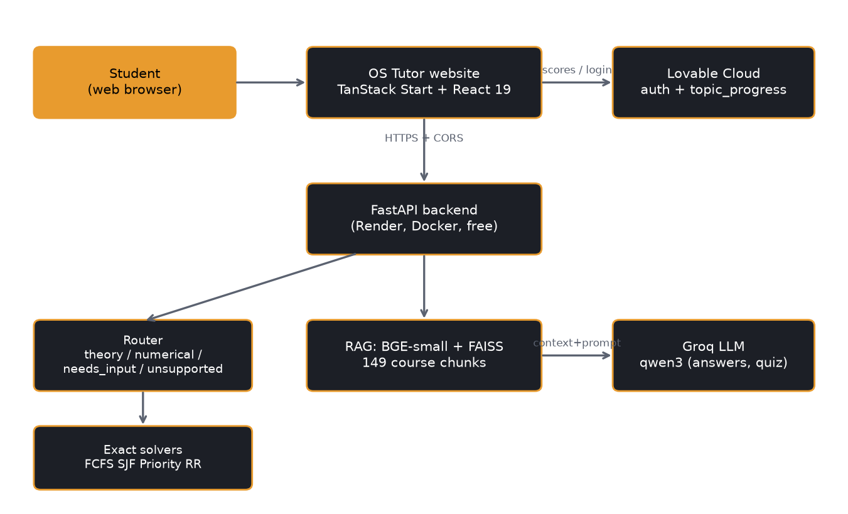
METHODOLOGY / ARCHITECTURE
How a question flows through the system
1
Website
Student asks a question or picks a quiz topic.
2
Router
Sorts it: theory, numerical, missing input or unsupported.
3
Retrieval
BGE-small embeddings + FAISS search over 149 course chunks.
4
Answer
Groq LLM writes from those chunks only; cleanup fixes text.
5
Solver
Numericals go to exact code solvers, never the LLM.
OS Tutor · OS Lab Project · 3

Slide 4
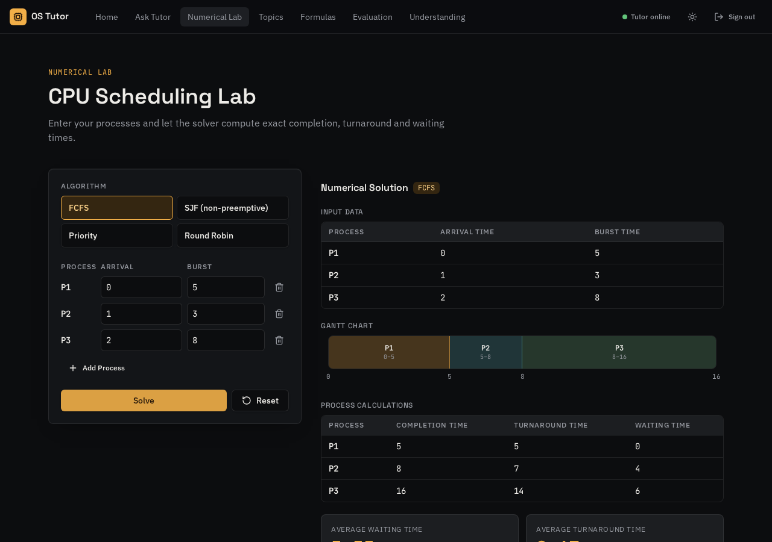
Research AND Development
From Kaggle prototype to an exact lab solver
Review 1 → 2
Kaggle RAG prototype with Qwen3-8B; text cleanup and accuracy scoring added.
Exact solvers
FCFS, SJF, Priority, Round Robin with idle gaps; four input formats.
Safe routing
Missing data asks the student; unsupported algorithms are declined.
Grounding
Out-of-syllabus questions get "not in course material" instead of a guess.
Numerical Lab: exact Gantt chart, completion, waiting and turnaround times
OS Tutor · OS Lab Project · 4

Slide 5
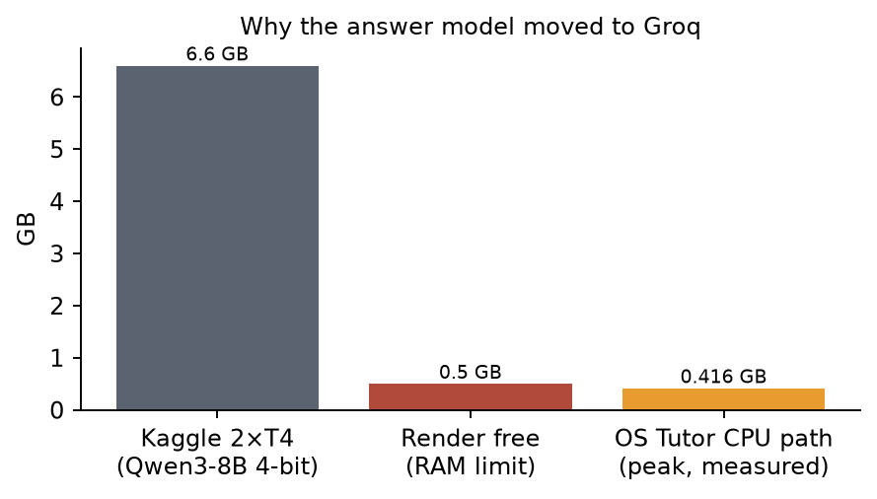
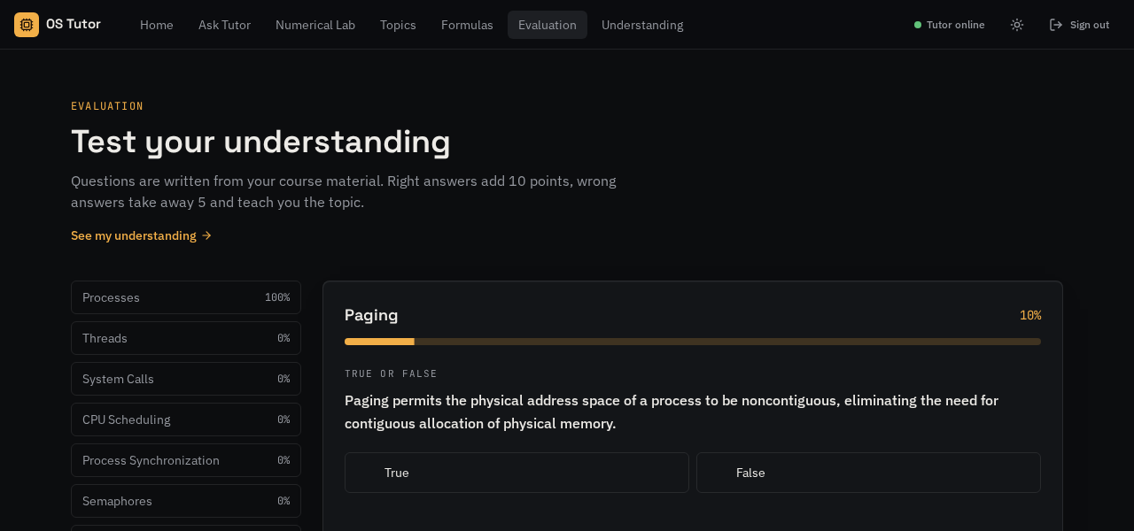
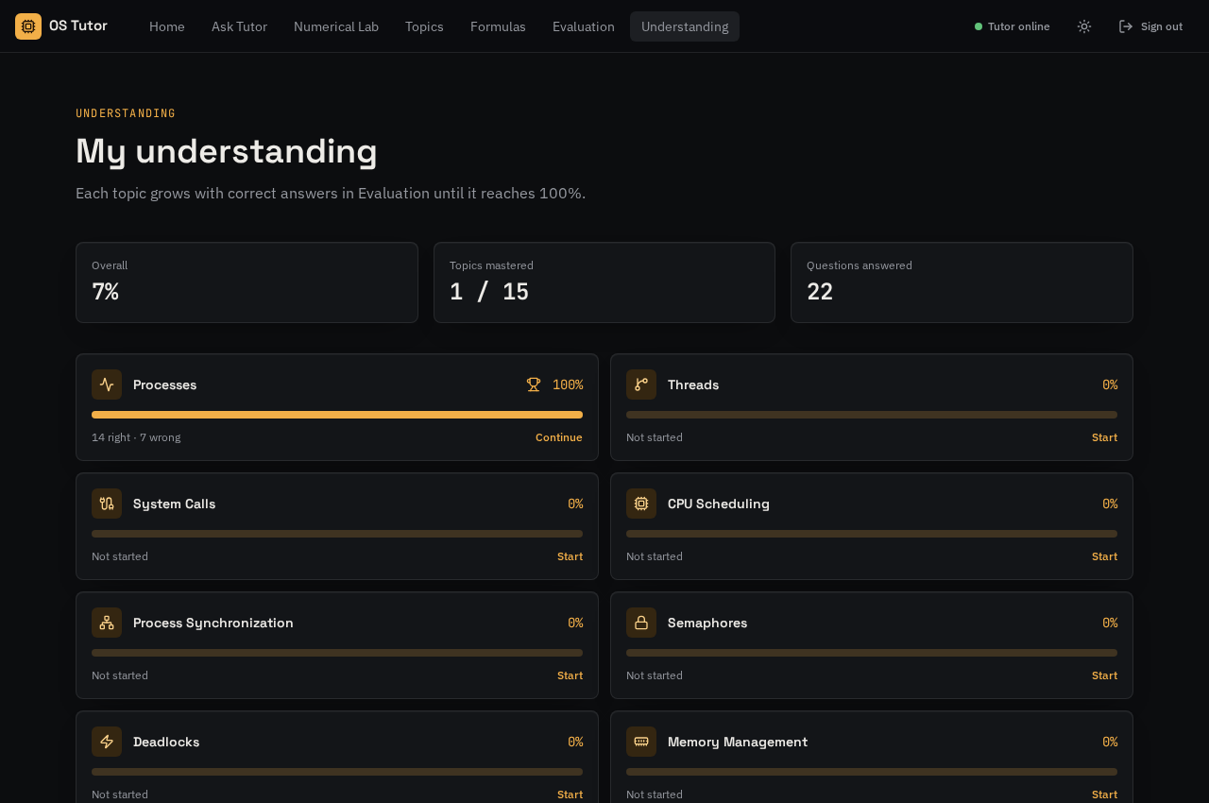
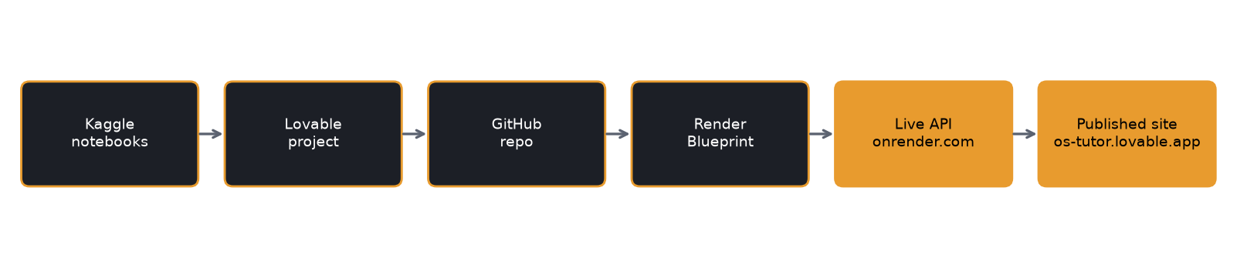
Research AND Development
Free deployment and the evaluation loop
Evaluation question
Problem: the 8B model needs 6.6 GB; Render free has 0.5 GB. Retrieval stays on CPU (0.416 GB peak) and Groq writes the answer.
Understanding page
Questions written from retrieved course chunks and strictly checked
Right +10, wrong -5 with a lesson; score 0-100% per topic
Scores saved per student account, across 15 topics
Fixed: CORS for each site address, free-host wake-up, busy-tutor messages
Kaggle → GitHub → Render Blueprint → live site
OS Tutor · OS Lab Project · 5

Slide 6
CONCLUSION
A free OS Lab tutor, live today
149
4
15
$0
course chunks indexed
scheduling algorithms solved exactly
topics tracked to 100%
running cost
Outcome
Cited answers from course notes, exact lab numericals with Gantt charts, and a quiz that teaches after mistakes, all live on the web.
Future scope
Preemptive algorithms (SRTF, preemptive Priority)
Page replacement and disk scheduling numericals
Always-on hosting to remove wake-up delay
OS Tutor · OS Lab Project · 6

Slide 7
REFERENCES
Sources and links
A. Silberschatz, P. B. Galvin, G. Gagne, Operating System Concepts, 10th ed., Wiley.
VIT University, Operating Systems course notes, Modules 1-7.
P. Lewis et al., "Retrieval-Augmented Generation for Knowledge-Intensive NLP Tasks," NeurIPS 2020.
S. Xiao et al., "C-Pack: Packaged Resources To Advance General Chinese Embedding" (BGE models), 2023.
J. Johnson, M. Douze, H. Jégou, "Billion-scale similarity search with GPUs" (FAISS), IEEE Trans. Big Data, 2019.
Qwen Team, Qwen3 Technical Report, 2025.
Documentation: FastAPI, Groq, Render, TanStack Start.
Live website
os-tutor.lovable.app
Tutor API
os-tutor-api.onrender.com
OS Tutor · OS Lab Project · 7

