Slide 1
Angular 17
Lesson 7—Directives

Slide 2

Angular Directives
Types of Angular Directives
Built-in Angular Directives
Working with Custom Directives

Slide 3
Directives
Topic 1—Angular Directives

Slide 4

What Are Angular 17 Directives?
Directives are used to separate the re-usable functions and features of Angular 17.
This is an angular decorator. We use this decorator to define a directive (the same meaning as @Component).
Note
Unlike components, directives don’t have a HTML template.
They add behavior to an existing DOM element.

Slide 5
Angular 17 Directives—Example
The example below is used to display the added behavior to an existing DOM element, where the textbox size is enlarged on mouseover event.
Angular
<input type=“text” autoGrow />

Slide 6
Directives
Topic 2—Types of Directives

Slide 7
Types of Directives
There are three types of directives, which include:
Components:
Structural Directives:
Attributes Directives:
The component directive includes directives with the Template.
This directive changes the behavior of a component or element by affecting how the template is rendered.
This type of directive changes the behavior of a calling component or element but doesn't affect the template.

Slide 8
Types of Directives—Component Directive
The naming convention for components is cname.component.ts.
You cannot create an Angular application without this directive.
Component Directives
A component directive requires a template along with its attached behavior.
This type of directive includes DOM elements.

Slide 9
Types of Directives—Component Directive
This is how components look:
>_
training@localhost:~
app.component.ts
import {Component} from ‘@angular/core’;
@Component({
selector: ‘my-app’,
template: ‘
<h1>Angular demo Boilerplate</h1>
<p>Hello World batch good afternoon friends!!</p>
<rb-mycomp></rb-mycomp>
‘,
})
export class AppComponent{
}

Slide 10
Types of Directives—Attribute Directive
Attribute directives are used to change the appearance or behavior of a component or a native DOM element.
An attribute directive requires building a controller class annotated with @Directive, which specifies the selector that identifies the attribute.
The controller class implements the desired directive behavior.
In this sample below, we can implement the colorChange directive by using "colorChange."
<divcolorChange ><div>
<pcolorChange ></p>

Slide 11
Types of Directives—Attribute Directive
There are predefined attribute directives.
The import statement specifies symbols from the Angular core.
Directive
ElementRef
Input
Provides the functionality of the @Directive decorator
Injects elements into the directive’s constructor so that the code can access the DOM element
Allows data to flow from the binding expression into the directive

Slide 12
Types of Directives—Attribute Directive
This is how the attribute looks:
>_
training@localhost:~
import { Directive, ElementRef, Input } from '@angular/core';
@Directive({ selector: '[ColorChange]' })
export class ColorChangeDirective {
constructor(er: ElementRef) {
er.nativeElement.style.backgroundColor = ‘green';
}
}

Slide 13
Types of Directives—Attribute Directive
There are two predefined, built-in attributes in Angular 17:
2. ngClass
ngStyle
ngClass

Slide 14
Types of Directives—Attribute Directive
ngStyle
Creating dynamic styles in web applications can be difficult.
In Angular 17, there are multiple ways to handle Dynamic CSS and CSS classes with the new template syntax.
These directives offer syntactic sugar for more complex ways of altering element styles.
It is possible to bind properties to values that can be updated by the user.
<div [ngStyle]="{'color': ‘green', 'font-size': '24px', '}">
working with style using ngStyle
</div>

Slide 15
Types of Directives—Attribute Directive
ngClass
The ngClass directive changes the class attribute that is bound to the component or attached element.
The ngClass Directive is an Angular 17 Attribute Directive that allows you to add or remove an HTML element of CSS class.
Using ngClass, you can create dynamic styles in HTML pages.
The ngClass attribute is applied to a DOM element; it is then bound to an expression.
The ngClass attribute evaluates the expression and changes the class attribute of the element to which it is applied.

Slide 16
Types of Directives—Attribute Directive
ngClass
The ngClass allows multiple ways to add and toggle CSS.
It is possible to bind these classes directly to component properties to update them dynamically as needed.
The expression of ngClass can be evaluated using 3 different options:
i. String
ii.Array
iii. Object

Slide 17
Directives
Topic 3—Built-in Angular Directives

Slide 18
Types of Directives—Binding to a String
You can use the String as an expression and can bind it directly to the ngClass attribute.
If multiple classes must be assigned, then separate each class with a space.
<element [ngClass]="'cssClass1 cssClass2'">...</element>
Example:
<div [ngClass]="‘cl1 cl2'">
User data Text withthe default classes
</div>
Note: cl1 and cl2 are css classes

Slide 19
Types of Directives—Binding to an Array
The same result can be achieved by using an array instead of a string.
Example:
<div [ngClass]=“[‘cl1’ , ‘cl2‘]">
User data Text withthe default classes
</div>
Note: cl1 and cl2 are css classes

Slide 20
Types of Directives—Binding to an Object
You can also bind the ngClass to an object.
Each property name of the object acts as a class name and is applied to the element if it is true.
Example:
div [ngClass]="['bold-text', 'green']">array of classes</div>
<div [ngClass]="'italic-text blue'">string of classes</div>
<div [ngClass]="{'small-text': true, 'red': true}">object of classes</div>

Slide 21

Demo—Attribute Directive
DEMO

Slide 22
Directives
Topic 4—Custom Attribute Directives

Slide 23
Custom Attributes Directives
Let’s start with creating the Attribute Directive. To do this, you need to create a class and decorate it with @directive decorators.
There are few important points to remember:
Decorate the class with @directive
Set the value of the selector property in @directive decorator function
Create a TypeScript class
Import required modules like Directive, ElementRef, and Renderer from Angular core library
In the constructor of the class, inject ElementRef and Renderer object
Custom Attributes Directives

Slide 24
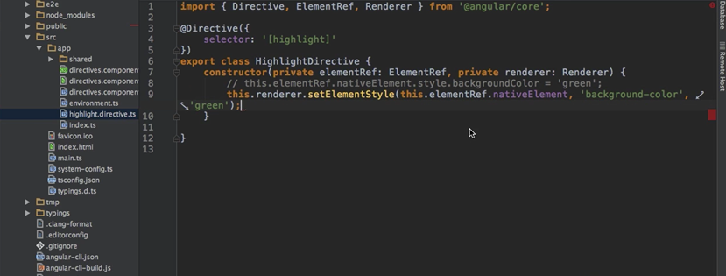
Creating Custom Directive
This class is created by overriding ElementRef and Renderer.

Slide 25
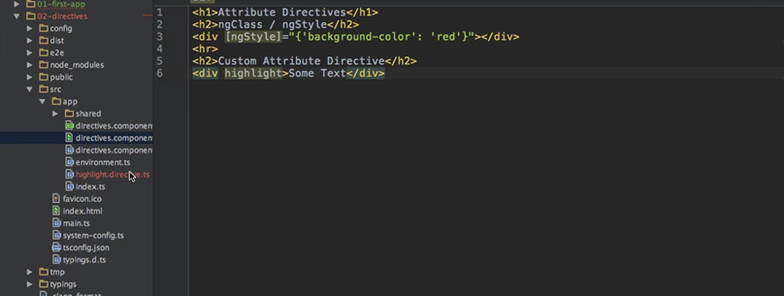
Creating Custom Directive
This is the method to “highlight” a directive in Template.

Slide 26
Structural Directive
Structural directives are responsible for HTML layout. They shape or reshape the DOM's structure, typically by adding, removing, or manipulating elements.
Angular has a powerful template engine that lets you easily manipulate the DOM structure of elements.
Structural directives are easy to recognize. An asterisk (*) precedes the directive attribute name.
While an Attribute directive modifies the appearance or behavior of an element, a Structural directive modifies the DOM layout.

Slide 27
Structural Directive
Structural Directives handle how a component or element renders through the use of the template tag.
This helps you to run some code that decides what the final rendered output will be.
Angular has a few built-in structural directives:
ngIf
ngSwitch
ngFor

Slide 28
ngif Directive
ngIf is the simplest structural directive and the easiest to understand.
It takes a Boolean expression and makes an entire chunk of the DOM appear or disappear.
The ngIf directive doesn't hide elements through CSS. It adds and removes them physically from the DOM.
Confirm this using browser developer tools to inspect the DOM.
Example:
<app-if-example *ngIf="exists">

Slide 29
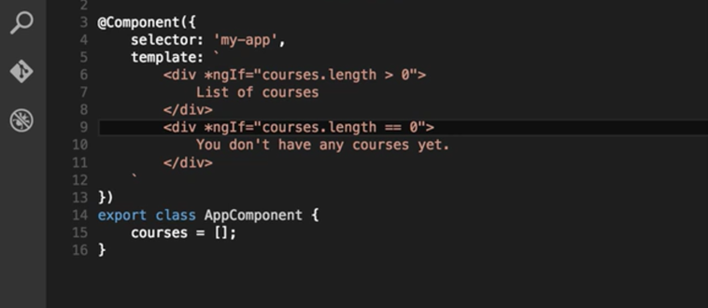
ngif Directive
This example displays only the courses that have some content within.

Slide 30
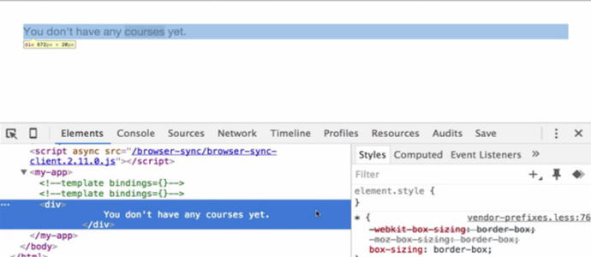
ngif Directive
If you inspect the DOM, you will find that content is physically removed from DOM as well.

Slide 31
ngswitch Directive
The Angular ngSwitch is actually a set of cooperating directives: ngSwitch, ngSwitchCase, and ngSwitchDefault.
ngSwitch is actually comprised of two directives: an attribute directive and a structural directive.
It's very similar to a switch statement in JavaScript and other programming languages, but in the template.
Example:
<div [ngSwitch]="tab">
<app-tab-content *ngSwitchCase="1">content 1</app-tab-content>
<app-tab-content *ngSwitchCase="2"> content 2</app-tab-content>
</div>

Slide 32
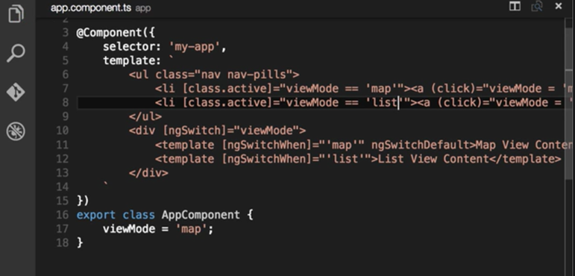
ngswitch Directive
Here, you can see the ngSwitch attribute directive being attached to an element.
The expression bound to the directive defines what it will be compared against in the switch structural directives.

Slide 33

ngswitch Directive
This example shows how you can switch between two different views using this directive.

Slide 34
ngfor Directive
The core directive ngFor allows you to build data presentation lists and tables in HTML templates.
With ngFor, you can print this data to the screen as a data table by generating HTML.
Example:
<div *ngFor="let item of usernames">
<div *appMydirective="item">
{{item.name}}
</div>
</div>

Slide 35
Demo—Attribute Directive
DEMO

Slide 36
Directives
Topic 17—Custom Structural Directives

Slide 37
Custom Structural Directives
The most important difference in the way you create attribute directives is how they are provided to the DOM.
Attribute directives use ElementRef and Renderer to render and re-render, while structural directives use TemplateRef and ViewContainerRef to update the DOM content.

Slide 38
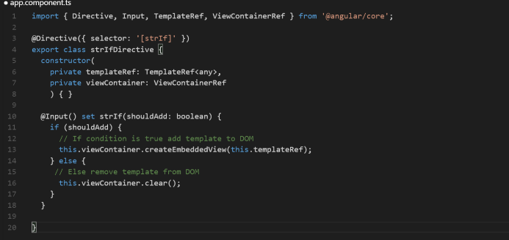
Custom Structural Directives
This demonstrates how to a create a directive by overriding TempRef and ViewContainerRef.

Slide 39
Directive is a concept through which we separate the re-usable functions and features of Angular 17.
Unlike components, directives don’t have a HTML template.
There are 3 types of directives: Component, Attribute, and Structural.
A component directive requires a template along with its attached behavior.
Attribute directives are used to change the appearance or behavior of a component or a native DOM element.
Structural directives are responsible for HTML layout.

Slide 41
Why do we use directives?
1
To Modify DOM
To Build Views
To break down large applications into smaller ones
To make small applications large

Slide 42
Why do we use directives?
1
To Modify DOM
To Build Views
To break down large applications into smaller ones
To make small applications large
a.
Directives are used to modify DOM.

Slide 43
ngFor is a structural directive.
2
True
False

Slide 44
ngFor is a structural directive.
2
True
False
a.
nfFor is a Structural Directive.

Slide 45
Which directive modifies the appearance or behavior of an element?
3
ngSwitch
ngIf
ngFor
ngStyle

Slide 46
Which directive modifies the appearance or behavior of an element?
3
ngSwitch
ngIf
ngFor
ngStyle
d.
ngStyle directive modifies the appearance or behavior of an element.

Slide 47
Which Directive allows us to add or remove an HTML element of CSS class?
4
ngStyle
ngClass
ngApply
ngCSS

Slide 48
Which Directive allows us to add or remove an HTML element of CSS class?
4
ngStyle
ngClass
ngApply
ngCSS
b.
ngClass directive allows us to add or remove CSS classes to an HTML element.

