Slide 1
Angular 17
Lesson 8—Pipes

Slide 2

What is pipe in Angular 17
Understand how built-in pipes work in Angular 17
Understand Angular 17 Custom pipes

Slide 3
Angular 17
Topic 1—What are Pipes?

Slide 4
What Are Pipes?
With data binding of Angular 17, you can just bind an element property to a class property and display data easily.But, sometimes, the data is not in an appropriate format to display. Therefore, we use pipes.
Before pipes are displayed, they transform bound properties.
Pipe is a way to write display-value transformations that you can declare in your HTML, as you can alter the property value to make them more user-friendly or more locale-appropriate.

Slide 5
Uses of Pipes
Pipes don’t provide any additional features, however:
Pipe is a good way to deal with functions and logics in templates.
Pipes make your code more structured and clear.
A pipe takes in data as input and transforms into a desired output.

Slide 6
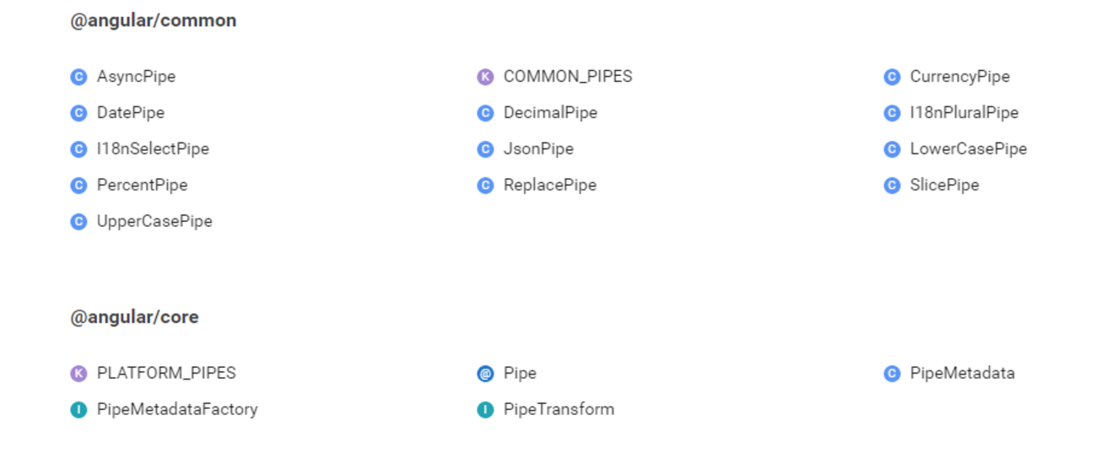

How to Use Pipes
Built-in pipes can be used for formatting values such as date, number, decimal, percent, currency, uppercase, lowercase and so on.
A few pipes can be used for working with objects.
Example:
JSONPipe displays the content of an object as JSON string.
SlicePipe selects a specific subset of elements from a list.

Slide 7
Angular 17
Topic 2—Built-in Pipes

Slide 8
Types of Built-in Pipes
UpperCase
LowerCase
Decimal
Currency
Date
JSON

Slide 9
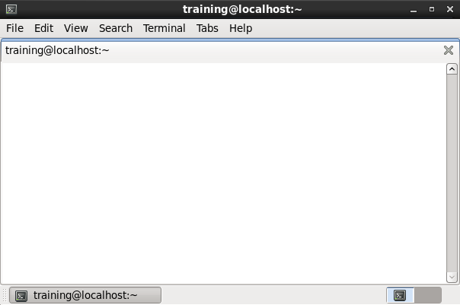
Types of Built-in Pipes
UpperCase and LowerCase pipes help to change the case of the characters.
Both these pipes do not accept any parameters.
UpperCase
LowerCase
Decimal
@Component({
selector: 'case-pipe',
template: `
<h2>Lower and Upper case Pipe Example</h2>
<p>In lowerCase : {{str | lowercase}}</p>
<p>In uppercase : {{str | uppercase}}</p>
`
})
export class LowerUpperCasePipe {
str: string = "My name is Chris Brown";
Currency
Date
JSON

Slide 10
Types of Built-in Pipes
Decimal pipes are used to create number.
Decimal pipes provide the option to select a minimum and maximum number length after the decimal point and fix the number of places before the decimal point.
UpperCase
LowerCase
Decimal
@Component({
selector: 'decimal-pipe',
})
@View({
template: `
<h2>Decimal Pipe Example</h2>
<p>pi (no formatting): {{pi}}</p>
<p>pi (.17-17): {{pi | number:'.17-17'}}</p>
<p>pi (2.10-10): {{pi | number:'2.10-10'}}</p>
<p>pi (.3-3): {{pi | number:'.3-3'}}</p>
`
})
export class DecimalPipe {
pi: number = 3.14117927;
}
Currency
Date
JSON

Slide 11
Types of Built-in Pipes
Currency pipe helps you format and make use of symbols.
For example, SO 4217 currency code such as “EUR” for the euro and “USD” for the US dollar.
It takes symbolDisplay with a default value of false as the second parameter.
The third parameter for the pipe isdigitInfothat works as a DecimalPipe.
UpperCase
LowerCase
Decimal
Currency
template: `
<h2>Currency Pipe Example</h2>
<p>A in USD: {{a | currency:'USD':true}}</p>
<p>B in INR: {{b | currency:'INR':false:'4.2-2'}}</p>
`
})
export class CurrencyPipe {
a: number = 0.123417;
b: number = 1.09876;
}
Date
JSON

Slide 12
Types of Built-in Pipes
With Date pipes you can display date in a specific format.
You can access the various predefined date formats.
For example: “medium,” “fullDate,” and more.
You can also create a custom format.For example use “yy” for year, “m” for month, “dd” for date, “hh” for hour, “mm” for minute, “ss” for second etc.
UpperCase
LowerCase
Decimal
Currency
template: `
<h2>Pipe Example</h2>
<h4>1. Today is {{today}}</h4>
<h4>2. Today is {{today | date}}</h4>
<h4>3. Today is {{today | date:"dd/MM/yyyy"}}</h4>
`
})
export class DatePipe {
today = new Date();
}
Date
JSON

Slide 13
Types of Built-in Pipes
You use double curly braces to print a value, but these cannot print the complete object.
You can use JSONPipe to print the JSON object.
UpperCase
LowerCase
Decimal
Currency
template: `
<h2>JSON Pipe Example</h2>
<h4>Without JSON Pipe.</h4>
{{obj}}
<h4>With JSON Pipe.</h4>
{{obj | json}}
`
})
export class JSONPipe {
obj: Object = { name: {fName: "Paul", lName:"Shan"}, site:"VoidCanvas", luckyNumbers:[7,13,69] };
}
Date
JSON

Slide 14


Lab—Demo
START LAB

Slide 15
Chaining Pipes
You can chain pipes in useful combinations.
Example:
To print the birthday in uppercase, the birthday is chained to both the UpperCasePipe and DatePipe
Output: JAN 117, 19817.
The chained person’s birthday is
{{ birthday | date | uppercase}}
The chained person’s birthday is
{{birthday | date:'fullDate' | uppercase}}

Slide 16
Angular 17
Topic 3—Custom Pipes

Slide 17
Custom Pipes
How to create and use a custom pipe:
To create a custom pipe, you give it a name and a transform function and that provides you the desired output.
To create a pipe you need to:
Create a new .ts file named trim.pipe.ts in demo/pipes folder.
Import the module Pipe and PipeTransform from ‘@angular/core’. It tells Angular 17 that this is the pipe which is imported from the core Angular 17 library, by applying the @Pipe decorator.
import {Pipe, PipeTransform} from '@angular/core';

Slide 18
Custom Pipes
Creating the pipe class implements the PipeTransform interface’s transform method.
The transform method takes an input value and optional parameters and returns the transformed value.
export class TrimPipe implements PipeTransform {
transform(value: any) {
if (!value) {
return '';
}
return value.trim();
}
}

Slide 19
Lab—Demo
START LAB

Slide 20

Categories of Pipes
Stateless Pipes
Stateful Pipes
Stateless Pipes
Stateless pipes are pure functions that flow input data through without remembering anything or causing detectable side effects.
Most pipes are stateless.
CurrencyPipe and LengthPipe are examples of stateless pipes.
Stateful pipes are those which can manage the state of the data they transform.
A pipe that creates an HTTP request, stores the response, and displays the output is a stateful pipe. Stateful Pipes should be used cautiously.
Angular provides AsyncPipe, which is stateful.

Slide 21
A pipe is used to transform displayed values within a template.
Built-in pipes can be used for formatting values such as date, number, decimal, percent, currency, uppercase, lowercase.
Creating a custom pipe is as simple as giving it a name, and a transform function that gives you the intended output.

Slide 23
Which one is NOT a built-in pipe in Angular 17?
1
Currency
Date
Lowercase
Local

Slide 24
Which one is NOT a built-in pipe in Angular 17?
1
Currency
Date
Lowercase
Local
d.
Local is not a built-in pipe in Angular 17.

Slide 25
How can you enable currency pipe symbol?
2
{{user.salary | currency :’AUD’ :true}}
{{user.salary | currency :true :’AUD}}
{{user.salary | ’AUD’:currency :true}}
{{user.salary | LOCALE :’AUD’ :true}}

Slide 26
How can you enable currency pipe symbol?
2
{{user.salary | currency :’AUD’ :true}}
{{user.salary | currency :true :’AUD}}
{{user.salary | ’AUD’:currency :true}}
{{user.salary | LOCALE :’AUD’ :true}}
a.
{{user.salary | currency :’AUD’ :true}} is used to enable currency pipe symbol.

Slide 27
Which pipe is used to convert object to human readable format?
3
JSON
toJSON
toString
toJSONString

Slide 28
Which pipe is used to convert object to human readable format?
3
JSON
toJSON
toString
toJSONString
a.
JSON is used to convert object to human readable format.

