Slide 1




Java 8:
Create The Future

Slide 2




Program Agenda
Java SE 8: Enhancing the Core Java Platform
Java ME 8: Building The Internet of Things
NetBeans 8: The IDE For Java 8
Where Next?

Slide 3


Java SE 8:
Enhancing The Core Java Platform

Slide 4

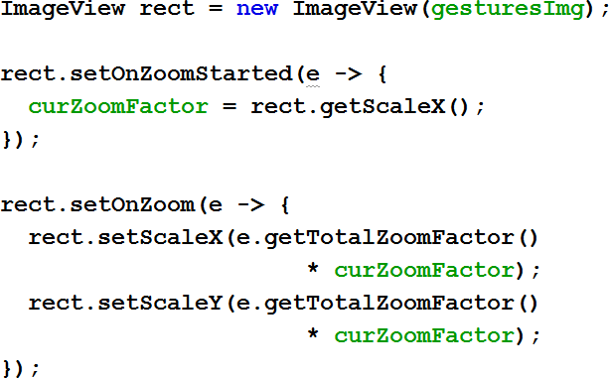

A simple lambda example – event handling
Handling the Zoom Gesture (ZoomEvent)

Slide 5
Lambda Expressions
Why Do We Need Them?
Almost all machines now are multi-core, multi-processor, or both
We need to make it simpler to write multi-threaded Java code
  Java has always had the concept of threads
  Even using the concurrency utilities and fork-join framework this is hard
Let’s add better library code
  This is good, but sometimes we need to change the language too
The answer: Lambda expressions and the streams API

Slide 6

The Problem: External Iteration
List<Student> students = ... double highestScore = 0.0; for (Student s : students) {
if (s.gradYear == 2011) {
if (s.score > highestScore) { highestScore = s.score;
}
}
}
Client controls iteration
Inherently serial: iterate from beginning to end
Not thread-safe because business logic is stateful (mutable accumulator variable)

Slide 7
Internal Iteration With Inner Classes
List<Student> students = ...
double highestScore = students.stream().
filter(new Predicate<Student>() {
public boolean test(Student s) { return s.getGradYear() == 2011;
}
}).
mapToDouble(new ToDoubleFunction<Student>() { public Double applyAsDouble(Student s) {
return s.getScore();
}
}).
max();
Iteration, filtering and accumulation are handled by the library
Not inherently serial – traversal
may be done in parallel
Traversal may be done lazily – so one pass, rather than three
Thread safe – client logic is stateless
High barrier to use
– Syntactically ugly

Slide 8
Internal Iteration With Lambdas
SomeList<Student> students = ...
double highestScore = students.stream(). filter(Student s -> s.getGradYear() == 2011). mapToDouble(Student s -> s.getScore()).
max();
More readable
More abstract
Less error-prone
No reliance on mutable state
Easier to make parallel

Slide 9
Lambda Expressions
Some Details
Lambda expressions represent anonymous functions
  Like a method, has a typed argument list, a return type, a set of thrown exceptions, and a body
  Not associated with a class
We now have parameterized behaviour, not just values
double highestScore = students.stream().
filter(Student s -> s.getGradYear() == 2011)
What
mapToDouble(Student s -> s.getScore()) max();
How

Slide 10
Lambda Expressions
Functional Interfaces
Definition
  A functional interface is an interface with only one abstract method
  However, the interface may have more than one method
Identified structurally
  Type is inferred from the context
  Works for both assignment and method parameter contexts
The type of a Lambda expression is a functional interface
  Instances of functional interfaces are created with Lambda expressions
  @FunctionalInterface annotation

Slide 11
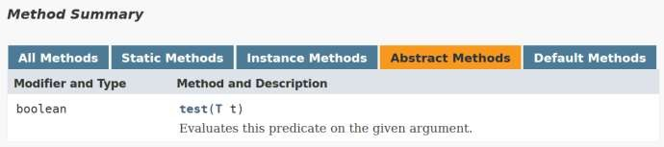
Internal Iteration With Lambdas
filter(Student s -> s.getGradYear() == 2011)
The type of this lambda is the Predicate functional interface
The lambda expression is an implementation of the test() method.

Slide 12
Type Inferrence
The compiler can often infer parameter types in a Lambda expression
Inferrence uses the target functional interface’s method signature
Fully statically typed (no dynamic typing sneaking in)
– More typing with less typing
static T void sort(List<T> l, Comparator<? super T> c); List<String> ls = getList();
Collections.sort(ls, (String x, String y) -> x.length() - y.length());
Collections.sort(ls, (x, y) -> x.length() - y.length());

Slide 13
Lambda Epressions
Local Variable Capture & Lexical Scoping
Lambda expressions can refer to effectively final local variables from
the enclosing scope
  This means a variable behaves as if it is marked final (even if it is not)
  The variable is assigned once
Lambda expressions are anonymous functions
  They are not associated with an object
  this will refer to the object in the surrounding scope

Slide 14
Method References
If a lambda only calls a method …
void createUI() {
Button button = new Button("Guess What I'm Thinking");
button.setOnAction(e -> guess(e));
...
}
// lambda only calls a method
void guess(ActionEvent event) {
Button button = (Button) event.getSource();
button.setText("You love Lambda!");
}
1
8

Slide 15
Method References
If a lambda only calls a metho…d, you can use a method reference
void createUI() {
Button button = new Button("Guess What I'm Thinking");
button.setOnAction(this::guess); // use method reference
...
}
void guess(ActionEvent event) {
Button button = (Button) event.getSource(); button.setText("You love Lambda!");
}
1
9

Slide 16
Method References
Method references let us reuse a method as a lambda expression
FileFilter x = (File f) -> f.canRead();
FileFilter x = File::canRead;

Slide 17
Constructor References
Same concept as a method reference
– For the constructor
Factory<List<String>> f = () -> return new ArrayList<String>();
Equivalent to
Factory<List<String>> f = ArrayList<String>::new;

Slide 18
Four Kinds of Method References
Reference to a static method:
ContainingClass::staticMethodName
Reference to an instance method of a particular object:
ContainingObject::instanceMethodName
Reference to an instance method of an arbitrary object of a particular type:
ContainingType::methodName
Reference to a constructor:
ClassName::new
2
2

Slide 19
Default Methods
Provide a mechanism to add new methods to existing interfaces
  Without breaking backwards compatability
  Gives Java multiple inheritance of behaviour, as well as types
    but not state!
public interface Set<T> extends Collection<T> {
... // The existing Set methods
default Spliterator<E> spliterator() {
return Spliterators.spliterator(this, Spliterator.DISTINCT);
}
}

Slide 20
Static Methods In Interfaces
Previously it was not possible to include static methods in an interface
Static methods, by definition, are not abstract
– @FunctionalInterface can have zero or more static methods
static <T> Predicate<T> isEqual(Object target) { return (null == target)
? Objects::isNull
: object -> target.equals(object);
}

Slide 21
Streams API
Aggregate Operations
Most business logic is about aggregate operations
  “Most profitable product by region”
  “Group transactions by currency”
As we have seen, up to now, Java mostly uses external iteration
  Inherently serial
  Frustratingly imperative
Java SE 8’s answer: Streams
  With help from Lambdas

Slide 22
Stream Overview
High Level
Abstraction for specifying aggregate computations
  Not a data structure
  Can be infinite
Simplifies the description of aggregate computations
  Exposes opportunities for optimization
  Fusing, laziness and parallelism

Slide 23




Stream Overview
Pipeline
A stream pipeline consists of three types of things
  A source
  Zero or more intermediate operations
  A terminal operation
    Producing a result or a side-effect
Source
int sum = transactions.stream().
filter(t -> t.getBuyer().getCity().equals(“London”)). mapToInt(Transaction::getPrice).
sum();
Intermediate operation
Terminal operation

Slide 24
Stream Overview
Execution
The filter and map methods don’t really do any work
  They set up a pipeline of operations and return a new Stream
All work happens when we get to the sum() operation
  filter()/map()/sum() fused into one pass on the data
    For both sequential and parallel pipelines
int sum = transactions.stream().
filter(t -> t.getBuyer().getCity().equals(“London”)). mapToInt(Transaction::getPrice).
// Lazy
// Lazy
sum(); // Execute the pipeline

Slide 25
Stream Sources
Many Ways To Create
From collections and arrays
  Collection.stream()
  Collection.parallelStream()
  Arrays.stream(T array) or Stream.of()
Static factories
  IntStream.range()
  Files.walk()
Roll your own
  java.util.Spliterator()

Slide 26
Stream Sources
Manage Three Aspects
Access to stream elements
Decomposition (for parallel operations)
  Fork-join framework
Stream characteristics (See Spliterator javadoc)
  ORDERED
  DISTINCT
  SORTED
  SIZED
  SUBSIZED
  NONNULL
  IMMUTABLE
  CONCURRENT

Slide 27
Stream Intermediate Operations
Uses lazy evaluation where possible
Can affect stream characteristics
  map() preserves SIZED but not DISTINCT or SORTED
Some operations fuse/convert to parallel better than others
  Stateless operations (map, filter) fuse/convert perfectly
  Stateful operations (sorted, distint, limit) fuse/convert to varying
degrees

Slide 28
Stream Terminal Operations
Invoking a terminal operation executes the pipeline
  All operations can execute sequentially or in parallel
Terminal operations can take advantage of pipeline characteristics
  toArray() can avoid copying for SIZED pipelines by allocating in
advance

Slide 29
Optional<T>
Reducing NullPointerException Occurences
Indicates that reference may, or may not have a value
  Makes developer responsible for checking
  A bit like a stream that can only have zero or one elements
Optional<GPSData> maybeGPS = Optional.of(gpsData); maybeGPS = Optional.ofNullable(gpsData);
maybeGPS.ifPresent(GPSData::printPosition); GPSData gps = maybeGPS.orElse(new GPSData());
maybeGPS.filter(g -> g.lastRead() < 2).ifPresent(GPSData.display());

Slide 30
java.util.function Package
Predicate<T>
  Determine if the input of type T matches some criteria
Consumer<T>
  Accept a single input argumentof type T, and return no result
Function<T, R>
  Apply a function to the input type T, generating a result of type R
Plus several more

Slide 31
Stream Example 1
Convert words in list to upper case
List<String> output = wordList. stream(). map(String::toUpperCase). collect(Collectors.toList());

Slide 32
Stream Example 2
Find words in list with even length
List<String> output = wordList.
stream().
filter(w -> (w.length() & 1 == 0). collect(Collectors.toList());

Slide 33
Stream Example 3
Count lines in a file
BufferedReader has new method
– Stream<String> lines()
long count = bufferedReader. lines().
count();

Slide 34
Stream Example 4
Find the length of the longest line in a file
int longest = reader. lines(). mapToInt(String::length). max().
getAsInt();

Slide 35
Stream Example 5
Collect all words in a file into a list
List<String> output = reader.
lines().
flatMap(line -> Stream.of(line.split(REGEXP))). filter(word -> word.length() > 0). collect(Collectors.toList());

Slide 36
Stream Example 6
List of words lowercased, in aphabetical order
List<String> output = reader.
lines().
flatMap(line -> Stream.of(line.split(REGEXP))). filter(word -> word.length() > 0). map(String::toLowerCase).
sorted().
collect(toList());

Slide 37
Annotations On Java Types
Annotations can currently only be used on type declarations
  Classes, methods, variable definitions
Extension for places where types are used
  e.g. parameters
Permits error detection by pluggable type checkers
  e.g. null pointer errors, race conditions, etc
public void process(@notnull List data) {…}

Slide 38
Concurrency Updates
Scalable update variables
  DoubleAccumulator, DoubleAdder, etc
  Multiple variables avoid update contention
  Good for frequent updates, infrequent reads
ConcurrentHashMap updates
  Improved scanning support, key computation
ForkJoinPool improvements
  Completion based design for IO bound applications
  Thread that is blocked hands work to thread that is running

Slide 39
Parallel Array Sorting
Additional utility methods in java.util.Arrays
  parallelSort (multiple signatures for different primitives)
Anticipated minimum improvement of 30% over sequential sort
  For dual core system with appropriate sized data set
Built on top of the fork-join framework
  Uses Doug Lea’s ParallelArray implementation
  Requires working space the same size as the array being sorted

Slide 40
Date And Time APIs
A new date, time, and calendar API for the Java SE platform
Supports standard time concepts
  Partial, duration, period, intervals
  date, time, instant, and time-zone
Provides a limited set of calendar systems and be extensible to others
Uses relevant standards, including ISO-8601, CLDR, and BCP47
Based on an explicit time-scale with a connection to UTC

Slide 41
Base64 Encoding and Decoding
Currently developers are forced to use non-public APIs
  sun.misc.BASE64Encoder
  sun.misc.BASE64Decoder
Java SE 8 now has a standard way
  java.util.Base64.Encoder
  java.util.Base64.Decoder
  encode, encodeToString, decode, wrap methods

Slide 42
Nashorn JavaScript Engine
Lightweight, high-performance JavaScript engine
– Integrated into JRE
Use existing javax.script API
ECMAScript-262 Edition 5.1 language specification compliance
New command-line tool, jjs to run JavaScript
Internationalised error messages and documentation

Slide 43
Removal Of The Permanent Generation
Permanently
No more need to tune the size of it
Current objects moved to Java heap or native memory
  Interned strings
  Class metadata
  Class static variables
Part of the HotSpot, JRockit convergence

Slide 44
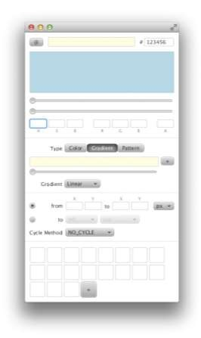
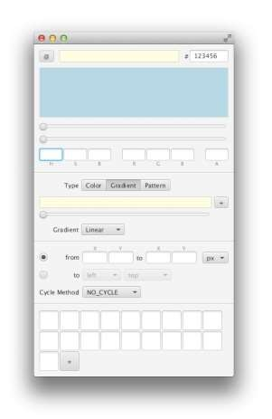
JavaFX 8
New Theme
Caspian
Modena
vs
4
8
All rights reserved.

Slide 45
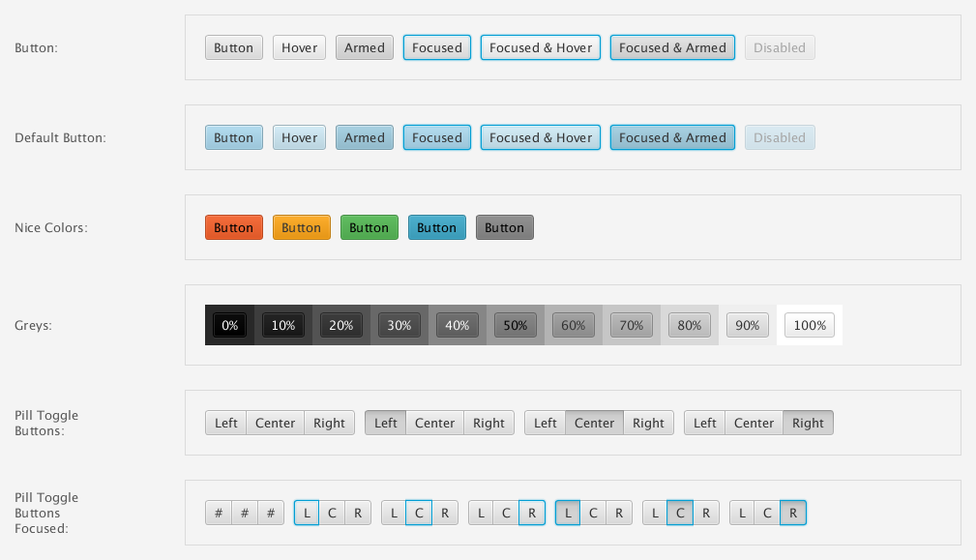
Modena
4
9

Slide 46


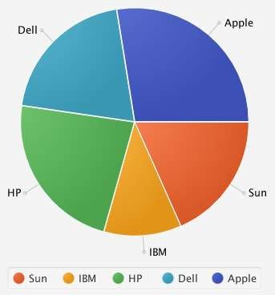
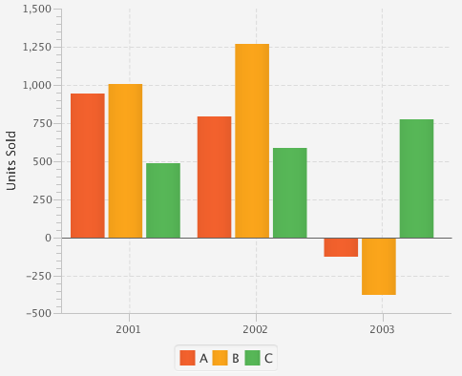


Modena
5
0

Slide 47
JavaFX 8
Improvements To Full Screen Mode
Customisable
  Configurable key combinations to exit full screen mode
  Ability to prevent user exiting full screen mode
// Set the key combination that the user can use to exit stage.setFullScreenExitKeyCombination(KeyCombination.NO_MATCH);
// Setup the click handler so we can escape from full screen Rectangle r = new Rectangle(0, 0, 250, 250); r.setOnMouseClicked(e -> stage.setFullScreen(false));
// Set full screen again stage.setFullScreen(true);

Slide 48
JavaFX 8
Printing Support
New API for printing
– Currently only supported on desktop
Any node can be printed
PrinterJob job = PrinterJob.createPrinterJob(printer); job.getJobSettings().setPageLayout(pageLayout); job.getJobSettings().setPrintQuality(PrintQuality.HIGH); job.getJobSettings().setPaperSource(PaperSource.MANUAL); job.getJobSettings().setCollation(Collation.COLLATED);
if (job.printPage(someRichText))
job.endJob();

Slide 49
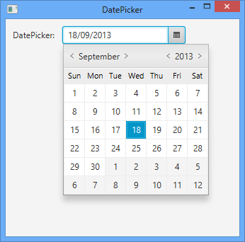
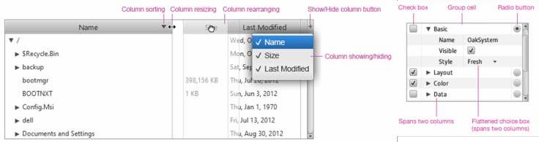
JavaFX 8
New Controls
DatePicker
TreeTableView

Slide 50
DatePicker
The JavaFX DatePicker is designed with the new Calendaring APIs in Java 8 using java.time
5
4

Slide 51
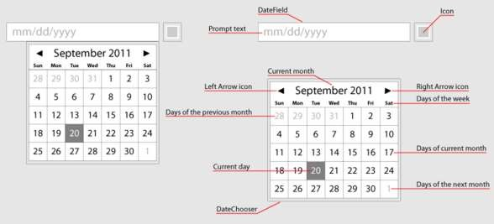
DatePicker
55

Slide 52
DatePicker
import java.time.LocalDate; // From new Date/Time API
...
LocalDate ld;
DatePicker dp = new DatePicker();
dp.setOnAction(e -> {
ld = dp.getValue(); System.out.println("Date selected " + ld);
});
5
6

Slide 53
Date Picker
5
7

Slide 54
TreeTableView
UI control with combined TreeView and TableView controls functionality
58 .
58

Slide 55

JavaFX 8
Touch Support
Gestures
  Swipe
  Scroll
  Rotate
  Zoom
Touch events and touch points

Slide 56





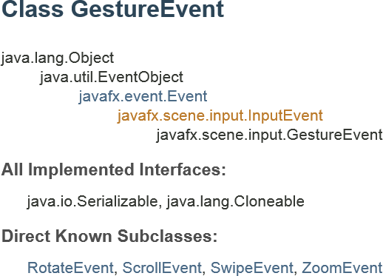

Touch Gestures

Slide 57

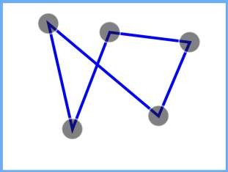
Handling Touch (TouchEvent/TouchPoint)
A TouchEvent contains information about a touch, including:
  Event type: Pressed, released, moved, or stationary
  Touch points: The TouchPoint instances that represent each of the points that were touched
Each TouchEvent has a unique ID to identify the
events and touch points in a multi-touch action

Slide 58
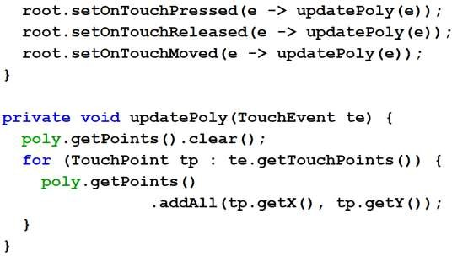
Responding to Touch Events

Slide 59



JavaFX 8
3D Support
Predefined shapes
  Box
  Cylinder
  Sphere
User-defined shapes
  TriangleMesh, MeshView
PhongMaterial
Lighting
Cameras

Slide 60

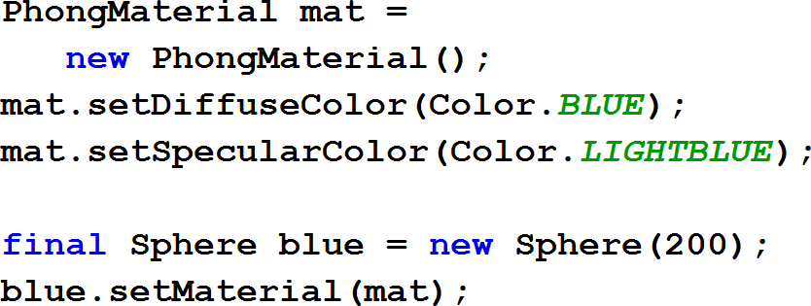
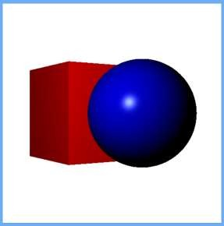
Creating Primitive Shapes and Materials
64

Slide 61

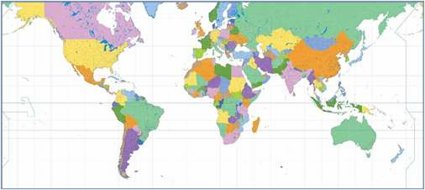

Placing a Texture on a Sphere
65

Slide 62
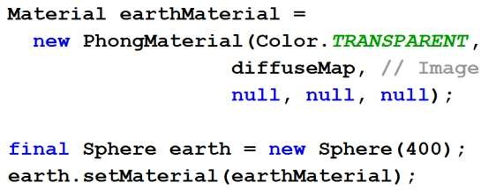
Placing a Texture on a Sphere
66

Slide 63

3D Lights
Lights are nodes in the scene graph
  PointLight
  AmbientLight
Default light provided if no active lights
67

Slide 64
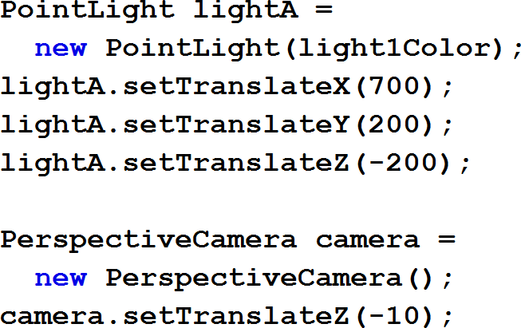

Lights, Camera, Action!
68

Slide 65
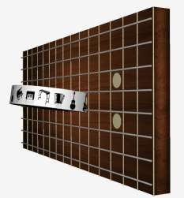
Example 3D multi-touch app: ZenGuitar3D

Slide 66
Compact Profiles
Approximate static footprint goals
Compact1 Profile
11Mb
Compact2 Profile
16Mb
Compact3 Profile
30Mb
Full JRE
54Mb

Slide 67
Java SE Embedded
Optimised binary for embedded use from devices to gateways
Latest Java innovations in the smallest footprint
Use of compact profiles
  Approximate JRE size 20.4Mb (ARM v7 VFS, Hard Float)
    Compact profile 1: 10.4Mb
    JavaFX: 10Mb
Production ready binary for popular platforms that run Linux
  ARM v6/7 with Hard floating point
  Raspberry Pi is one of the reference platforms

Slide 68
Java ME 8:
Building The Internet of Things

Slide 69















Java ME 8 Focus
Footprint
100MB+
ARM Cortex M3/M4
ARM Cortex-A
10MB-100MB
1MB-10MB
50KB-1MB
Java SE Embedded
Java Embedded Suite
Oracle Event Processing Embedded
Java Card
Java ME Embedded
Java SE
DESKTOP SERVER
SECURITY
SMALL EMBEDDED
MEDIUM EMBEDDED LARGE EMBEDDED

Slide 70







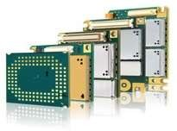




































Java ME 8 Platform Overview
Use Case Software
(e.g. smart pen)
Use Case Software
(e.g. wireless module)
Use Case Software
(e.g. control unit)
Use Case Software
(e.g. smart meter)
Additional
APIs
(Examples)
Wireless
Communication
Protocols and Data Conversion
Security and Management
Additional Optional APIs
Messaging
Sensors
Additional
Optional JSRs
Vertical Specific APIs
Location Web Services
Application Platform
Java ME Embedded Profile (MEEP) 8 (JSR 361)
On-Device I/O
Generic Connection
Framework
GCF 8
Security and Trust
Services
SATSA
(JSR 177)
Access
Device I/O
API
Java VM
Java ME Connected Limited Device Configuration (CLDC) 8 (JSR 360)

Slide 71
Java ME 8 Key Features
Aligned with Java SE 8
  Language, libraries, VM
Designed for embedded
  Fully headless operation
  Remote software provisioning and management
Highly portable and scalable
  Minimum RAM footprint of 1Mb
Consistent across devices

Slide 72
Java ME 8 Key Features
Advanced application platform
  Multi-application model
Modularised software services
  Faster and more flexible software development and deployment
Multi-client domains (“partitioning”)
  Different clients can have different security domains
Access to peripheral devices (Device I/O API)
Compatible with JCP/JSR standard APIs

Slide 73

Connected Limited Device Configuration 8
CLDC 8 Key Features
Language Alignment with SE 8
VM Alignment with SE 8
Library Alignment with SE 8
Compact Configuration for very small devices
GCF 8 to provides flexible networking
Developer leverage of tools, APIs and knowledge

Slide 74
Generic Connection Framework 8
Substantially Increased Range of Connection Types
SecureServerConnection
SecureDatagramConnection
ModemConnection
UDPMulticastConnection
CommConnection
HttpConnection
HttpsConnection
SecureConnection
ServerSocketConnection
SocketConnection
UDPDatagramConnection

Slide 75











Java ME Embedded Profile (MEEP) 8
Architecture
Application or Service
Application or Service Application or Service
MEEP 8
javax. microedition. rms (optional)
javax. microedition. media (optional)
javax. microedition. key (optional)
javax. microedition. lui
(optional)
javax. microedition. cellular (optional)
NEW UPDATED
javax. microedition. swm (optional)
javax. microedition. event (optional)
javax. microedition. power (optional)
javax. microedition. io
(optional)
javax. microedition. midlet
CLDC 8

Slide 76
NetBeans 8:
The IDE For Java 8

Slide 77
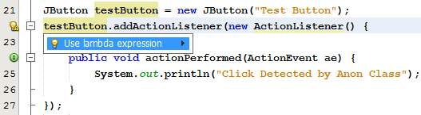


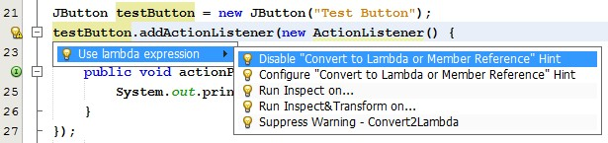
Tools for Java SE 8
Lambda Expressions
Quickly convert anonymous inner
classes
to lambdas

Slide 78
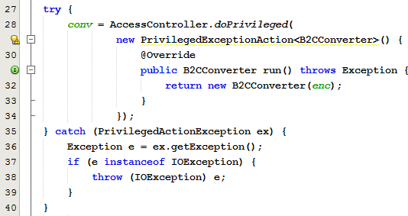

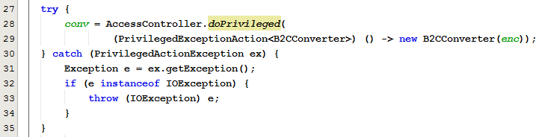
Tools for Java SE 8
Lambda Expressions
Static analysis
to ensure
safe transformation,
automatically
add cast
for correct type

Slide 79
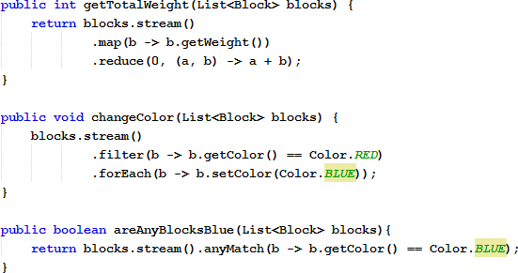
Tools for Java SE 8
Internal Iterators via Java 8 Streams
1
Editor support for functional operations
over collections
2
3

Slide 80
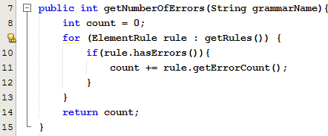

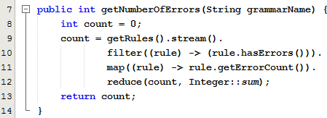
Tools for Java SE 8
Internal Iterators via Java 8 Streams
Smoothly convert to internal iterators via hints and tips

Slide 81
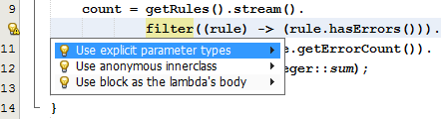

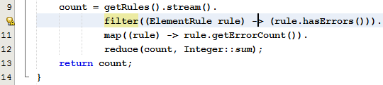
Tools for Java SE 8
Explicit Parameter Types For Lambda Expressions
Quickly add explicit parameter types for readability

Slide 82
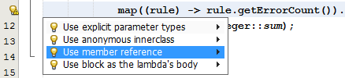

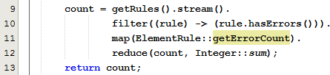
Tools for Java SE 8
Method References
Easily convert
from lambdas
to method references

Slide 83
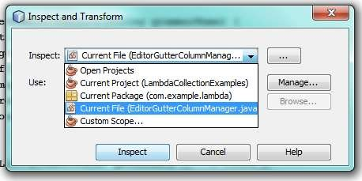
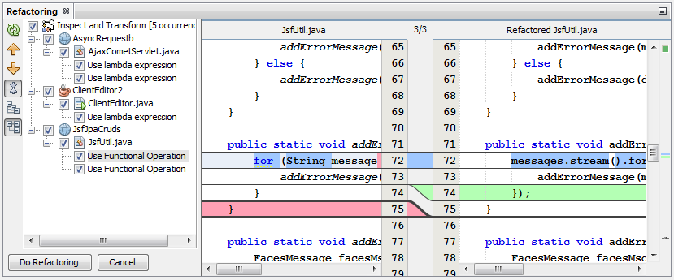
Tools for Java SE 8
Refactoring in Batch Mode
Specify a scope
for upgrading to Java 8
  All/current projects
  Specific package
  Specific class
Run converters
Visually preview proposals for refactoring

Slide 84
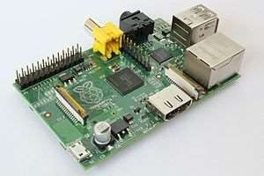
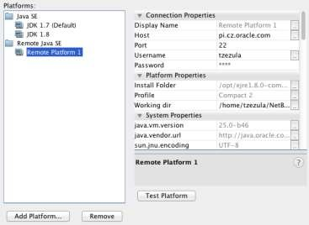
Tools for Java SE Embedded 8
Seamless Integration
Full Development Cycle support against a remote platform
  Intuitive development
  One-click deploy
  Remote debugging
  Comprehensive remote profiling
Complete end to end integration for Raspberry Pi and other embedded devices,
  e.g.Web Services.

Slide 85
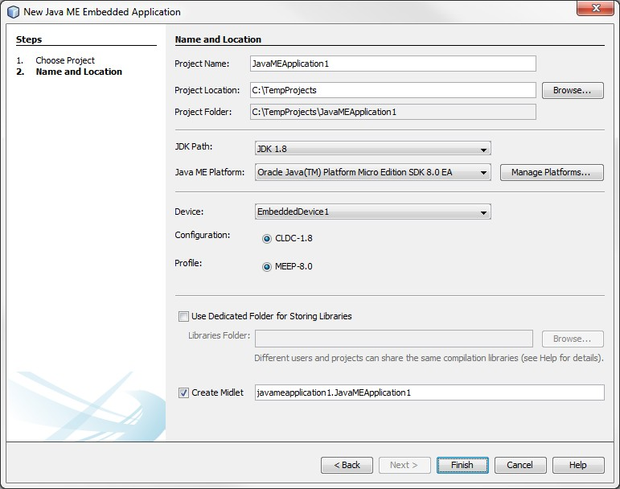
Tools for Java ME Embedded 8
Seamless Integration
Java ME 8 CLDC
Platform Emulator
Intuitive tools and editors
for JDK 8 on Java ME
Simple customization of optional packages

Slide 86
Conclusions
Java SE 8 adds powerful new features to the core
  Lambda expressions, streams and functions
  New controls, stylesheet and 3D support in JavaFX
Java ME 8 focused on embedded development
  Device I/O APIs
NetBeans 8, ready for Java 8 development
  Lambda support, embedded support
Java continues to evolve

Slide 87
Java 9 And Beyond
Java Never Stops
Modularisation of the Java platform
  Project Jigsaw
Foreign function interface
  Like JNI
Enhanced volatiles

Slide 88


9 Oracle and/or its affiliates. All rights reserved.

