Slide 1

EIF ETHRAA | FULL STACK ENGINEERING CAPSTONE PROJECT
EIF Ethraa Full Stack Capstone Project
A modern UAE banking platform — engineered to simulate real enterprise workflows, secure transactions, and digital KYC verification at scale.

Slide 2
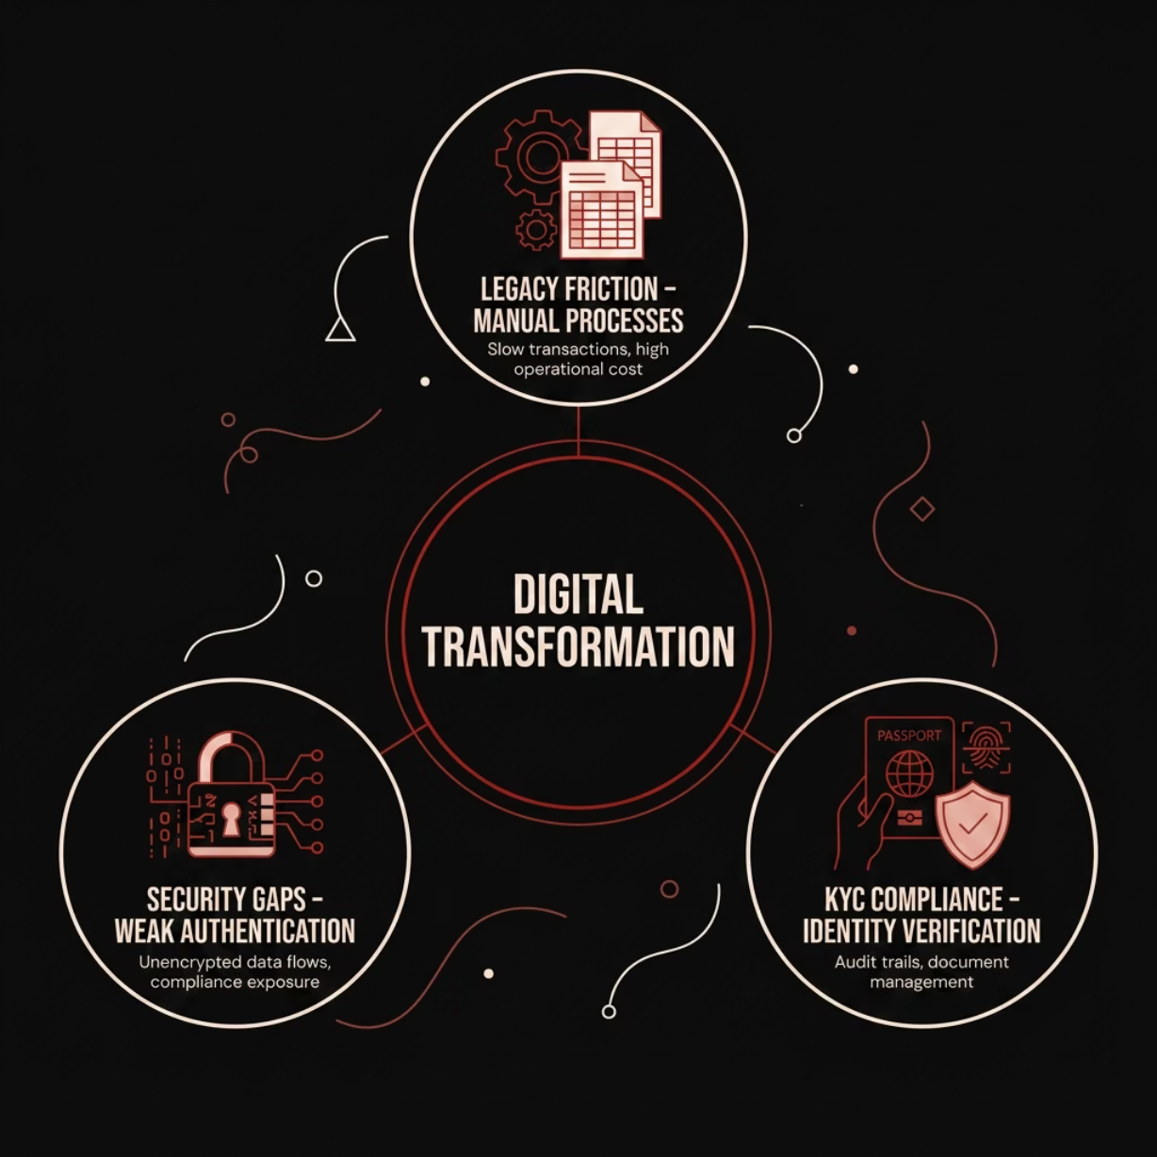

BUSINESS CONTEXT
The Digital Banking Imperative
Traditional banking infrastructure is under pressure. Customers expect seamless digital experiences, regulators demand rigorous KYC compliance, and institutions must modernize without compromising security or operational integrity.
Legacy Friction
KYC Compliance
Security Gaps
Manual processes create bottlenecks and elevated operational risk
Regulatory identity verification demands precision and auditability
Conventional systems lack modern authentication and encryption standards
EIF ETHRAA | FULL STACK ENGINEERING CAPSTONE PROJECT

Slide 3

STRATEGIC VISION
Project Vision & Objectives
Customer Experience
Deliver a seamless, intuitive digital banking journey aligned with UAE customer expectations
Secure Workflows
Engineer end-to-end encrypted transactions with JWT-based authentication and role-based access
Real-World Simulation
Mirror authentic UAE banking operations — Emirates ID transfers, KYC flows, and live transaction processing
Enterprise-Ready
Build with production-grade tooling: Spring Boot, React, Docker, Kubernetes, and AWS cloud infrastructure
EIF ETHRAA | FULL STACK ENGINEERING CAPSTONE PROJECT

Slide 4
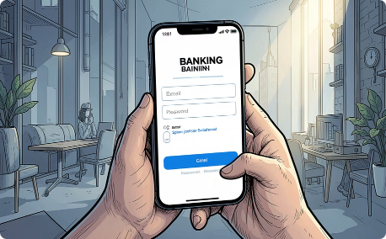
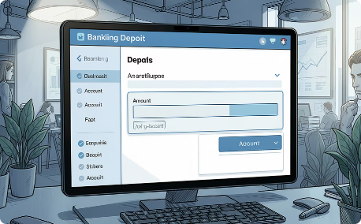
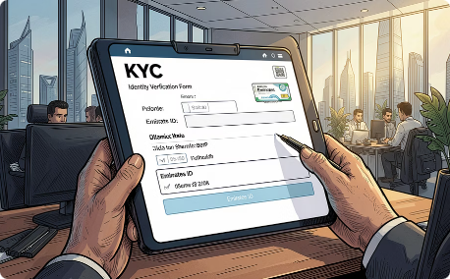
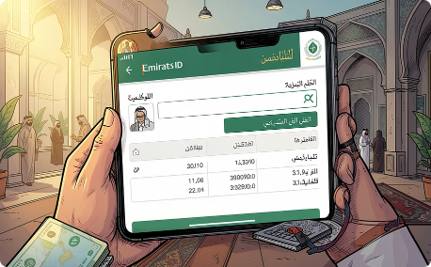
CAPABILITIES
Platform Features at a Glance
Authentication
Deposit & Withdraw
KYC Management
Fund Transfer
Secure registration and JWT-protected login with session management
Real-time balance updates with validated transaction processing
Digital identity verification with document submission and compliance tracking
Instant transfers via Emirates ID with real-time validation and confirmation
EIF ETHRAA | FULL STACK ENGINEERING CAPSTONE PROJECT

Slide 5
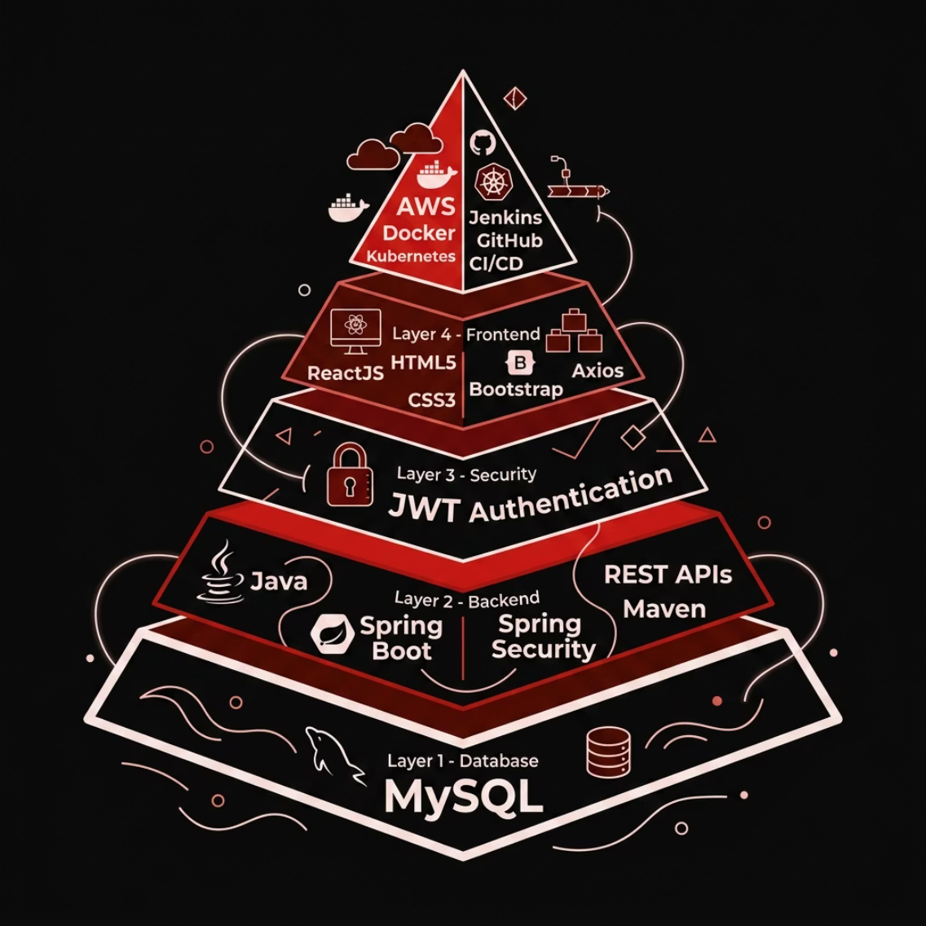

ENGINEERING
Technology Stack
A production-grade, enterprise-aligned stack — selected for scalability, security, and cloud-native deployment readiness across every layer of the application.
Frontend
Backend
Database
Security
ReactJS · HTML5 · CSS3 · Bootstrap · Axios
Java · Spring Boot · Spring Security · REST APIs · Maven
MySQL — relational data persistence
JWT Authentication · Role-based access control
Cloud & DevOps
AWS · Docker · Kubernetes · Jenkins · GitHub · CI/CD
EIF ETHRAA | FULL STACK ENGINEERING CAPSTONE PROJECT

Slide 6

ARCHITECTURE
System Architecture Overview
API & Security
Spring Boot REST APIs with Spring Security and JWT
Core: React UI
User interface making API calls via Axios
The architecture follows a clean separation of concerns — React communicates with Spring Boot via RESTful APIs, secured by JWT tokens, with all data persisted in MySQL and deployed on AWS using containerized CI/CD pipelines.
EIF ETHRAA | FULL STACK ENGINEERING CAPSTONE PROJECT

Slide 7
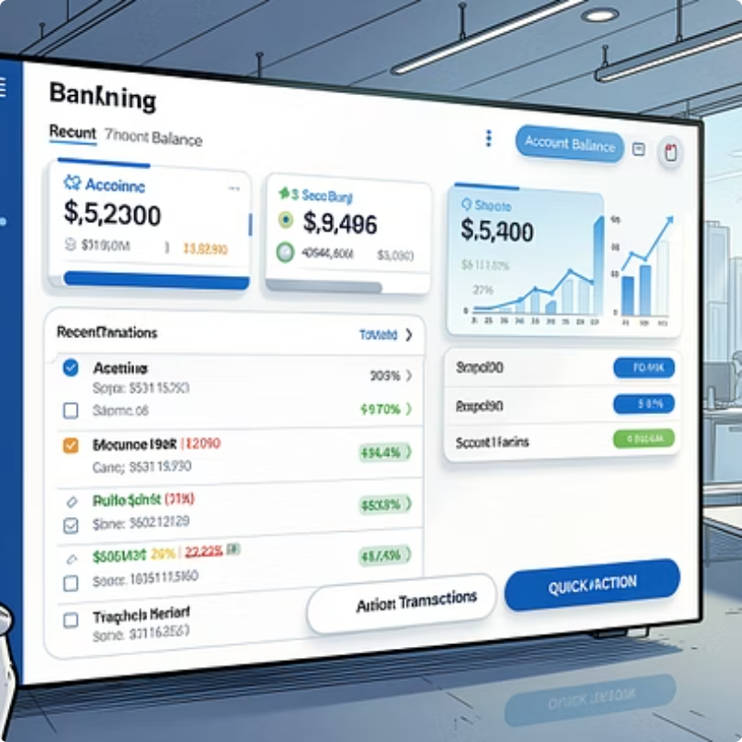
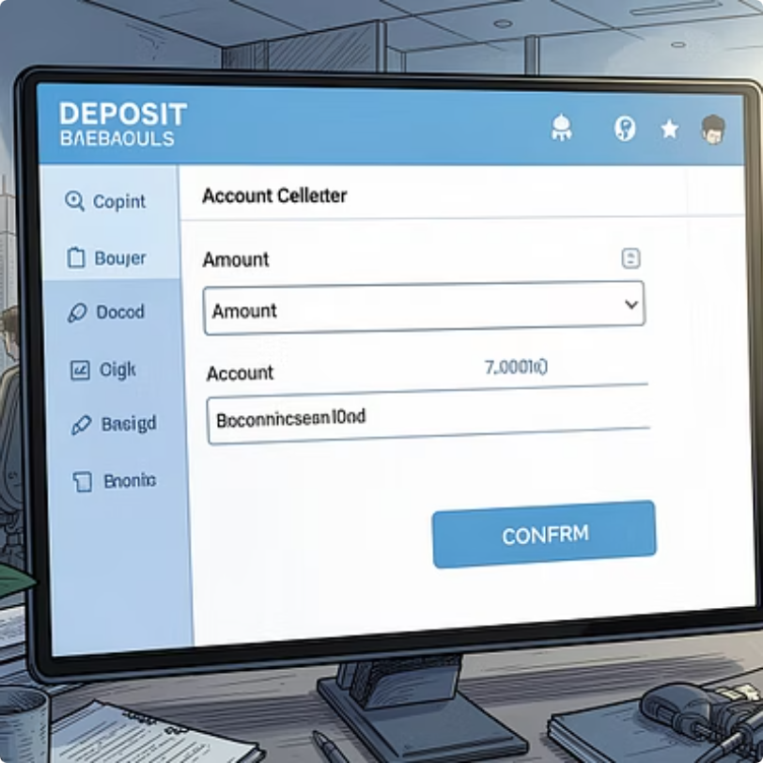
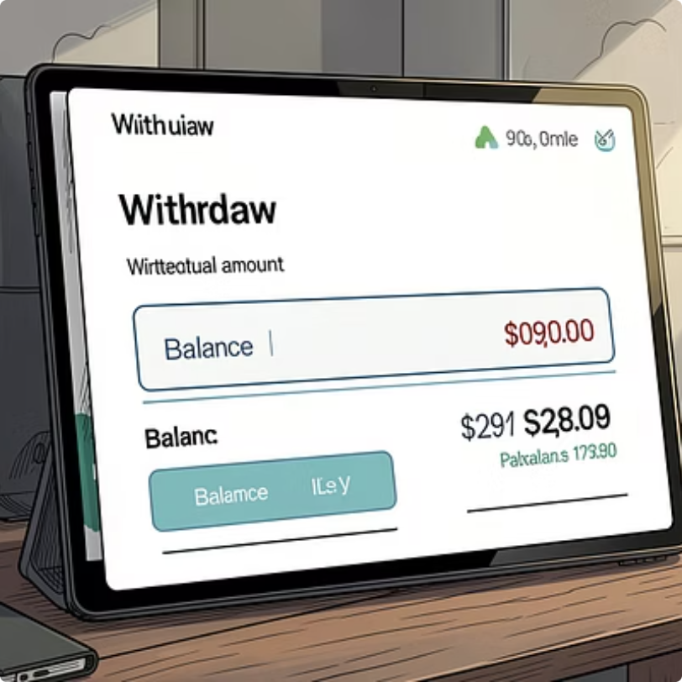
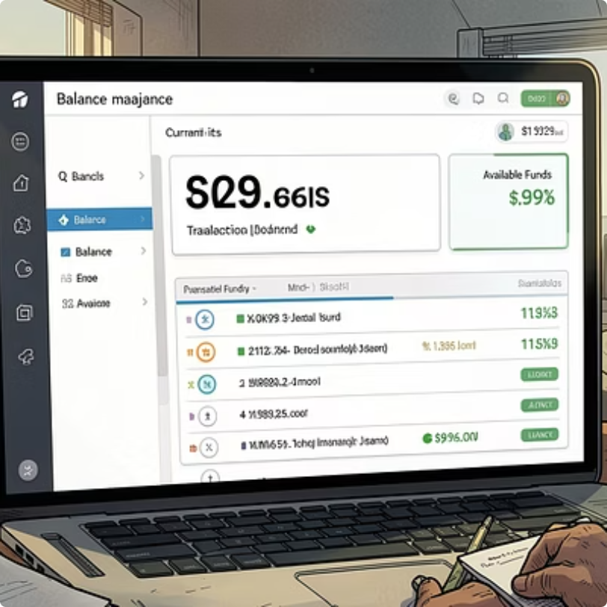
UI SHOWCASE
Banking Dashboard Screens
Each screen reflects enterprise-grade UX principles — clear visual hierarchy, real-time data feedback, and streamlined interaction flows designed for both desktop and mobile contexts.
EIF ETHRAA | FULL STACK ENGINEERING CAPSTONE PROJECT

Slide 8
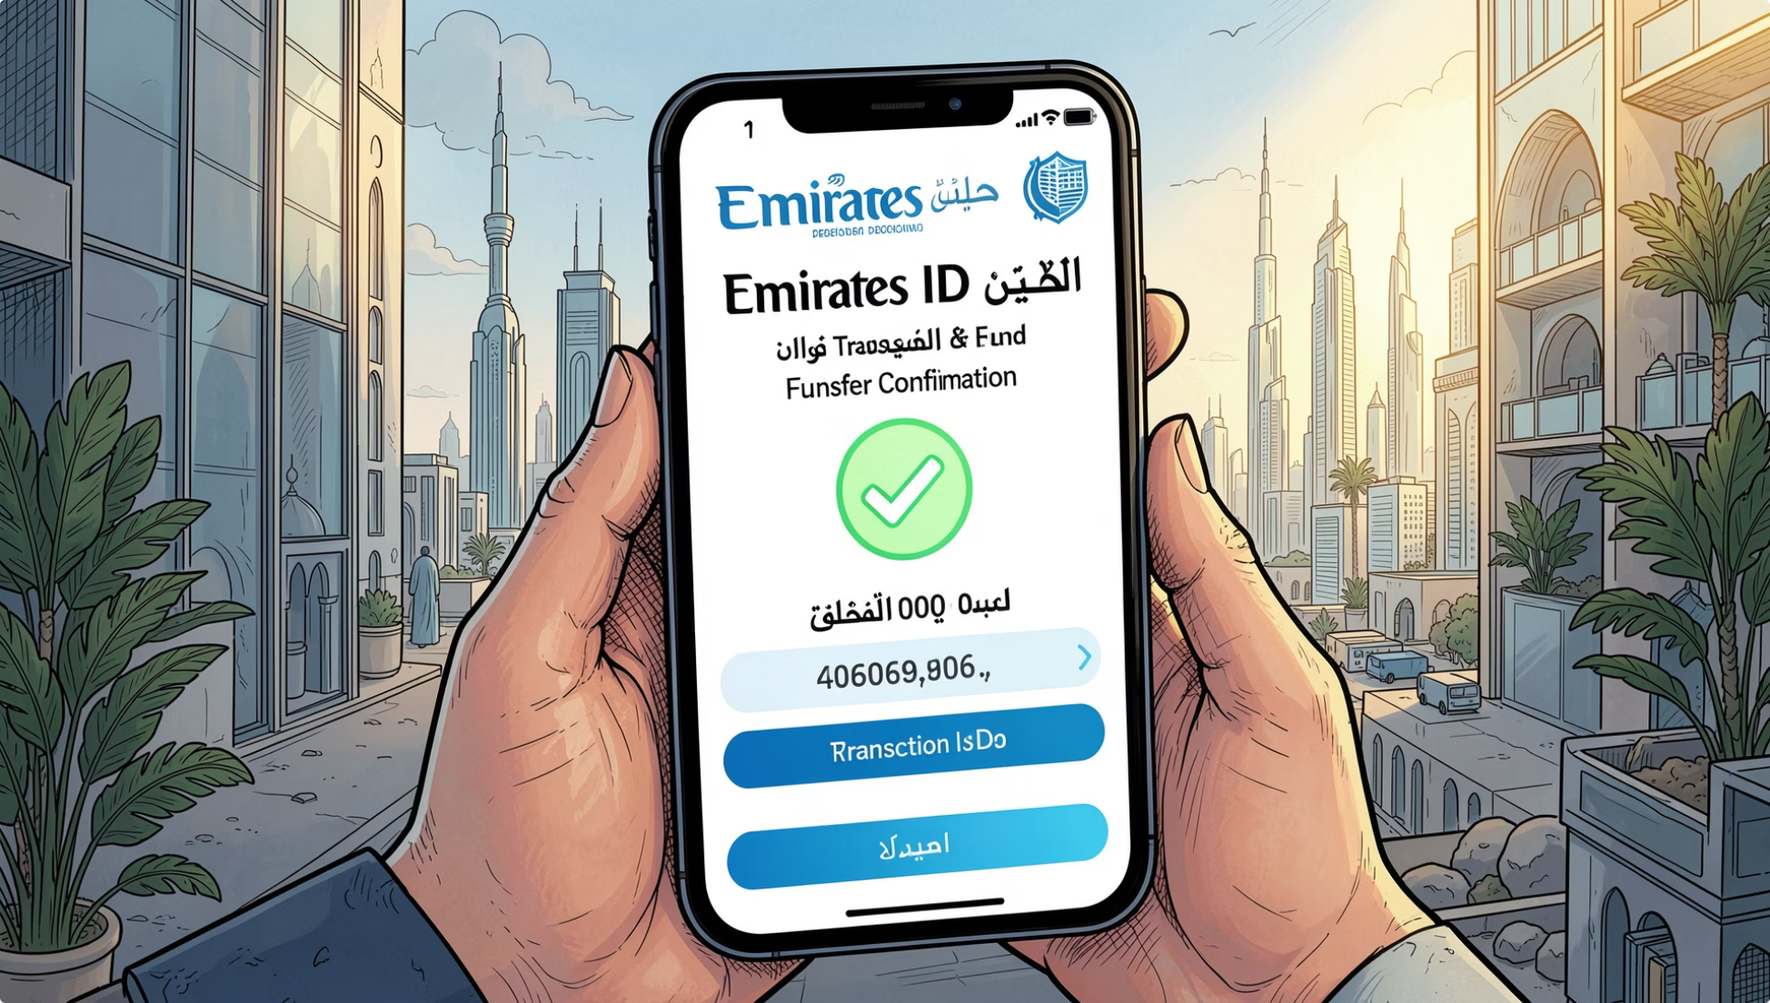
WORKFLOWS
KYC & Fund Transfer Workflows
Emirates ID Transfer Flow
Customers initiate transfers by entering a recipient's Emirates ID — the system validates identity, confirms balance, and processes the transaction in real time.
KYC Update Process
Users submit identity documents through a guided digital form. The system validates, stores, and flags records for compliance review automatically.
Identity Input
Document Upload
Transaction Success
Emirates ID entry with real-time validation
Secure KYC document submission
Instant confirmation with reference number
EIF ETHRAA | FULL STACK ENGINEERING CAPSTONE PROJECT

Slide 9
OUTCOMES
Key Learning Outcomes
Full Stack Development
REST API Integration
End-to-end application build — from React frontend to Spring Boot backend
Designed and consumed RESTful services with Axios and Spring Data
Database Integration
Security Implementation
MySQL schema design, JPA entity mapping, and transactional data management
JWT authentication, Spring Security configuration, and secure session handling
DevOps & Cloud
Enterprise Banking Workflows
Docker containerization, Kubernetes orchestration, and CI/CD pipelines on AWS
Real-world UAE banking scenarios — KYC, Emirates ID transfers, and compliance
EIF ETHRAA | FULL STACK ENGINEERING CAPSTONE PROJECT

Slide 10

CLOSING
Conclusion
The EIF Ethraa Capstone Project demonstrates that modern banking platforms can be built with enterprise rigor — combining secure architecture, intuitive UX, and cloud-native deployment in a single, cohesive solution.
✅ Secure
🏦 Banking-Grade
JWT-protected, compliance-ready
UAE workflows, KYC, Emirates ID
☁️ Cloud-Ready
AWS, Docker, Kubernetes, CI/CD
EIF ETHRAA | FULL STACK ENGINEERING CAPSTONE PROJECT

