Slide 1




Core Java
Lesson 11—Java Database Connectivity ( JDBC)

Slide 2


Learning Objectives
At the end of this lesson, you should be able to:
Define Java Database Connectivity (JDBC) and its Architecture
Explain Drivers and the types of Drivers
Explain JDBC application programming interface (API) Setup a Project for JDBC Usage
Discuss Transaction Management Using JDBC

Slide 3
JDBC
Topic 1—JDBC and its Architecture

Slide 4


Introduction to JDBC
JDBC is the application programming interface (API) that allows Java programs to access database
management systems.
The JDBC API consists of a set of interfaces and classes written in the Java programming
language.
JDBC interface:
Connection
Statement
PrepareStatement
ResultSet
JDBC Classes:
DriverManager
Manager

Slide 5



Uses of JDBC
Connects database to Java application
Works on queries like create and updates to the database
Retrieves the results received from the database in answer to query JDBC is both platform and database-independent.
Java Application
JDBC
Database

Slide 6
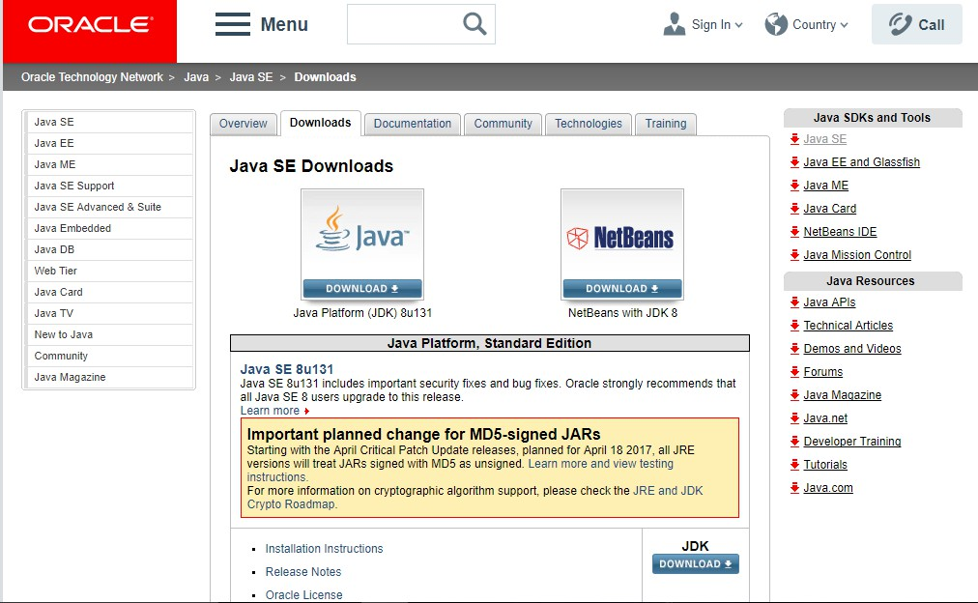
Environment Setup of JDBC
Install the latest version of the Java SE SDK.

Slide 7
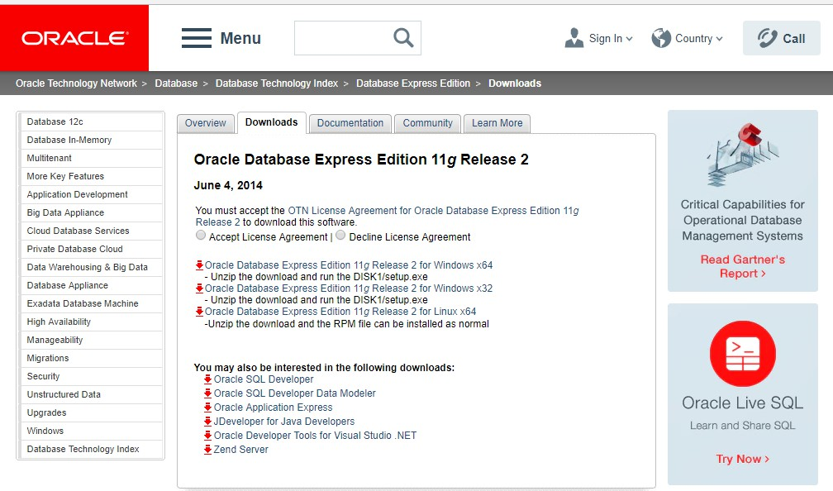
Environment Setup of JDBC (Contd.)
Install your database management system (DBMS) if needed.

Slide 8
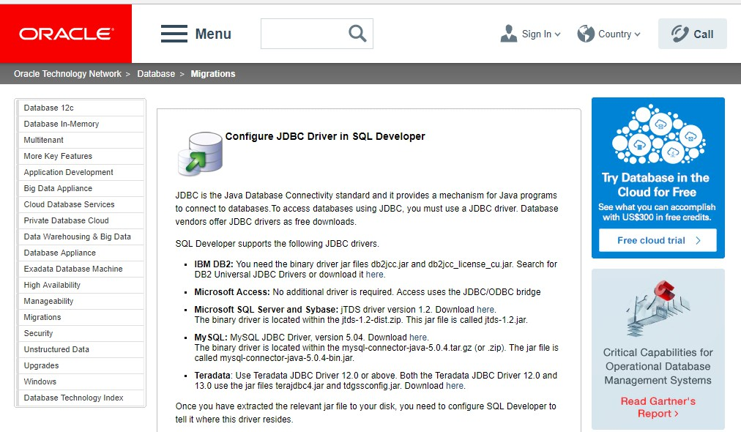
Environment Setup of JDBC (Contd.)
Install a JDBC driver from the vendor of your database.

Slide 9
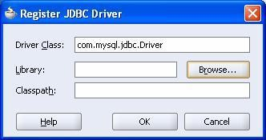
Connecting to Database
Connecting to Database involves five steps:
1
Register the drive class
The forName() method of Class is used to register the driver class. This method dynamically
loads the driver class.
Syntax of forName() method
public static void forName(String className)throws ClassNotFoundException
Example of registering the OracleDriver class
class.forName(“oracle.jdbc.OracleDriver”);

Slide 10
Connecting to Database (Contd.)
2
The getConnection() method of DriverManager class is used to create connection with the database.
Syntax of getConnection() method
public static Connection getConnection(String url)throws SQLException
public static Connection getConnection(String url,String name,String password) throws SQLException
Example of establishing a connection with the Oracle Database
Connection con=DriverManager.getConnection(
"jdbc:oracle:thin:@localhost:1521:xe","system","password");

Slide 11
Connecting to Database (Contd.)
3
Create the Statement Object
The createStatement() method of Connection interface is used to create statement. The object of
statement executes queries in the database.
Syntax of createStatement() method
1. public Statement createStatement()throws SQLException
Example of creating Statement Object
1. Statement stmt=con.createStatement();

Slide 12
Connecting to Database (Contd.)
4
Execute a query
The executeQuery() method of Statement interface is used to execute queries in the database. This
method returns the object of ResultSet. This can be used to get all the records of a table.
Syntax of executeQuery() method
1. public ResultSet executeQuery(String sql)throws SQLException
Example of executing query
ResultSet rs=stmt.executeQuery("select * from emp");
while(rs.next())
{
System.out.println(rs.getInt(1)+" "+rs.getString(2));
}

Slide 13
Connecting to Database (Contd.)
5
Close the connection object
By closing connection object statement, ResultSet will be closed automatically. The close() method of
Connection interface is used to close the connection.
Syntax of close() method
1. public void close()throws SQLException
Example of executing query:
1. con.close();

Slide 14
JDBC
Topic 2—Drivers in JDBC

Slide 15
JDBC Drivers
There are 4 types of Drivers:
Type 1
Type 2
Type 3
Type 4
JDBC ODBC
Bridge Driver
Native API Driver
Network Protocol Driver
ODBC Driver
Thin Driver
Vendor DataBase Library
Middleware
Vendor DataBase
Library
Database
Database
Database
Database

Slide 16
JDBC Drivers (Contd.)
There are 4 types of Drivers:
Type 1
Type 2 Type 3 Type 4
_{Native API Driver} Network Protocol Driver
Thin Driver
Vendor DataBase
_{Library} Middleware
Database Database Database
JDBC ODBC
Bridge Driver
ODBC Driver
Vendor DataBase
Library
Database
Type 1: JDBC-ODBC bridge
Open Database Connectivity (ODBC) drivers are generally dependent on a native library, which limits their
portability. Example: JDBC-ODBC.

Slide 17
JDBC Drivers (Contd.)
There are 4 types of Drivers:
Type 1
Type 2
Type 3 Type 4
Network Protocol Driver
Thin Driver
Middleware
Database Database
JDBC ODBC
Bridge Driver
Native API Driver
ODBC Driver
Vendor DataBase Library
Vendor DataBase
Library
Database
Database
Type 2: Native-API driver
These drivers are written partly in the native code and partly in Java programming language. These drivers use a
native client library, and because of this, their portability is limited.

Slide 18
JDBC Drivers (Contd.)
There are 4 types of Drivers:
Type 1
Type 2
Type 3
Type 4
Thin Driver
Database
JDBC ODBC
Bridge Driver
Native API Driver
Network Protocol Driver
ODBC Driver
Vendor DataBase Library
Middleware
Vendor DataBase
Library
Database
Database
Database
Type 3: Network-Protocol driver (Middleware driver)
These drivers use a pure Java client and communicate with a middleware server using a database-independent
protocol. The middleware server then communicates the client's requests to the data source.

Slide 19
JDBC Drivers (Contd.)
There are 4 types of Drivers:
Type 1
Type 2
Type 3
Type 4
JDBC ODBC
Bridge Driver
Native API Driver
Network Protocol Driver
ODBC Driver
Thin Driver
Vendor DataBase Library
Middleware
Vendor DataBase
Library
Database
Database
Database
Database
Type 4: Database-Protocol driver (Pure Java driver) or thin driver
These drivers are based on pure Java and implement the network protocol for a specific data source. Data
source is connected directly to client.

Slide 20
JDBC
Topic 3—JDBC API

Slide 21
JDBC API
JDBC API can access any kind of tabular data, specifically data stored in relational database management system (RDBMS).
API contains descriptions of all the features of a product or software. It represents classes and interfaces that software programs can use to communicate with each other.
Packages:
java.sql.package
javax.sql.package
Interface in JDBC:
Connection
Statement
PreparedStatement
CallableStatementResultset
ResultSetMetaData
DatabaseMetaData
Driver
Blob
Clob
Classes in JDBC:
DriverManager
SQLException
Types
Date
Time

Slide 22
JDBC
Topic 4—Example Using JDBC

Slide 23
Connecting Java Application with Oracle Database
Oracle has provided two types of JDBC driver software to connect java application to a database of oracle server.
Oracle OCI Driver Oracle thin Driver
Properties of Oracle thin driver:
Driver Class: | Oracle.Jdbc.OracleDriver
Connection url: | jdbc:oracle:thin:@localhost:1521:xe
Username: | The default username for the oracle database is system.
password | Password is given by the user at the time of installing the oracle database.
jdbc is the API
oracle is the database
thin is the driver
localhost is the server name on which oracle is running, we may also use IP address
1521 is the port number and
XE is the Oracle service name.

Slide 24
Connecting Java Application with Oracle Database (Contd.)
Examples
import java.sql.*;
class OracleCon
{
public static void main(String args[]){ try
{
Class.forName("oracle.jdbc.OracleDriver");
//step1 load the driver class
Connection con=DriverManager.getConnection( "jdbc:oracle:thin:@localhost:1521:xe","system","oracle");
Statement stmt=con.createStatement(); //step3 create the statement object
ResultSet rs=stmt.executeQuery("select * from student"); //step4 execute query
while(rs.next())
System.out.println(rs.getInt(1)+" con.close();
}
catch(Exception e)
{
System.out.println(e);
}
}
}
"+rs.getString(2)+"
"+rs.getString(3));
//step5 close the connection object

Slide 25
JDBC
Topic 5—Transaction Management using JDBC

Slide 26
Transaction Management—JDBC
Transaction represents a single unit of work.
The ACID (Atomicity, Consistency, isolation and durability) properties describe transaction management.
Atomicity means that every transaction is successful or nothing is successful.
Consistency ensures that the database is brought from one consistent state to another consistent state.
Isolation ensures that transaction is isolated from other transaction.
Durability means that once a transaction has been committed, it will remain so, even in the event of errors or power loss.

Slide 27
Transaction Management—JDBC (Contd.)
Statement: It is used for general-purpose access to your database. It is useful when you are using static SQL statements at runtime. The Statement interface cannot accept parameters.
Statement stmt = null;
try
{
stmt = conn.createStatement( );
. . . }
catch (SQLException e) {
. . . }
finally {
. . .}

Slide 28
Transaction Management—JDBC (Contd.)
PreparedStatement: The PreparedStatement interface extends the Statement interface and provides you added functionality. It has a few advantages over a generic Statement object.
The prepareStatement() method of Connection interface is used to return the object of
PreparedStatement.
Syntax:
public PreparedStatement prepareStatement(String query)throws SQLException{}

Slide 29
Transaction Management—JDBC (Contd.)
The important methods of PreparedStatement interface are given below:
Method | Description
public void setInt(int paramIndex, int value) | sets the integer value to the given parameter index.
public void setString(int paramIndex, String value) | sets the String value to the given parameter index.
public void setFloat(int paramIndex, float value) | sets the float value to the given parameter index.
public void setDouble(int paramIndex, double value) | sets the double value to the given parameter index.
public int executeUpdate() | executes the query. It is used for create, drop, insert, update, delete etc.
public ResultSet executeQuery() | executes the select query. It returns an instance of ResultSet.

Slide 30
Transaction Management—JDBC (Contd.)
Example for PreparedStatement:
PreparedStatement pstmt = null;
try
{
String SQL = "Update Employees SET age = ? WHERE id = ?"; pstmt = conn.prepareStatement(SQL);
. . . }
catch (SQLException e) {
. . . }
finally {
. . . }

Slide 31
Transaction Management—JDBC (Contd.)
Example - Transaction Management in JDBC using statement
import java.sql.*;
class FetchRecords
{
public static void main(String args[])throws Exception{
Class.forName("oracle.jdbc.driver.OracleDriver");
Connection con=DriverManager.getConnection("jdbc:oracle:thin:@localhost:1521:xe","system ","oracle");
con.setAutoCommit(false);
Statement stmt=con.createStatement();
stmt.executeUpdate("insert into user420 values(190,'abhi',40000)"); stmt.executeUpdate("insert into user420 values(191,'umesh',50000)"); con.commit();
con.close();
}}

Slide 32
Transaction Management—JDBC (Contd.)
Example - Transaction Management in JDBC using PreparedSTATEMENT
import java.sql.*;
import java.io.*; class TM
{
public static void main(String args[]){ try{
class.forName("oracle.jdbc.driver.OracleDriver");
Connection con=DriverManager.getConnection("jdbc:oracle:thin:@localhost:1521:xe","system","oracle"); con.setAutoCommit(false);
PreparedStatement ps=con.prepareStatement("insert into user420 values(?,?,?)"); BufferedReader br=new BufferedReader(new InputStreamReader(System.in)); while(true){
System.out.println("enter id"); String s1=br.readLine();
int id=Integer.parseInt(s1); System.out.println("enter name"); String name=br.readLine(); System.out.println("enter salary"); String s3=br.readLine();

Slide 33
Transaction Management—JDBC (Contd.)
Example - Transaction Management in JDBC using PreparedSTATEMENT
int salary=Integer.parseInt(s3);
ps.setInt(1,id); ps.setString(2,name); ps.setInt(3,salary); ps.executeUpdate();
System.out.println("commit/rollback"); String answer=br.readLine(); if(answer.equals("commit")){ con.commit(); } if(answer.equals("rollback")){ con.rollback();
}
System.out.println("Want to add more records y/n"); String ans=br.readLine();
if(ans.equals("n")){ break;
} }
con.commit();
System.out.println("record successfully saved"); con.close();//before closing connection commit() is called
}catch(Exception e){System.out.println(e);}
}}

Slide 34
Transaction Management—JDBC Callable Statement
CallableStatement interface is used to call the stored procedures and functions.
Example of getting the instance of CallableStatement:
CallableStatement stmt=con.prepareCall("{call myprocedure(?,?)}");
Example of calling the function using JDBC:
First, create a function in the database:
create or replace function sum4
(n1 in number,n2 in number) return number
is
temp number(8); begin
temp :=n1+n2; return temp; end;
/

Slide 35
Transaction Management—JDBC Callable Statement (Contd.)
Once you have created a function in database, call that function:
import java.sql.*;
public class FuncSum {
public static void main(String[] args) throws Exception{ Class.forName("oracle.jdbc.driver.OracleDriver"); Connection con=DriverManager.getConnection(
"jdbc:oracle:thin:@localhost:1521:xe","system","oracle"); CallableStatement stmt=con.prepareCall("{?= call sum4(?,?)}"); stmt.setInt(2,10);
stmt.setInt(3,43); stmt.registerOutParameter(1,Types.INTEGER); stmt.execute(); System.out.println(stmt.getInt(1));
}
}

Slide 36
JDBC in Java 8
There are two major changes in JDBC for Java 8.
1
Oracle does not support the JDBC-ODBC Bridge. Oracle recommends that you use JDBC drivers
provided by the vendor of your database instead of the JDBC-ODBC Bridge.
2
Additional Features:
Addition of REF_CURSOR support
Addition of java.sql.DriverAction Interface
Addition of security check on deregisterDriver Method in DriverManager Class
Addition of the java.sql.SQLType Interface
Addition of the java.sql.JDBCType Enum
Add Support for large update counts
Changes to the existing interfaces
Rowset 1.2: Lists the enhancements for JDBC RowSet.

Slide 37

Key Takeaways
JDBC is an API that allows Java programs to access database management systems.
JDBC has 4 types of drivers: JDBC-ODBC bridge, Native-API driver, Network- Protocol driver (Middleware driver), and Database-Protocol driver (Pure Java driver) or thin driver.
JDBC API can access any kind of tabular data, specifically data stored in RDBMS.
Oracle provides two types of JDBC driver software to connect Java application to a database of oracle server.
Transaction represents a single unit of work.

Slide 38

Quiz

Slide 39

QUIZ 1
is the return type of execute() method of any Statement object.
a. int
b.
long
c.
ResultSet
d.
Boolean

Slide 40

QUIZ 1
is the return type of execute() method of any Statement object.
a. int
b.
long
c.
ResultSet
d.
Boolean
The correct answer is d. Boolean
Boolean is the return type of execute() method of any Statement object.

Slide 41
QUIZ 2
To establish a connection to a Database, DriverManager needs a .
a. URL
b.
Class name
c.
Username
d.
Password

Slide 42
QUIZ 2
To establish a connection to a Database, DriverManager needs a .
a. URL
b.
Class name
c.
Username
d.
Password
The correct answer is a, c, and d.
To establish a connection to a Database, DriverManager needs URL, Class name, and Username.

Slide 43

Thank You

