Slide 1

Application Scaling

Slide 2
What Does Cluster Do?

Slide 3
Node.js runs in a single thread. While it’s still very fast in most cases, this really doesn’t take advantage of multiple processors if they’re available.
The Cluster module allows you to create a small network of separate processes which can share server ports; this gives your Node.js app access to the full power of your server.

Slide 4
The cluster Module
The core cluster module allows a single application to be forked as multiple processes.
var http = require("http");
var cluster = require("cluster");
var numCPUs = require("os").cpus().length;
if (cluster.isMaster) {
for (var i = 0; i < numCPUs; i++) {
console.log("Forking child");
cluster.fork();
}
} else {
http.createServer(function (request, response) {
console.log(process.pid + ": request for " + request.url);
response.writeHead(200);
response.end("Hello World!");
}).listen(8000);
}

Slide 5
The cluster Events
fork
message
online
listening
disconnect
exit
error
M
Fork event
W
online event
The difference between 'fork' and 'online' is that fork is emitted when the master forks a worker, and 'online' is emitted when the worker is running.

Slide 6
The cluster Events
var http = require("http");
var cluster = require("cluster");
var numCPUs = require("os").cpus().length;
if (cluster.isMaster) {
cluster.on("fork", function (worker) {
console.log("Attempting to fork worker");
});
cluster.on("online", function (worker) {
console.log("Successfully forked worker");
});
for (var i = 0; i < numCPUs; i++) {
cluster.fork();
}
} else {
// implement worker code
}

Slide 7
The workers Object
The master process can loop over all of its workers by iterating through the workers object, a property of the cluster module.
var http = require("http");
var cluster = require("cluster");
var numCPUs = require("os").cpus().length;
if (cluster.isMaster) {
for (var i = 0; i < numCPUs; i++) {
cluster.fork();
}
for (var id in cluster.workers) {
console.log("Killing " + id);
cluster.workers[id].kill();
}
}

Slide 8
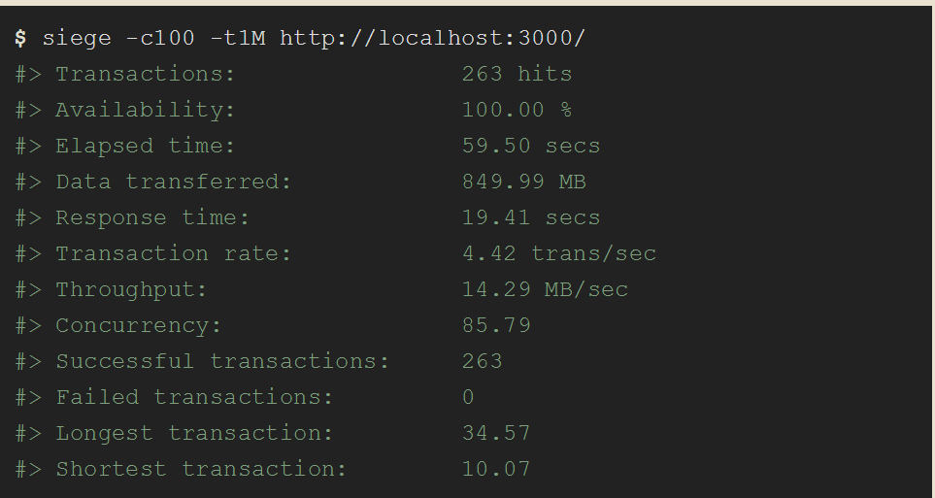
Without clustering:

Slide 9
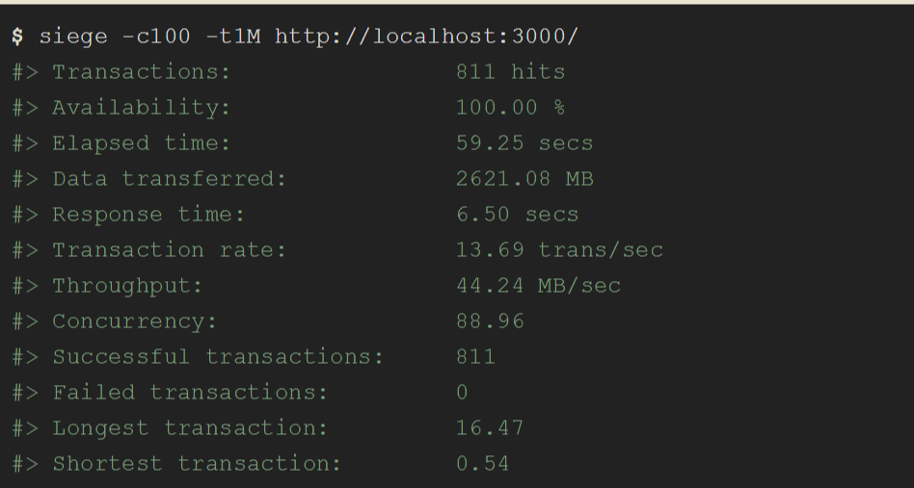
With cluster

Slide 10
The Worker Class
A Worker object contains all public information and method about a worker.
In the master it can be obtained using cluster.workers.
In a worker it can be obtained using cluster.worker
if (cluster.isMaster) {
var worker = cluster.fork();
worker.send('hi there');
} else if (cluster.isWorker) {
process.on('message', function (msg) {
process.send(msg);
});
}

