Slide 1
Node.js
How Javascrit is changing server programming

Slide 2
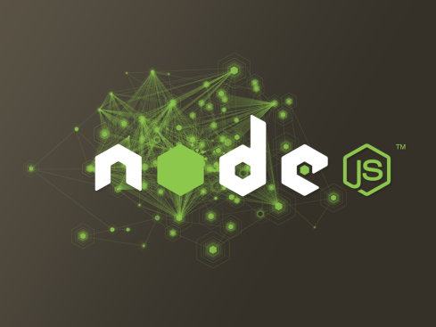
Agenda
Introduction
What makes Node so ___ ?
How to Node ….
Hello world
Tweeter Console
NPM to the rescue
… and not to Node
Grunt
Redis Commander
Node.js and Microsoft
Questions
“Most languages were designed to
solve computational problems, but
Node.js is different “
“ Node.js was designed from the
ground up to efficiently handle the
communication that is at the heart
of modern web applications “

Slide 3
Quick overview
Brief History
Invented by Ryan Dahl of Joyent, spring 2009 (4 years)
Solving the upload progress bar problem on Flickr
Jan. 2012 Dahl stepped aside, promoting coworker and NPM creator Isaac Schlueter
First Stable Build on Windows : v0.6.0 (November 2011)
With the Help of Microsoft
Node's goal is to provide an easy way to build scalable network programs
Now
Development and maintenance is sponsored by Joyent (Cloud infrastructure)
But many contributors : StrongLoop, Voxer, Joyent, Microsoft, Mozilla, …
#3 repository on GitHub (500 contributors, 10 000 commits)
V0.10 (March 2013) : 35 000 downloads /day, 1 000 000 downloads in 3 months
Run on Linux, Mac, Windows, … and in the Cloud (Supported by major Cloud Platforms)

Slide 4

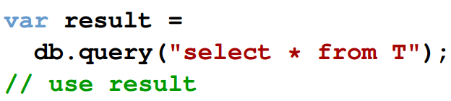
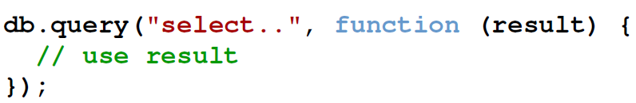
“I/O needs to be done differently” Inspiration
Many web applications have code, like this:
What is the software doing while it queries the database?
In many cases, just waiting for the response.
(blocks the thread)
But a line of code like this
allows the program to return to the event loop immediately.
This is how I/O should be done.

Slide 5
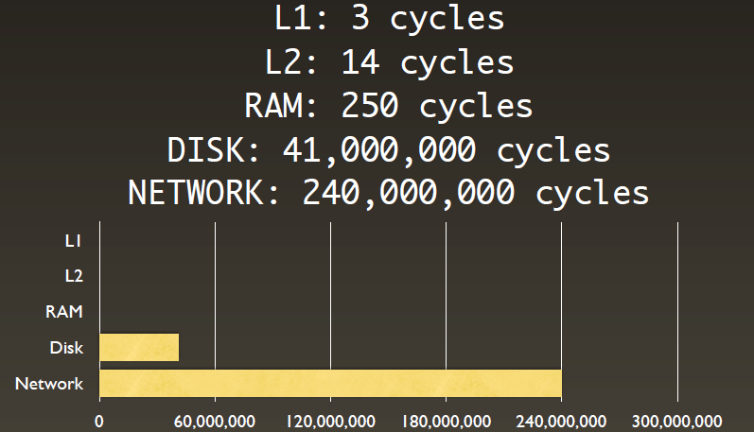
Typical I/O latency

Slide 6
What makes Node so special ?
Server-side JavaScript
most widely used programing language of the web
async by nature
Non-blocking I/O
do not wait slow ressources to respond
Built using V8 JavaScript Engine (from Chrome)
very fast and getting faster after each release
« Event-based » or « Asynchronous »
all execution initiated by an event
« Everything runs in parallel except your code »
Single-threaded Event Loop, limited to one CPU
no threads
no locks or no execution concurrency
events are executed in order

Slide 7
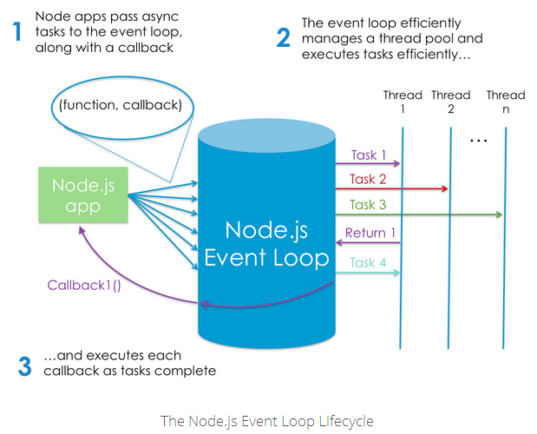
Node.js Processing Model

Slide 8
What makes Node.js so popular ?
It’s fast and scalable
JavaScript all the way
Minimal learning curve
JS is now the ubiquitous language of the web
Allow code re-use between front-end and back-end.
Web centric
Being based on JS and V8, node.js naturally attracts mainly web developers
Minimalist Core API and efficient module system
Active development
Always asynchronous
All I/O done in Node is by design asynchronous
Non-fragmented community

Slide 9
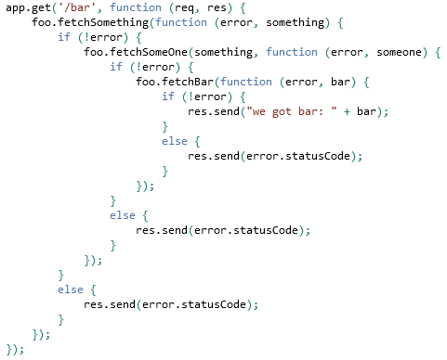

What makes Node.js so difficult ?
Asynchronous code
Single Event Loop
if # entries = 10,000
doSomething() takes ~1ms
you block for 10 seconds!
each node process is bound to one core
everything you do blocks
Easy to write code like this
(async may help you)

Slide 10





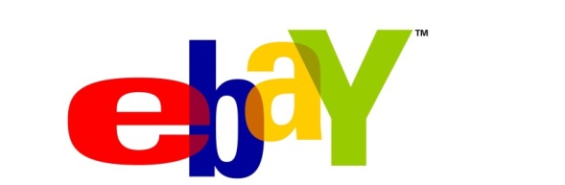



Companies using node
https://github.com/joyent/node/wiki/Projects,-Applications,-and-Companies-Using-Node

Slide 11


Finally, is it good for everything ?
Good Use Case
JSON API
Streaming
Real-time Pub/Sub systems
Chatty apps
Dashboards
Queues
Proxy
Bad Use Case
CPU heavy apps
Memory intensive apps
Simple CRUD / HTML apps

Slide 12
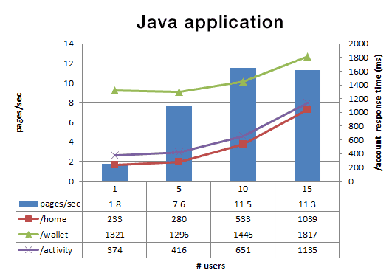
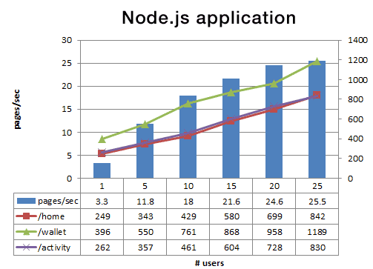
Node.js at Paypal Nov 2013, https://www.paypal-engineering.com/2013/11/22/node-js-at-paypal/
Node.js version Vs Java
Built almost twice as fast with fewer people
Written in 33% fewer lines of code
Constructed with 40% fewer files
Node.js performance Vs Java
Double the requests per second vs. the Java application
35% decrease in the average response time

Slide 13

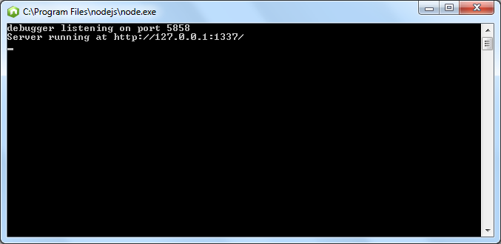
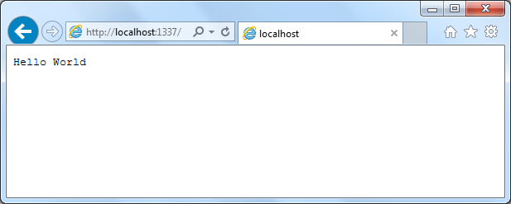
Hello World

Slide 14
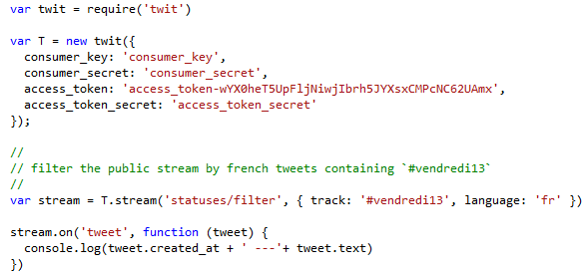
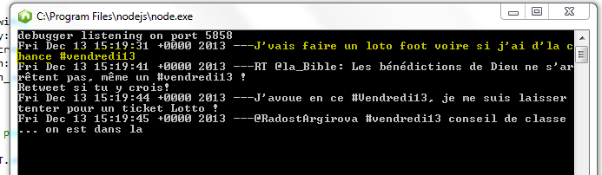
Tweeter Console

Slide 15

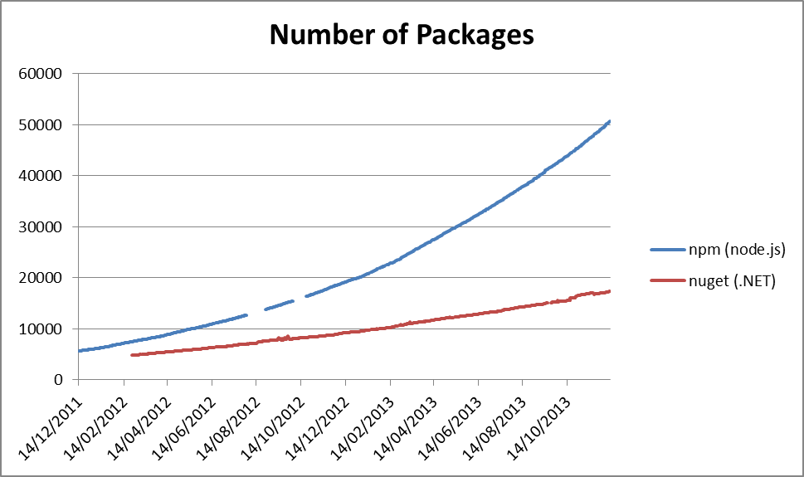
NPM : Node package manager innovation through modularity
Set of publicly available, reusable components, available through easy installation via an online repository, with version and dependency management
Preinstalled with Node.js
Approx. 50 544 online packages (Dec 2013)
+150 packages per day (#1 of all packages managers)
Features
publish, install, discover, and develop node programs
open to all, and anyone can publish their own module
puts modules in a place where node.js can find them
Manage dependencies & modules with package.json
“Node.js is successful because of npm”
“don’t worry about multiple versions causing conflicts because npm will automatically partition them. In other words: it just works.”

Slide 16
Interesting Modules
Express Web application framework for node
Underscore JavaScript's utility belt _
Commander Complete solution for node.js command-line interfaces
Async Higher-order functions and common patterns for asynchronous code
Socket.IO Realtime framework, with WebSockets and cross-browser fallbacks support
node_redis redis client for node
Jade Server-side templating engine
Request Standard HTTP client
node-unit Easy unit testing for node.js and the browser
winston a multi-transport async logging library for node.js
Forever simple CLI tool for ensuring that a given script runs continuously
node-sqlserver Microsoft Driver for Node.js for SQL Server
google-api Official client library for accessing Google APIs
azure-sdk Azure SDK for Node.js
… also more than 50 000 packages

Slide 17

Grunt : The Javascript Task Runner The Build Tool for JavaScript and Web Applications
“Grunt is a task-based command line build tool for JavaScript projects.”
Use the Power of JavaScript/Node to Automating Repetitive Tasks
Common Build Tasks (configured in gruntfile.js)
Concatenate grunt-contrib-concat
Compress grunt-contrib-compress
Minify grunt-contrib-htmlmin, grunt-contrib-cssmin
Linting (JsLint, JsHint) grunt-contrib-jshint , grunt-contrib-csslint
Testing grunt-contrib-qunit, grunt-contrib-nodeunit
Optimize Image grunt-contrib-imagemin
Monitor Files grunt-contrib-watch
Publish grunt-contrib-copy
YOUR TASK HERE
Who uses Grunt ?
Twitter, Jquery, Bootstrap, WordPress, Adobe, Pinterest, Facebook, …

Slide 18
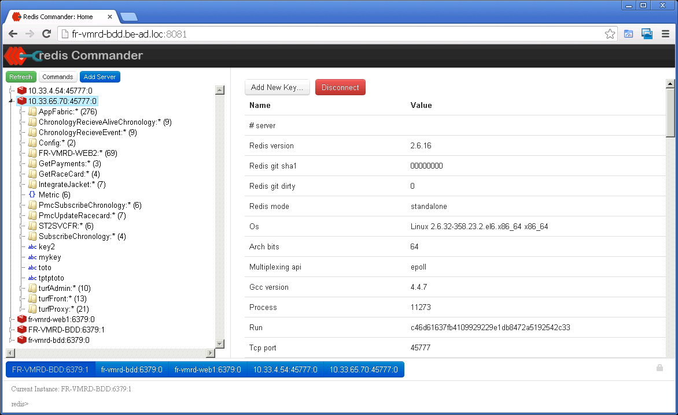
Redis Commander Built with Node

Slide 19
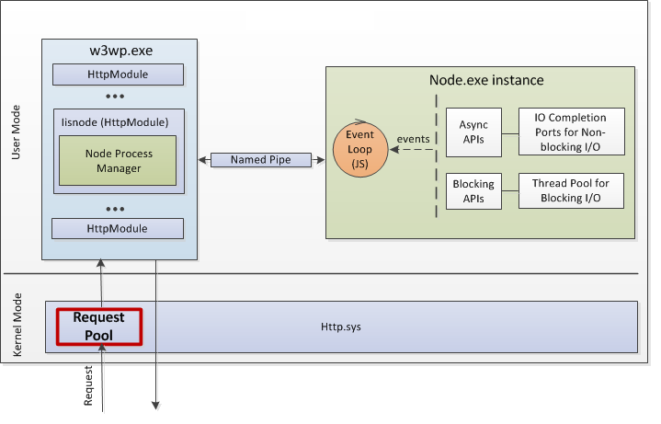

IISNode Host Node.js app in IIS
Native IIS module that allows hosting of node.js applications in IIS on Windows.
Node Process management
Side by side with other content types.
Scalability on multi-core servers
Integrated debugging
Auto-update
Access to logs over HTTP
Minimal changes to node.js application code
Integrated management experience
Other IIS benefits : Port sharing, security, URL rewriting, compression, caching, logging
Important Node : Windows Azure Node.js hosting is powered by IISNode !

Slide 20
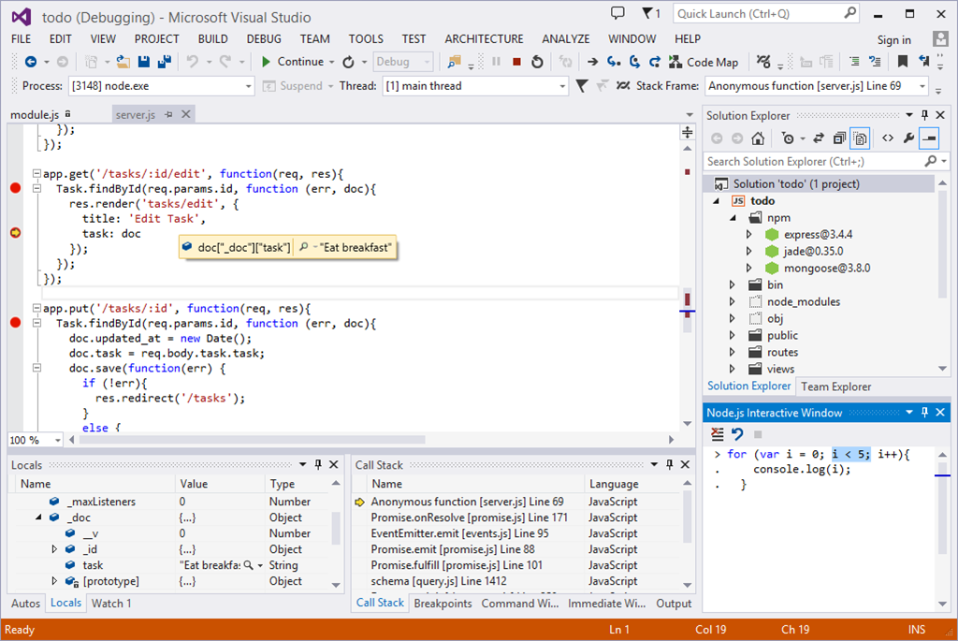
Node.js for Visual Studio Users Node.js Tools for Visual Studio (Alpha)
Turns Visual Studio into a Node.js IDE.
Editing
Intellisense
Profiling
Npm integration
Debugging locally and remotely (Windows/Mac/Linux)
Azure Deployment
…
You can also try

Slide 21
Questions

