Slide 1
Wireless TCP Performance Issues
Slides originally from Carey Williamson
Notes derived from “Computer Networking: A Top Down Approach”, by Jim Kurose and Keith Ross, Addison-Wesley.
Slides are adapted from the book’s companion Web site, with changes by Anirban Mahanti and Carey Williamson.

Slide 2

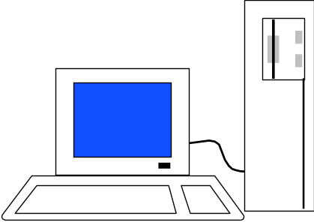

Example #1
Wireless TCP Performance Problems
Low capacity,
high error rate
Wired Internet
High
capacity,
low
error
rate
Wireless
Access
Hard to distinguish losses
here from losses here

Slide 3
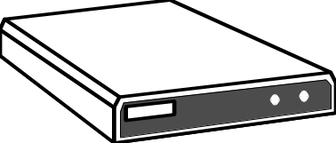
Example #1 (Cont’d)
Solution: “wireless-aware TCP” (I-TCP, ProxyTCP, Snoop-TCP, split connections...)

Slide 4
Example #2
Wireless TCP Fairness Problems
D
DATA
ACK
Wired Internet
Wireless
Bottleneck
AP
U
DATA
Loss of ACK = Loss of DATA
ACK

Slide 5

Example #3
Multi-hop “ad hoc” networking
Kelly
Carey

Slide 6
Example #3 (Cont’d)
Multi-hop “ad hoc” networking
Kelly
Carey

Slide 7
Example #3 (Cont’d)
Multi-hop “ad hoc” networking
Kelly
Carey

Slide 8
Example #3 (Cont’d)
Multi-hop “ad hoc” networking
Kelly
Carey

Slide 9
Example #3 (Cont’d)
Multi-hop “ad hoc” networking
Kelly
Carey

Slide 10
Example #3 (Cont’d)
Multi-hop “ad hoc” networking
Kelly
Carey

Slide 11
Example #3 (Cont’d)
Multi-hop “ad hoc” networking
Kelly
Carey

Slide 12
Example #3 (Cont’d)
Multi-hop “ad hoc” networking
Kelly
Carey

Slide 13
Example #3 (Cont’d)
Multi-hop “ad hoc” networking
Kelly
Carey

Slide 14
Example #3 (Cont’d)
Multi-hop “ad hoc” networking
Kelly
Carey

Slide 15
Example #3 (Cont’d)
Two interesting subproblems:
  Dynamic ad hoc routing: node movement can disrupt the IP routing path at any time, disrupting TCP connection; yet another way to lose packets!!!; possible solution: Explicit Loss Notification (ELN)? Handoff? Route prediction?
  TCP flow control: the bursty nature of TCP packet transmissions can create contention for the shared wireless channel among forwarding nodes; collisions between DATA and ACKs possible solution: rate-based flow control? Burst mode? Spatial reuse of channels?

Slide 16
Summary of Wireless TCP
TCP is the “four wheel drive” of TP’s
Wireless is a newly emerging technology with rapidly growing deployment popularity
“TCP” and “Wireless” don’t fit together all that well
Making TCP smarter about wireless helps!

