Slide 1
Smart City Traffic AI Cloud Project CMPE 281 Spring 2024 Group 2
System Analysis and Design Document
Under the guidance of Prof. Zeyu Gao
Project Group : 2
Aravind
Pragnesh
Ravi Teja
Shreekar
Dt : 21-Feb-2024

Slide 2
Project Details Project Group ID : 2 Project Topic : Option #1 – Smart City Traffic AI Cloud Platform
- Building Smart City Traffic AI Cloud Platform Project Task Partition : Pragnesh : 1-A smart city traffic AI cloud system dashboard along with the NoSQL DB Shreekar : 3-Smart City IOT Station Management Aravind : 4-CCTV Camera Device Management Ravi Teja : 2 –Traffic Tracking Drone Scheduling Management and Relational DB, Backend Integration of the components

Slide 3
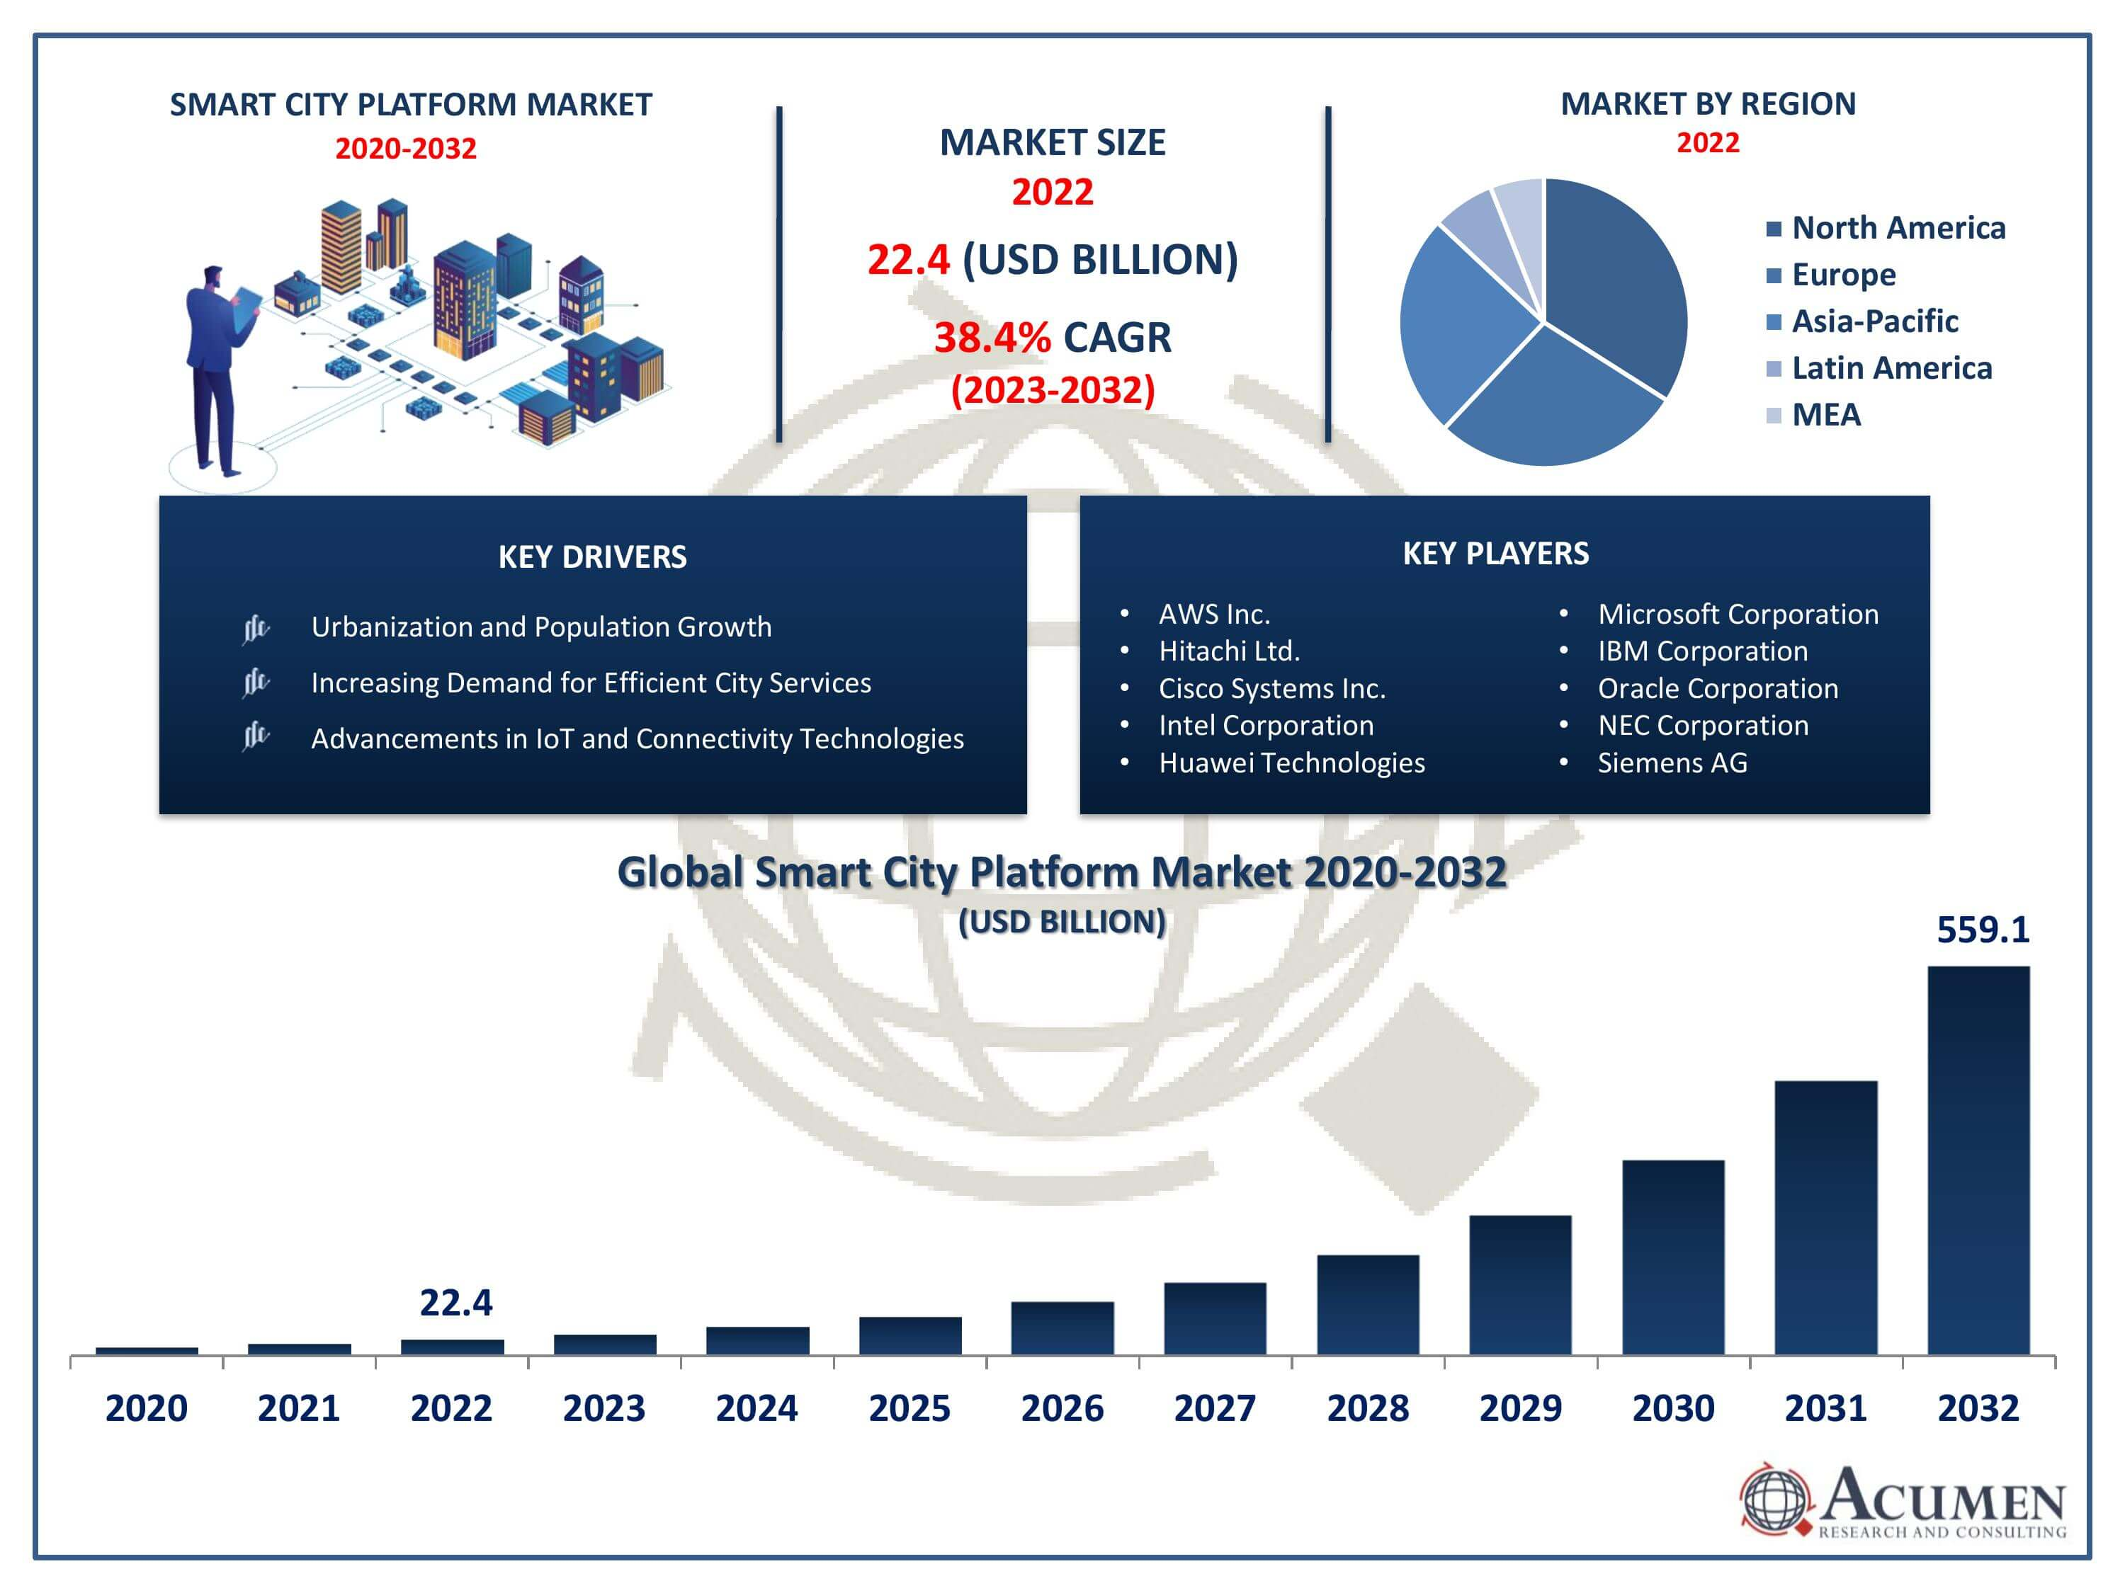
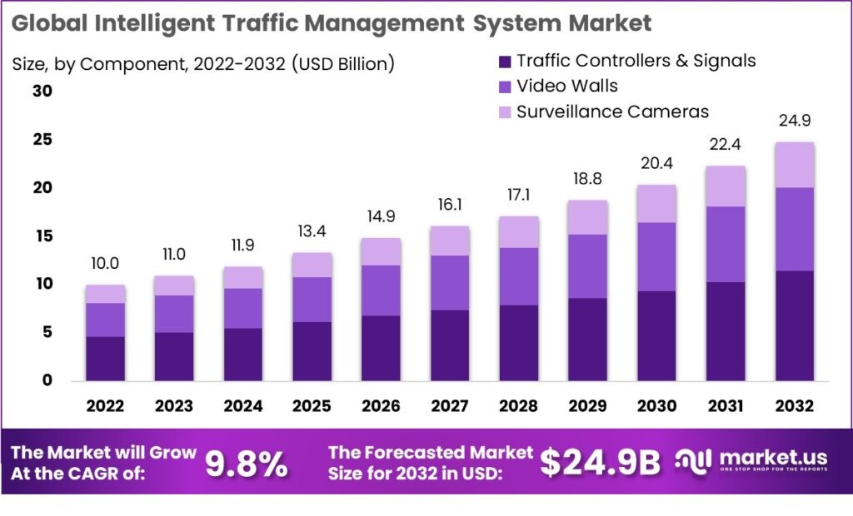
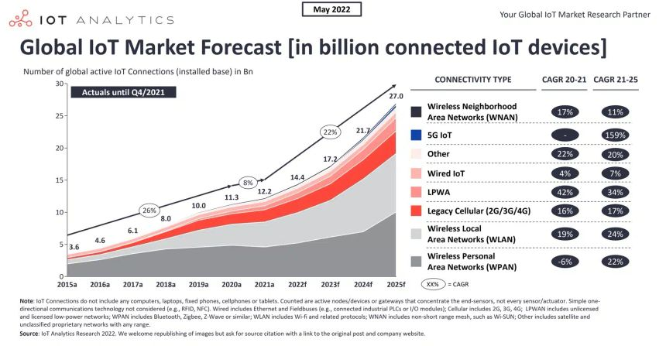
Market research & analysis for the project system
Reference : https://www.acumenresearchandconsulting.com/
Notes:
Reference : https://www.acumenresearchandconsulting.com/smart-city-platform-market#:~:text=The%20Smart%20City%20Platform%20Market,38.4%25%20from%202023%20to%202032.&text=By%20deployment%20model%2C%20the%20cloud,of%20revenue%20share%20in%202022

Slide 4
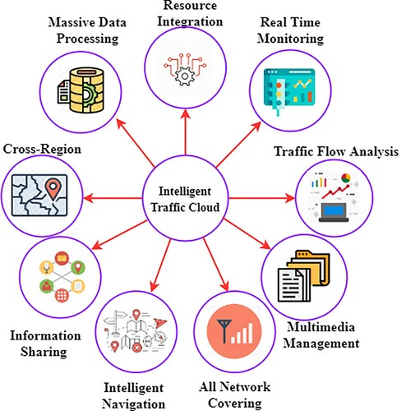
Introduction
Brief overview of the project objectives
The Smart City Traffic AI Cloud Project aims to revolutionize urban traffic management through the implementation of advanced AI and cloud technologies.
This involves the development of a cloud-based platform that leverages real-time data analysis and prediction to optimize traffic flow and reduce congestion in smart cities.
Expected outcomes and benefits of the Smart City Traffic AI Cloud platform
Enhanced traffic flow: By providing real-time insights into traffic patterns, the platform can optimize traffic signal timings and route recommendations, leading to smoother traffic flow.
Reduced congestion: With proactive management of traffic incidents and congestion hotspots, the platform can minimize congestion and improve overall city mobility.
Improved city mobility: Citizens and commuters will experience reduced travel times and improved accessibility, leading to a more efficient and sustainable urban transportation system

Slide 5
System Requirements and Analysis
Objective:
Enhance urban traffic management and public safety via a cloud-based platform integrating real-time data from IoT, drones, and CCTV for analytics and predictive insights.
Key Functionalities:
Traffic Agents: Real-time dashboard, traffic flow management, drone and device (IoT, CCTV) management.
Public Access: Traffic condition access, alerts on traffic updates.
Technical Specifications:
Performance: Real-time data processing with minimal latency.
Scalability: Cloud infrastructure to support growing data and user base.
Security: Data encryption, secure authentication, role-based access.
Architecture: Microservices with RESTful API integration for device and user communication.
Data Management: Collection & Processing: From IoT sensors, CCTV, drones.
Storage:
Hybrid (Relational and NoSQL) databases for structured and unstructured data.
User Interface:
Intuitive, accessible, responsive design for traffic agents and the public.
Compliance:
Adheres to data protection, privacy, and drone operation standards.

Slide 6
Components
Component #1 – Smart City Traffic AI Cloud System Dashboard:*
1. *User-Centric Interface:* Develop an intuitive graphic user interface to facilitate seamless system and user interactions. The map-based city traffic view empowers users with real-time insights into traffic statues, flow, and issues, promoting informed decision-making.
2. Data Integration for Actionable Insights:* Emphasize the dashboard's ability to integrate diverse datasets, providing a holistic view of city traffic. This ensures efficient monitoring, enabling authorities to take proactive measures based on real-time data.
Component #2 – Smart City Traffic Tracking Drone Schedule Setup and Management:*
1. *Customized Surveillance Scheduling:* Enable clients to define and set up surveillance flying schedules, tailoring drone operations to specific traffic patterns and critical periods. This customization enhances the adaptability and effectiveness of the surveillance system.
2. *Enhanced Aerial Perspective (Optional):* Highlight the optional drone feature as a valuable addition, offering an aerial perspective for traffic tracking. This capability adds depth to the surveillance, aiding in identifying and addressing traffic issues from unique vantage points.
Component #3 – Smart City IoT Station Management:*
1. IOT Management system:* Implement a robust system for adding, updating, and accessing deployed camera devices within the Smart City IoT station. This ensures efficient management of the IoT infrastructure, optimizing device performance and longevity.
2. Real-Time Data Retrieval:* Showcase the capability to retrieve real-time data from deployed camera devices. This feature empowers users with instant access to critical information, fostering quick response to changing traffic conditions or security concerns.
Component #4 – CCTV Camera Device Management:*
1. *Seamless Device Integration:* Implement user-friendly functionalities for adding, updating, and accessing deployed CCTV camera devices. This ensures a smooth integration process and efficient management of the CCTV network within the smart city infrastructure.

Slide 7
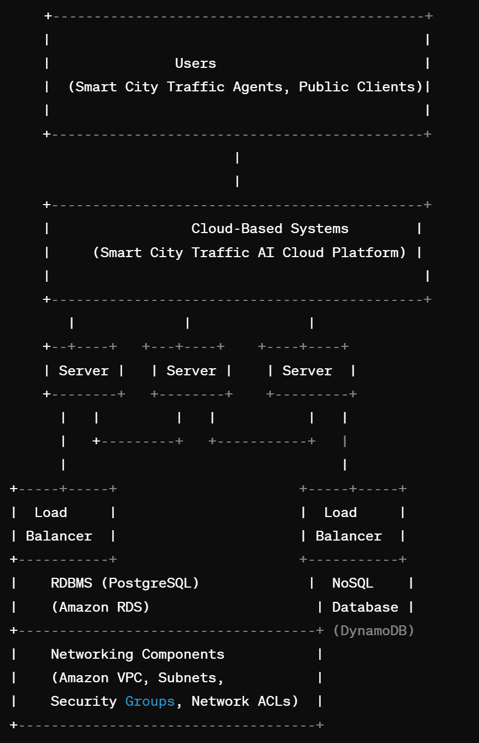
Cloud System Infrastructure Design
Persona:
Smart city traffic agents
Public city clients
Cloud-Based Systems:
Smart City Traffic AI Cloud platform
Hosted on AWS (Amazon Web Services), leveraging various services for scalability, reliability, and security.
Servers:
Compute instances for hosting application services and databases.
Auto-scaling groups to dynamically adjust server capacity based on traffic load.
Data Storage and Databases:
Relational Database Management System (RDBMS) for structured data storage:
Hosted on Amazon RDS (Relational Database Service) using PostgreSQL.
NoSQL Database for semi-structured and unstructured data storage:
Hosted on Amazon DynamoDB for its scalability and flexibility.
Load Balancers:
Elastic Load Balancer (ELB) to distribute incoming traffic across multiple servers.
Application Load Balancer (ALB) for routing HTTP/HTTPS traffic to the appropriate services.
Networking Connectivity:
Amazon VPC (Virtual Private Cloud) for creating isolated network environments.
Subnets for organizing resources and controlling access.
Security groups and Network ACLs (Access Control Lists) for network security and traffic control.

Slide 8
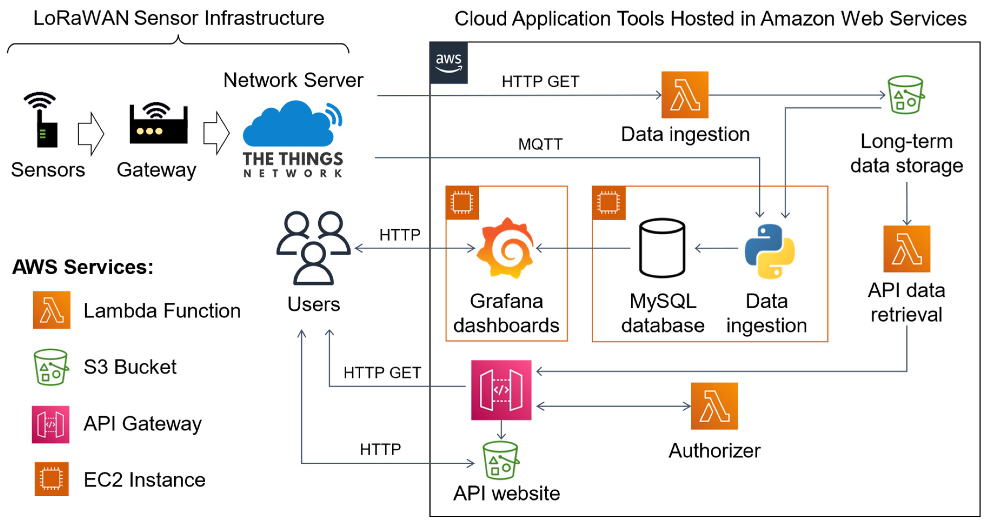
Smart IOT Management system
Cloud-based System Infrastructure
Cloud-based system infrastructure diagram
This diagram illustrates the architecture of the Smart City Traffic AI Cloud platform, including its various components and their interactions. It includes:
Different user groups: Smart city traffic agents, public city clients
Cloud-based systems and servers: Hosting the platform's services and functionalities
Data storage and DBs: Relational and NoSQL databases for storing traffic data
Load balancing and scalability: Ensuring efficient distribution of traffic load across servers and the ability to scale resources dynamically
Networking connectivity: Communication channels between components and external systems

Slide 9
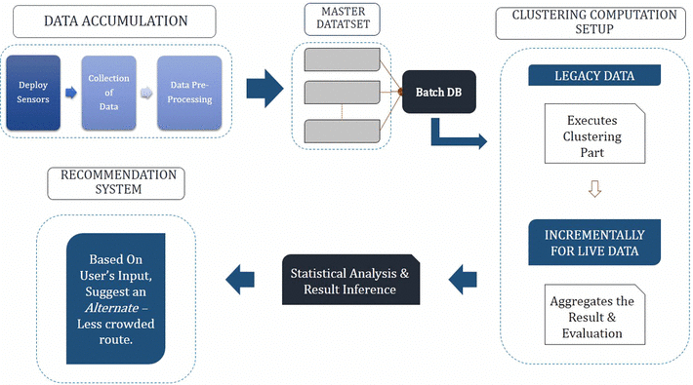
System DB and Data Design
Rational DB Design and NoSQL DB Design
4.1 System DB design using ERD diagram for Structured Data (User profiles & Billing)
The Entity-Relationship Diagram (ERD) illustrates the relational database design for the Smart City Traffic AI Cloud platform. It shows the entities, relationships, and attributes involved in storing traffic data and managing system entities.
4.2 System NoSQL DB design using MongoDB for Raw Data
The NoSQL database design for the platform is based on MongoDB, a document-oriented database system. It provides flexibility in handling unstructured traffic data and allows for horizontal scalability to accommodate growing data volumes.

Slide 10
System Dashboard UI Design
User Dashboard Architecture and UI Operation Behaviour
System Dashboard UI Design
Architecture:
User Dashboard Architecture Design:
Layout: The dashboard features a user-friendly layout with intuitive navigation and clear visualization of traffic data.
Components: It integrates modules for real-time traffic monitoring, surveillance scheduling, and device management.
Data Visualization: Utilizes interactive charts, maps, and graphs to present traffic flow, congestion areas, and surveillance status effectively.
User Interface Operation Design:
Navigation Controls: Users can easily navigate between different sections and functionalities using intuitive menus and buttons.
Responsive Design: The dashboard is designed to be responsive, ensuring seamless access and usability across various devices including desktops, tablets, and smartphones.
Interactivity: Provides interactive elements such as filters, tooltips, and hover effects for users to explore data and gain insights effortlessly.

Slide 11
Impact on the Society
Improved Traffic Management: The platform optimizes traffic flow, reduces congestion, and enhances overall urban mobility, leading to smoother and more efficient transportation systems.
Enhanced Safety and Security: By providing real-time monitoring and predictive insights, the platform enables proactive management of traffic incidents, contributing to safer road conditions and reduced accident rates.
Data-Driven Decision Making: Access to comprehensive traffic data and analytics empowers city authorities and traffic agents to make informed decisions, allocate resources effectively, and implement targeted interventions to address traffic challenges.
Efficient Resource Utilization: Through intelligent scheduling of surveillance missions and optimized deployment of resources, the platform helps maximize the efficiency and effectiveness of traffic management operations, minimizing costs and resource wastage.

