Slide 1

ICT942 — CYBER SECURITY PROJECT
Healthcare Integration & Clinical Terminology Test Harness
A synthetic FHIR test harness for FAZ Australia's MedTalk Connect — Stage 1 Design & Feasibility
Sonam Pelden • Charity Gwese • Rikesh Aryal • Zubair Adil Soomro
Industry Partner: FAZ Australia (MedTalk) | Mentor: Atif Nisar | Supervisor: Md Ashraf Uddin

Slide 2






Presentation Overview
01
02
Introduction
Project Planning & Management
Business context, problem statement, goals & stakeholders
Charter, roadmap, RACI, risk register, feasibility
03
04
Industry & Technology Landscape
Solution Design
Standards review, comparative analysis, gap analysis
Architecture, technology stack, security & cost
05
06
Proof of Concept & Evaluation
Conclusion & Recommendations
Sprint plan, PoC description, testing & validation
Key findings and path into Stage 2
2

Slide 3
Business Context & Problem Statement
FAZ Australia is a Canberra health-tech company behind MedTalk, an AI clinical scribe used across Australian clinics, integrated with EMR systems via MedTalk Connect (FHIR-based). The Problem: MedTalk Connect has no safe, isolated way to validate FHIR data exchange or SNOMED CT-AU → ICD-10-AM → MBS terminology mapping before production deployment. Why it matters: Undetected failures risk incorrect clinical documentation, billing errors, and privacy breaches under the Privacy Act 1988 (Cth) and My Health Records Act 2012 (Cth).
0
Real patient records used — 100% synthetic by design
3
Connectors in scope: Oracle Health, Best Practice/Halo, Epic
3

Slide 4


Goals, Scope & Stakeholders
Project Goal
Key Stakeholders
Design and validate a synthetic FHIR test harness so FAZ Australia can safely verify interoperability and terminology mapping — without real patient data.
Atif Nisar
Industry Mentor — High interest, High influence
Md Ashraf Uddin
Academic Supervisor — Medium interest, High influence
IN SCOPE
OUT OF SCOPE
• FHIR/HL7v2/SMART auth architecture • SNOMED CT-AU → ICD-10-AM → MBS mapping design • Written test plan (happy path, errors)
• Building the harness (Stage 2) • Real patient data / production EMR • Changes to MedTalk's AI/NLP engine
Project Team
Delivery Team — High interest, High influence
MedTalk Engineering
End users of harness — High interest, Medium influence
4

Slide 5

Project Charter & Roadmap
Charter Highlights
8-Week Roadmap
Purpose: Deliver a synthetic FHIR test harness for MedTalk Connect validation. Authority: Md Ashraf Uddin & Atif Nisar jointly approve scope and stage gates. Value: Lower compliance risk, faster connector onboarding, reusable CI/CD asset.
W1–2
Charter & Stakeholder Analysis
W3–4
Requirements & SRS
W5
Feasibility & Risk (Stage 1 done)
W6
Report Drafting: Sections 1–3
W7
Design, PoC Planning: Sections 4–6
W8
Finalise, Rehearse, Submit (13 Sept)
5

Slide 6
Team Roles & RACI Matrix
Deliverable | Sonam | Charity | Rikesh | Zubair
Charter & Planning | R/A | C | C | I
Business/Clinical Context | A | R | I | I
Tech Landscape Analysis | C | R (3.1) | R/A (3.2–4) | I
Solution Architecture | R/A | I | C | I
Security Design & Cost | C | I | R/A | C
PoC & Testing | I | R (5.2) | C | R/A (5.1,5.3)
Report Compilation | A | C | C | R
R = Responsible A = Accountable C = Consulted I = Informed
6

Slide 7
Risk Register — Top Risks
ID | Risk | Score | Rating | Response
R1 | Connector crash/hang on slow FHIR response | 6 | High | Automated slow-response test
R4 | Cross-tenant data leakage | 4 | High | Row-level tenant isolation + gateway checks
R5 | Real patient identifier in synthetic dataset | 4 | High | Luhn-check rejection rule
R9 | Team's limited healthcare-semantics experience | 4 | Medium | Curated SNOMED subset, mentor guidance
R10 | Scope creep from broad brief | 4 | Medium | Fixed endpoint list, agreed exclusions
Score = Likelihood × Impact. All ten Stage-1 risks are mapped to automated failure-mode tests or architectural controls.
7

Slide 8



Feasibility Study — Six Dimensions
Technical
Economic
Operational
High
High
Medium-High
Mature open-source stack (FHIR R4, AU Core, HAPI FHIR); main risk is healthcare semantics, not tools.
~$150 AUD total cost; open-source + free-tier hosting under WIL arrangement.
Confirmed mentor commitment and tooling; risk is competing university workloads.
Legal
Ethical
Cybersecurity
High
High
High
No real patient data used; Luhn-check validation technically enforces compliance.
No real-patient harm possible by design; focus is AI-generated data integrity.
Layered controls reduce every identified threat to Low residual risk.
8

Slide 9
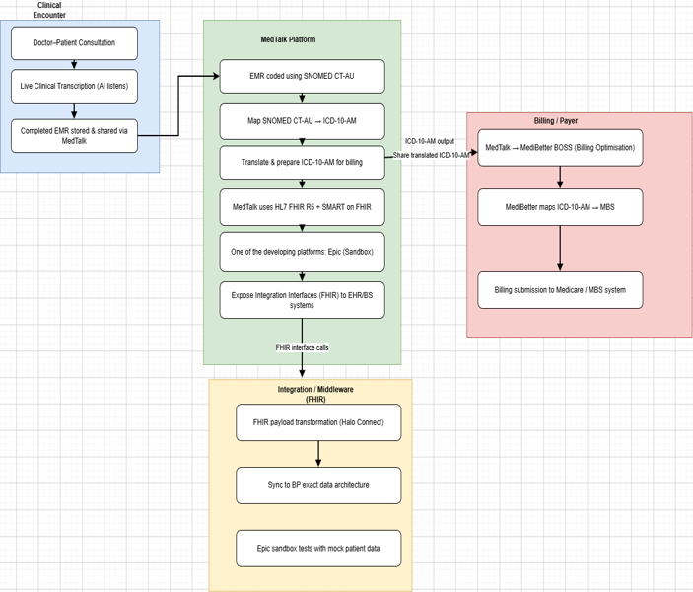
Faz Australia — MedTalk Clinical Documentation Platform: Current State (As-Is) Faz Australia — MedTalk Clinical Documentation Platform: Current State (As-Is)
INDUSTRY & TECHNOLOGY LANDSCAPE ANALYSIS
MedTalk (Faz Australia) is an AI clinical documentation tool: it transcribes doctor–patient consultations live, codes the EMR in SNOMED CT-AU, maps codes to ICD-10-AM, and shares billing data via MediBetter BOSS to the MBS. (MediBetter, 2026)
It integrates with Best Practice via Halo Connect and HL7 FHIR R5 / SMART on FHIR, using Epic’s developer sandbox to test integrations against mock patient data before go-live. (MedTalk AI, 2020)
Epic onboarding costs ~US$500 (listing) + up to US$1,900 (membership) + US$40K–350K (build labour, read-only to full bidirectional FHIR); MedTalk–MediBetter API fees run US$100–500. (Choudhary, 2026; MarkiTech.AI, 2025)
Key pain point: no reusable, safe test environment — restricted sandbox access slows development, makes issues hard to reproduce, and raises compliance exposure.
MedTalk data flow: clinical encounter → coding → FHIR integration → billing

Slide 10
Comparative Analysis of existing Solutions
SMART Health IT Sandbox
Epic App Orchard / Sandbox
MediRecords Developer Sandbox
Synapxe HealthX Innovation Sandbox
Strength Open, well-documented sandbox purpose-built for testing SMART on FHIR apps.
Strength Mirrors real Epic EHR behaviour, testable against mock patient data before go-live.
Strength Australian-context FHIR/Connect API testing aligned to local standards.
Strength National-scale sandbox supporting a broad health-tech innovation ecosystem.
Limitation Scoped to the SMART app ecosystem that is for authentication only does not validate full cross-system, multi-vendor data exchange.
Limitation Epic-specific; formal onboarding plus US$40K–350K build labour restrict accessibility.
(Choudhary, 2026; Bonami Software, 2026)
Limitation Bound to Singapore’s governance/standards — not directly transferable to Australian FHIR/SNOMED CT-AU context.
(Synapxe, 2023)
Limitation Scoped to MediRecords’ own APIs only — not a vendor-neutral environment.
(MediRecords Connect, 2026)
The gap: each platform is vendor- or ecosystem-bound. None offers a vendor-neutral environment that validates FHIR exchange, SNOMED CT-AU/ICD-10-AM terminology and authentication together, before and after deployment — the role the proposed Test Harness fills.

Slide 11
Technology & Market Survey
HL7 FHIR
SNOMED CT-AU → ICD-10-AM
Australia’s preferred clinical terminology (SNOMED CT + Australian Medicines Terminology), mapped to ICD-10-AM for diagnosis coding and onward to MBS for billing. (SNOMED CT-AU & AMT Release, 2022)
Central exchange standard for patient data, appointments and clinical notes; supports RESTful APIs, documents and messaging. Free to build on, unlike the trademarked “HL7” name. (eCQI, 2025)
Synthetic Patient Data
Synthea generates realistic synthetic EHRs, but on US demographics; CSIRO’s Australian-context equivalent exists but is not publicly available for this project.
SMART on FHIR & Halo Connect
SMART on FHIR provides OAuth 2.0-based secure app authorisation. Halo Connect (Halo Link + Halo Cloud) bridges local practice databases to external FHIR/SQL consumers. (SMART on FHIR, n.d.; Halo Connect Documentation, 2026

Slide 12
Gap Analysis From Current State to Test harness
m Current State to Test Harness
1
Unsafe / restricted testing
2
Basic API connectivity
↓
Fully synthetic test environment
↓
Standards-aligned interoperability (FHIR + SNOMED CT-AU + ICD-10-AM)
3
Text generation only
4
Happy-path testing
↓
Verified clinical coding with known terminology mapping
↓
Resilience testing (delays, bad data, dropped connections)
5
Manual validation
6
Fragmented tooling
↓
Reusable automated test suite
↓
Single, unified validation workflow
Proposed solution: a centralised, vendor-neutral Test Harness — built on synthetic data — that unifies FHIR messaging, terminology validation and automated resilience testing for MedTalk, before and after production deployment.

Slide 13

Thank You
Questions & Discussion
Sonam Pelden • Charity Gwese • Rikesh Aryal • Zubair Adil Soomro

