Slide 1

ICT942 — CYBER SECURITY PROJECT
Healthcare Integration & Clinical Terminology Test Harness
A synthetic FHIR test harness for FAZ Australia's MedTalk Connect — Stage 1 Design & Feasibility
Sonam Pelden • Charity Gwese • Rikesh Aryal • Zubair Adil Soomro
Industry Partner: FAZ Australia (MedTalk) | Mentor: Atif Nisar | Supervisor: Md Ashraf Uddin

Slide 2






Presentation Overview
01
02
Introduction
Project Planning & Management
Business context, problem statement, goals & stakeholders
Charter, roadmap, RACI, risk register, feasibility
03
04
Industry & Technology Landscape
Solution Design
Standards review, comparative analysis, gap analysis
Architecture, technology stack, security & cost
05
06
Proof of Concept & Evaluation
Conclusion & Recommendations
Sprint plan, PoC description, testing & validation
Key findings and path into Stage 2
2

Slide 3
Business Context & Problem Statement
FAZ Australia is a Canberra health-tech company behind MedTalk, an AI clinical scribe used across Australian clinics, integrated with EMR systems via MedTalk Connect (FHIR-based).
The Problem: MedTalk Connect has no safe, isolated way to validate FHIR data exchange or SNOMED CT-AU → ICD-10-AM → MBS terminology mapping before production deployment.
Why it matters: Undetected failures risk incorrect clinical documentation, billing errors, and privacy breaches under the Privacy Act 1988 (Cth) and My Health Records Act 2012 (Cth).
0
Real patient records used — 100% synthetic by design
3
Connectors in scope: Oracle Health, Best Practice/Halo, Epic
3

Slide 4


Goals, Scope & Stakeholders
Project Goal
Key Stakeholders
Design and validate a synthetic FHIR test harness so FAZ Australia can safely verify interoperability and terminology mapping — without real patient data.
Atif Nisar
Industry Mentor — High interest, High influence
Md Ashraf Uddin
Academic Supervisor — Medium interest, High influence
IN SCOPE
OUT OF SCOPE
• FHIR/HL7v2/SMART auth architecture
• SNOMED CT-AU → ICD-10-AM → MBS mapping design
• Written test plan (happy path, errors)
• Building the harness (Stage 2)
• Real patient data / production EMR
• Changes to MedTalk's AI/NLP engine
Project Team
Delivery Team — High interest, High influence
MedTalk Engineering
End users of harness — High interest, Medium influence
4

Slide 5

Project Charter & Roadmap
Charter Highlights
8-Week Roadmap
Purpose: Deliver a synthetic FHIR test harness for MedTalk Connect validation.
Authority: Md Ashraf Uddin & Atif Nisar jointly approve scope and stage gates.
Value: Lower compliance risk, faster connector onboarding, reusable CI/CD asset.
W1–2
Charter & Stakeholder Analysis
W3–4
Requirements & SRS
W5
Feasibility & Risk (Stage 1 done)
W6
Report Drafting: Sections 1–3
W7
Design, PoC Planning: Sections 4–6
W8
Finalise, Rehearse, Submit (13 Sept)
5

Slide 6
Team Roles & RACI Matrix
Deliverable | Sonam | Charity | Rikesh | Zubair
Charter & Planning | R/A | C | C | I
Business/Clinical Context | A | R | I | I
Tech Landscape Analysis | C | R (3.1) | R/A (3.2–4) | I
Solution Architecture | R/A | I | C | I
Security Design & Cost | C | I | R/A | C
PoC & Testing | I | R (5.2) | C | R/A (5.1,5.3)
Report Compilation | A | C | C | R
R = Responsible A = Accountable C = Consulted I = Informed
6

Slide 7
Risk Register — Top Risks
ID | Risk | Score | Rating | Response
R1 | Connector crash/hang on slow FHIR response | 6 | High | Automated slow-response test
R4 | Cross-tenant data leakage | 4 | High | Row-level tenant isolation + gateway checks
R5 | Real patient identifier in synthetic dataset | 4 | High | Luhn-check rejection rule
R9 | Team's limited healthcare-semantics experience | 4 | Medium | Curated SNOMED subset, mentor guidance
R10 | Scope creep from broad brief | 4 | Medium | Fixed endpoint list, agreed exclusions
Score = Likelihood × Impact. All ten Stage-1 risks are mapped to automated failure-mode tests or architectural controls.
7

Slide 8



Feasibility Study — Six Dimensions
Technical
Economic
Operational
High
High
Medium-High
Mature open-source stack (FHIR R4, AU Core, HAPI FHIR); main risk is healthcare semantics, not tools.
~$150 AUD total cost; open-source + free-tier hosting under WIL arrangement.
Confirmed mentor commitment and tooling; risk is competing university workloads.
Legal
Ethical
Cybersecurity
High
High
High
No real patient data used; Luhn-check validation technically enforces compliance.
No real-patient harm possible by design; focus is AI-generated data integrity.
Layered controls reduce every identified threat to Low residual risk.
8

Slide 9
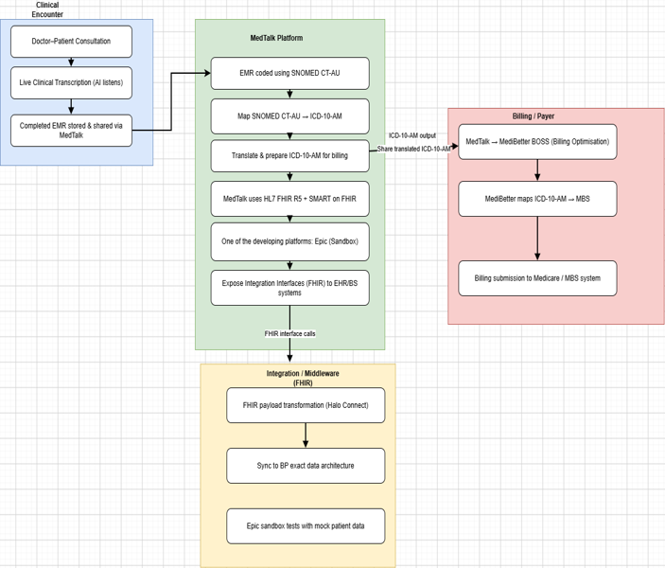
Faz Australia — MedTalk Clinical Documentation Platform: Current State (As-Is)
Faz Australia — MedTalk Clinical Documentation Platform: Current State (As-Is)
INDUSTRY & TECHNOLOGY LANDSCAPE ANALYSIS
MedTalk (Faz Australia) is an AI clinical documentation tool: it transcribes doctor–patient consultations live, codes the EMR in SNOMED CT-AU, maps codes to ICD-10-AM, and shares billing data via MediBetter BOSS to the MBS. (MediBetter, 2026)
It integrates with Best Practice via Halo Connect and HL7 FHIR R5 / SMART on FHIR, using Epic’s developer sandbox to test integrations against mock patient data before go-live. (MedTalk AI, 2020)
Epic onboarding costs ~US$500 (listing) + up to US$1,900 (membership) + US$40K–350K (build labour, read-only to full bidirectional FHIR); MedTalk–MediBetter API fees run US$100–500. (Choudhary, 2026; MarkiTech.AI, 2025)
Key pain point: no reusable, safe test environment — restricted sandbox access slows development, makes issues hard to reproduce, and raises compliance exposure.
MedTalk data flow: clinical encounter → coding → FHIR integration → billing

Slide 10
Comparative Analysis of existing Solutions
SMART Health IT Sandbox
Epic App Orchard / Sandbox
MediRecords Developer Sandbox
Synapxe HealthX Innovation Sandbox
Strength
Open, well-documented sandbox purpose-built for testing SMART on FHIR apps.
Strength
Mirrors real Epic EHR behaviour, testable against mock patient data before go-live.
Strength
Australian-context FHIR/Connect API testing aligned to local standards.
Strength
National-scale sandbox supporting a broad health-tech innovation ecosystem.
Limitation
Scoped to the SMART app ecosystem that is for authentication only does not validate full cross-system, multi-vendor data exchange.
Limitation
Epic-specific; formal onboarding plus US$40K–350K build labour restrict accessibility.
(Choudhary, 2026; Bonami Software, 2026)
Limitation
Bound to Singapore’s governance/standards — not directly transferable to Australian FHIR/SNOMED CT-AU context.
(Synapxe, 2023)
Limitation
Scoped to MediRecords’ own APIs only — not a vendor-neutral environment.
(MediRecords Connect, 2026)
The gap: each platform is vendor- or ecosystem-bound. None offers a vendor-neutral environment that validates FHIR exchange, SNOMED CT-AU/ICD-10-AM terminology and authentication together, before and after deployment — the role the proposed Test Harness fills.

Slide 11
Technology & Market Survey
HL7 FHIR
SNOMED CT-AU → ICD-10-AM
Australia’s preferred clinical terminology (SNOMED CT + Australian Medicines Terminology), mapped to ICD-10-AM for diagnosis coding and onward to MBS for billing. (SNOMED CT-AU & AMT Release, 2022)
Central exchange standard for patient data, appointments and clinical notes; supports RESTful APIs, documents and messaging. Free to build on, unlike the trademarked “HL7” name. (eCQI, 2025)
Synthetic Patient Data
Synthea generates realistic synthetic EHRs, but on US demographics; CSIRO’s Australian-context equivalent exists but is not publicly available for this project.
SMART on FHIR & Halo Connect
SMART on FHIR provides OAuth 2.0-based secure app authorisation. Halo Connect (Halo Link + Halo Cloud) bridges local practice databases to external FHIR/SQL consumers. (SMART on FHIR, n.d.; Halo Connect Documentation, 2026

Slide 12
Gap Analysis From Current State to Test harness
m Current State to Test Harness
1
Unsafe / restricted testing
2
Basic API connectivity
↓
Fully synthetic test environment
↓
Standards-aligned interoperability (FHIR + SNOMED CT-AU + ICD-10-AM)
3
Text generation only
4
Happy-path testing
↓
Verified clinical coding with known terminology mapping
↓
Resilience testing (delays, bad data, dropped connections)
5
Manual validation
6
Fragmented tooling
↓
Reusable automated test suite
↓
Single, unified validation workflow
Proposed solution: a centralised, vendor-neutral Test Harness — built on synthetic data — that unifies FHIR messaging, terminology validation and automated resilience testing for MedTalk, before and after production deployment.

Slide 13
Technical Solution Overview
01
Target Objective
Provides a controlled testing environment to mitigate cybersecurity and clinical-safety risks identified in the current-state analysis
02
Core Capabilities
Evaluates system interoperability, automated terminology mapping, and end-to-end connector behaviours without exposing real patient information
03
Technical Foundation
Built entirely on synthetic data pipelines, FHIR R4 specifications, Australian healthcare interoperability standards, and simulated EMR targets.

Slide 14
Proposed Solution Architecture
Primary End-Users: Grants controlled system access specifically to authorized MedTalk Connect engineering teams and testing personnel – Doctors as actors in testing env.
Data Generation Pipeline: Powers scenario building by generating synthetic patient demographics and clinical encounter profiles stripped of realistic patient identifiers.
Validation & Compliance: Routes generated records through strict validation control checks to guarantee compliance with synthetic constraints prior to testing.
Interoperability Testing Layer: Transforms validated datasets into FHIR R4 objects and simulated HL7 v2 messages to feed the downstream test execution engines.
Terminology Mapping Matrix: Evaluates translation chains by mapping representative clinical concepts across SNOMED CT-AU, ICD-10-AM, and MBS code systems.

Slide 15
Security design & control mapping
Identify
Protect
Detect
Respond / Recover
Synthetic-only patient data; real-identifier ranges (e.g. IHI prefix 800360) rejected before use.
SMART on FHIR + OAuth 2.0 at login; tenant isolation between connectors; input validation on FHIR resources.
Structured error handling surfaces malformed data, slow responses and dropped connections during test runs.
Immutable audit logging for traceability; Stage 2 adds incident response and backup/recovery controls.
Login screen ties directly into this: the SSO/token gateway is the Protect-layer entry point for the whole harness.

Slide 16

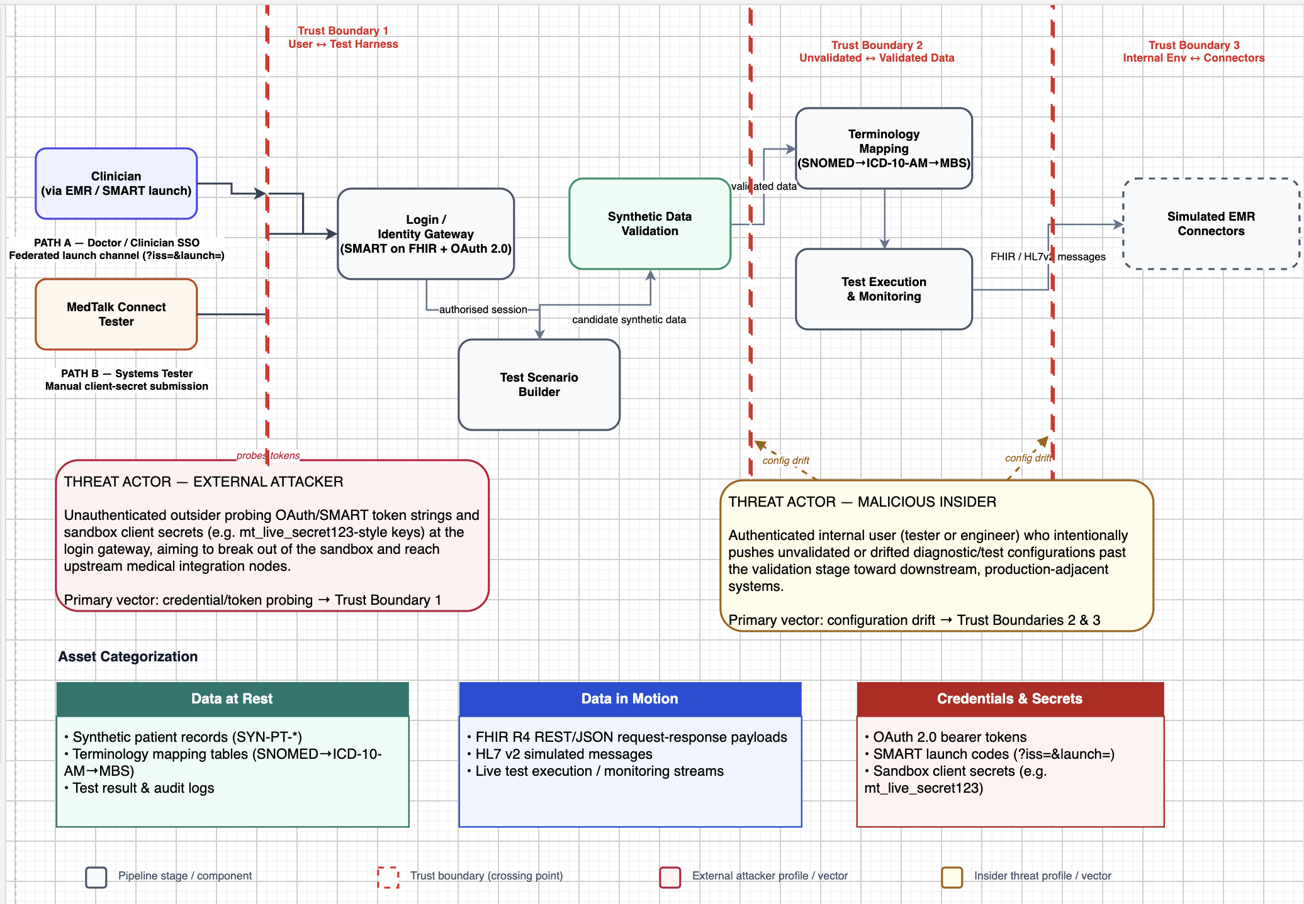
Security design & control mapping
Federated Access Paths: Clinicians use federated SMART on FHIR launches, while testers access via manual sandbox tokens.
Identity Protection (Boundary 1): Both authenticated paths converge at the identity gateway to intercept external credential-probing threats.
Pipeline Integrity (Boundary 2): Secure serialization tracks data moving through scenario building, synthetic validation, and terminology mapping.
Connectors (Boundary 3): Simulated EMR connectors isolate outgoing traffic to mitigate configuration drift from malicious insiders.

Slide 17

Tech stack & cost justification
React
Stateful frontend for scenario builder, live results & connector status — no licence cost.
Estimated project cost
FastAPI / Node.js
~$0 AUD
Either serves the sandbox FHIR API equally well — the pick is team-skill led, not technical.
FHIR R4 + AU Core
Free-tier hosting + open-source tools only — no client or College budget allocated.
Right fit for testing interoperability in an Australian healthcare context.
SNOMED CT-AU → ICD-10-AM / MBS
—
Labour excluded — this is a student project, not a commercial build.
Foundation for the clinical and billing terminology mapping under test.
SMART on FHIR + OAuth 2.0
—
Docker & full deployment costs deferred to Stage 2 implementation.
The authentication approach behind the login gateway on the previous slide.
Postman / Newman
—
No reliable ROI figure yet — inventing one without incident/labour data would be inappropriate.
External protocol-level API validation that unit tests alone can't cover.

Slide 18



The login flow, screen by screen
Two authentication paths lead to two different role-based hubs — this is what I built and coded.
Doctor permissions
3.0A Clinician Hub
LOGIN: IDENTITY & ACCESS GATEWAY
Profile: Dr. Alex Smith · Badge: SMART-Active
Centred welcome banner; canvas locked for optimisation metrics
Path A — Clinician SSO
1.0 Welcome
Get Started
Auto-triggered by SMART launch params (?iss= &launch=) — simulates PRODA / AD.
Initial app gate entry
Path B — Tester Token Entry
3.0B System Tester Base
Masked secret-key entry — authenticates a developer sandbox key, no clinical data touched.
Profile: Harness Master Tester · Badge: AU-Sandbox
Centred welcome banner; canvas locked awaiting pipeline config
Test permissions
Why two paths?
Clinicians authenticate through a federated SSO simulation (standing in for PRODA/AD) so no credentials are handled by MedTalk Connect directly. Testers authenticate with a scoped sandbox token so they can run harness scenarios without ever touching a clinical identity path — keeping the two trust boundaries described in Section 4 (user access vs. connector isolation) separate from screen one onward.

Slide 19
Sprint Plan
How Stage 2 will convert the Stage 1 design and Postman PoC into a working test harness
SPRINT 1
SPRINT 2
Core Test Harness Foundation
Integration, Security & Validation
• Confirm backend framework and standards
• Configure Docker Compose environment
• Build Test Harness API + Patient workflow
• Set up PostgreSQL synthetic-data store
• Connect HAPI FHIR validation service
• Create automated test scaffold
• Execute seven failure-mode test cases
• Add slow, malformed, dropped and unavailable simulations
• Implement auth, RBAC and tenant isolation
• Validate SNOMED CT-AU → ICD-10-AM/MBS mappings
• Develop React scenario/results interface
• Produce test report and regression evidence
Stage 1 has delivered the architecture, planned tests and a limited Postman PoC. ICT946 will implement and test the complete harness incrementally.
24

Slide 20
Proof of Concept, Testing and Cybersecurity Evaluation
01
Working Proof of Concept
I configured a synthetic FHIR R4 Patient mock endpoint in Postman that responds to GET /fhir/R4/Patient/SYNTH-001 with a synthetic Patient resource and HTTP 200 OK.
02
Testing and validation
Three tests were executed. The HTTP status and FHIR Patient structure tests passed, while the FHIR-specific Content-Type test failed because application/fhir+json was not configured. The failure was documented for correction and regression testing.
03
Security, privacy and governance
The PoC uses synthetic patient data only. NIST CSF 2.0 was used to map data security, access control and monitoring controls, while authentication and stronger security controls remain planned.

Slide 21
Proof of Concept, Testing and Cybersecurity Evaluation
Synthetic FHIR R4 Patient endpoint
Postman mock server
GET /fhir/R4/Patient/SYNTH-001
200 OK
Synthetic data only
Test | Result
HTTP 200 response | ✅ Pass
FHIR Patient structure | ✅ Pass
FHIR Content-Type | ❌ Fail
Security / Privacy:
NIST CSF 2.0
Synthetic data → Partial data-security implementation
Authentication/RBAC → Planned
Endpoint monitoring → Partial
3

Slide 22
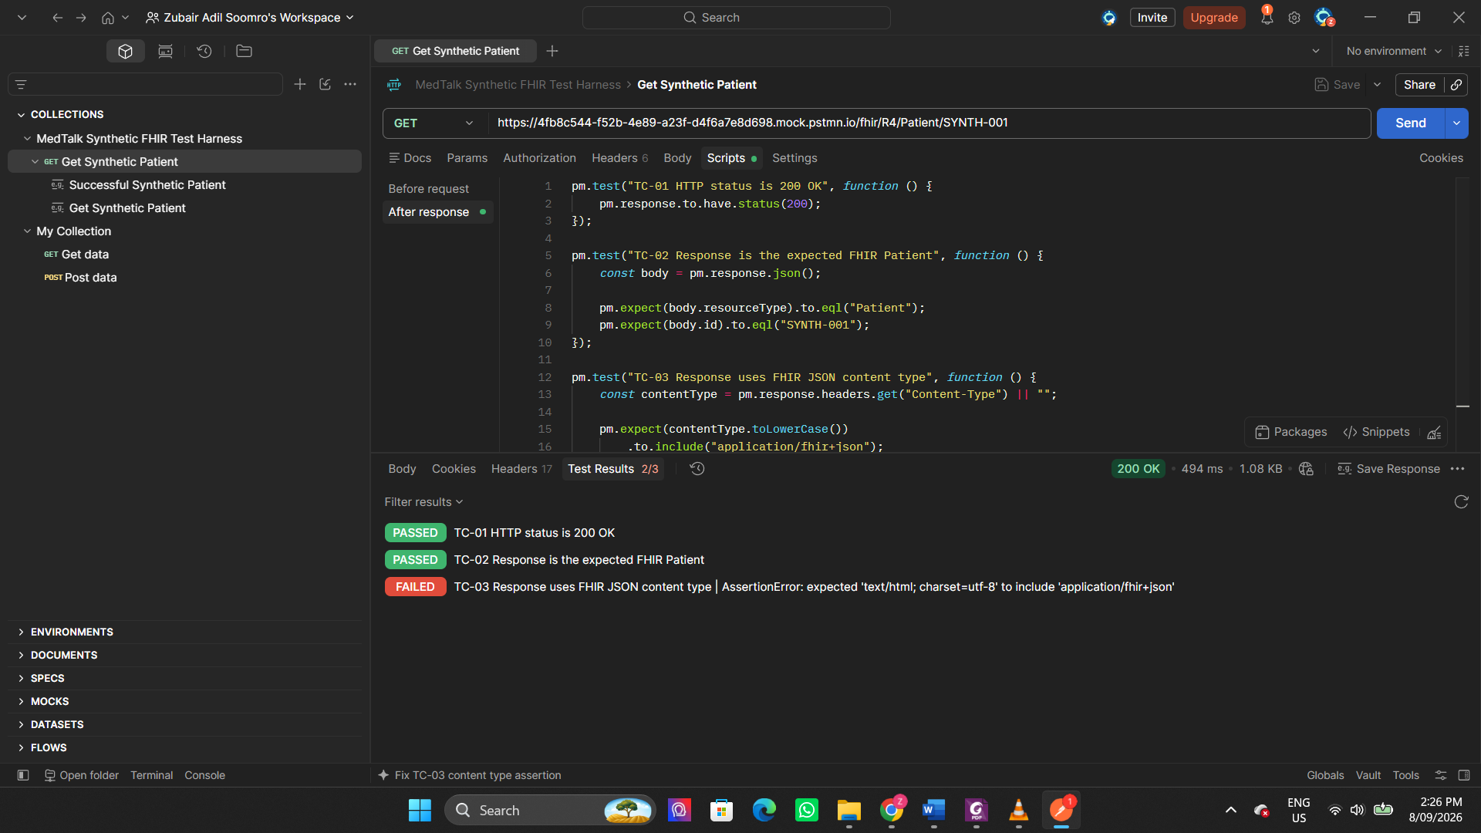

Slide 23
Stage 2 Priorities & Recommendations
What must be completed before the test harness is treated as production-adjacent
Immediate priorities
Current Stage 1 status
01
Correct and retest the failed FHIR Content-Type issue
Limited PoC demonstrated
3 Postman tests executed
2 Pass / 1 Fail
No full deployment readiness
02
Implement authentication, RBAC and tenant isolation
03
Run the seven failure-mode tests with recorded outcomes
04
Add HAPI/AU Core validation and terminology mapping checks
Recommendation
05
Introduce logging, monitoring and security/privacy review gates
Proceed to ICT946 implementation ,but present the current work as a design-stage PoC — not as a production-ready harness.
Message for the audience: the PoC proves feasibility and exposes gaps; Stage 2 proves reliability, security and repeatability.
25

Slide 24

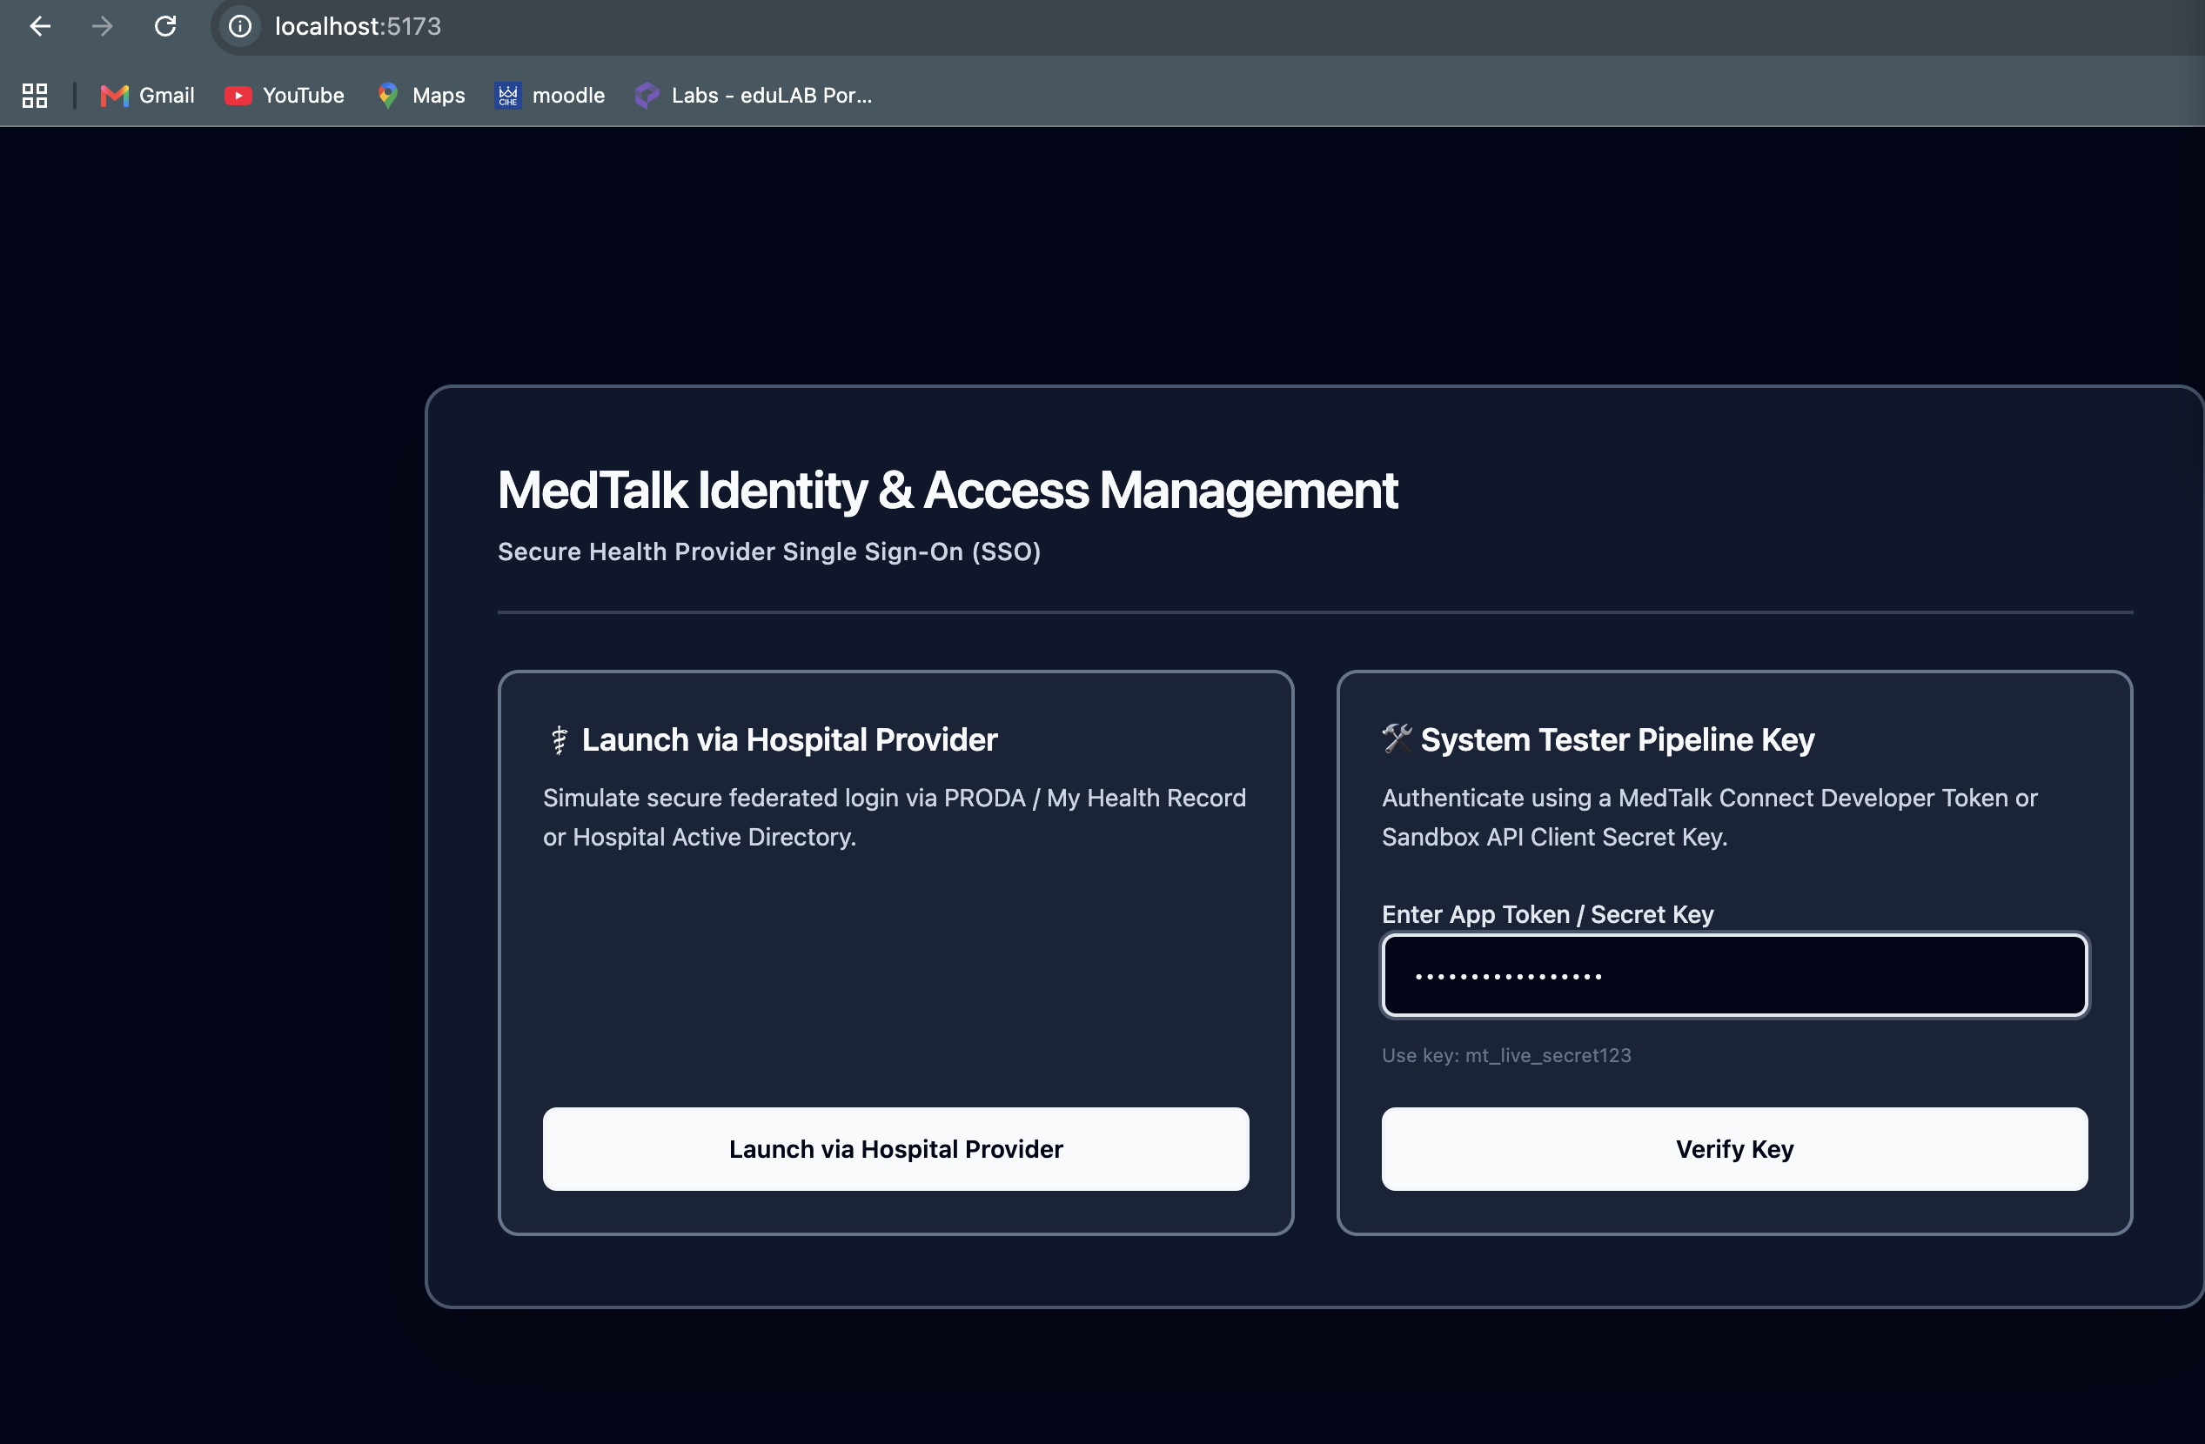
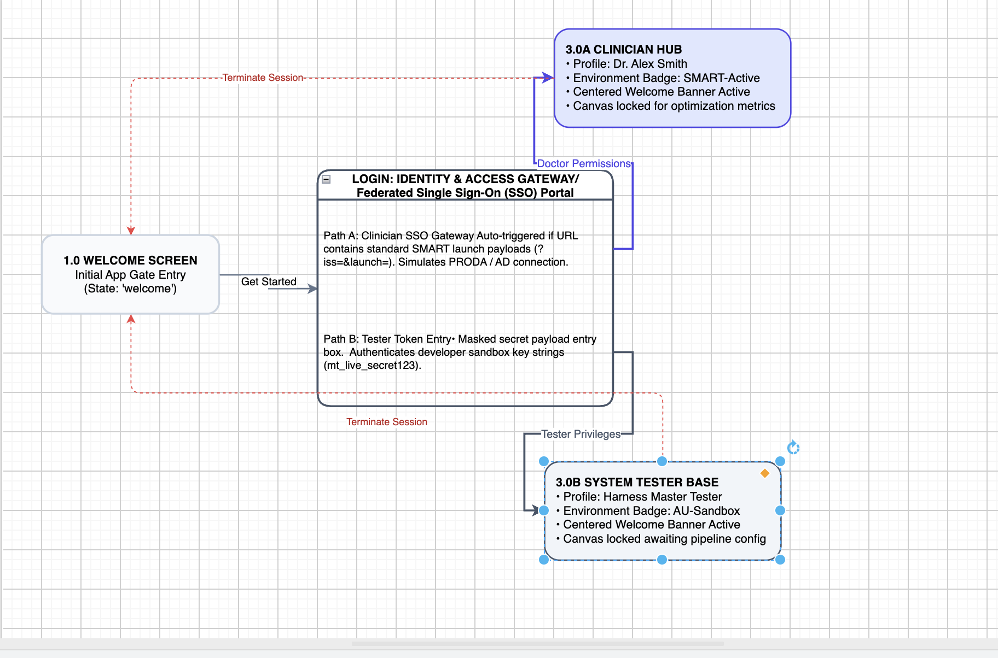
Proof of work
https://github.com/SkinnySeal17/HEAALTHCARE_SYSTEM/tree/main/Proof_of_Work
Login Flow & Solution Design
6

Slide 25
References
Australian Government. (1988). Privacy Act 1988 (Cth). https://www.legislation.gov.au/Details/C2022C00361
Australian Government. (2012). My Health Records Act 2012 (Cth). https://www.legislation.gov.au/Details/C2017C00313
Choudhary, J. (2026). How to Get Your App Into Epic (2026). Nirmitee.io. https://nirmitee.io/blog/how-to-get-your-app-into-epic/
eCQI. (2025). FHIR® - Fast Healthcare Interoperability Resources® - About | eCQI Resource Center. Healthit.gov. https://ecqi.healthit.gov/fhir/about
FAZ Australia. (n.d.). Project brief and requirements specification [Unpublished internal document].
HL7 Australia. (n.d.). AU Core Implementation Guide (v1.0.0). HL7 International. http://hl7.org.au/fhir/core/
HL7 International. (2019). HL7 FHIR Release 4 (R4). https://hl7.org/fhir/R4/
MediBetter | Integrations. (2026). Medibetter.com.au. https://medibetter.com.au/integrations/
MediRecords Connect: Getting Started with Connect & FHIR APIs. (2026). Knowledge Base. https://support.medirecords.com/hc/en-us/articles/13936381648399-MediRecords-Connect-Getting-Started-with-Connect-FHIR-APIs
SMART on FHIR. (n.d.). Docs.smarthealthit.org. Retrieved September 11, 2026, from https://docs.smarthealthit.org/
Standards Australia. (2007). Implementation of HL7 version 2.3.1 messages — Patient administration (AS 4700.2-2007).
Synapxe - HealthX Innovation Sandbox. (2023). Healthx.sg. https://innovation.healthx.sg/
2

Slide 26

Thank You
Questions & Discussion
Sonam Pelden • Charity Gwese • Rikesh Aryal • Zubair Adil Soomro

