Slide 1
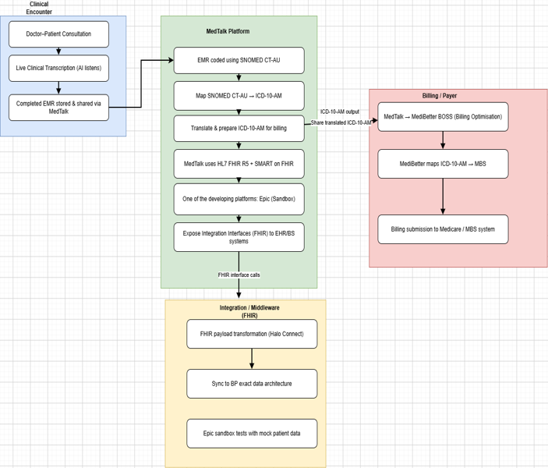
Faz Australia — MedTalk Clinical Documentation Platform: Current State (As-Is)
Faz Australia — MedTalk Clinical Documentation Platform: Current State (As-Is)
INDUSTRY & TECHNOLOGY LANDSCAPE ANALYSIS
MedTalk (Faz Australia) is an AI clinical documentation tool: it transcribes doctor–patient consultations live, codes the EMR in SNOMED CT-AU, maps codes to ICD-10-AM, and shares billing data via MediBetter BOSS to the MBS. (MediBetter, 2026)
It integrates with Best Practice via Halo Connect and HL7 FHIR R5 / SMART on FHIR, using Epic’s developer sandbox to test integrations against mock patient data before go-live. (MedTalk AI, 2020)
Epic onboarding costs ~US$500 (listing) + up to US$1,900 (membership) + US$40K–350K (build labour, read-only to full bidirectional FHIR); MedTalk–MediBetter API fees run US$100–500. (Choudhary, 2026; MarkiTech.AI, 2025)
Key pain point: no reusable, safe test environment — restricted sandbox access slows development, makes issues hard to reproduce, and raises compliance exposure.
MedTalk data flow: clinical encounter → coding → FHIR integration → billing

Slide 2
Comparative Analysis of existing Solutions
SMART Health IT Sandbox
Epic App Orchard / Sandbox
MediRecords Developer Sandbox
Synapxe HealthX Innovation Sandbox
Strength
Open, well-documented sandbox purpose-built for testing SMART on FHIR apps.
Strength
Mirrors real Epic EHR behaviour, testable against mock patient data before go-live.
Strength
National-scale sandbox supporting a broad health-tech innovation ecosystem.
Strength
Australian-context FHIR/Connect API testing aligned to local standards.
Limitation
Scoped to the SMART app ecosystem that is for authentication only does not validate full cross-system, multi-vendor data exchange.
Limitation
Epic-specific; formal onboarding plus US$40K–350K build labour restrict accessibility.
(Choudhary, 2026; Bonami Software, 2026)
Limitation
Scoped to MediRecords’ own APIs only — not a vendor-neutral environment.
(MediRecords Connect, 2026)
Limitation
Bound to Singapore’s governance/standards — not directly transferable to Australian FHIR/SNOMED CT-AU context.
(Synapxe, 2023)
The gap: each platform is vendor- or ecosystem-bound. None offers a vendor-neutral environment that validates FHIR exchange, SNOMED CT-AU/ICD-10-AM terminology and authentication together, before and after deployment — the role the proposed Test Harness fills.

Slide 3
Technology & Market Survey
HL7 FHIR
SNOMED CT-AU → ICD-10-AM
Australia’s preferred clinical terminology (SNOMED CT + Australian Medicines Terminology), mapped to ICD-10-AM for diagnosis coding and onward to MBS for billing. (SNOMED CT-AU & AMT Release, 2022)
Central exchange standard for patient data, appointments and clinical notes; supports RESTful APIs, documents and messaging. Free to build on, unlike the trademarked “HL7” name. (eCQI, 2025)
Synthetic Patient Data
Synthea generates realistic synthetic EHRs, but on US demographics; CSIRO’s Australian-context equivalent exists but is not publicly available for this project.
SMART on FHIR & Halo Connect
SMART on FHIR provides OAuth 2.0-based secure app authorisation. Halo Connect (Halo Link + Halo Cloud) bridges local practice databases to external FHIR/SQL consumers. (SMART on FHIR, n.d.; Halo Connect Documentation, 2026

Slide 4
Gap Analysis From Current State to Test harness
m Current State to Test Harness
1
Unsafe / restricted testing
2
Basic API connectivity
↓
Fully synthetic test environment
↓
Standards-aligned interoperability (FHIR + SNOMED CT-AU + ICD-10-AM)
3
Text generation only
4
Happy-path testing
↓
Verified clinical coding with known terminology mapping
↓
Resilience testing (delays, bad data, dropped connections)
5
Manual validation
6
Fragmented tooling
↓
Reusable automated test suite
↓
Single, unified validation workflow
Proposed solution: a centralised, vendor-neutral Test Harness — built on synthetic data — that unifies FHIR messaging, terminology validation and automated resilience testing for MedTalk, before and after production deployment.

