Slide 2
What is Github?
Github is a file or code-sharing service to collaborate with different people.
GitHub is a highly used software that is typically used for version control. It is helpful when more than just one person is working on a project. Say for example, a software developer team wants to build a website and everyone has to update their codes simultaneously while working on the project. In this case, Github helps them to build a centralized repository where everyone can upload, edit, and manage the code files.

Slide 3
Why using Github?
GitHub has various advantages but many people often have a doubt as to why not use dropbox or any cloud based system? Let me take the same example forward to answer this question. Say more than two software developers are working on the same file and they want to update it simultaneously. Unfortunately, the person who save the file first will get precedence over the others. While in Github, this is not the case. Github document the changes and reflect them in an organized manner to avoid any chaos between any of the files uploaded.
Therefore using GitHub centralized repository, it avoids all the confusion and working on the same code becomes very easy.

Slide 4
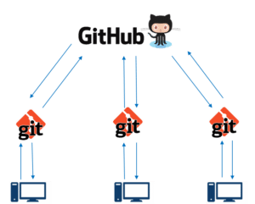
If you look at the image on the left, GitHub is a central repository and Git is a tool which allows you to create a local repository. Now people usually get confused between git and GitHub but its actually very different. Git is a version control tool that will allow you to perform all kinds of operations to fetch data from the central server or push data to it whereas GitHub is a core hosting platform for version control collaboration. GitHub is a company that allows you to host a central repository in a remote server.

Slide 5
GitHub Repository
A repository is a storage space where your project lives. It can be local to a folder on your computer, or it can be a storage space on GitHub or another online host. You can keep code files, text files, images or any kind of a file in a repository. You need a GitHub repository when you have done some changes and are ready to be uploaded. This GitHub repository acts as your remote repository.
by default a GitHub repository is public which means that anyone can view the contents of this repository whereas in a private repository, you can choose who can view the content. Also, private repository is a paid version.

Slide 6
Github Branches
Branches help you to work on different versions of a repository at one time. Let’s say you want to add a new feature (which is in the development phase), and you are afraid at the same time whether to make changes to your main project or not. This is where git branching comes to rescue. Branches allow you to move back and forth between the different states/versions of a project. In the above scenario, you can create a new branch and test the new feature without affecting the main branch. Once you are done with it, you can merge the changes from new branch to the main branch.

Slide 7
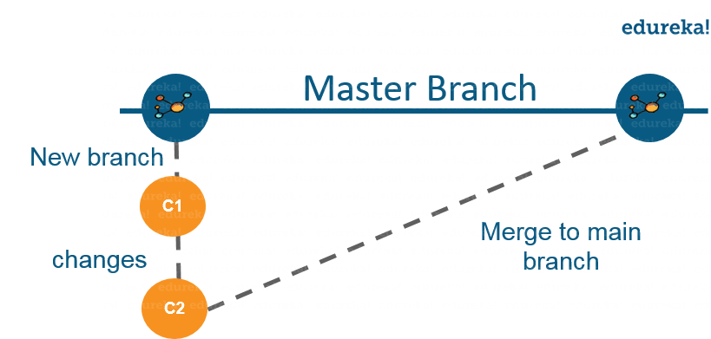
Here the main branch is the master branch, which is there in your repository by default.
As depicted in the above image, there is a master/ production branch which has a new branch for testing. Under this branch, two set of changes are done and once it completed, it is merged back to the master branch.

Slide 8
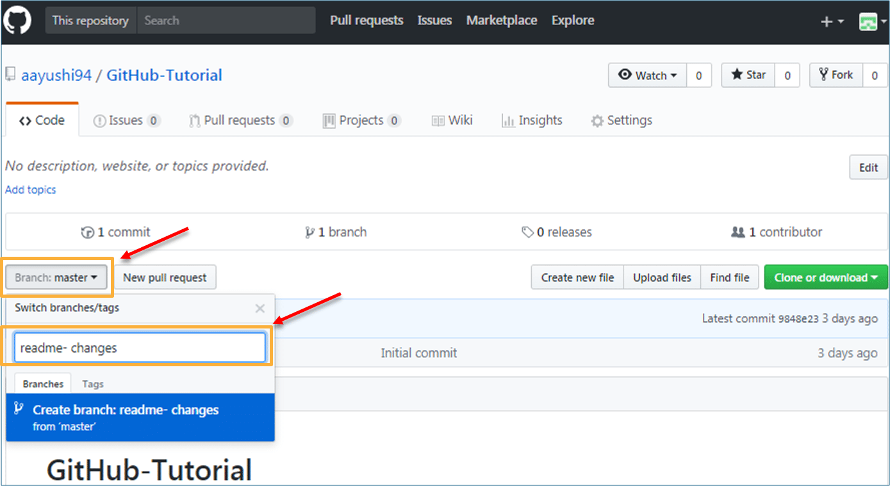
To create a branch in GitHub, follow the below steps:
Click on the dropdown “Branch: master”
As soon as you click on the branch, you can find an existing branch or you can create a new one.

Slide 9
Github operations
Commit Command:
This operation helps you to save the changes in your file. When you commit a file, you should always provide the message, just to keep in the mind the changes done by you. Though this message is not compulsory but it is always recommended so that it can differentiate the various versions or commits you have done so far to your repository. These commit messages maintain the history of changes which in turn help other contributors to understand the file better.

Slide 10
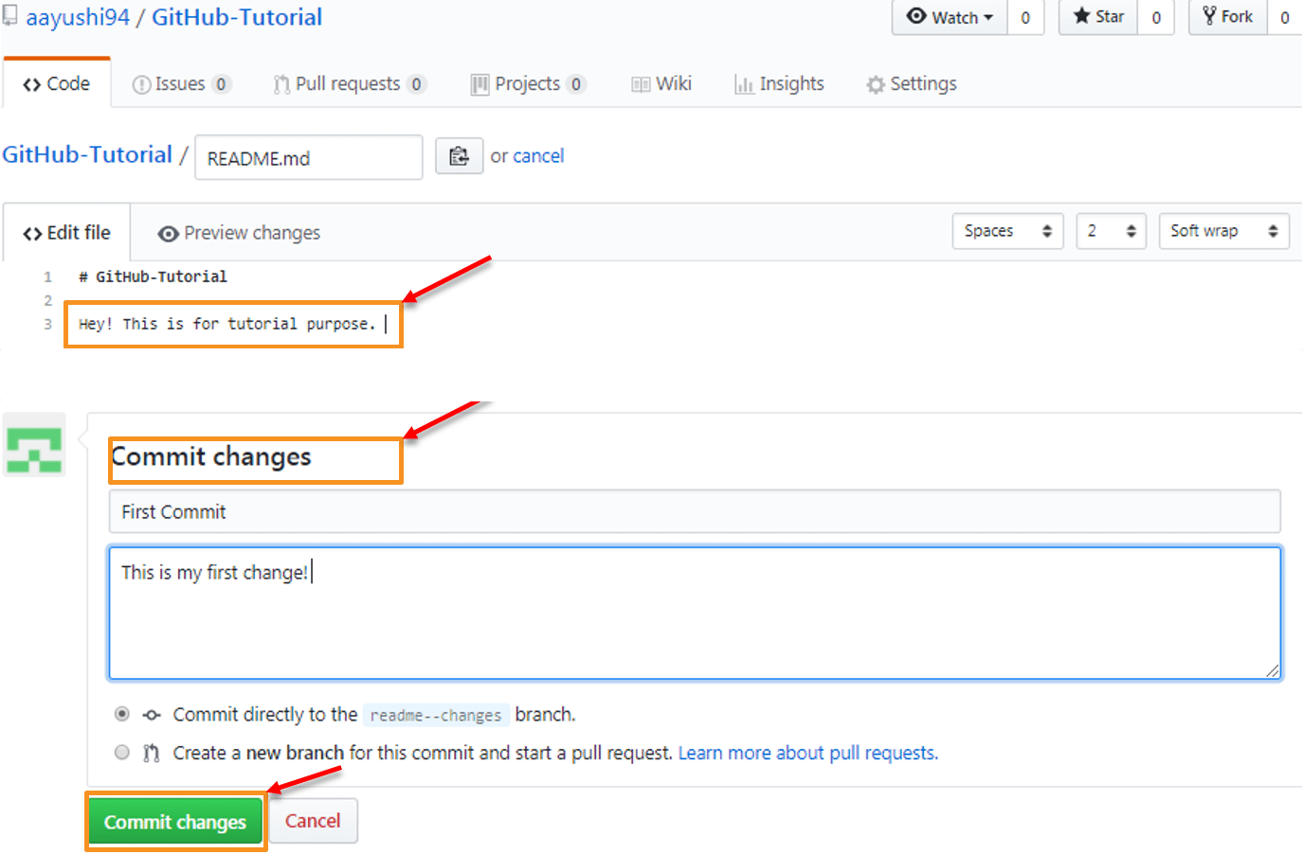
To make our first commit, follow the below steps:
Click on “readme- changes” file which we have just created.
Click on the “edit” or a pencil icon in the righmost corner of the file.
Once you click on that, an editor will open where you can type in the changes or anything.
Write a commit message which identifies your changes.
Click commit changes in the end.

Slide 11
Pull Command:
Pull command is the most important command in GitHub. It tell the changes done in the file and request other contributors to view it as well as merge it with the master branch. Once the commit is done, anyone can pull the file and can start a discussion over it. Once its all done, you can merge the file. Pull command compares the changes which are done in the file and if there are any conflicts, you can manually resolve it.
Now let us see different steps involved to pull request in GitHub:
Click the ‘Pull requests’ tab.
Click ‘New pull request’.
Once you click on pull request, select the branch and click ‘readme- changes’ file to view changes between the two files present in our repository.
Click “Create pull request”.
Enter any title, description to your changes and click on “Create pull request”. Refer to the below screenshots.

Slide 12
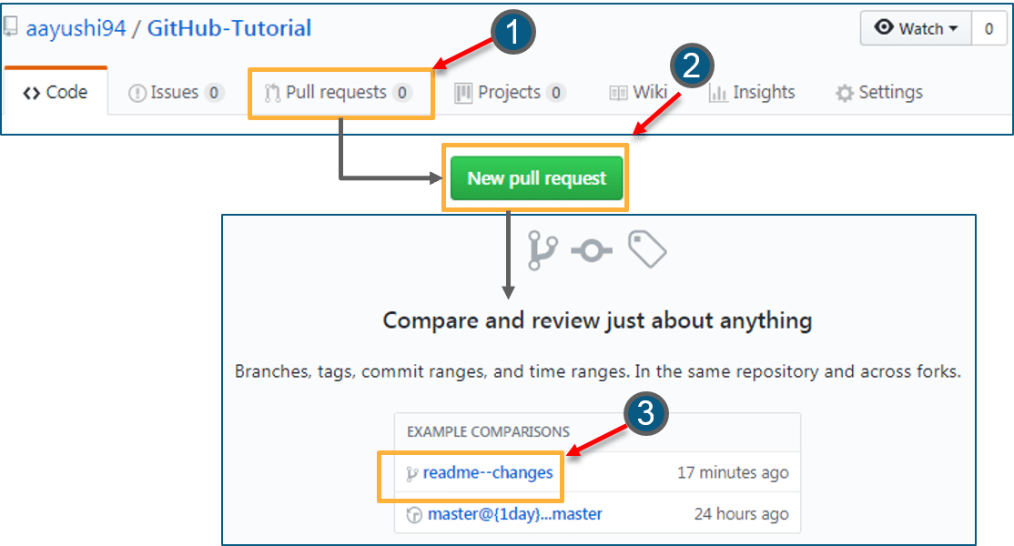

Slide 13
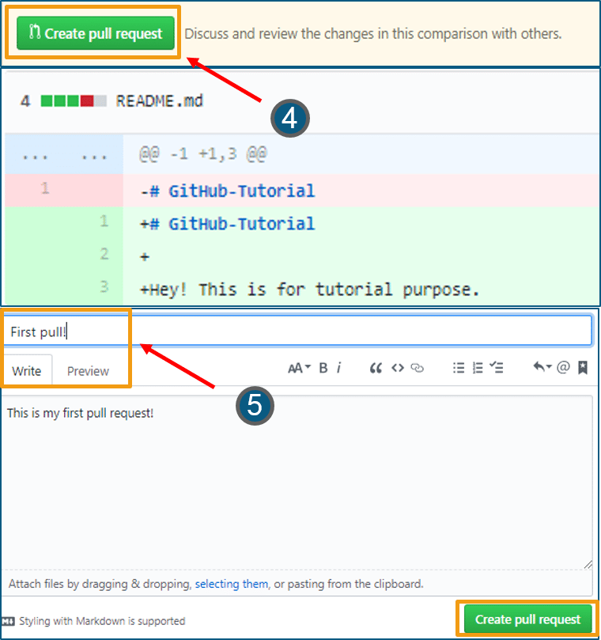

Slide 14
Merge Command:
Here comes the last command which merge the changes into the main master branch. We saw the changes in pink and green color, now let’s merge the “readme- changes” file with the master branch/ read-me. Go through the below steps to merge pull request.
Click on “Merge pull request” to merge the changes into master branch.
Click “Confirm merge”.
You can delete the branch once all the changes have been incorporated and if there are no conflicts. Refer to the below screenshots.

Slide 15
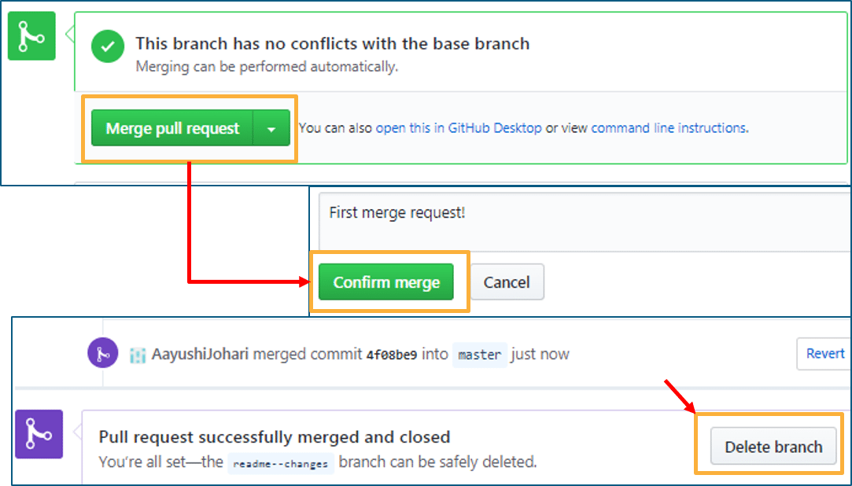

Slide 16
GIT:
Supposing you already have chocolatey
Install GIT : (Open powershell as admin) # choco install git
Features
Git BASH: Git for Windows provides a BASH emulation used to run Git from the command line. *NIX users should feel right at home, as the BASH emulation behaves just like the "git" command in LINUX and UNIX environments.
Git GUI: As Windows users commonly expect graphical user interfaces, Git for Windows also provides the Git GUI, a powerful alternative to Git BASH, offering a graphical version of just about every Git command line function, as well as comprehensive visual diff tools.
Shell Integration: Simply right-click on a folder in Windows Explorer to access the BASH or GUI.

Slide 17
Here are the most common Git commands
git init: This command sets up a new Git repository in the current directory. It prepares the folder to track changes and manage versions of files.
git clone <repository>: Cloning creates a local copy of a remote repository (like one on GitHub) on your computer. It allows you to work with the project locally.
git add <file>: This command adds a file or changes to the staging area. It prepares the file or changes to be committed and included in the next commit.
git commit -m "<message>": Committing saves the changes in the staging area to the repository. You provide a descriptive message to explain what the changes are about.
git status: This command shows the current status of your repository. It tells you which files are modified, which are staged for commit, and if there are any untracked files.
git pull: Pulling fetches the latest changes from a remote repository and merges them into your current branch. It's useful to keep your local copy up to date with the remote repository.
git push: Pushing sends your local branch commits to the remote repository. It updates the remote repository with your changes.
git branch: Branching allows you to create different "branches" of your project. This command lists all the branches in your repository.

Slide 18
git checkout <branch>: Checking out a branch switches your working directory to the specified branch. You can work on a different branch and make changes without affecting other branches.
git merge <branch>: Merging combines changes from one branch into another. It takes the changes made on a source branch and integrates them into the target branch.
git remote add <name> <url>: This command associates a remote repository with a name and URL. It allows you to refer to the remote repository by a name when pushing or pulling changes.
git log: The log command displays a log of commits in reverse chronological order. It shows the commit history, including commit messages and information about who made the changes.
git diff: This command shows the differences between your working directory and the repository. It helps you see the changes you've made but haven't committed yet.
git stash: Stashing allows you to temporarily save changes that are not ready to be committed. It lets you switch to a different branch without committing the changes you're currently working on.
git reset <file>: Resetting unstages a file, removing it from the staging area. It undoes the "git add" command for a specific file, so the changes won't be included in the next commit.

Slide 19
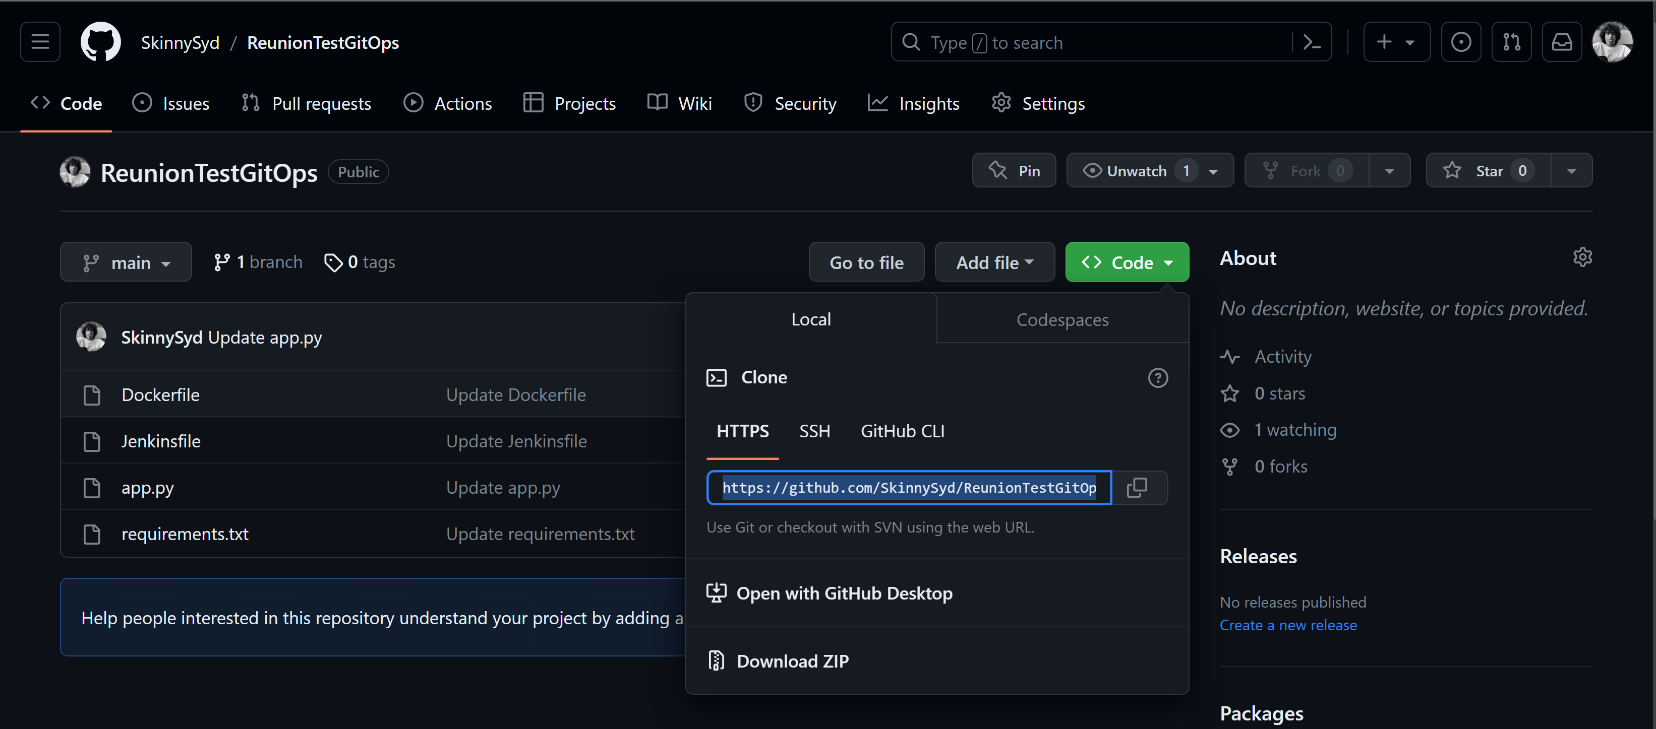
git clone
You can obtain the URL of a GitHub repository directly from the "Code" tab on the repository's page.

Slide 20
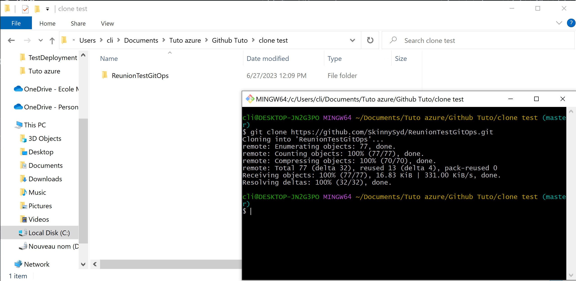
It allows you to fetch all the files, commit history, and branches from the remote repository and create a working copy on your computer.

Slide 21
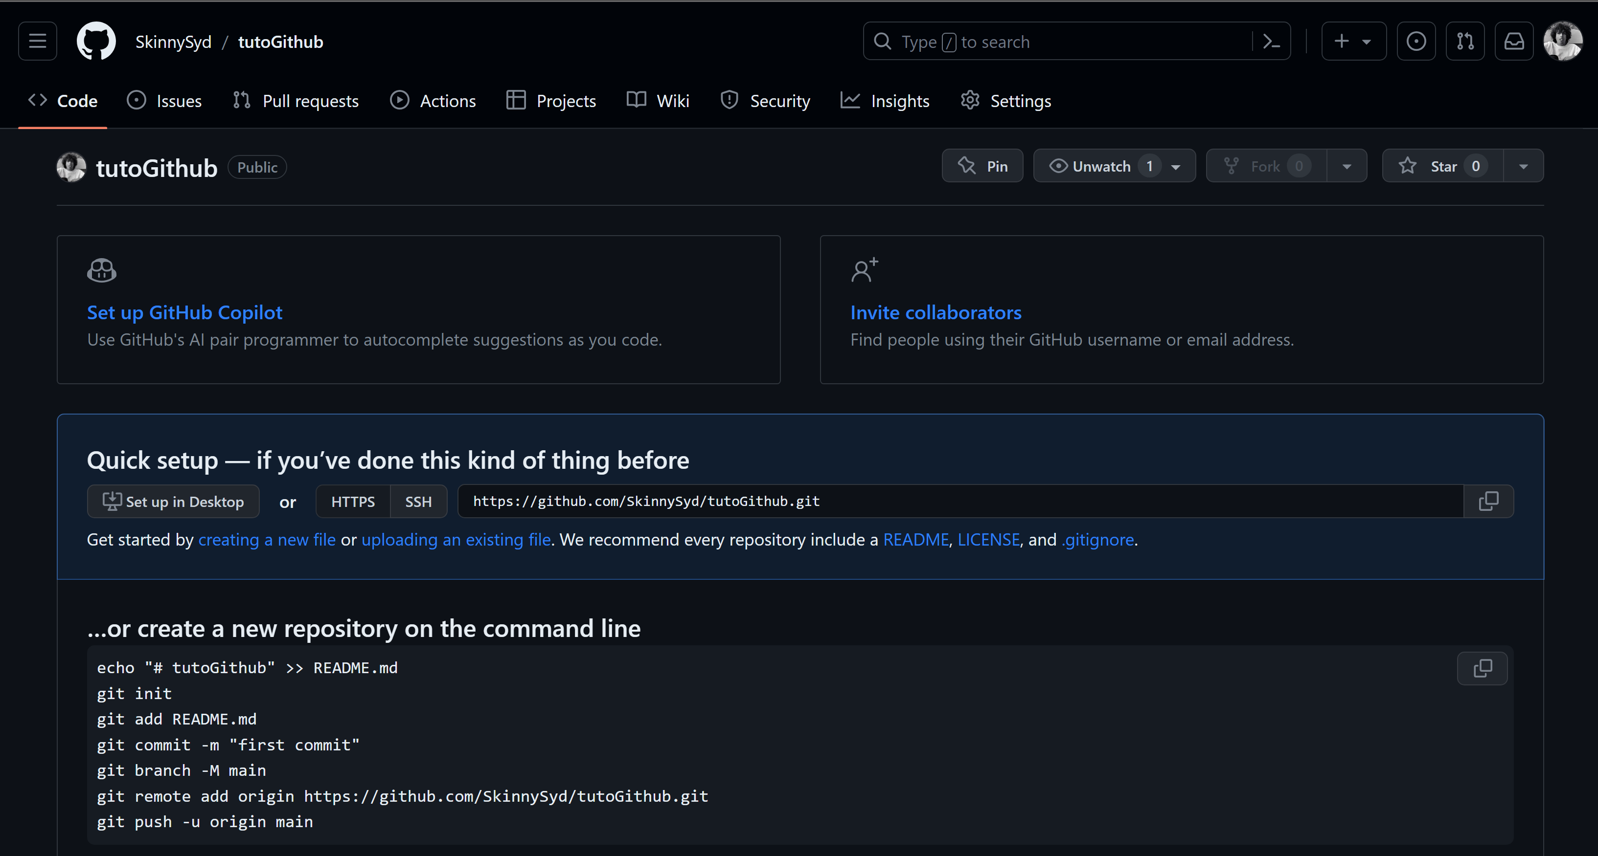
Creating a new github repository

Slide 22
These commands demonstrate the process of creating a new repository on GitHub, initializing it locally, and pushing your initial commit. The command git init is only used one time.
git init
git add <filename>
git commit -m "first commit"
git branch -M main
git remote add origin https://github.com/SkinnySyd/tutoGithub.git
git push -u origin main

Slide 23
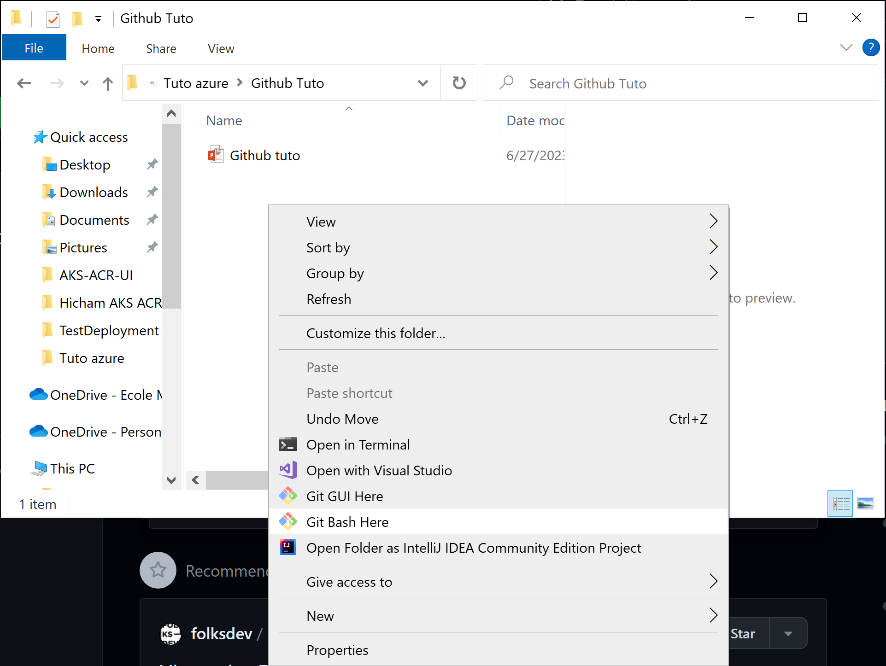
Git init

Slide 24
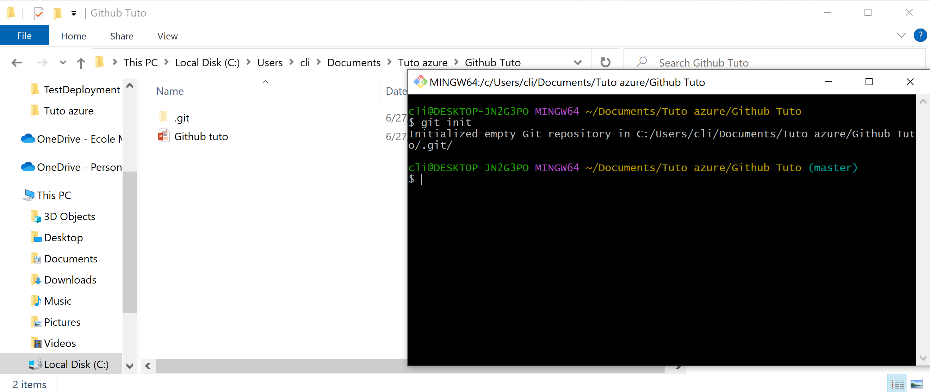
A hidden sub directory .git is created and it contains all the information necessary for version control.

Slide 25
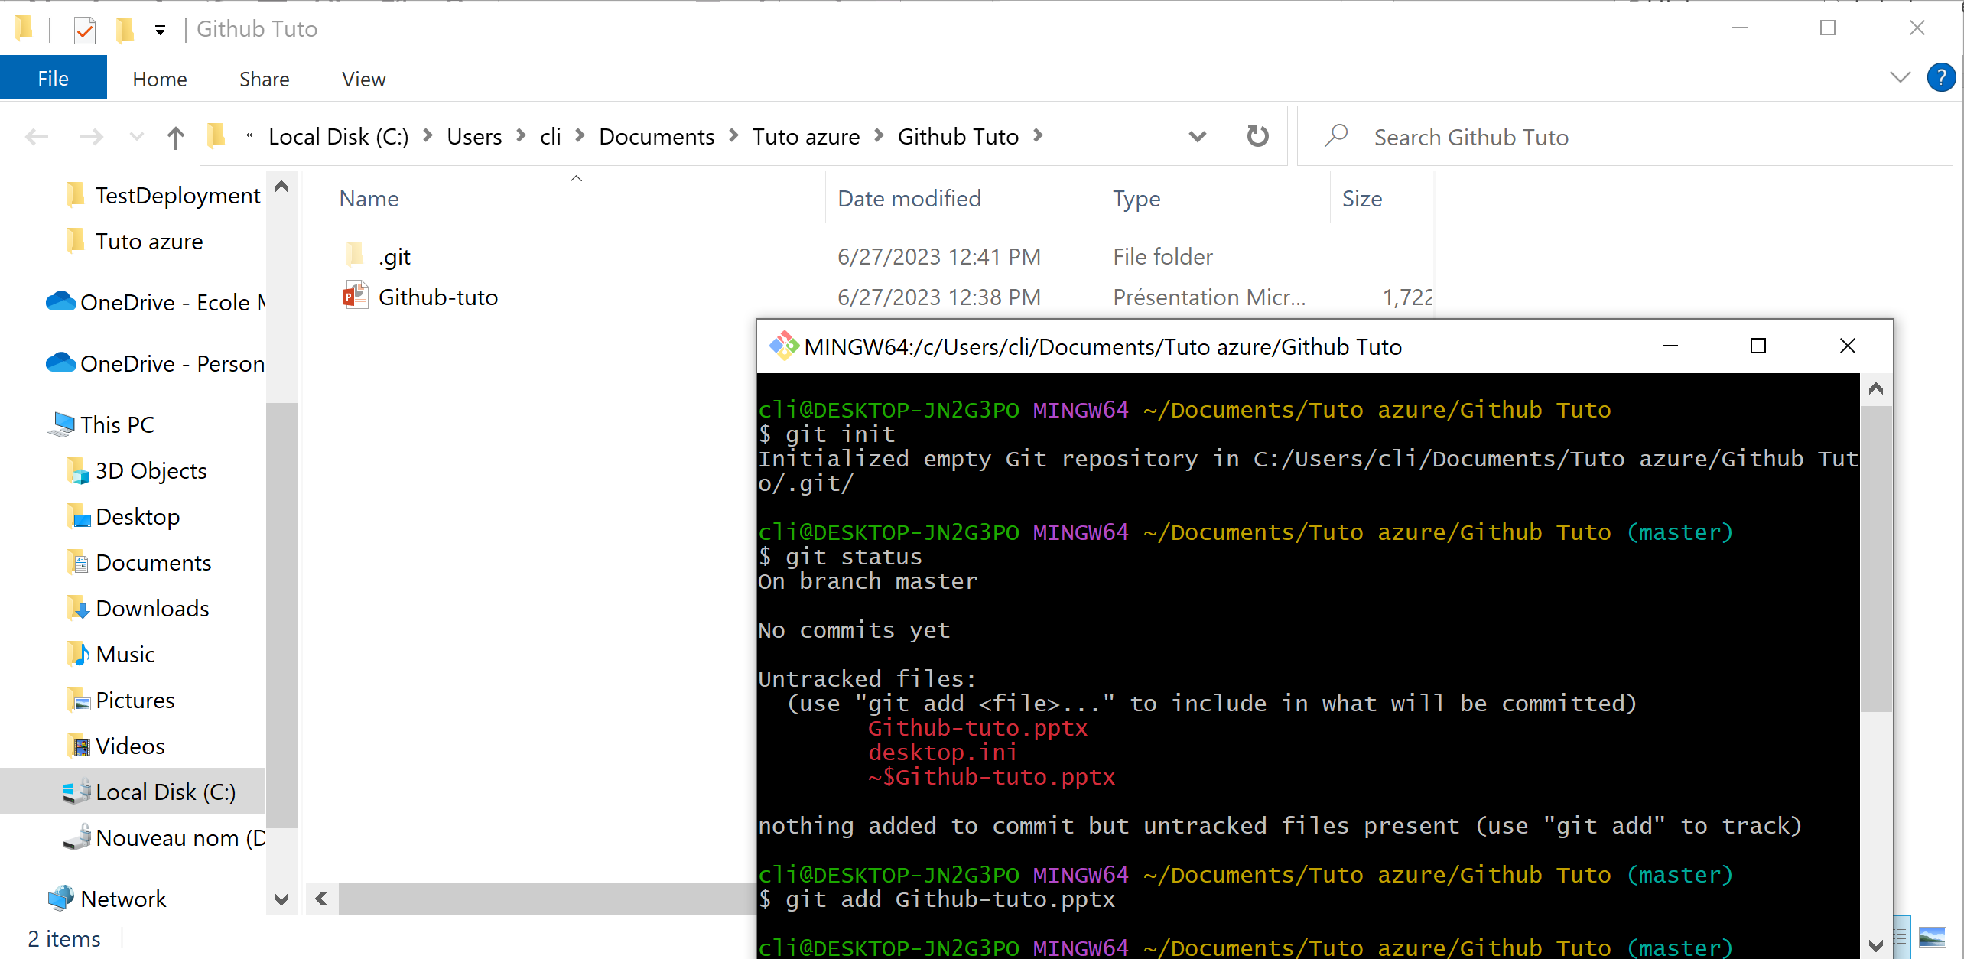
Git add

Slide 26
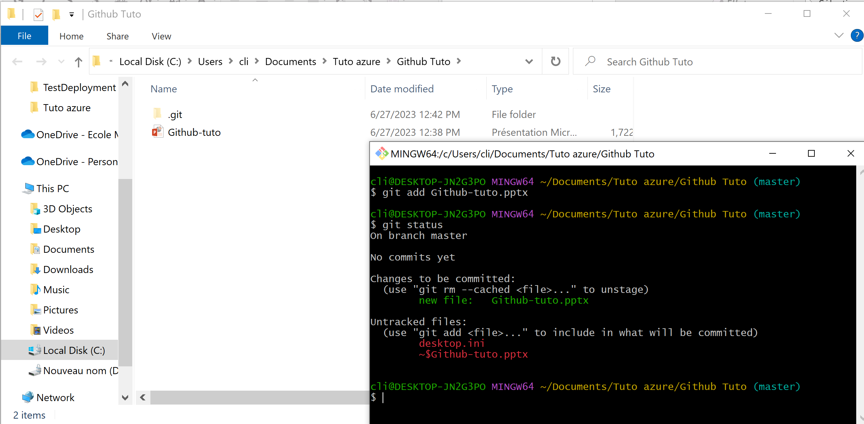
we have added the file "Github-tuto.pptx" to the staging area. This means that Git is tracking changes made to this file and it will be included in the next commit.

Slide 27
Running git status displays the current status of your repository. "On branch master": Indicates that you are currently on the "master" branch. "No commits yet": Indicates that there haven't been any commits made to the repository yet. "Changes to be committed": This section shows the changes that have been added to the staging area and will be included in the next commit. In this case, it lists the "Github-tuto.pptx" file as a new file to be committed. "Untracked files": This section lists files that Git is not currently tracking.

Slide 28
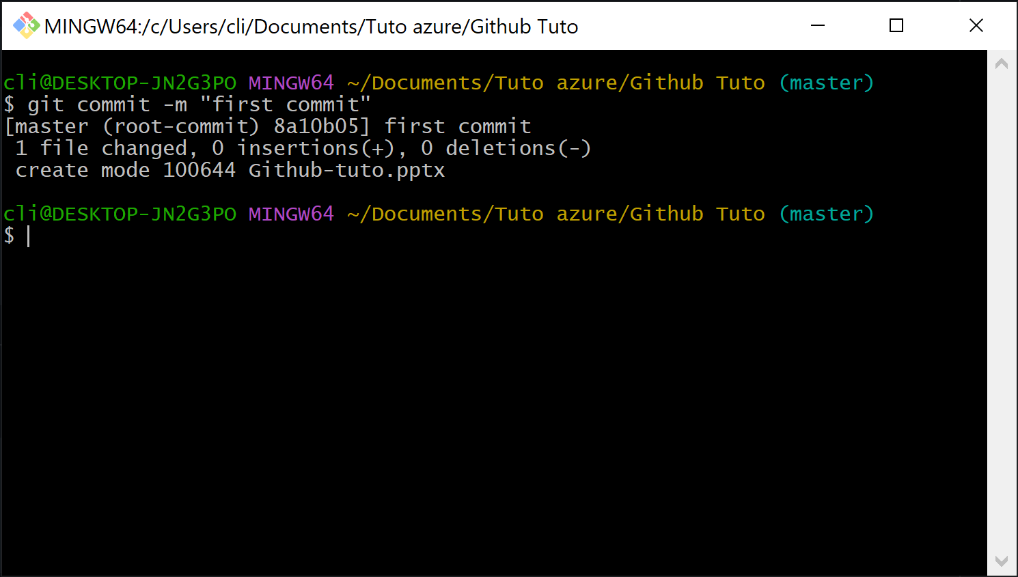
Git commit The output indicates that we have successfully made our first commit to the "master" branch

Slide 29
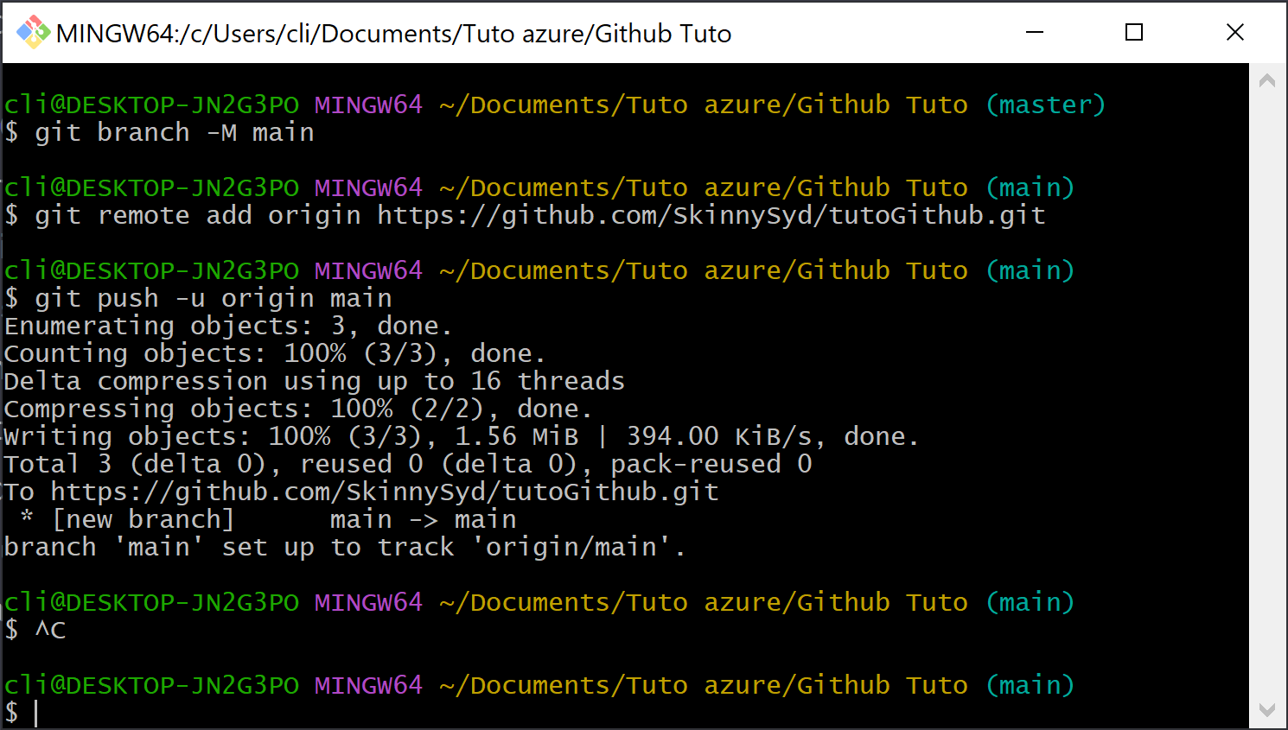
Git push

Slide 30
git branch -M main: This command renames the current branch to "main." By using the -M option, you forcefully rename the branch even if a branch with the new name already exists.
git remote add origin https://github.com/SkinnySyd/tutoGithub.git: This command adds a remote repository named "origin" and associates it with the specified URL https://github.com/SkinnySyd/tutoGithub.git. This allows you to push your local commits to the remote repository.
git push -u origin main: This command pushes your local branch "main" to the remote repository "origin." The -u flag sets up tracking, which means that in the future, you can simply use git push without specifying the branch and remote.

Slide 31
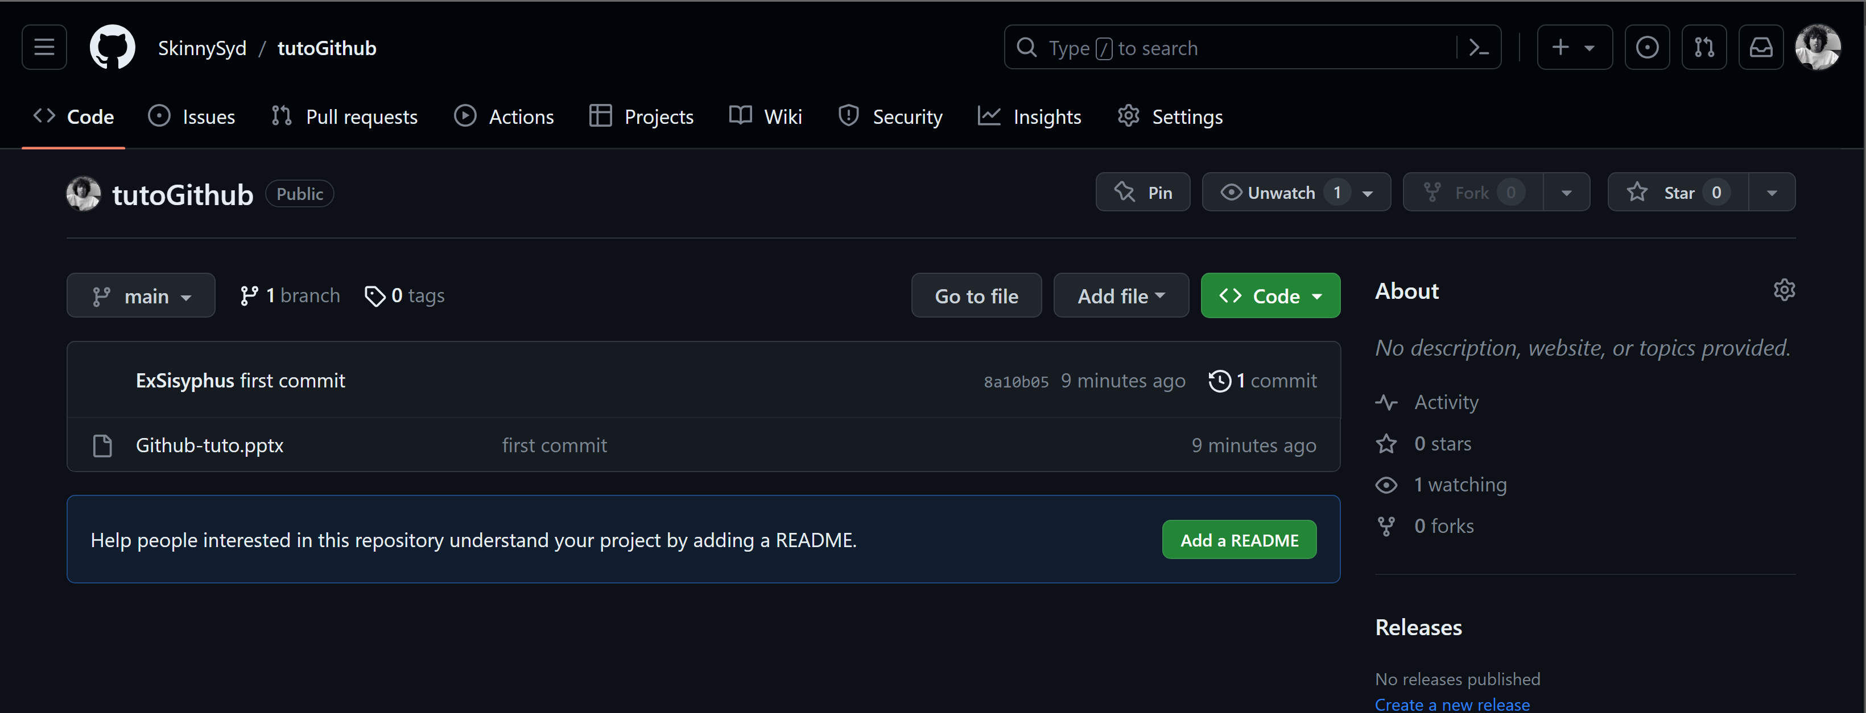
The remote repository is successfully created

Slide 32
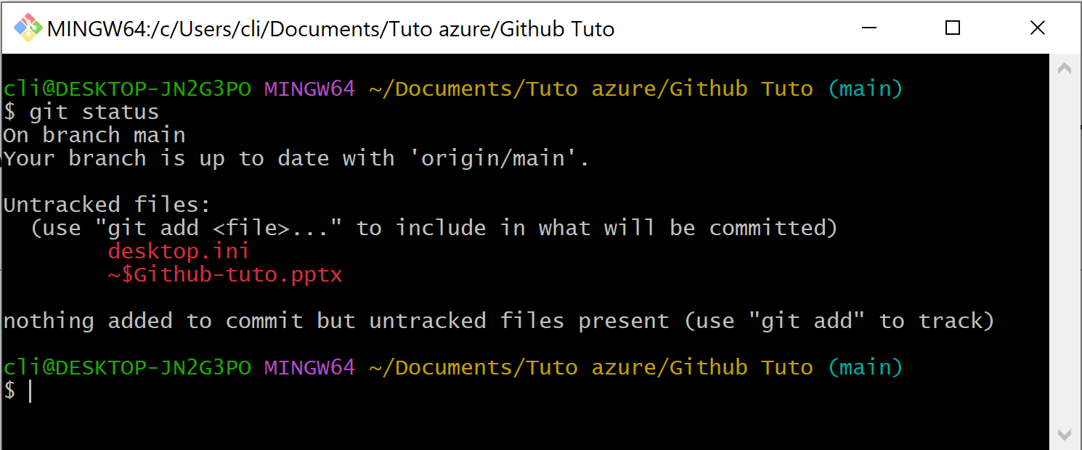
If we made changes on the local files
Local repository status before changes

Slide 33
What is Jenkins and what it is used for ?
Jenkins is an open source continuous integration/continuous delivery and deployment (CI/CD) automation software DevOps tool written in the Java programming language. It is used to implement CI/CD workflows, called pipelines.
Pipelines :
A continuous integration and continuous deployment (CI/CD) pipeline is a series of steps that must be performed in order to deliver a new version of software. CI/CD pipelines are a practice focused on improving software delivery throughout the software development life cycle via automation.

