Slide 1
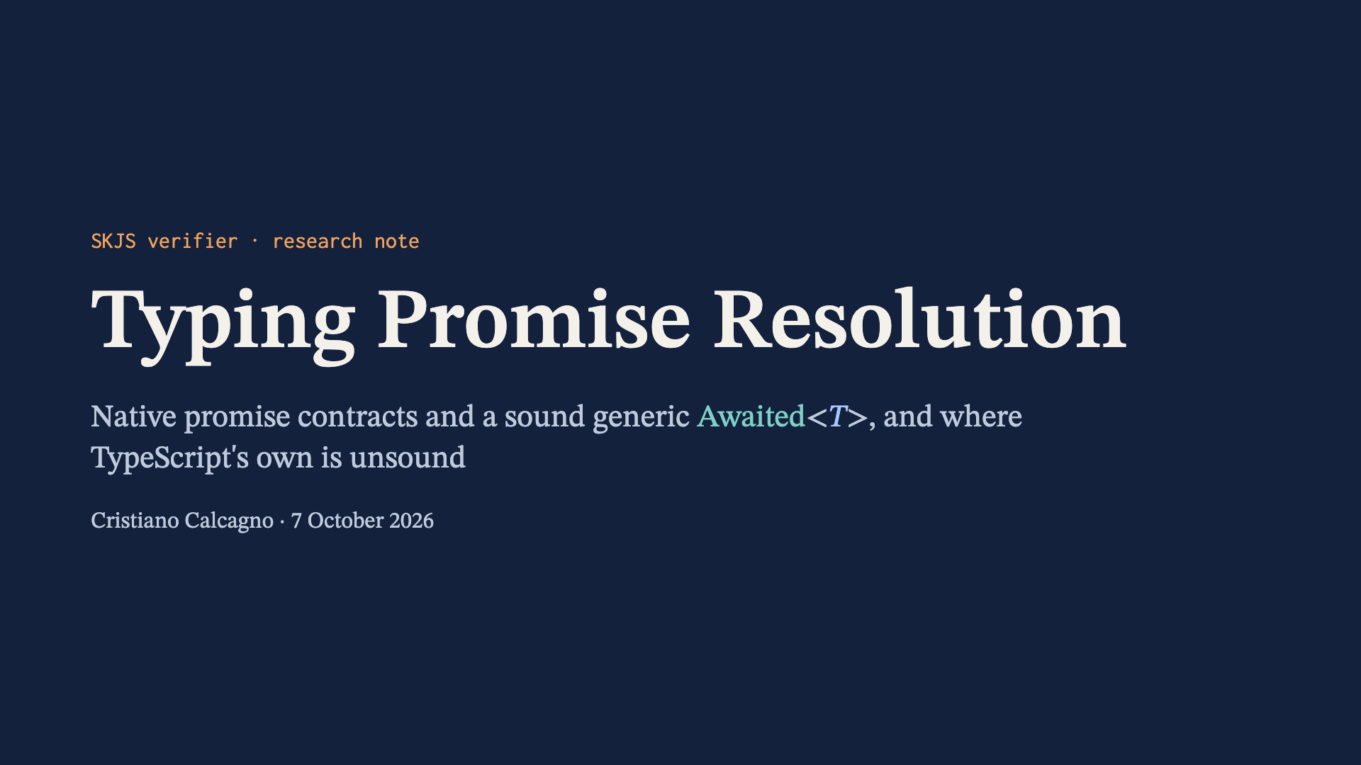
Notes:
This deck summarises research/promise-normalization.md and research/promise-coverage-audit.md. Nothing in it is implemented; laws are argued, not mechanized.

Slide 2
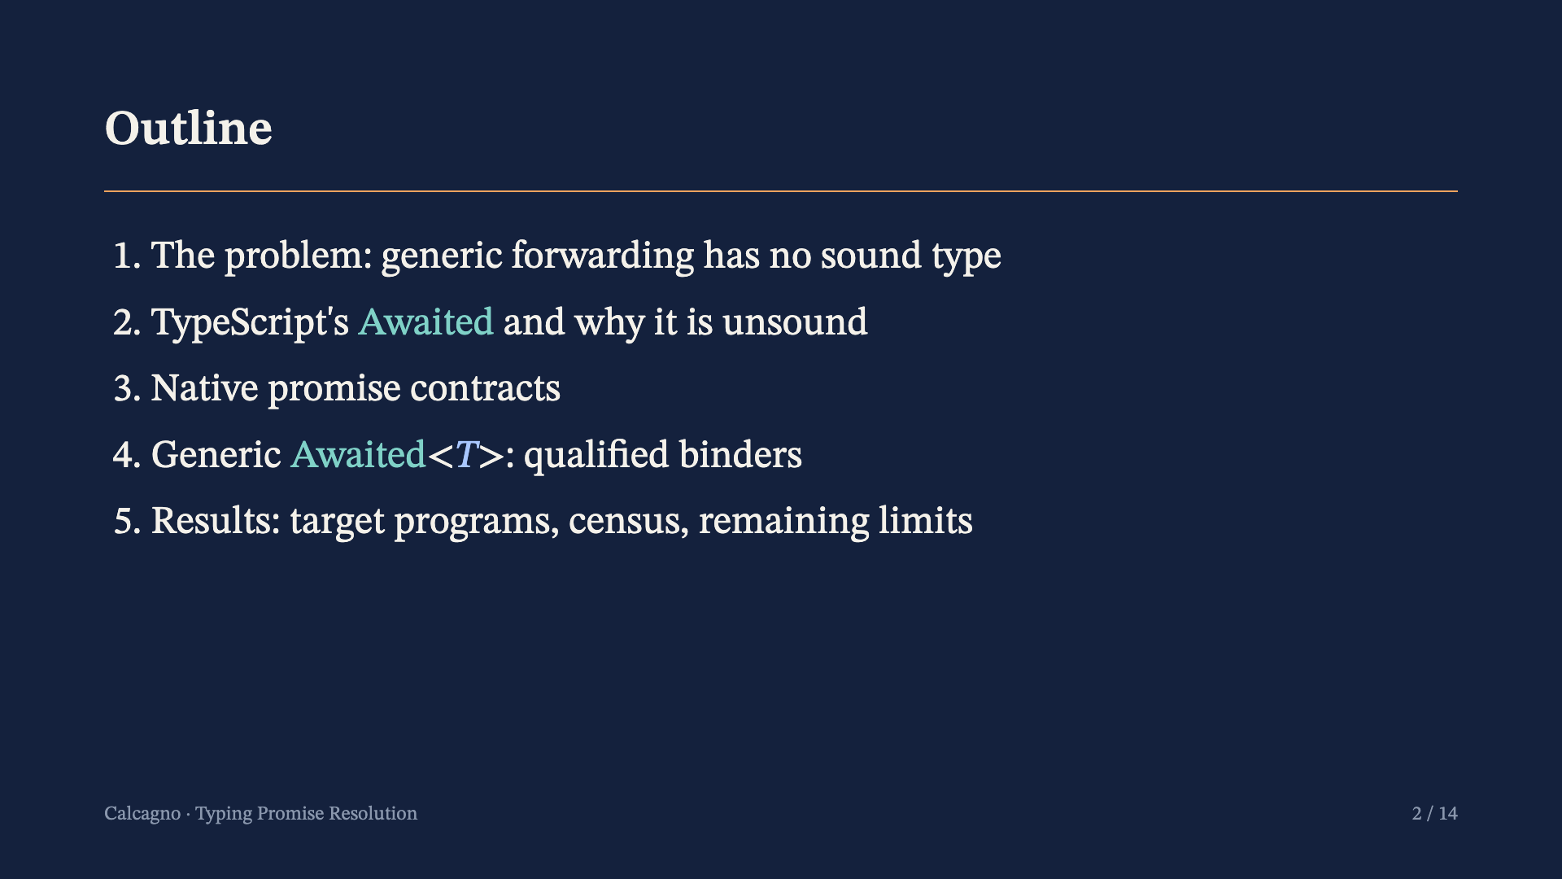

Slide 3
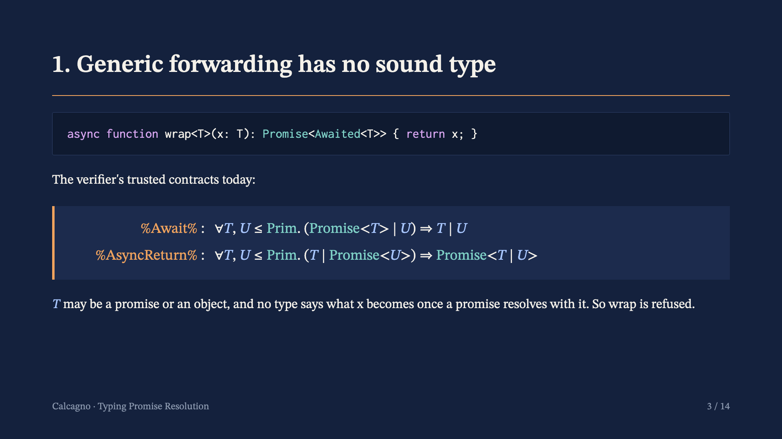
Notes:
The two trusted contracts bound the non-promise side to primitives, on which resolution never calls then. That keeps them sound but rules out any generic forwarder.

Slide 4
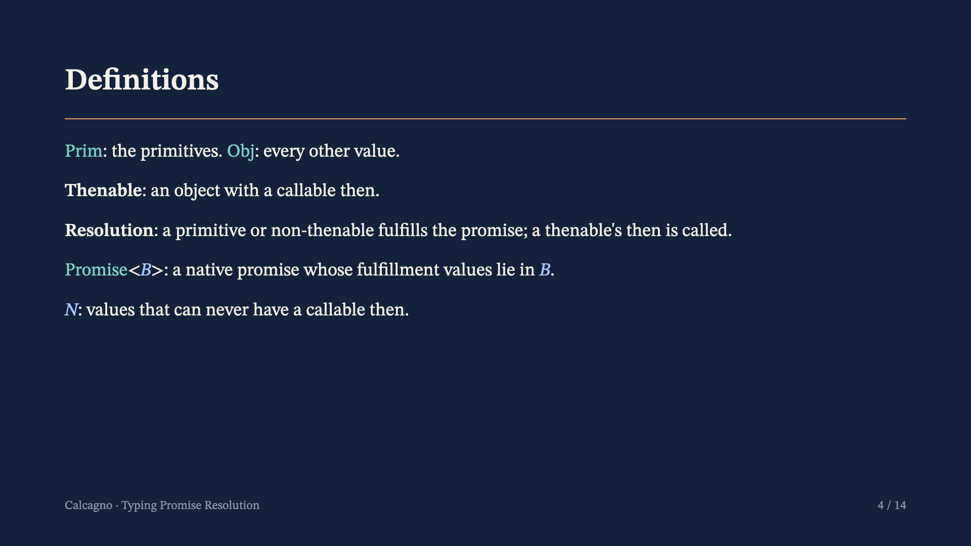
Notes:
Resolution follows ECMA-262, which looks up then only on objects; a thenable's then runs in a later job. A Promise may also reject or stay pending. N includes primitives, readonly arrays, and records whose type rules out then for their lifetime.

Slide 5
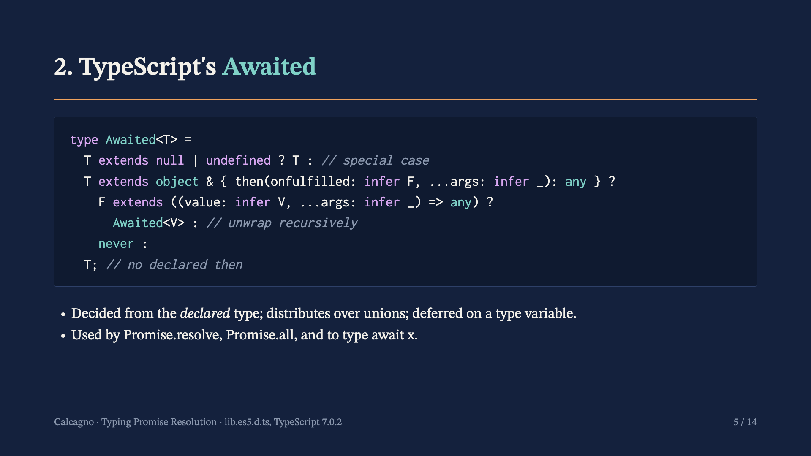
Notes:
Cases: null or undefined gives itself; an object type declaring then whose first parameter is a function (value: V, ...) gives Awaited of V; a non-function first parameter gives never; every other type gives itself.

Slide 6
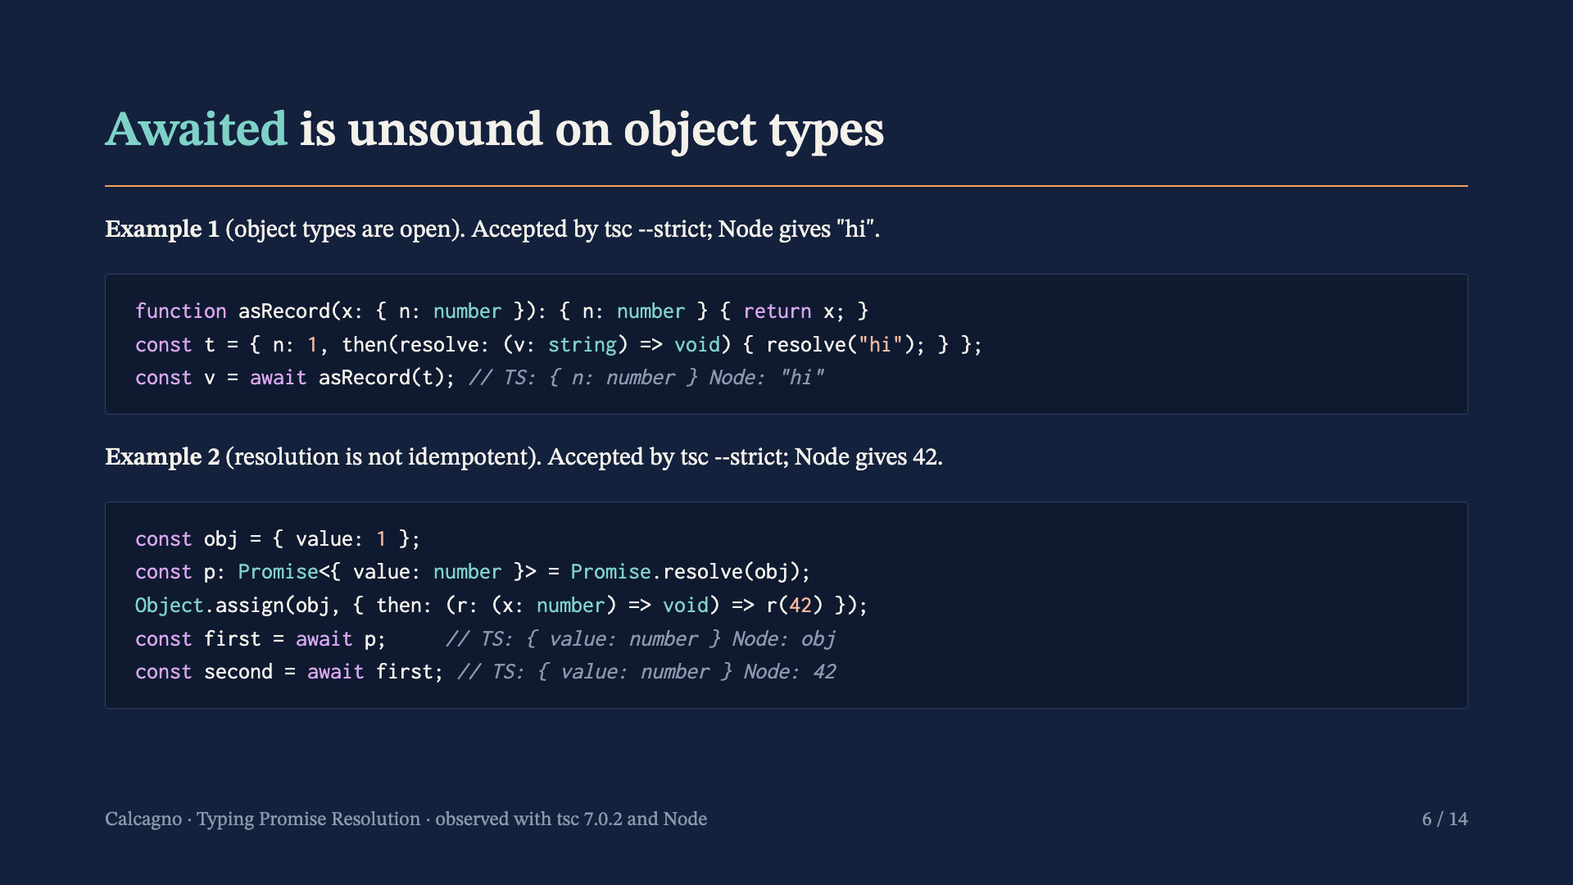
Notes:
Example 1 is width subtyping: Awaited of a type with no declared then is the type itself, but the runtime value carries one. Example 2 breaks Awaited<Awaited<T>> = Awaited<T>: a value resolution already produced resolves the promise again with a different result.

Slide 7
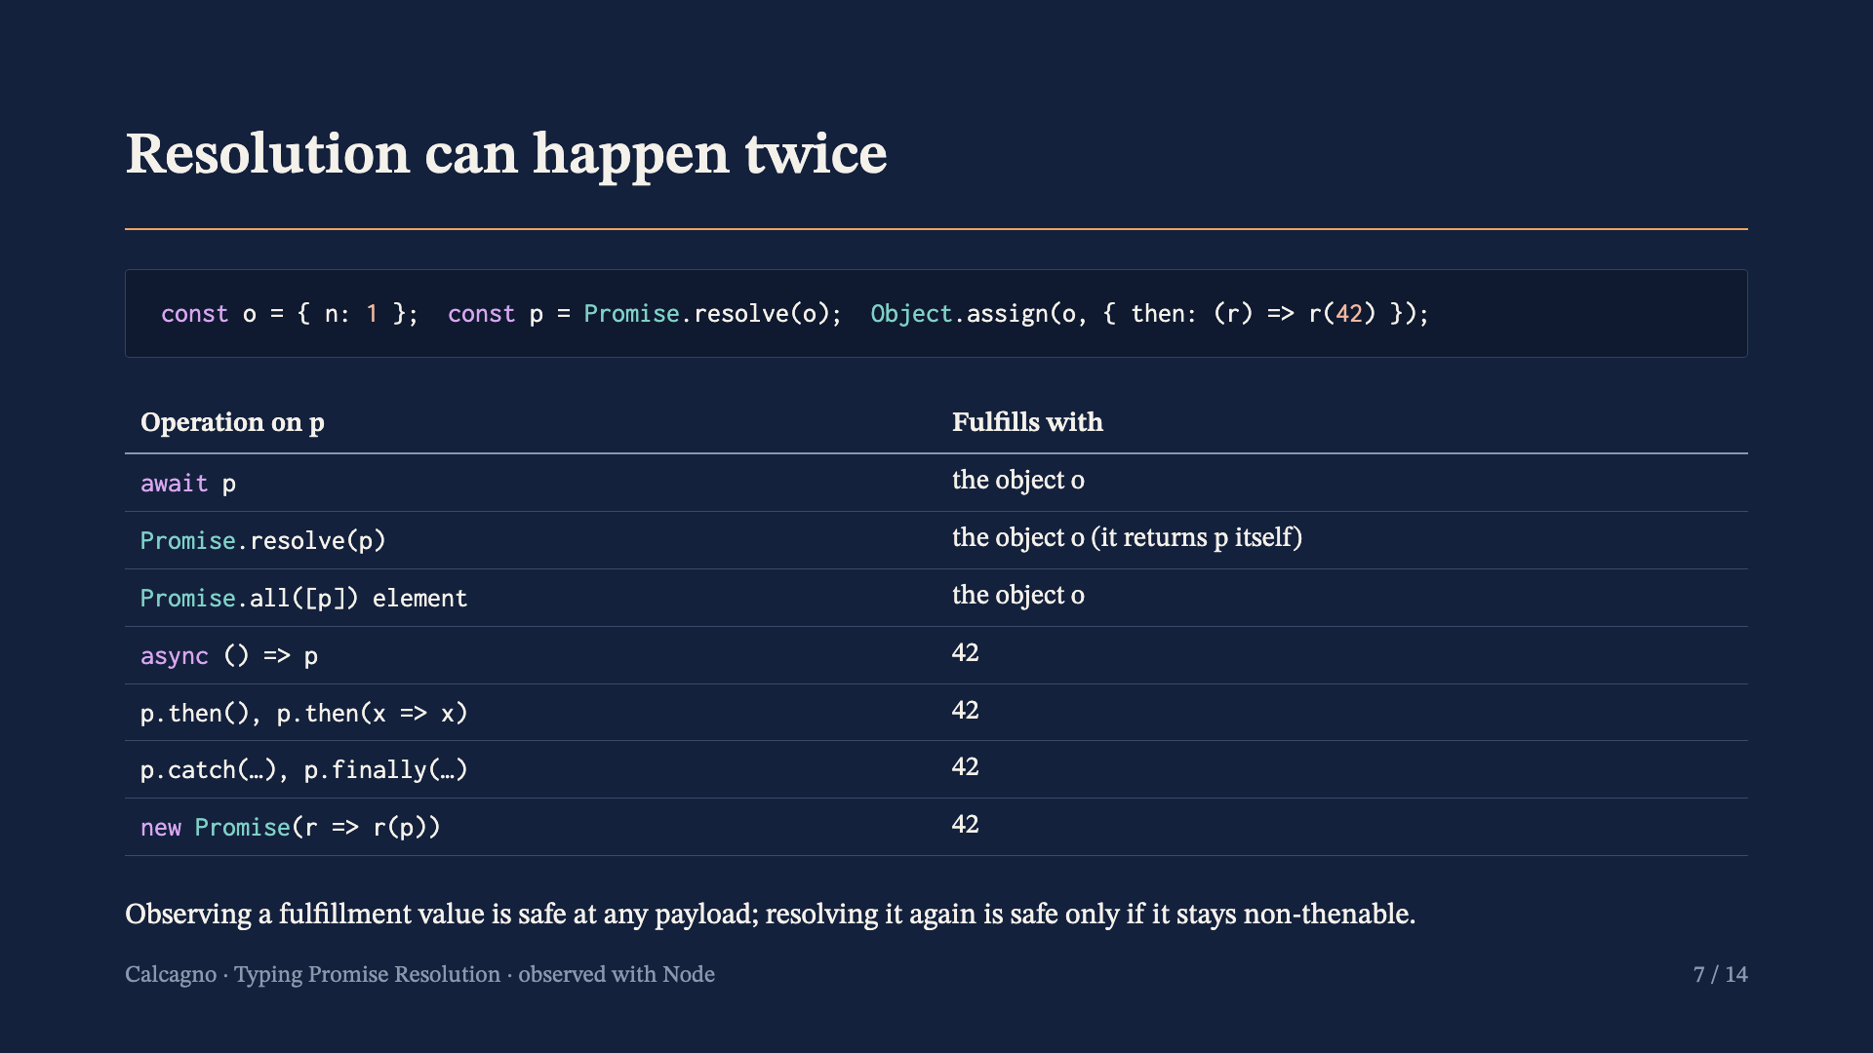
Notes:
Observed with Node. await, Promise.resolve and Promise.all read the native promise's fulfillment value once. Async return, then, catch, finally and the executor's resolver resolve a fresh promise with that value, which calls a then the object acquired after the original promise fulfilled.

Slide 8
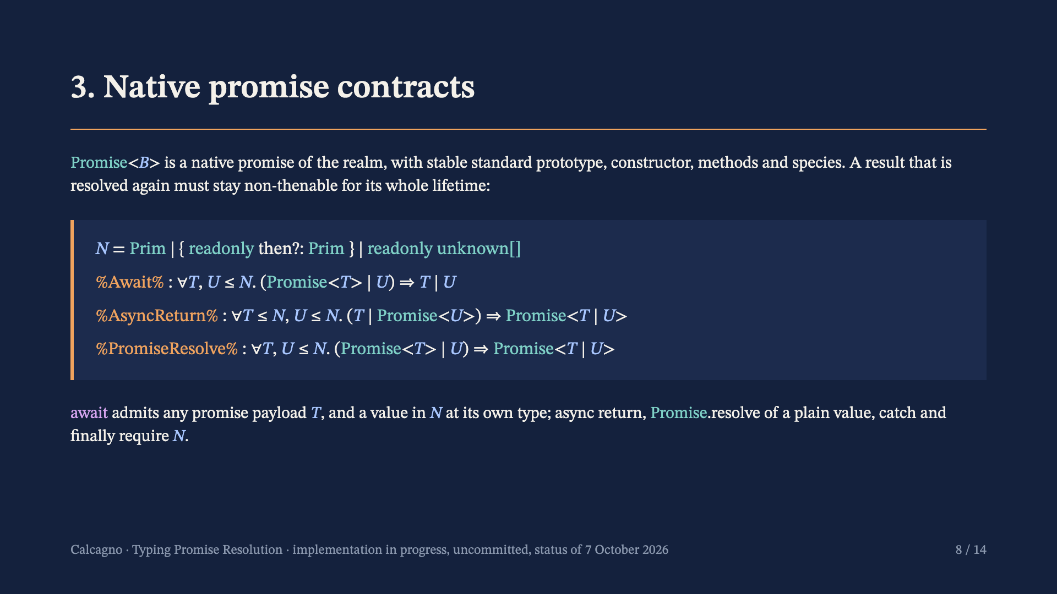
Notes:
Prim is the set of primitives. The record arm needs a lifetime read contract for then, or its absence. Ordinary arrays own no then and have stable prototypes without one. Await reads a native promise's payload once, so any payload is safe, and a value in N is never thenable, so awaiting it yields itself. Promise.resolve keeps an existing native promise through its constructor identity path, so it admits any payload.

Slide 9
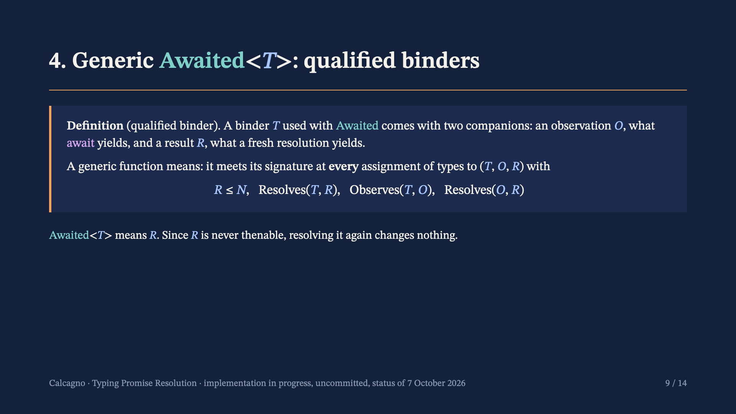
Notes:
This is the meaning of a qualified scheme in codex's semantics (descriptorDomain in ResolutionDescriptors.lean): the scheme's reassignments are restricted to coherent descriptor tuples. A call supplies one such tuple, a descriptor. The relations are fixed outside the recursive type graph.

Slide 10
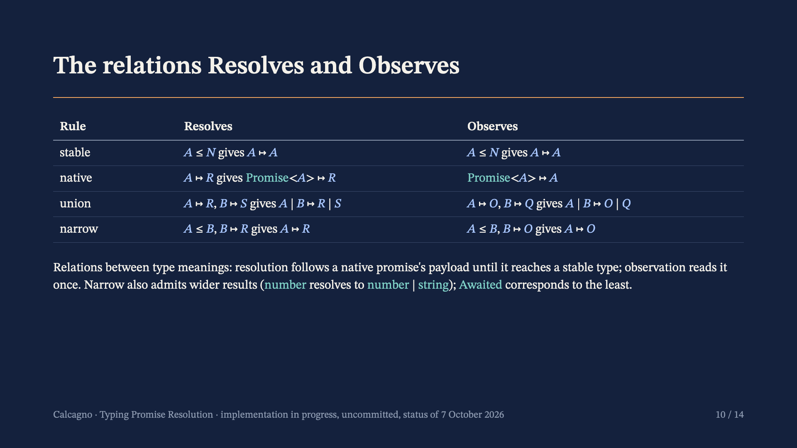
Notes:
These are the inductive relations Resolves and Observes in ResolutionCapabilities.lean. A type with no derivation, such as an open record, has no descriptor, so a generic instantiation at it is refused.

Slide 11
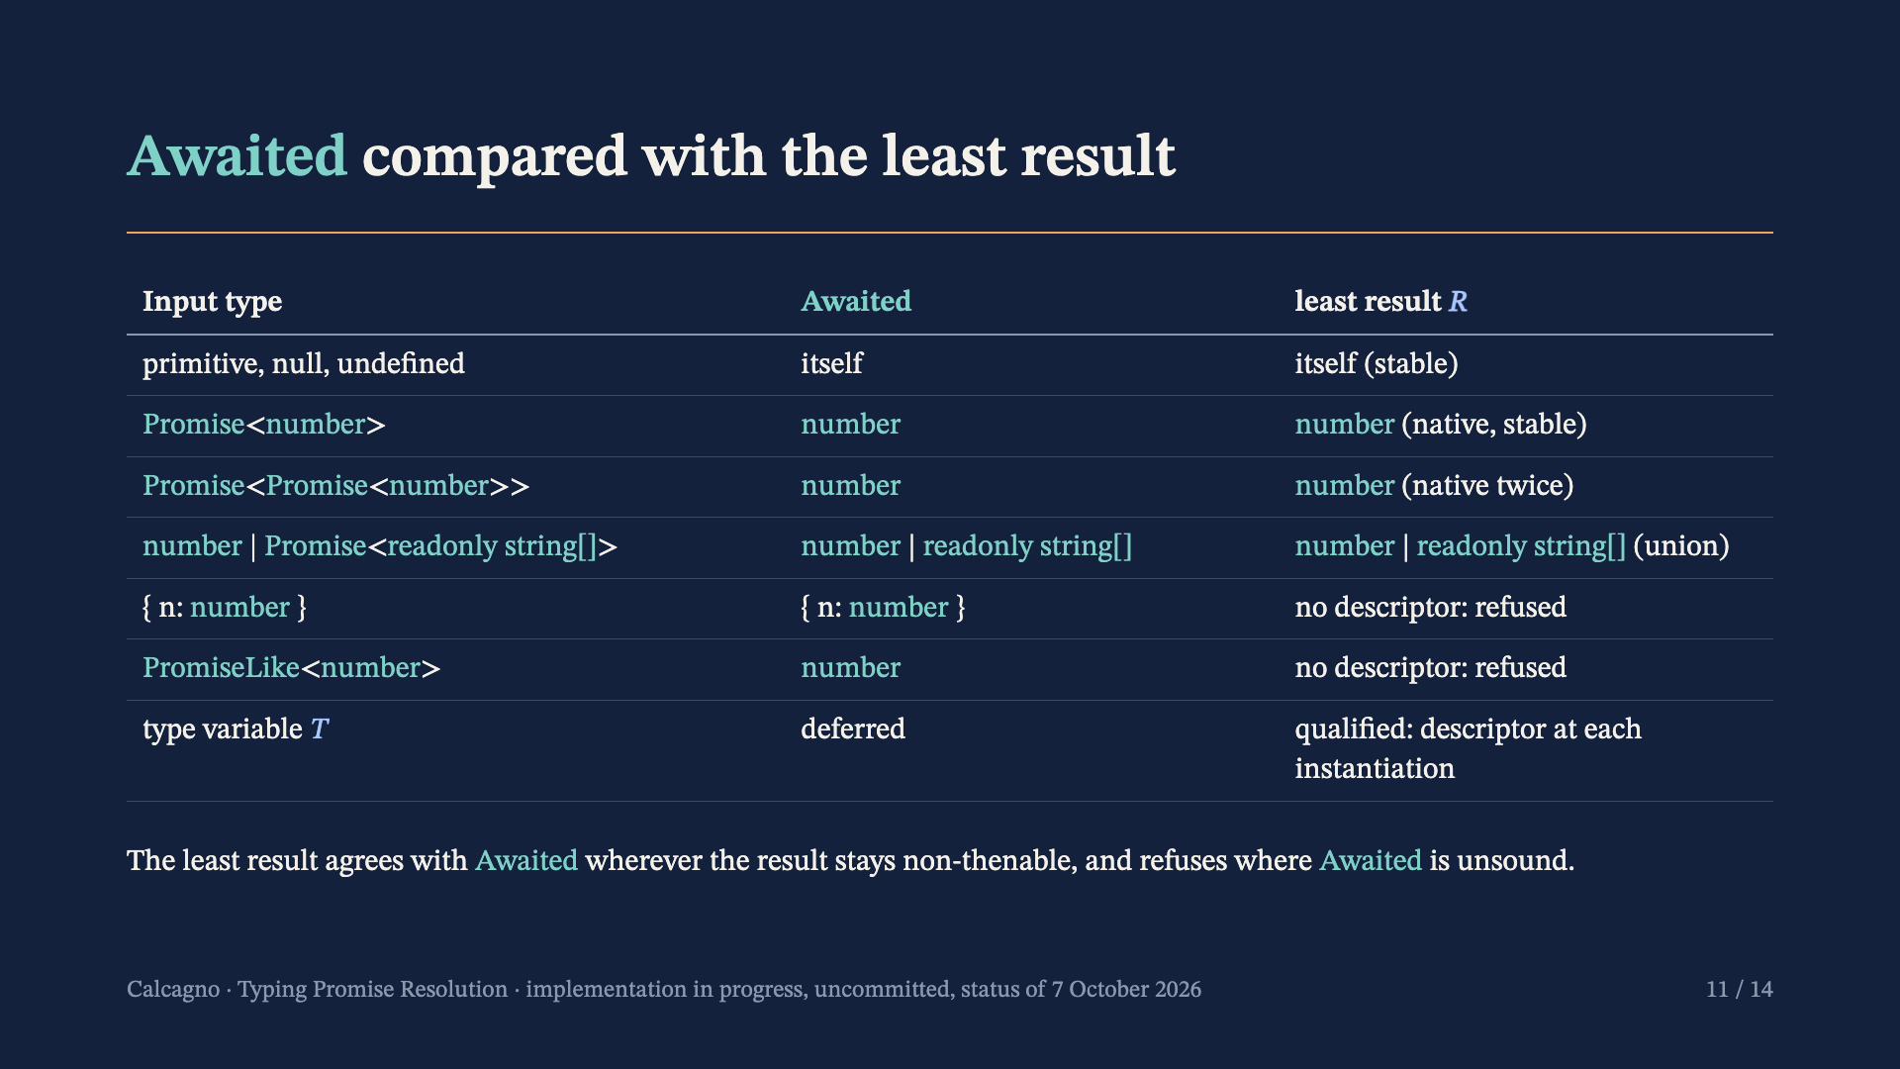
Notes:
Derived from the classification rules on the previous slide. The open record is exactly where TypeScript's Awaited is unsound; PromiseLike needs a rule for typed thenables, which neither design has.

Slide 12
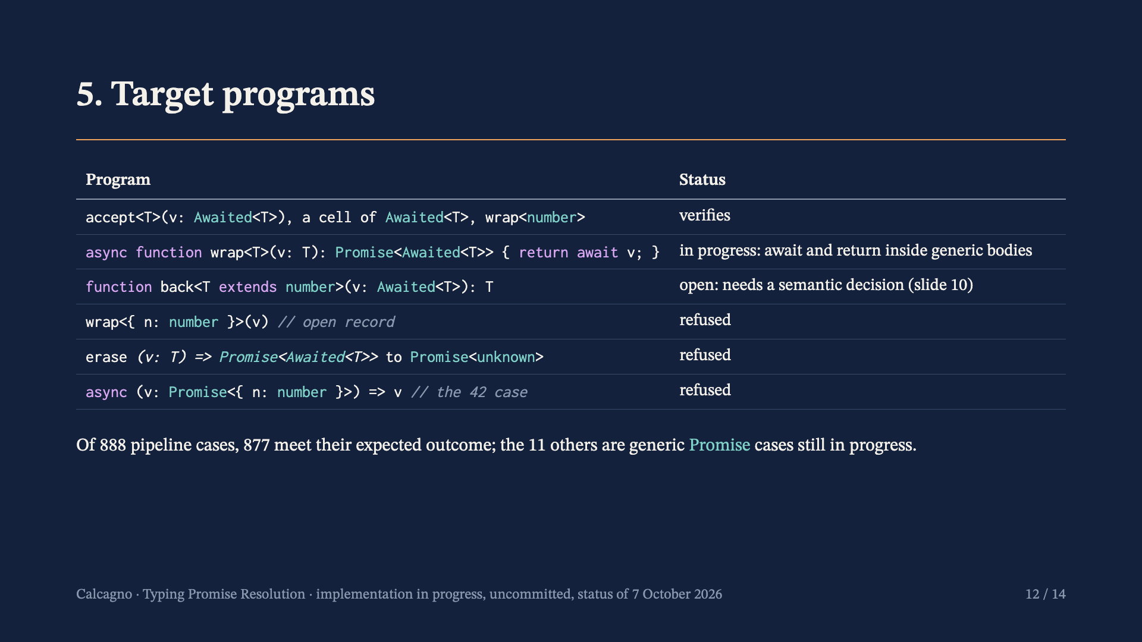
Notes:
Status as the implementation reports it, not yet committed. The associated-result case verifies end to end. The generic wrap with return await still waits for await and return inside generic bodies. All refused programs are refused; eight negative cases are refused earlier than their intended obligation or with a different message, which the remaining work settles.

Slide 13
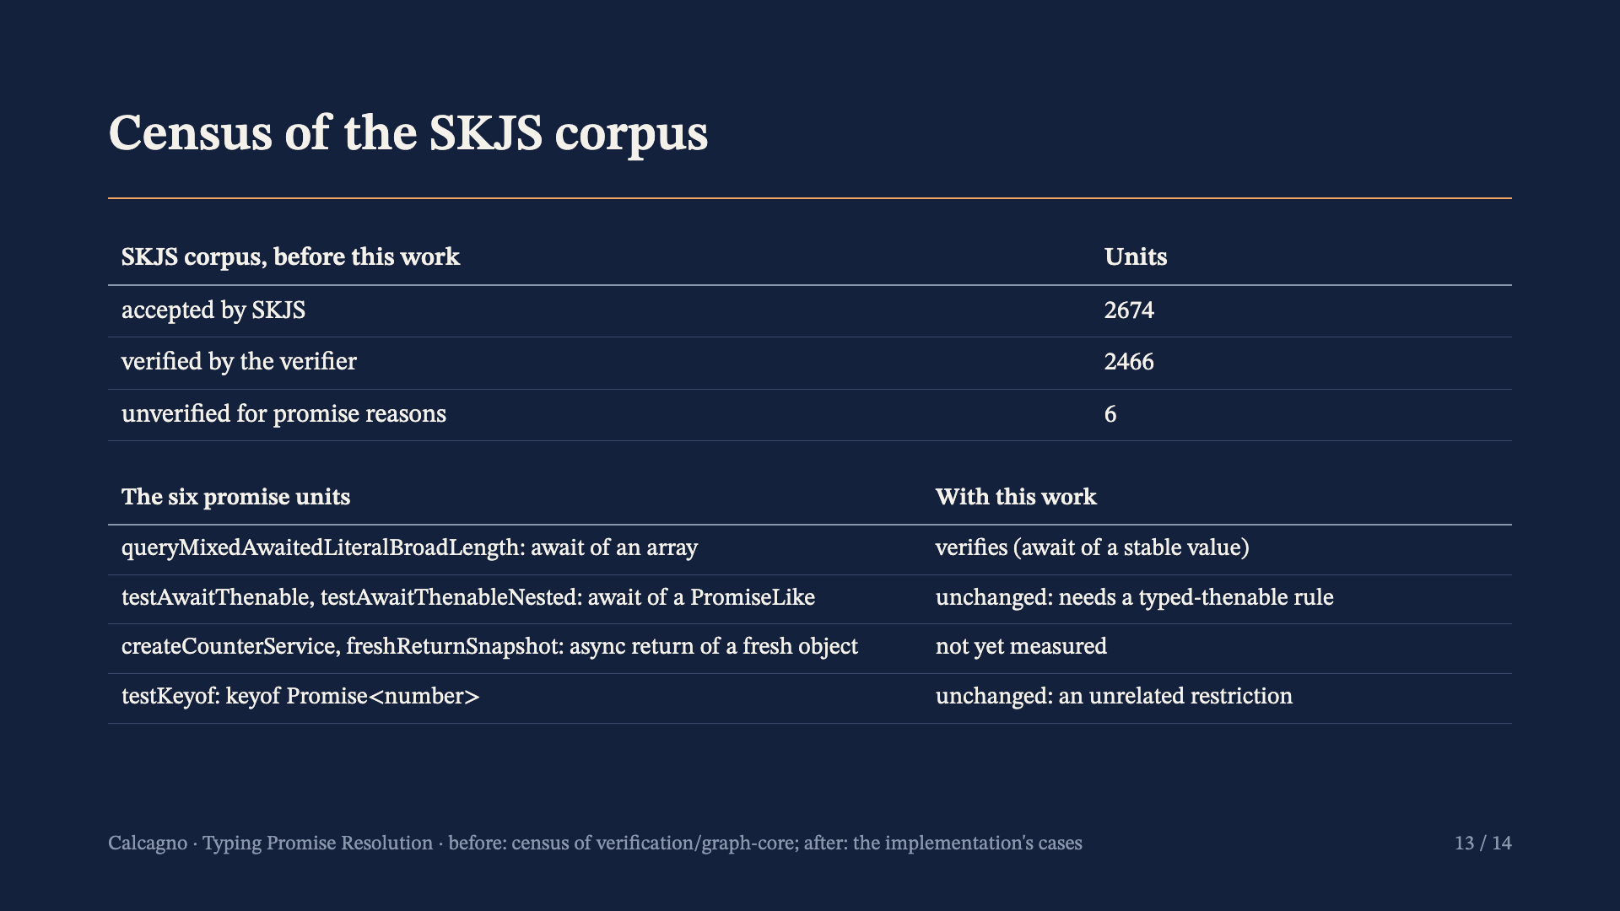
Notes:
Before: skjs-coverage.json on verification/graph-core. The array unit verifies in the implementation's stable-await case. A full census rerun follows the commit.

Slide 14
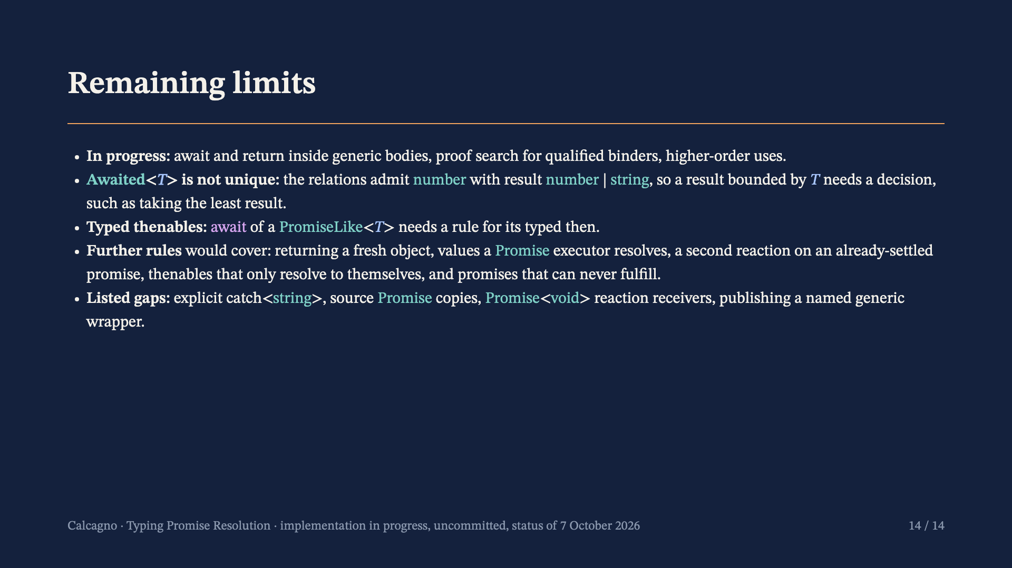
Notes:
The non-uniqueness comes from the narrow rule: number is below number | string, which resolves to itself. Only programs that need Awaited<T> to be at most a specific type are affected. The further rules are described in research/promise-coverage-audit.md.

